Slide 1
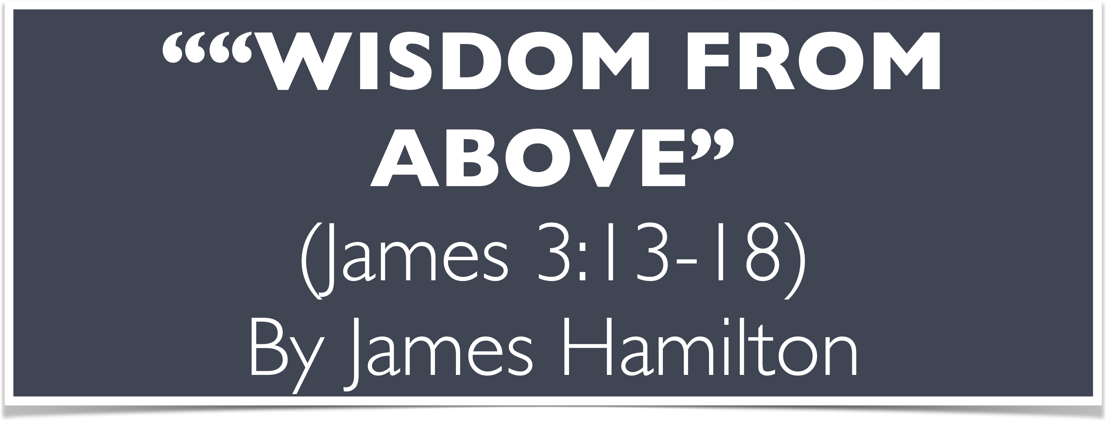
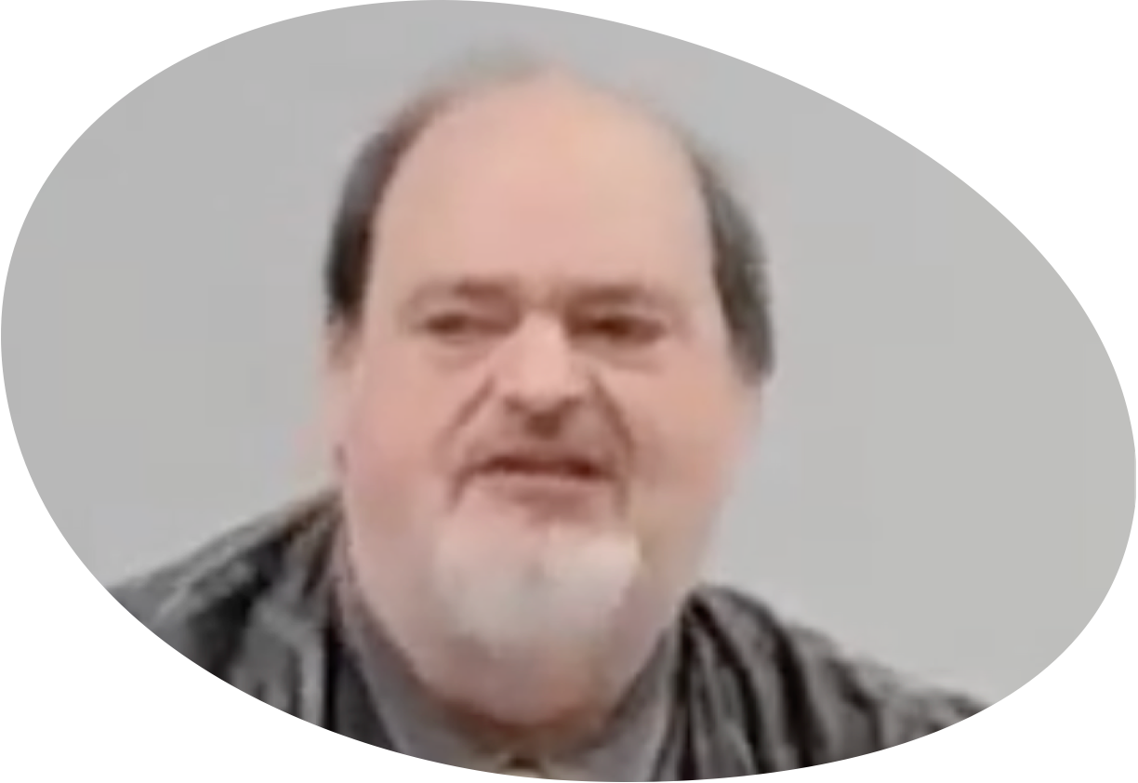
“Church of Christ MEETING @ 9500 AR 5, Alexander AR. 72002”
TODAY’S LESSON
Sunday evening lesson live stream 4:00 PM ^{CDT} June 30, 2024
https://www.youtube.com/user/donmcclain11/live / https://www.bryantchurchofchrist.com

Slide 2
WISDOM FROM ABOVE
THE EPISTLE OF JAMES

Slide 3
Which James?
Not I
Not James Randolph
James Bar Zebadiah? Matt. 10:2; Acts 12:1
James Bar Alphaios? Mark 15:40
James brother of Jesus? Distinct from 11 named apostles in Acts 1:14; included among apostles in Galatians 1:19
James, of God and Lord Jesus Christ, a slave
To The Twelve Tribes of the Diaspora John 7:35

Slide 4
James 1
Introduction to major themes in epistle
v.2-4 reaction to trials
v.5-8 acceptable prayer
v.1:9-11 classism
v.12-18 reaction to temptation
v.19-21 attitude to receive the word
v.22-25 application of the word
v.26-27 false religion vs. true religion

Slide 5
James 1
Introduction to major themes in epistle
v.2-4 reaction to trials
v.5-8 acceptable prayer
v.1:9-11 classism
v.12-18 reaction to temptation
v.19-21 attitude to receive the word
v.22-25 application of the word
v.26-27 false religion vs. true religion

Slide 6
James 1:2-4
2 My brethren, count it all joy when you fall into various trials, 3 knowing that the testing of your faith produces patience. 4 But let patience have its perfect work, that you may be perfect and complete, lacking nothing.

Slide 7
James 1
Introduction to major themes in epistle
v.2-4 reaction to trials
v.5-8 acceptable prayer
v.1:9-11 classism
v.12-18 reaction to temptation
v.19-21 attitude to receive the word
v.22-25 application of the word
v.26-27 false religion vs. true religion

Slide 8
James 1
Introduction to major themes in epistle
v.2-4 reaction to trials PATIENCE 5:7-12
v.5-8 acceptable prayer
v.1:9-11 classism
v.12-18 reaction to temptation
v.19-21 attitude to receive the word
v.22-25 application of the word
v.26-27 false religion vs. true religion

Slide 9
James 1:5-8
5 If any of you lacks wisdom, let him ask God, who gives to all liberally and without reproach, and it will be given to him. 6 But let him ask in faith, with no doubting, for he who doubts is like a wave of the sea driven and tossed by the wind. 7 For let not that man suppose that he will receive anything from the Lord; 8 he is a double-minded man, unstable in all his ways.

Slide 10
James 1
Introduction to major themes in epistle
v.2-4 reaction to trials PATIENCE 5:7-12
v.5-8 acceptable prayer
v.1:9-11 classism
v.12-18 reaction to temptation
v.19-21 attitude to receive the word
v.22-25 application of the word
v.26-27 false religion vs. true religion

Slide 11
James 1
Introduction to major themes in epistle
v.2-4 reaction to trials PATIENCE 5:7-12
v.5-8 acceptable prayer FAITH 4:1-3; 5:13-18
v.1:9-11 classism
v.12-18 reaction to temptation
v.19-21 attitude to receive the word
v.22-25 application of the word
v.26-27 false religion vs. true religion

Slide 12
James 1:9-11
9 Let the lowly brother glory in his exaltation, 10 but the rich in his humiliation, because as a flower of the field he will pass away. 11 For no sooner has the sun risen with a burning heat than it withers the grass; its flower falls, and its beautiful appearance perishes. So the rich man also will fade away in his pursuits.

Slide 13
James 1
Introduction to major themes in epistle
v.2-4 reaction to trials PATIENCE 5:7-12
v.5-8 acceptable prayer FAITH 4:1-3; 5:13-18
v.1:9-11 classism
v.12-18 reaction to temptation
v.19-21 attitude to receive the word
v.22-25 application of the word
v.26-27 false religion vs. true religion

Slide 14
James 1
Introduction to major themes in epistle
v.2-4 reaction to trials PATIENCE 5:7-12
v.5-8 acceptable prayer FAITH 4:1-3; 5:13-18
v.1:9-11 classism HUMILITY 2:1-13; 5:1-6
v.12-18 reaction to temptation
v.19-21 attitude to receive the word
v.22-25 application of the word
v.26-27 false religion vs. true religion

Slide 15
James 1:12-18
12 Blessed is the man who endures temptation; for when he has been approved, he will receive the crown of life which the Lord has promised to those who love Him.
13 Let no one say when he is tempted, “I am tempted by God”; for God cannot be tempted by evil, nor does He Himself tempt anyone.
14 But each one is tempted when he is drawn away by his own desires and enticed.

Slide 16
James 1:12-18
15 Then, when desire has conceived, it gives birth to sin; and sin, when it is full-grown, brings forth death.
16 Do not be deceived, my beloved brethren. 17 Every good gift and every perfect gift is from above, and comes down from the Father of lights, with whom there is no variation or shadow of turning. 18 Of His own will He brought us forth by the word of truth, that we might be a kind of firstfruits of His creatures.

Slide 17
James 1
Introduction to major themes in epistle
v.2-4 reaction to trials PATIENCE 5:7-12
v.5-8 acceptable prayer FAITH 4:1-3; 5:13-18
v.1:9-11 classism HUMILITY 2:1-13; 5:1-6
v.12-18 reaction to temptation
v.19-21 attitude to receive the word
v.22-25 application of the word
v.26-27 false religion vs. true religion

Slide 18
James 1
Introduction to major themes in epistle
v.2-4 reaction to trials PATIENCE 5:7-12
v.5-8 acceptable prayer FAITH 4:1-3; 5:13-18
v.1:9-11 classism HUMILITY 2:1-13; 5:1-6
v.12-18 reaction to temptation WISDOM 3:13-18
v.19-21 attitude to receive the word
v.22-25 application of the word
v.26-27 false religion vs. true religion

Slide 19
James 1:19-21
19 So then, my beloved brethren, let every man be swift to hear, slow to speak, slow to wrath; 20 for the wrath of man does not produce the righteousness of God.
21 Therefore lay aside all filthiness and overflow of wickedness, and receive with meekness the implanted word, which is able to save your souls.

Slide 20
James 1
Introduction to major themes in epistle
v.2-4 reaction to trials PATIENCE 5:7-12
v.5-8 acceptable prayer FAITH 4:1-3; 5:13-18
v.1:9-11 classism HUMILITY 2:1-13; 5:1-6
v.12-18 reaction to temptation WISDOM 3:13-18
v.19-21 attitude to receive the word
v.22-25 application of the word
v.26-27 false religion vs. true religion

Slide 21
James 1
Introduction to major themes in epistle
v.2-4 reaction to trials PATIENCE 5:7-12
v.5-8 acceptable prayer FAITH 4:1-3; 5:13-18
v.1:9-11 classism HUMILITY 2:1-13; 5:1-6
v.12-18 reaction to temptation WISDOM 3:13-18
v.19-21 attitude to receive the word MEEKNESS 2:1-13; 4:1-12
v.22-25 application of the word
v.26-27 false religion vs. true religion

Slide 22
James 1:22-25
22 But be doers of the word, and not hearers only, deceiving yourselves. 23 For if anyone is a hearer of the word and not a doer, he is like a man observing his natural face in a mirror; 24 for he observes himself, goes away, and immediately forgets what kind of man he was. 25 But he who looks into the perfect law of liberty and continues in it, and is not a forgetful hearer but a doer of the work, this one will be blessed in what he does.

Slide 23
James 1
Introduction to major themes in epistle
v.2-4 reaction to trials PATIENCE 5:7-12
v.5-8 acceptable prayer FAITH 4:1-3; 5:13-18
v.1:9-11 classism HUMILITY 2:1-13; 5:1-6
v.12-18 reaction to temptation WISDOM 3:13-18
v.19-21 attitude to receive the word MEEKNESS 2:1-13; 4:1-12
v.22-25 application of the word
v.26-27 false religion vs. true religion

Slide 24
James 1
Introduction to major themes in epistle
v.2-4 reaction to trials PATIENCE 5:7-12
v.5-8 acceptable prayer FAITH 4:1-3; 5:13-18
v.1:9-11 classism HUMILITY 2:1-13; 5:1-6
v.12-18 reaction to temptation WISDOM 3:13-18
v.19-21 attitude to receive the word MEEKNESS 2:1-13; 4:1-12
v.22-25 application of the word ZEAL 2:14-26; 4:13-17
v.26-27 false religion vs. true religion

Slide 25
James 1:26-27
26 If anyone among you thinks he is religious, and does not bridle his tongue but deceives his own heart, this one's religion is useless. 27 Pure and undefiled religion before God and the Father is this: to visit orphans and widows in their trouble, and to keep oneself unspotted from the world.

Slide 26
James 1
Introduction to major themes in epistle
v.2-4 reaction to trials PATIENCE 5:7-12
v.5-8 acceptable prayer FAITH 4:1-3; 5:13-18
v.1:9-11 classism HUMILITY 2:1-13; 5:1-6
v.12-18 reaction to temptation WISDOM 3:13-18
v.19-21 attitude to receive the word MEEKNESS 2:1-13; 4:1-12
v.22-25 application of the word ZEAL 2:14-26; 4:13-17
v.26-27 false religion vs. true religion

Slide 27
James 1
Introduction to major themes in epistle
v.2-4 reaction to trials PATIENCE 5:7-12
v.5-8 acceptable prayer FAITH 4:1-3; 5:13-18
v.1:9-11 classism HUMILITY 2:1-13; 5:1-6
v.12-18 reaction to temptation WISDOM 3:13-18
v.19-21 attitude to receive the word MEEKNESS 2:1-13; 4:1-12
v.22-25 application of the word ZEAL 2:14-26; 4:13-17
v.26-27 false religion vs. true religion WISDOM 3:1-12

Slide 28
The Double-Minded Man
Introduced in 1:8
Prays but does not expect God to respond 1:6-8
Acknowledges God but blames God for temptations 1:13-21
Hears the word but does not do it 1:22-25
Religious but doesn’t control his speech 1:26
Worships God but judges his brother 2:1-13
Claims he has faith without works 2:14-26

Slide 29
The Double-Minded Man
Blesses God but curses men 3:1-12
Seeks honor without responsibility 3:13-18
Prays but doesn’t receive 4:1-12; 1:5-8
Wants friendship with God and the world 4:4
Knows to do good but does not do it 4:13-17
Persecuted by the rich but wants to be rich and be friends with the rich 5:1-6

Slide 30
Simple Outline of James
Greeting 1:1
I. Introduction to Themes in James 1:2-27
II. A Perfect Man Vs. A Double-Minded Man 2:1-5:6
III. Applications of Spiritual Wisdom 5:7-20

Slide 31
WISDOM FROM ABOVE
Greeting 1:1
I. Portraits of Spiritual Wisdom 1:2-27
II. A Perfect Man Vs. A Double-Minded Man 2:1-5:6
I’Applications of Spiritual Wisdom 5:7-20

Slide 32
Portraits of Spiritual Wisdom 1:2-27
A. Wisdom has perspective to be patient 1:2-4
B. Wisdom must be diligently sought by obedient faith 1:5-8
C. Wisdom has an accurate perspective of self and others 1:9-11
D. Wisdom avoids yielding to temptation 1:12-15
E. Wisdom honors God for everything good in life 1:16-18
F. Wisdom is slow to wrath and does not speak hastily 1:19-21
G. Wisdom follows God’s perfect law of liberty 1:22-25
H. Wisdom realizes and practices pure service to God 1:26-27

Slide 33
A Perfect Man vs. a Double-Minded Man 2:1-5:7
A. Rich and Poor 2:1-13
B. Faith and Works 2:14-26
C. Blessing and Cursing 3:1-12
D. Wisdom from Above 3:13-18
C’Blessing and Cursing 4:1-12
B’Faith and Works 4:13-17
A’Rich and Poor 5:1-6

Slide 34
Applications of Spiritual Wisdom 5:1-6
A. Wisdom endures and keeps one’s soul 5:7-12 (see Luke 21:19)
B. Wisdom helps needy souls spiritually, emotionally, socially, and physically 5:13-18
C. Wisdom wins lost souls 5:19-20 (see Proverbs 11:30)

Slide 35
James 5:19-20
19 Brethren, if anyone among you wanders from the truth, and someone turns him back, ²⁰ let him know that he who turns a sinner from the error of his way will save a soul from death and cover a multitude of sins.
Gal. 6:1; Acts 8:23-24; 2 Cor. 13:5; 1 John 1:8-10
Luke 19:10; 24:47; Mark 16:16; Acts 2:38

Slide 37
“Church of Christ MEETING @ 9500 AR 5, Alexander AR. 72002”
TODAY’S LESSON
Sunday evening lesson live stream 4:00 PM ^{CDT} June 30, 2024
https://www.youtube.com/user/donmcclain11/live / https://www.bryantchurchofchrist.com

