Slide 1
(Matthew 23:23,24)

Slide 2
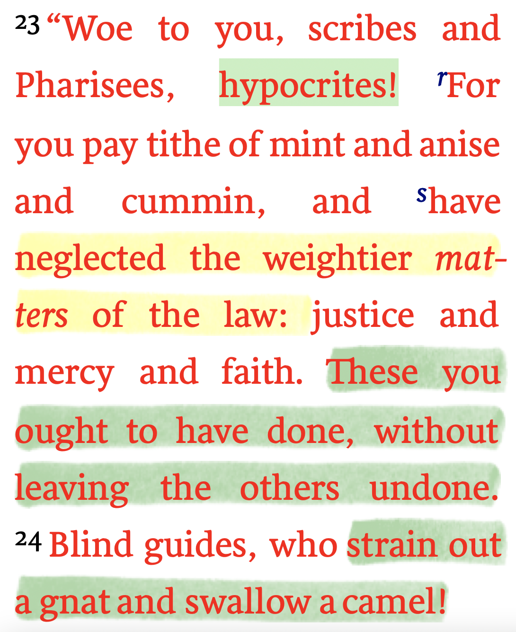
The Nature of Hypocrisy
Matthew 23:23,24 (NKJV)
Eight times in (Matt. 23) speaking directly to the scribes and Pharisees, Jesus said: “Woe to you, scribes and Pharisees, hypocrites” (vs 13, 14, 15, 16, 23, 25, 27, 29)…
Jesus NEVER rebuked the the scribes and Pharisees for keeping the Law!

Slide 3
The Nature of Hypocrisy
Matthew 23:23,24 (NKJV)
Hypocrisy defined: “the false claim to or pretense of having admirable principles or beliefs…”
The hypocrite -- one thing on the outside, something else on the inside…

Slide 4
The Hypocrisy of the Scribes & Pharisees
Giving (Mat 6:2)
Praying (Mat 6:5)
Fasting (Mat 6:16)
Judging (Mat 7:5)
Worship (Mat 15:7-9)
Doctrine (Mat 16:12)
In applying scripture (Luke 14:1-6)
Did not follow their own teaching (Mat. 23:3)

Slide 5
The Hypocrisy of the Scribes & Pharisees
MATTHEW 23
Abused their authority (v. 1-4)
Loved praises of men (v. 5-12)
Impediment to others entering into the kingdom (v. 13).
Religious but unjust in their conduct (v. 14).
A bad influence on new converts (v. 15).
Foolish & blind in religious duties (v. 16-22).

Slide 6
The Hypocrisy of the Scribes & Pharisees
MATTHEW 23
Lacked judgment, mercy and faith (v. 23).
Magnified the external errors of others while overlooking their sinful attitudes & character. (v. 24; cf Mat 7:1-4).
Externally, religiously meticulous, but internally very wicked (vs. 25-28).
Praised the martyred prophets, but persecuted Christ & his apostles (vs. 29-32).

Slide 7
The Hypocrisy of the Scribes & Pharisees
MATTHEW 23
They emphasized outward actions while ignoring internal character and attitudes.
Jesus emphasizes the internal character and attitudes behind our actions.

Slide 8
What Are “Weightier Matters”?
“These you ought to have done” : giving a tenth of “mint, and anise and cummin,” were less “weighty.
But - they were STILL required to give a tenth - they were required to keep the jots and tittles of the Law!
Jesus is NOT teaching that when God’s grace is coupled with our sincerity, keeping His commands is unnecessary.

Slide 9
What Are “Weightier Matters”?
Lou-Nida: βαρύςc, εῖα, ύ: pertaining to being important in view of substantive character.
BDAG: “‘heavy’ … the component of heaviness resident in the object depicted dominates …”
Vines: “in the comparative degree “weightier,” 23:23, of details of the law of God.”

Slide 10
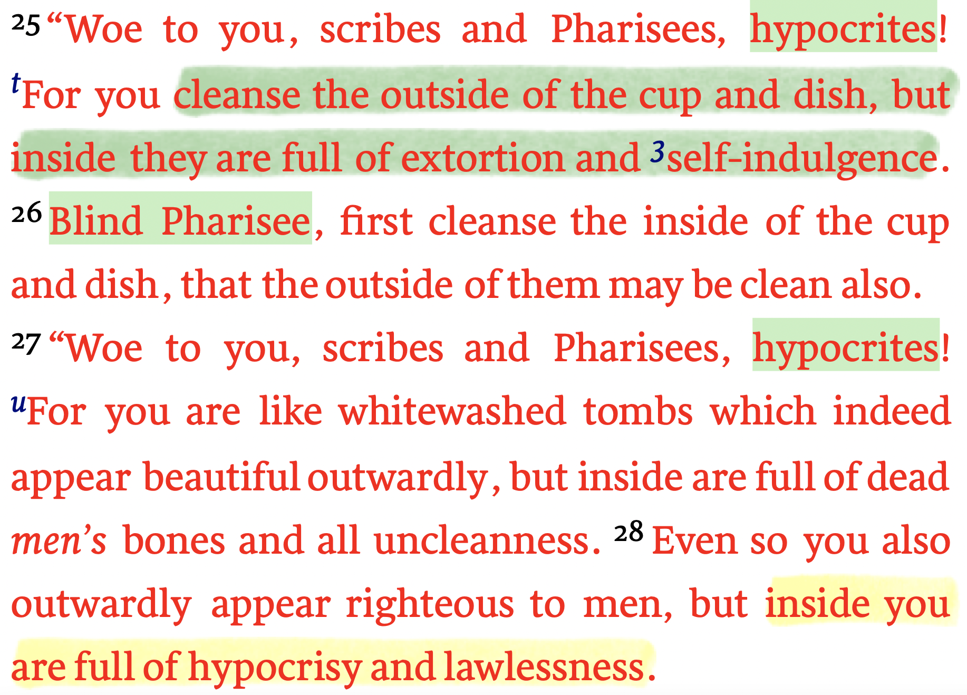
What Are “Weightier Matters”?
Their actions appeared to be right, but their hearts were NOT right!
When our heart is right we will seek to do what is right!

Slide 11
What Are “Weightier Matters”?
Matthew 23:23–24 (NKJV)
²³ “Woe to you, scribes and Pharisees, hypocrites! For you pay tithe of mint and anise and cummin, and have neglected the weightier matters of the law: justice and mercy and faith. These you ought to have done, without leaving the others undone. ²⁴ Blind guides, who strain out a gnat and swallow a camel!

Slide 12
What Are “Weightier Matters”?
Micah 6:8 (NKJV)
⁸ He has shown you, O man, what is good; And what does the Lord require of you But to do justly, To love mercy, And to walk humbly with your God?

Slide 13
What Are “Weightier Matters”?
Hosea 12:5–6 (NKJV)
⁵ That is, the Lord God of hosts. The Lord is His memorable name. ⁶ So you, by the help of your God, return; Observe mercy and justice, And wait on your God continually.

Slide 14
What Are “Weightier Matters”?
JUSTICE: “administration of what is right and fair” (BDAG) / the absence of partiality in the treatment of others.
MERCY: “kindness or concern expressed for someone in need, compassion, pity, clemency” (BDAG)
FAITH: “the state of being someone in whom confidence can be placed, faithfulness, reliability, fidelity, commitment” (BDAG)
Full of extortion and self-indulgence (25)
Full of hypocrisy and lawlessness (28)
Condemned the innocent (29-35)

Slide 15
Matthew 5:18–20 (NKJV)
¹⁸ For assuredly, I say to you, till heaven and earth pass away, one jot or one tittle will by no means pass from the law till all is fulfilled. ¹⁹ Whoever therefore breaks one of the least of these commandments, and teaches men so, shall be called least in the kingdom of heaven; but whoever does and teaches them, he shall be called great in the kingdom of heaven. ²⁰ For I say to you, that unless your righteousness exceeds the righteousness of the scribes and Pharisees, you will by no means enter the kingdom of heaven.

Slide 16
Matthew 7:24 (NKJV)
²⁴ “Therefore whoever hears these sayings of Mine, and does them, I will liken him to a wise man who built his house on the rock.”

Slide 17
What Are “Weightier Matters”?
DEEDS
(Col. 3:17)
WORSHIP
(John 4:24)
HOME
(Eph. 5:22-6:4)
INFLUENCE
(MT. 5:13-16)
NEIGHBOR
(Mark 12:31)
WORK
(Eph. 4:28)
SPEECH
(Col. 4:6)

Slide 18
God will reject my worship, service or good deeds if I do not treat my fellow man fairly, compassionately or faithfully!
This truth does NOT negate my obligation before God to seek out and obey His will in all things.
We cannot neglect any of God’s word and expect Him to be pleased with us.

Slide 19
A “head full” of truth, in and of itself, does NOT make one righteous before God - One MUST apply the entirety of truth to His life.
If we are fundamentally godly in character, we will seek to know all of God’s will and desire to obey Him.
God knows our hearts & our deeds! (Heb. 4:13)

Slide 20
I MUST seek more than obey certain commands (God’s word is not a buffet line) — I must SEEK to become godly in character! (Col. 3:12-17)
My character is a choice - something to be done (Mat. 23:23; Prov. 4:23; 2 Pet. 1:5-10)

Slide 21
Godly character produces humble submission to everything God commands, including baptism, worship, the work of the church, doctrinal soundness, etc. (Mat. 28:18-20; Jas 3:11-18; Col. 3:17)

Slide 22
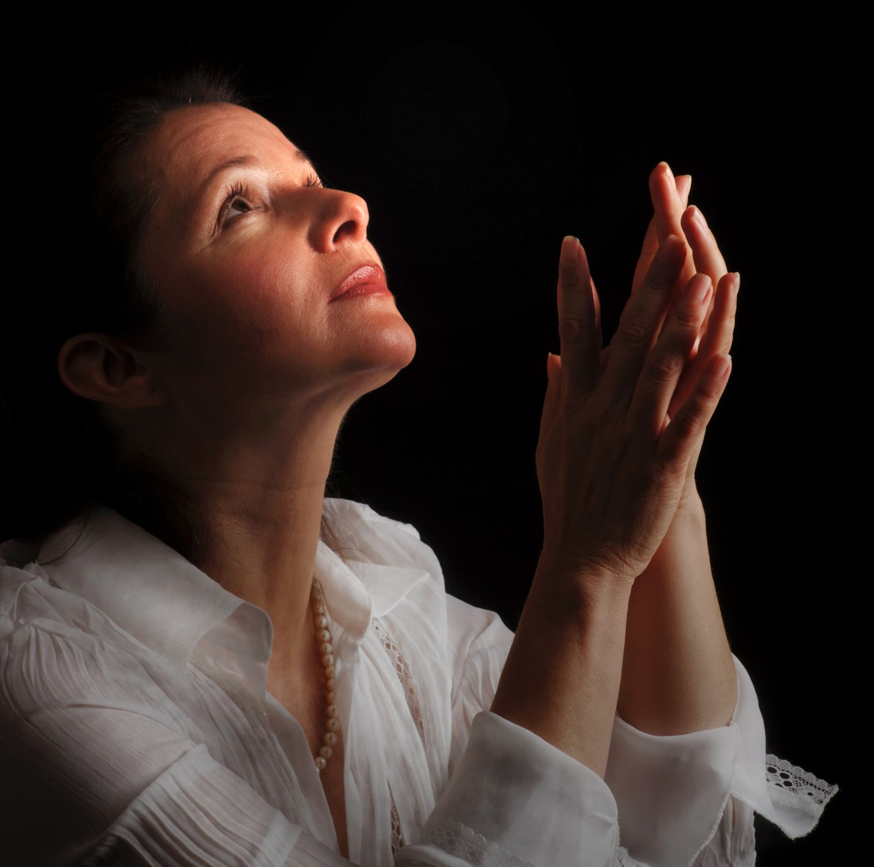

Slide 24
Charts by Don McClain
Preached: April 25, 2021 / West 65th Street church of Christ / March 17, 2024 / Bryant church of Christ 9500 AR 5, Alexander AR 72002 / Phone: 501-568-1062 / Email – donmcclain@sbcglobal.net
More Keynote, PPT & Audio Sermons WWW.BRYANTCHURCHOFCHRIST.COM

Slide 25
Luke 18:9–14 (NKJV)
⁹ Also He spoke this parable to some who trusted in themselves that they were righteous, and despised others: ¹⁰ “Two men went up to the temple to pray, one a Pharisee and the other a tax collector. ¹¹ The Pharisee stood and prayed thus with himself, ‘God, I thank You that I am not like other men—extortioners, unjust, adulterers, or even as this tax collector. ¹² I fast twice a week; I give tithes of all that I possess.’ ¹³ And the tax collector, standing afar off, would not so much as raise his eyes to heaven, but beat his breast, saying, ‘God, be merciful to me a sinner!’ ¹⁴ I tell you, this man went down to his house justified rather than the other; for everyone who exalts himself will be humbled, and he who humbles himself will be exalted.”

