Slide 1
(Ephesians 1:1-14)

Slide 2
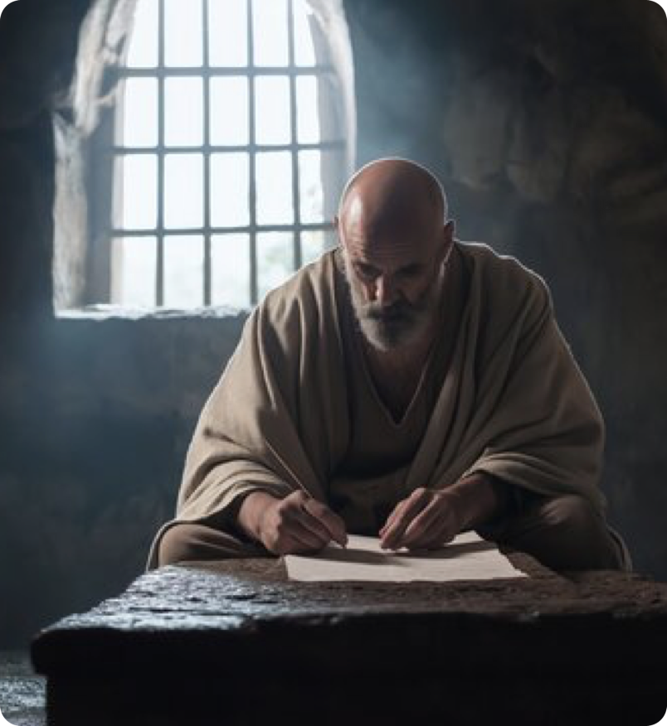
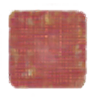

One of Paul’s four “Prison Epistles” (Eph. 3:1; 4:1; 6:20; cf. Phil. 1:7; Col. 4:10; Phile. 9)
A syllabus on the Lord’s church.
“church” (ekklesia (ἐκκλησία, 1577), occurs nine times (1:22; 3:10,21; 5:23,24,25,27, 29,32).
“body” (referring to the church) occurs nine more times (1:23; 2:16; 3:6; 4:4, 12, 16 (twice); 5:23, 30).

Slide 3
Christ - the head of it (1:22; 5:23).
The fullness of Christ (1:22, 23).
God’s manifold wisdom (3:10).
God is glorified in it (3:21).
There is one body (church) (4:4).
Christ loves her (5:23).
Christ saves her (5:23).
Christ gave himself for her (5:25).
To be holy, without blemish (5:27).
Will be presented to Christ (5:27).
Beloved bride of Christ (5:31, 32).

Slide 4

The letter is addressed to
the “saints” (hagiois, ones set apart for God’s use), who were residing in Ephesus.
The “faithful in Christ Jesus” further defines the recipients.
All are invited to receive and enjoy God’s saving grace, (Titus 2:11,12; 1 Jn 2:1,2; John 3:16; 1 Tim. 2:4; 2 Pet. 3:9), but only those who are believers in Christ actually do (Eph. 1:2-13; 5:25-27)
Ephesians 1:1–2 (NKJV)
¹ Paul, an apostle of Jesus Christ by the will of God, To the saints who are in Ephesus, and faithful in Christ Jesus: ² Grace to you and peace from God our Father and the Lord Jesus Christ.

Slide 5
God has “BLESSED US”
Only the “faithful in Christ Jesus” possess and experience “every spiritual blessing in the heavenly places in Christ.”
Those NOT in Christ, or those who are NOT faithful, (i.e., those not abiding in His teaching), do NOT participate in these spiritual blessings, (John 15:1-10; 2 Jn 9,10)
Ephesians 1:3 (NKJV)
³ Blessed be the God and Father of our Lord Jesus Christ, who has blessed us with every spiritual blessing in the heavenly places in Christ,

Slide 6
“He chose us in Him”
Paul does NOT say, “just as He chose us “to be” in Him! It says He chose us “IN HIM!” Big difference!
Individuals are NOT unconditionally elected and then put in Christ; those in Christ are God’s chosen people (Isa. 42:1; 1 Pet. 2:6,9).
Ephesians 1:4 (NKJV)
⁴ just as He chose us in Him before the foundation of the world, that we should be holy and without blame before Him in love,

Slide 7
“He chose us in Him”
Christ serves as the sphere and means of our election.
Individuals share in the election of Christ by being IN HIS BODY, (Gal. 3:26-29).
Before the foundation of the world, God made His sovereign choice: those in Christ would be His people.
Ephesians 1:4 (NKJV)
⁴ just as He chose us in Him before the foundation of the world, that we should be holy and without blame before Him in love,

Slide 8
“He chose us in Him”
The sphere was chosen “Before the foundation of the world,”(cf. 2 Tim.1:9; 1 Pet. 1:18-21)
God predetermined the status, character & condition of the believer in Christ (Cf. Mat 5:3-10; 2 Cor 6:17,18; 7:1; etc.).
Ephesians 1:4 (NKJV)
⁴ just as He chose us in Him before the foundation of the world, that we should be holy and without blame before Him in love,

Slide 9
ELECTION IS A SPIRITUAL BLESSING THAT IS FOUND ONLY IN CHRIST.
NO SPIRITUAL BLESSING IS ENJOYED PRIOR TO BEING RAISED UP WITH CHRIST AND SEATED IN THE HEAVENLY PLACES WITH HIM — INCLUDING “ELECTION” (Eph. 2:4–7, 12–13)
Ephesians 1:4 (NKJV)
⁴ just as He chose us in Him before the foundation of the world, that we should be holy and without blame before Him in love,

Slide 10
Predestined — προορίζω - proorizō
Strong’s - to limit in advance …predetermine: determine before, ordain, predestinate.
Thayer: G4309 1) to predetermine, decide beforehand 2) in the NT of God decreeing from eternity 3) to foreordain, appoint beforehand.
BDAG: decide upon beforehand, predetermine,
Ephesians 1:5–6 (NKJV)
⁵ having predestined us to adoption as sons by Jesus Christ to Himself, according to the good pleasure of His will, ⁶ to the praise of the glory of His grace, by which He made us accepted in the Beloved.

Slide 11
Predestined — προορίζω - proorizō
It is originally a geographical term, but is also applied to any thing determined or demonstrated.
Here it points to God’s fixed purpose or predetermination to bestow upon those who are “IN CHRIST” the blessing of the adoption through belief of the truth (Eph. 1:5,13)
Ephesians 1:5–6 (NKJV)
⁵ having predestined us to adoption as sons by Jesus Christ to Himself, according to the good pleasure of His will, ⁶ to the praise of the glory of His grace, by which He made us accepted in the Beloved.

Slide 12

Predestined — προορίζω - proorizō
The necessity of Jesus’s death . . .
Acts 4:27–28 (NASB95)
²⁷ “For truly in this city there were gathered together against Your holy servant Jesus, whom You anointed, both Herod and Pontius Pilate, along with the Gentiles and the peoples of Israel, ²⁸ to do whatever Your hand and Your purpose predestined to occur.

Slide 13
Predestined — προορίζω - proorizō
Romans 8:29–30 (NASB95)
²⁹ For those whom He foreknew, He also predestined to become conformed to the image of His Son, so that He would be the firstborn among many brethren; ³⁰ and these whom He predestined, He also called; and these whom He called, He also justified; and these whom He justified, He also glorified.
The necessity of Jesus’s death . . .
That His children will be conformed to the image of Jesus.

Slide 14
Predestined — προορίζω - proorizō
1 Corinthians 2:7–8 (NASB95)
⁷ but we speak God’s wisdom in a mystery, the hidden wisdom which God predestined before the ages to our glory; ⁸ the wisdom which none of the rulers of this age has understood; for if they had understood it they would not have crucified the Lord of glory;
The necessity of Jesus’s death . . .
That His children will be conformed to the image of Jesus.
That the gospel of Christ would be a mystery until He chose to reveal it.

Slide 15
Predestined — προορίζω - proorizō
Ephesians 1:5–6 (NASB95)
⁵ He predestined us to adoption as sons through Jesus Christ to Himself, according to the kind intention of His will, ⁶ to the praise of the glory of His grace, which He freely bestowed on us in the Beloved.
The necessity of Jesus’s death . . .
That His children will be conformed to the image of Jesus.
That the gospel of Christ would be a mystery until He chose to reveal it.
That believers in Jesus Christ would be adopted as God's very own children.

Slide 16
Predestined — προορίζω - proorizō
The necessity of Jesus’s death . . .
That His children will be conformed to the image of Jesus.
That the gospel of Christ would be a mystery until He chose to reveal it.
That believers in Jesus Christ would be adopted as God's very own children.
That believers in Christ should be to the praise of God's glory.
Ephesians 1:11–12 (NASB95)
¹¹ also we have obtained an inheritance, having been predestined according to His purpose who works all things after the counsel of His will, ¹² to the end that we who were the first to hope in Christ would be to the praise of His glory.

Slide 17
“to adoption as sons”
“by Jesus Christ to Himself,”— God predetermined that believers in Jesus Christ would be adopted as His very own children (1:1,10; 3:11; Ac 19:1-10; John 1:12; 3:3-5; Gal 3:26-29; 1 Pet 1:22,23).
Full enjoyment of our υἱοθεσία will be realized in the redemption of our bodies (Rom. 8:16,23-25)
Ephesians 1:5–6 (NKJV)
⁵ having predestined us to adoption as sons by Jesus Christ to Himself, according to the good pleasure of His will, ⁶ to the praise of the glory of His grace, by which He made us accepted in the Beloved.

Slide 18
“to adoption as sons”
Accomplished “according to the good pleasure of His (God’s) will,” (Eph 1:9; Phili 2:13; 2 Thes 1:11).
God’s gracious provision in and through Jesus is certainly worthy of praise (1:10; Titus 3:3-5; Rom 5:6-8,11)
It is by God’s grace that “acceptance” in Christ is made possible (2:1-9; Rom 5:8-10)
Ephesians 1:5–6 (NKJV)
⁵ having predestined us to adoption as sons by Jesus Christ to Himself, according to the good pleasure of His will, ⁶ to the praise of the glory of His grace, by which He made us accepted in the Beloved.

Slide 19
“In Him we have redemption”
Redemption, refers to deliverance or a releasing from bondage or setting one free by paying a ransom (John 8:34 cf. Rom. 7:14; 3:23,24)
We have redemption ONLY through Jesus’s blood (Mat 20:28; 26:28; Acts 20:28; Rom 3:23-26; 1 Cor 6:20; Gals 3:13; 4:5; Col 1:13,14; 1 Timothy 2:5,6; 1 Pet 1:18-20; 2 Peter 2:1)
Ephesians 1:7–8 (NKJV)
⁷ In Him we have redemption through His blood, the forgiveness of sins, according to the riches of His grace ⁸ which He made to abound toward us in all wisdom and prudence,

Slide 20
“In Him we have redemption”
Redemption from the power, guilt, & spiritual consequences of sin (Col. 1:14; 3:23; Mt 1:21; Jn 8:32,33; Rom. 6-8; Heb. 9:12)
Our sins are forgiven, washed away, cut away by Jesus’s blood when we are baptized into Christ and continue to walk in the light (Acts 2:38; 22:16; Rom. 6:3-6; Col. 2:11-13)
Ephesians 1:7–8 (NKJV)
⁷ In Him we have redemption through His blood, the forgiveness of sins, according to the riches of His grace ⁸ which He made to abound toward us in all wisdom and prudence,

Slide 21
“according to the riches of His grace”
Redemption / forgiveness cannot be deserved or earned (2:8,9; Rom. 4:1-6; Titus 3:5)
Do we understand and fully appreciate the greatness of God’s provisions for us (9,10; 3:5; 20,21; Col 1:9-12, 25-29; Ro 5:15-21; 2 Cor 9:8; Phili4:13)?
Ephesians 1:7–8 (NKJV)
⁷ In Him we have redemption through His blood, the forgiveness of sins, according to the riches of His grace ⁸ which He made to abound toward us in all wisdom and prudence,

Slide 22
“the mystery of His will”
“Mystery” – had been hidden – but now revealed (3:3-5; 1:9; 5:32; Rom. 16:25)
According to God’s good pleasure, He purposed to reconcile sinful man to Himself by sending His Son to die & raising Him from the dead (3:11; 2:16; 1 Pet 1:20; Gal 3:26-29; Ro 5:12-21; 2 Cor 5:18; Col 1:20-22)
Ephesians 1:9 (NKJV)
⁹ having made known to us the mystery of His will, according to His good pleasure which He purposed in Himself,

Slide 23
“the mystery of His will”
“in the dispensation of the fullness of the times” (Gal. 4:4,5)
“He might gather together in one all things in Christ…” under the headship of Christ (1:22,23; cf. 2:15; 3:15; Col. 1:19,20; 2:9,10).
The salvation God provides in His Son was no afterthought.
Ephesians 1:10 (NKJV)
¹⁰ that in the dispensation of the fullness of the times He might gather together in one all things in Christ, both which are in heaven and which are on earth—in Him.

Slide 24
“In Him also we have obtained an inheritance”
“In whom also we were made a heritage, (ASV) (cf. v. 12,18)
We are thus heirs with Christ having obtained “an inheritance” in Him (Acts 26:18; Gal 4:7; Mark 10:30; Titus 1:2; Rom 8:24, 25; 1 Peter 1:3-5, 9; 1 John 2:25)
Ephesians 1:11–12 (NKJV)
¹¹ In Him also we have obtained an inheritance, being predestined according to the purpose of Him who works all things according to the counsel of His will, ¹² that we who first trusted in Christ should be to the praise of His glory.

Slide 25
“In Him also we have obtained an inheritance”
This was according to God’s plan and purpose (1:4; Is 46:10; 2 Tim 1:9; 1 Pet 1:18-20).
“That we” (Jewish Christians, or apostles in contrast with the “you” of 13), should be a people devoted to the praise of his glory.” (Acts 3:26; Rom 1:16)
Ephesians 1:11–12 (NKJV)
¹¹ In Him also we have obtained an inheritance, being predestined according to the purpose of Him who works all things according to the counsel of His will, ¹² that we who first trusted in Christ should be to the praise of His glory.

Slide 26
“In whom you also” (you also were included in Christ - [NIV] Gentile believers) (2:11,12; Col. 1:21-23; 1 Pet. 2:10)
“Having heard [ASV]” - It’s through the gospel that we receive the inheritance (Mark 16:15,16; Jam 1:18-25; 2 Thes 2:13,14; Ro 1:16,17; Acts 8:30-39)
“Having believed” (Rom 10:17; Acts 16:34; 19:5; Gal 3:26,27)
Ephesians 1:13 (NKJV)
¹³ In Him you also trusted, after you heard the word of truth, the gospel of your salvation; in whom also, having believed, you were sealed with the Holy Spirit of promise,

Slide 27
“In whom . . . you were sealed with the Holy Spirit of promise” - Marked or identified as belonging to God (4:30; 2 Cor. 1:22; cf. Rom. 8:14-17; 2 Tim 2:19).
Ephesians 1:13 (NKJV)
¹³ In Him you also trusted, after you heard the word of truth, the gospel of your salvation; in whom also, having believed, you were sealed with the Holy Spirit of promise,

Slide 28
“In whom . . . you were sealed with the Holy Spirit of promise” - Marked or identified as belonging to God (4:30; 2 Cor. 1:22; cf. Rom. 8:14-17; 2 Tim 2:19).
“Who is the guarantee” – A “pledge,” “assurance or guarantee of something forthcoming, (not “a down payment” or “partial payment”) (Gal. 4:4-7; Gen.38:15-20)
Ephesians 1:14 (NKJV)
¹⁴ who is the guarantee of our inheritance until the redemption of the purchased possession, to the praise of His glory.

Slide 29
The seal & guarantee relates to the genuineness of the message and the authenticity of the message’s impact on believers (Rom. 8:12-39; 2 Cor. 1:22; 5:5)
It is therefore with faith & hope we look forward to the consummation of the promises in Christ, i.e., the redemption of our bodies & eternal life in heaven (Ro 8:23-25; 2 Tim 4:8)
Ephesians 1:14 (NKJV)
¹⁴ who is the guarantee of our inheritance until the redemption of the purchased possession, to the praise of His glory.

Slide 30
All spiritual blessings are found only in Christ, given only to those who are in Christ, and are of much greater value to us than the material - Matthew 16:24-26.

Slide 31
If we are in Christ, do we fully understand how RICH we actually are?
If we are NOT in Christ, do we realize how truly impoverished & destitute we truly are?
NO LIFE / NO HOPE - LOST!

Slide 32
Inside Christ
Saved / Hope
ALL spiritual blessings
Chosen
A child of God
Accepted
Redeemed
Forgiven
A Heavenly Inheritance
Outside Christ
Lost Without Hope
NO spiritual blessings
NOT chosen
NOT children of God
NOT accepted
NO redemption
NO forgiveness
NO heavenly Inheritance
Baptized Into
Rom. 6:3-6
Gal. 3:26,27
Acts 2:38,47

Slide 34
Charts by Don McClain /
Preached September 17, 2017 West 65th Street church of Christ
Preached October 12, 2025 Alexander church of Christ
501-568-1062 / Email – donmcclain@sbcglobal.net
www.alexanderchurchofchrist.com

Slide 35
Colossians 1:9–14 (NKJV)
⁹ For this reason we also, since the day we heard it, do not cease to pray for you, and to ask that you may be filled with the knowledge of His will in all wisdom and spiritual understanding; ¹⁰ that you may walk worthy of the Lord, fully pleasing Him, being fruitful in every good work and increasing in the knowledge of God; ¹¹ strengthened with all might, according to His glorious power, for all patience and longsuffering with joy; ¹² giving thanks to the Father who has qualified us to be partakers of the inheritance of the saints in the light. ¹³ He has delivered us from the power of darkness and conveyed us into the kingdom of the Son of His love, ¹⁴ in whom we have redemption through His blood, the forgiveness of sins.

