Slide 1
(Ephesians 1:15-23)

Slide 2

All Spiritual Blessings are In Christ (1:3)
He chose us in him (1:4)
Adopted as Sons (1:5)
Accepted In Christ (1:6)
Redemption & Forgiveness (1:7,8)
Obtained An Inheritance (1:11-14)

Slide 3
All Spiritual Blessings are In Christ (1:3)
God has provided these riches in Christ according to His predetermined will!
God has provided these riches by His sovereign power!

Slide 4
PAUL’S PRAYER FOR THOSE IN CHRIST:
That we understand and know of God’s power to accomplish all He has promised, and the supremacy of Christ over all things.
The importance of our confidence in His power!

Slide 5
Ephesians 1:15–23 (NKJV)
¹⁵ Therefore I also, after I heard of your faith in the Lord Jesus and your love for all the saints, ¹⁶ do not cease to give thanks for you, making mention of you in my prayers: ¹⁷ that the God of our Lord Jesus Christ, the Father of glory, may give to you the spirit of wisdom and revelation in the knowledge of Him, ¹⁸ the eyes of your understanding being enlightened; that you may know what is the hope of His calling, what are the riches of the glory of His inheritance in the saints,

Slide 6
Ephesians 1:15–23 (NKJV)
¹⁹ and what is the exceeding greatness of His power toward us who believe, according to the working of His mighty power ²⁰ which He worked in Christ when He raised Him from the dead and seated Him at His right hand in the heavenly places, ²¹ far above all principality and power and might and dominion, and every name that is named, not only in this age but also in that which is to come. ²² And He put all things under His feet, and gave Him to be head over all things to the church, ²³ which is His body, the fullness of Him who fills all in all.

Slide 7
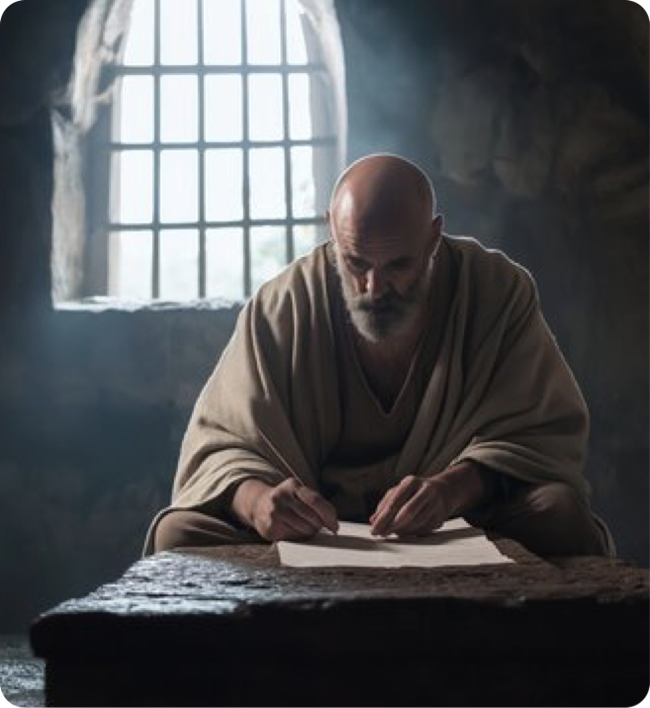

The constant object of Paul's prayers: 1:15-16
Paul had heard of their faith in the Lord Jesus [they had a faith that worked] (James 2:17,18,20-24; Luke 5:17-25; Gen. 22:12)
Paul had heard of their love for all the saints - [They had a love that worked] (Gal. 5:6; 1 John 3:14-20)
Ephesians 1:15–16 (NKJV)
¹⁵ Therefore I also, after I heard of your faith in the Lord Jesus and your love for all the saints,

Slide 8
The constant object of Paul's prayers: 1:15-16
Paul had heard of their faith in the Lord Jesus [they had a faith that worked] (James 2:17,18,20-24; Luke 5:17-25; Gen. 22:12)
Paul had heard of their love for all the saints - [They had a love that worked] (Gal. 5:6; 1 John 3:14-20)
Paul did not cease to pray for them (Rom. 1:8,9; Col. 1:3,9)
Ephesians 1:15–16 (NKJV)
¹⁶ do not cease to give thanks for you, making mention of you in my prayers:

Slide 9
Paul Prays They Receive Spiritual Insight: 1:17-18a
That God may give to you a spirit, [i.e., an attitude] of wisdom and revelation (compare Col. 1:9-12; 2 Thes. 2:10-12)
This wisdom and revelation is found in a complete and full knowledge of God [experiential knowledge, not mere education] (Eph. 3:18,19).
Enlightening the understanding [spiritual insight] (3:16-18; Col. 1:9; Acts 26:18; 2 Cor. 4:6; 5:14; Heb. 6:4)
Ephesians 1:17–18 (NKJV)
¹⁷ that the God of our Lord Jesus Christ, the Father of glory, may give to you the spirit of wisdom and revelation in the knowledge of Him, ¹⁸ the eyes of your understanding being enlightened; …

Slide 10

THAT YOU MAY KNOW
“What is the hope of His calling” (18b)
Hope, confident expectation: We have EVERY REASON to have confidence in both God’s will and ability to give us what He has promised (Titus 1:2; Hebrews 10:23)
God has called us to eternal life in Christ (Eph 4:4; Rom 8:24,25; Titus 1:2; 2 Thes. 2:14; 1 John 5:13)
Ephesians 1:18 (NKJV)
¹⁸ … that you may know what is the hope of His calling, what are the riches of the glory of His inheritance in the saints,

Slide 11
THAT YOU MAY KNOW
“What is the hope of His calling” (18b)
Hope is practical, “everyone who has this hope in Him purifies himself, just as He is pure.”(1 John 3:1-3; )
How would an accurate, confident perspective of our spiritual future help us navigate and persevere though this life? (2 Cor. 4:16-5:5; Rom. 8:17,18,28-39)
Ephesians 1:18 (NKJV)
¹⁸ … that you may know what is the hope of His calling, what are the riches of the glory of His inheritance in the saints,

Slide 12
THAT YOU MAY KNOW
“… what are the riches of the glory of His inheritance in the saints” (18c)
God will inherit those whom He has purchased (v. 7,11).
Paul uses superlative language to convey a treasure beyond all worldly value [riches / abundance (ploutos) and splendor / majesty (doxa)] (cf. Mat. 16:26; Mar. 8:36; Lu. 9:25)
Ephesians 1:18 (NKJV)
¹⁸ … that you may know what is the hope of His calling, what are the riches of the glory of His inheritance in the saints,

Slide 13
THAT YOU MAY KNOW
“… what is the exceeding greatness of His power toward us who believe” (19)
Paul describes God's power toward believers as immeasurable (cf. 3:7, 20; Acts 26:8; Rom. 1:4; Heb. 13:20).
Knowledge of His power towards us empowers us to live the Christian life faithfully, with courage and strength (3:16; 6:10-18; 1 Cor, 10:13; Col. 1:11)
Ephesians 1:19 (NKJV)
¹⁹ and what is the exceeding greatness of His power toward us who believe, according to the working of His mighty power

Slide 14
THE PROVISION AND EXALTATION OF CHRIST (20-23)
The greatest example of God’s saving power is the resurrection & exaltation of Christ (v.20; Phili 3:10; 1 Cor. 15)
God’s power and execution of His redemptive plan was accomplished in raising His Son, Jesus Christ, from the dead (cf. Rom. 8:11; 2 Cor. 4:14).
The place and position of highest honor - “The Father's throne has also become Christ's throne (Reve 3:21).
Ephesians 1:20 (NKJV)
²⁰ which He worked in Christ when He raised Him from the dead and seated Him at His right hand in the heavenly places,

Slide 15
THE PROVISION AND EXALTATION OF CHRIST (20-23)
The greatest example of God’s saving power is the resurrection & exaltation of Christ (v.20; Phili 3:10; 1 Cor. 15)
Jesus is king and priest now fulfilling Psalm 110:1-4 (cf. Acts 2:34-35; Zechariah 6:13; Hebrews 4:14-16).
The resurrection is not merely a past event but the source of the same power available to believers (1 Cor. 6:14; 15:21-58; Rom. 8:11)
Ephesians 1:20 (NKJV)
²⁰ which He worked in Christ when He raised Him from the dead and seated Him at His right hand in the heavenly places,

Slide 16
THE PROVISION AND EXALTATION OF CHRIST (20-23)
Christ's universal authority (v. 21)
The terms rule (archē), authority (exousia), power (dynamis), and dominion (kyriotēs)—emphasize the extent of Christ's preeminence over every form of authority - human and spiritual, in all realms (Mat. 28:18; Rom. 14:9; Phil. 2:9, 10; 1 Pet. 3:22; 1 Cor. 15:27)
Ephesians 1:21 (NKJV)
²¹ far above all principality and power and might and dominion, and every name that is named, not only in this age but also in that which is to come.

Slide 17
THE PROVISION AND EXALTATION OF CHRIST (20-23)
"And God placed all things under his feet" (v. 22)
Christ has dominion over all creation (Psalm 8:6; 110:1; Matt. 28:18; 1 Cor. 15:27).
Placing all things "under his feet" is a sign of total, complete, and certain subjugation, including his enemies (He. 2:8; 1 Cor. 15:25, 27).
Ephesians 1:22–23 (NKJV)
²² And He put all things under His feet, and gave Him to be head over all things to the church, ²³ which is His body, the fullness of Him who fills all in all.

Slide 18
CHRIST: HEAD OF HIS CHURCH / BODY (22-23)
"and gave Him to be head over all things to the church" (v. 22)
Because of this supreme authority, Christ is designated as the head "to the church," meaning he is the ultimate source of direction and power for his people (ch. 3:21; Mat. 16:18; Ac. 20:28; Col. 1:18, 24; 3:15; 1 Tim. 3:15; Heb. 12:22–24).
Ephesians 1:22–23 (NKJV)
²² And He put all things under His feet, and gave Him to be head over all things to the church, ²³ which is His body, the fullness of Him who fills all in all.

Slide 19
CHRIST: HEAD OF HIS CHURCH / BODY (22-23)
"and gave Him to be head over all things to the church" (v. 22)
As a body needs a head for life and direction, the church needs Christ’s authority to guide and empower its actions, ministries, and purpose in the world (Eph. 5:24; 1 Cor. 12:12-27).
Christ, through His body (the church), fulfills His purposes in the world (1 Tim 3:15; Mat. 5:13-16; Phili. 2:15,16).
Ephesians 1:22–23 (NKJV)
²² And He put all things under His feet, and gave Him to be head over all things to the church, ²³ which is His body, the fullness of Him who fills all in all.

Slide 20
CHRIST: HEAD OF HIS CHURCH / BODY (22-23)
"His body, the fullness of Him who fills all in all" (v. 23)
The church is the vessel that is "filled" with all that the Father provides in Christ (1 Cor. 12:12-27).
The church is the primary recipient and steward of that fullness, as Paul’s prayer that the believers be "filled with all the fullness of God" (Eph 1:3; 3:19; cf. Col. 1:19; 2:9).
Ephesians 1:22–23 (NKJV)
²² And He put all things under His feet, and gave Him to be head over all things to the church, ²³ which is His body, the fullness of Him who fills all in all.

Slide 21
All spiritual blessings are found only in Christ, given only to those who are in Christ, and are of much greater value than anything this temporal, material world can ever provide Matthew 16:24-26.

Slide 22
May we understand the immense wealth and glory we possess as God's treasured possession.

Slide 23
Through a deeper understanding of God’s grace, will, and power, we can be strengthened and more confident of our glorious future which is guaranteed all the faithful IN CHRIST.

Slide 24
If you are NOT in Christ, do you realize the immense poverty you are in and the hopelessness you should feel? John 8:34; Mat. 11:28-30

Slide 25
Christ’S CHURCH
ALL spiritual blessings
Chosen
A child of God
Accepted
Redeemed
Forgiven
A Heavenly Inheritance
Outside Christ
Lost Without Hope
NO spiritual blessings
NOT chosen
NOT children of God
NOT accepted
NO redemption
NO forgiveness
NO heavenly Inheritance
Baptized Into
Rom. 6:3-6
Gal. 3:26,27
Acts 2:38,47
HAS HOPE

Slide 27
Charts by Don McClain /
Preached October 26, 2025 Alexander church of Christ
501-568-1062 / Email – donmcclain@sbcglobal.net
www.alexanderchurchofchrist.com

Slide 28
Romans 8:16–19 (NKJV)
¹⁶ The Spirit Himself bears witness with our spirit that we are children of God, ¹⁷ and if children, then heirs—heirs of God and joint heirs with Christ, if indeed we suffer with Him, that we may also be glorified together. ¹⁸ For I consider that the sufferings of this present time are not worthy to be compared with the glory which shall be revealed in us. ¹⁹ For the earnest expectation of the creation eagerly waits for the revealing of the sons of God.

