Slide 1
(Ephesians 2:11-22)

Slide 2

All Spiritual Blessings In Christ – 1:3-16
Paul’s Prayer For The Ephesians – 1:17-23
Saved By Grace Through Faith – 2:1-10

Slide 3
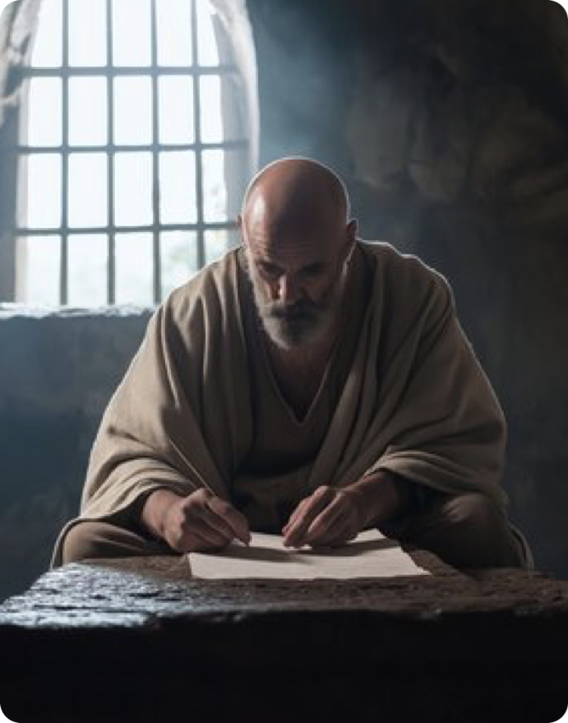
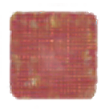
Paul calls the Gentile converts to “remember” their former status to heighten appreciation for present reality in Christ (2:11).
God’s saving work in Christ has abolished the dividing wall between Jew and Gentile and constituted a new, unified people — the church — as God’s dwelling (2:11–22).

Slide 4
Ephesians 2:11–22 (NKJV)
¹¹ Therefore remember that you, once Gentiles in the flesh—who are called Uncircumcision by what is called the Circumcision made in the flesh by hands—¹² that at that time you were without Christ, being aliens from the commonwealth of Israel and strangers from the covenants of promise, having no hope and without God in the world. ¹³ But now in Christ Jesus you who once were far off have been brought near by the blood of Christ.

Slide 5
Ephesians 2:11–22 (NKJV)
¹⁴ For He Himself is our peace, who has made both one, and has broken down the middle wall of separation, ¹⁵ having abolished in His flesh the enmity, that is, the law of commandments contained in ordinances, so as to create in Himself one new man from the two, thus making peace, ¹⁶ and that He might reconcile them both to God in one body through the cross, thereby putting to death the enmity. ¹⁷ And He came and preached peace to you who were afar off and to those who were near.

Slide 6
Ephesians 2:11–22 (NKJV)
¹⁸ For through Him we both have access by one Spirit to the Father. ¹⁹ Now, therefore, you are no longer strangers and foreigners, but fellow citizens with the saints and members of the household of God, ²⁰ having been built on the foundation of the apostles and prophets, Jesus Christ Himself being the chief cornerstone, ²¹ in whom the whole building, being fitted together, grows into a holy temple in the Lord, ²² in whom you also are being built together for a dwelling place of God in the Spirit.

Slide 7
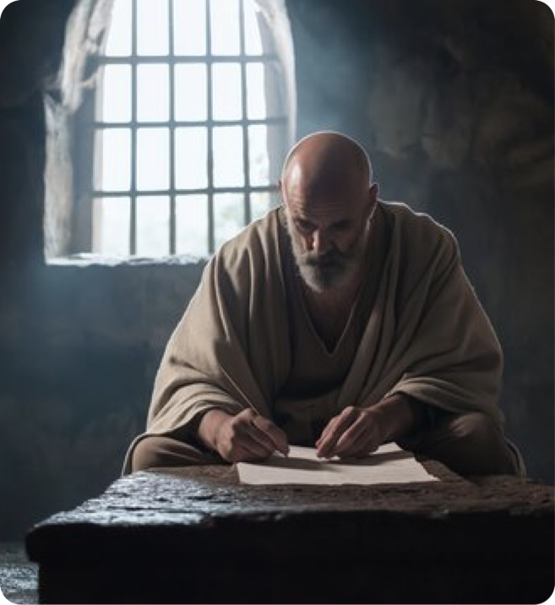
GENTILES' CONDITION “BEFORE & WITHOUT” CHRIST (2:11,12)
Remember , (mnemoneuo - μνημονεύω, 3421 / present, active, imperative),
“Gentiles in the flesh,” I.e., not descendants of Abraham, Isaac, and Jacob — “uncircumcised,” (Gen 12:2a; cf. Rom. 9:4)
Ephesians 2:11 (NKJV)
¹¹ Therefore remember that you, once Gentiles in the flesh—who are called Uncircumcision by what is called the Circumcision made in the flesh by hands—

Slide 8
GENTILES' CONDITION “BEFORE & WITHOUT” CHRIST (2:11,12)
The terms “circumcision” (the Jews) and “uncircumcision” (the Gentiles) carried implications of spiritual status, inclusion in the covenant, and community belonging.
Gentiles lacked covenantal standing, access to God’s promises, and hope — a comprehensive alienation (social, religious, eschatological).
Ephesians 2:11 (NKJV)
¹¹ Therefore remember that you, once Gentiles in the flesh—who are called Uncircumcision by what is called the Circumcision made in the flesh by hands—

Slide 9
GENTILES' CONDITION “BEFORE & WITHOUT” CHRIST (2:11,12)
The Gentiles were "without Christ," indicating that they had no hope in the promised Messiah (Jno. 10:16; Col. 1:21).
The phrase "alienated from the commonwealth of Israel" portrays a picture of exclusion not only from physical Israel but also from the spiritual blessings tied to God’s promises (cf. 4:18; 1 Pet. 2:10)
Ephesians 2:12 (NKJV)
¹² that at that time you were without Christ, being aliens from the commonwealth of Israel and strangers from the covenants of promise, having no hope and without God in the world.

Slide 10
GENTILES' CONDITION “BEFORE & WITHOUT” CHRIST (2:11,12)
Though some Gentiles were admitted into Judaism as proselytes, Gentiles as a whole were excluded; they were thus alienated from the benefits of God’s previous covenant people (Rom. 3:1; 9:1-4; 1 Peter 2:10).
Ephesians 2:12 (NKJV)
¹² that at that time you were without Christ, being aliens from the commonwealth of Israel and strangers from the covenants of promise, having no hope and without God in the world.
⁴ who are Israelites, to whom pertain the adoption, the glory, the covenants, the giving of the law, the service of God, and the promises; (Romans 9:4 - NKJV)

Slide 11
GENTILES' CONDITION “BEFORE & WITHOUT” CHRIST (2:11,12)
"Strangers from the covenants of promise" (12) — (National / Land / Blessing) (Gen. 12:1–3; 15:18–21; 17:1–8; Deut. 28–30).
"Having no hope" (12) no hope of a personal Messiah-to save them.
"Without God in the world" (12) as a people, did not have God’s laws, guidance, or association (2 Ch. 15:3; 1 Th. 4:5; cf. Acts 14:16,17)
Ephesians 2:12 (NKJV)
¹² that at that time you were without Christ, being aliens from the commonwealth of Israel and strangers from the covenants of promise, having no hope and without God in the world.

Slide 12
GENTILES' CONDITION “NOW & IN” CHRIST” (2:13-18)
“But now in Christ Jesus” — locative christology: all benefits are located “in” the Messiah; union with Christ is the medium for ALL TRUE BLESSINGS (1:3-14; Ro. 8:1; 2 Co. 5:17; Ga. 3:28).
“Have been brought near by the blood of Christ” — restored access and peace with God through Christ’s death (cf. 1:7; Rom. 3:23-30; Col. 1:13, 14, 21, 22; 1 Pe. 1:18,19).
Ephesians 2:13 (NKJV)
¹³ But now in Christ Jesus you who once were far off have been brought near by the blood of Christ.

Slide 13
GENTILES' CONDITION “NOW & IN” CHRIST” (2:13-18)
“For He Himself is our peace” — Christ as personified Peace: not merely a provider of peace but is our peace (Ac. 10:36; Ro. 5:1; Col. 1:20).
“Both” refers to Jews and Gentiles.
“Dividing wall” — barrier between Jews and Gentiles, the laws, customs, and religious practices that segregated the two groups (Ac. 10:28; Col. 2:13–19)
Ephesians 2:14–15 (NKJV)
¹⁴ For He Himself is our peace, who has made both one, and has broken down the middle wall of separation, ¹⁵ having abolished in His flesh the enmity, that is, the law of commandments contained in ordinances, so as to create in Himself one new man from the two, thus making peace,

Slide 14
GENTILES' CONDITION “NOW & IN” CHRIST” (2:13-18)
“Having abolished in His flesh the enmity” — the system of legal ordinances that functioned to maintain separation has been nullified (Eze 20:10-12; Lev. 20:24-26; Col. 1:22. He. 10:19–22).
“The law of commandments contained in ordinances,” the Law of Moses was fulfilled and thus is no longer in effect (Mat. 5:17,18).
Ephesians 2:14–15 (NKJV)
¹⁴ For He Himself is our peace, who has made both one, and has broken down the middle wall of separation, ¹⁵ having abolished in His flesh the enmity, that is, the law of commandments contained in ordinances, so as to create in Himself one new man from the two, thus making peace,

Slide 15
GENTILES' CONDITION “NOW & IN” CHRIST” (2:13-18)
Ephesians 2:14–15 (NKJV)
¹⁴ For He Himself is our peace, who has made both one, and has broken down the middle wall of separation, ¹⁵ having abolished in His flesh the enmity, that is, the law of commandments contained in ordinances, so as to create in Himself one new man from the two, thus making peace,
Matthew 5:17–18 (NKJV)
¹⁷ “Do not think that I came to destroy the Law or the Prophets. I did not come to destroy but to fulfill. ¹⁸ For assuredly, I say to you, till heaven and earth pass away, one jot or one tittle will by no means pass from the law till all is fulfilled.

Slide 16
GENTILES' CONDITION “NOW & IN” CHRIST” (2:13-18)
Colossians 2:14,16,17 (NKJV)
¹⁴ having wiped out the handwriting of requirements that was against us, which was contrary to us. And He has taken it out of the way, having nailed it to the cross. … ¹⁶ So let no one judge you in food or in drink, or regarding a festival or a new moon or sabbaths, ¹⁷ which are a shadow of things to come, but the substance is of Christ.
Ephesians 2:14–15 (NKJV)
¹⁴ For He Himself is our peace, who has made both one, and has broken down the middle wall of separation, ¹⁵ having abolished in His flesh the enmity, that is, the law of commandments contained in ordinances, so as to create in Himself one new man from the two, thus making peace,

Slide 17
GENTILES' CONDITION “NOW & IN” CHRIST” (2:13-18)
2 Corinthians 3:7–11 (NKJV)
⁷ But if the ministry of death, written and engraved on stones, was glorious, so that the children of Israel could not look steadily at the face of Moses because of the glory of his countenance, which glory was passing away, ⁸ how will the ministry of the Spirit not be more glorious?
Ephesians 2:14–15 (NKJV)
¹⁴ For He Himself is our peace, who has made both one, and has broken down the middle wall of separation, ¹⁵ having abolished in His flesh the enmity, that is, the law of commandments contained in ordinances, so as to create in Himself one new man from the two, thus making peace,

Slide 18
GENTILES' CONDITION “NOW & IN” CHRIST” (2:13-18)
2 Corinthians 3:7–11 (NKJV)
⁹ For if the ministry of condemnation had glory, the ministry of righteousness exceeds much more in glory. ¹⁰ For even what was made glorious had no glory in this respect, because of the glory that excels. ¹¹ For if what is passing away was glorious, what remains is much more glorious.
Ephesians 2:14–15 (NKJV)
¹⁴ For He Himself is our peace, who has made both one, and has broken down the middle wall of separation, ¹⁵ having abolished in His flesh the enmity, that is, the law of commandments contained in ordinances, so as to create in Himself one new man from the two, thus making peace,

Slide 19
GENTILES' CONDITION “NOW & IN” CHRIST” (2:13-18)
Galatians 3:19 (NKJV)
¹⁹ What purpose then does the law serve? It was added because of transgressions, till the Seed should come to whom the promise was made; and it was appointed through angels by the hand of a mediator.
Ephesians 2:14–15 (NKJV)
¹⁴ For He Himself is our peace, who has made both one, and has broken down the middle wall of separation, ¹⁵ having abolished in His flesh the enmity, that is, the law of commandments contained in ordinances, so as to create in Himself one new man from the two, thus making peace,

Slide 20
GENTILES' CONDITION “NOW & IN” CHRIST” (2:13-18)
Hebrews 7:18 (NKJV)
¹⁸ For on the one hand there is an annulling of the former commandment because of its weakness and unprofitableness, ¹⁹ for the law made nothing perfect;
Ephesians 2:14–15 (NKJV)
¹⁴ For He Himself is our peace, who has made both one, and has broken down the middle wall of separation, ¹⁵ having abolished in His flesh the enmity, that is, the law of commandments contained in ordinances, so as to create in Himself one new man from the two, thus making peace,

Slide 21
GENTILES' CONDITION “NOW & IN” CHRIST” (2:13-18)
Hebrews 8:13 (NKJV)
¹³ In that He says, “A new covenant,” He has made the first obsolete. Now what is becoming obsolete and growing old is ready to vanish away.
Ephesians 2:14–15 (NKJV)
¹⁴ For He Himself is our peace, who has made both one, and has broken down the middle wall of separation, ¹⁵ having abolished in His flesh the enmity, that is, the law of commandments contained in ordinances, so as to create in Himself one new man from the two, thus making peace,

Slide 22
GENTILES' CONDITION “NOW & IN” CHRIST” (2:13-18)
Hebrews 10:9 (NKJV)
⁹ then He said, “Behold, I have come to do Your will, O God.” He takes away the first that He may establish the second. ¹⁰ By that will we have been sanctified through the offering of the body of Jesus Christ once for all.
Ephesians 2:14–15 (NKJV)
¹⁴ For He Himself is our peace, who has made both one, and has broken down the middle wall of separation, ¹⁵ having abolished in His flesh the enmity, that is, the law of commandments contained in ordinances, so as to create in Himself one new man from the two, thus making peace,

Slide 23
GENTILES' CONDITION “NOW & IN” CHRIST” (2:13-18)
Jesus removed every aspect or every ordinance in the law, including such things as the ordinances pertaining to the Sabbath Day. (Heb. 8:13-9:4; 10:9).
In its place Christ brought a universal system, which still includes laws and ordinances (James 1:25; Rom. 8:1,2; Gal. 5:19-21).
Ephesians 2:14–15 (NKJV)
¹⁴ For He Himself is our peace, who has made both one, and has broken down the middle wall of separation, ¹⁵ having abolished in His flesh the enmity, that is, the law of commandments contained in ordinances, so as to create in Himself one new man from the two, thus making peace,

Slide 24
GENTILES' CONDITION “NOW & IN” CHRIST” (2:13-18)
“As to create in Himself one new man” — new corporate entity transcending old ethnic categories; realized in the church, HIS BODY.
“So making peace” — reconciliation not only vertically (with God) but also horizontally (between peoples), producing a SINGULAR reconciled community, i.e., His church (Col. 1:21–22; Acts 2:41-47; 10:34-48)
Ephesians 2:14–15 (NKJV)
¹⁴ For He Himself is our peace, who has made both one, and has broken down the middle wall of separation, ¹⁵ having abolished in His flesh the enmity, that is, the law of commandments contained in ordinances, so as to create in Himself one new man from the two, thus making peace,

Slide 25
GENTILES' CONDITION “NOW & IN” CHRIST” (2:13-18)
“that He might reconcile them both to God in one body” — Both Jew and Gentile have been separated from God by sin, (Rom. 1:18-3:23).
“through the cross” — we find God’s provision of grace and mercy in the sacrifice of Jesus, with which He cleanses us, purchases us, and sanctifies us (2 Cor. 5:18; Col. 1:20–22; 2:12-14; 1 Jn 1:5-2:2)
Ephesians 2:16 (NKJV)
¹⁶ and that He might reconcile them both to God in one body through the cross, thereby putting to death the enmity.

Slide 26
GENTILES' CONDITION “NOW & IN” CHRIST” (2:13-18)
“He came and preached peace to you” — Isaiah 57:19. Jesus preached the gospel to both Jews and Gentiles via. His Apostles (Mat. 28:19,20; Mk. 16:15,16; John 14:26; 16:13; Ac. 2:38, 26:23; 2 Cor. 5:18-21).
“through Him we both have access by one Spirit to the Father” — Jesus, (Jn 14:6), Spirit, (1 Cor. 12:13), the Father, (4:5-6).
Ephesians 2:17–18 (NKJV)
¹⁷ And He came and preached peace to you who were afar off and to those who were near. ¹⁸ For through Him we both have access by one Spirit to the Father.

Slide 27
ONE IN CHRIST JESUS (2:19-22)
ONE KINGDOM — fellow citizens, both Jews and Gentiles, with Jesus as KING (Col. 1:13; Phi. 3:20).
ONE FAMILY — the household of God (3:15; Acts 10:34-37; Gal. 3:26-29; 1 Jn. 3:1).
Ephesians 2:19 (NKJV)
¹⁹ Now, therefore, you are no longer strangers and foreigners, but fellow citizens with the saints and members of the household of God,

Slide 28
ONE IN CHRIST JESUS (2:19-22)
ONE KINGDOM — fellow citizens, both Jews and Gentiles, with Jesus as KING (Col. 1:13; Phi. 3:20).
ONE FAMILY — the household of God (3:15; Acts 10:34-37; Gal. 3:26-29; 1 Jn. 3:1).
ONE TEMPLE — Built on one foundation, (20), TOGETHER into ONE BODY, a dwelling place of GOD, (Ac. 4:11, 12. 1 Pe. 2:5-8)
Ephesians 2:20–22 (NKJV)
²⁰ having been built on the foundation of the apostles and prophets, Jesus Christ Himself being the chief cornerstone, ²¹ in whom the whole building, being fitted together, grows into a holy temple in the Lord, ²² in whom you also are being built together for a dwelling place of God in the Spirit.

Slide 29
ONE IN CHRIST JESUS (2:19-22)
“Apostles and prophets” — authoritative witnesses and apostolic-prophetic revelation as foundational.
Christ as “cornerstone” (petra gonias): the orientation, unity, and structural integrity of the building. Old Testament echo (e.g., Psalm 118:22; Isaiah): Messiah as both foundation and standard.
Ephesians 2:20–22 (NKJV)
²⁰ having been built on the foundation of the apostles and prophets, Jesus Christ Himself being the chief cornerstone, ²¹ in whom the whole building, being fitted together, grows into a holy temple in the Lord, ²² in whom you also are being built together for a dwelling place of God in the Spirit.

Slide 30
REMEMBER — where we were without Christ.
REMEMBER — what we have in Christ.
REMEMBER — we are to be ONE in Christ.
You can be baptized into Christ NOW!
(Rom. 6:3-6; Gal. 3:26,27)

Slide 31
Saved by grace through faith …
Baptized Into
Rom. 6:3-6
Gal. 3:26,27
Acts 2:38,47
HAS HOPE
Christ’S CHURCH
ALL spiritual blessings
Chosen
A child of God
Accepted
Redeemed
Forgiven
A Heavenly Inheritance
Outside Christ
Lost Without Hope
NO spiritual blessings
NOT chosen
NOT children of God
NOT accepted
NO redemption
NO forgiveness
NO heavenly Inheritance

Slide 33
Charts by Don McClain /
Preached December 21, 2025 PM Alexander church of Christ
501-568-1062 / Email – donmcclain@sbcglobal.net
www.alexanderchurchofchrist.com

Slide 34
1 Peter 2:4–10 (NKJV)
⁴ Coming to Him as to a living stone, rejected indeed by men, but chosen by God and precious, ⁵ you also, as living stones, are being built up a spiritual house, a holy priesthood, to offer up spiritual sacrifices acceptable to God through Jesus Christ. ⁶ Therefore it is also contained in the Scripture, “Behold, I lay in Zion A chief cornerstone, elect, precious, And he who believes on Him will by no means be put to shame.” ⁷ Therefore, to you who believe, He is precious; but to those who are disobedient, “The stone which the builders rejected Has become the chief cornerstone,”

Slide 35
1 Peter 2:4–10 (NKJV)
⁸ and “A stone of stumbling And a rock of offense.” They stumble, being disobedient to the word, to which they also were appointed. ⁹ But you are a chosen generation, a royal priesthood, a holy nation, His own special people, that you may proclaim the praises of Him who called you out of darkness into His marvelous light; ¹⁰ who once were not a people but are now the people of God, who had not obtained mercy but now have obtained mercy.

