Slide 1
¹³ Let us hear the conclusion of the whole matter: Fear God and keep His commandments, For this is man’s all. — Ecclesiastes 12:9-14 (NKJV)

Slide 2

Life is frequently disappointing, unfair, oppressive, tragic, and seemingly without point or meaning.
BUT, we should NOT take the message of Ecclesiastes to be predominately negative!
The wise man points us away from worthless things to the things in life that REALLY MATTER!
¹³ Let us hear the conclusion of the whole matter: Fear God and keep His commandments, For this is man’s all. — Ecclesiastes 12:9-14 (NKJV)

Slide 3

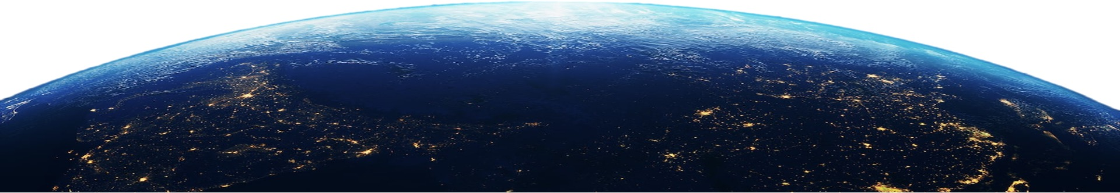
HEAVENLY, SPIRITUAL PERSPECTIVE
LIMITED EARTHLY PERSPECTIVE

Slide 4

The last 2 chapters emphasize the need to INVEST our resources, time, efforts, & abilities toward that which will LAST instead of towards things that will PERISH (12:7)
God will hold us all accountable to our PURPOSE in the end. (12:13,14)
¹³ Let us hear the conclusion of the whole matter: Fear God and keep His commandments, For this is man’s all. — Ecclesiastes 12:9-14 (NKJV)

Slide 5
Restatement of the result of the Preacher's search for meaning (12:8)
The value of wisdom, and a warning against the wrong kind of study (12:9- 12)
The grand conclusion — The REAL PURPOSE for our existence (12:13-14).
¹³ Let us hear the conclusion of the whole matter: Fear God and keep His commandments, For this is man’s all. — Ecclesiastes 12:9-14 (NKJV)

Slide 6
Ecclesiastes 12:9–14 (NKJV)
⁹ And moreover, because the Preacher was wise, he still taught the people knowledge; yes, he pondered and sought out and set in order many proverbs. ¹⁰ The Preacher sought to find acceptable words; and what was written was upright—words of truth. ¹¹ The words of the wise are like goads, and the words of scholars are like well-driven nails, given by one Shepherd. ¹² And further, my son, be admonished by these. Of making many books there is no end, and much study is wearisome to the flesh. ¹³ Let us hear the conclusion of the whole matter: Fear God and keep His commandments, For this is man’s all. ¹⁴ For God will bring every work into judgment, Including every secret thing, Whether good or evil.

Slide 7






The Preacher’s Conclusion (12:8)
Ecclesiastes 12:8 (NKJV)
⁸ “Vanity of vanities,” says the Preacher, “All is vanity.”
(cf. 1:2, 14; 2:17; 4:4)

Slide 8
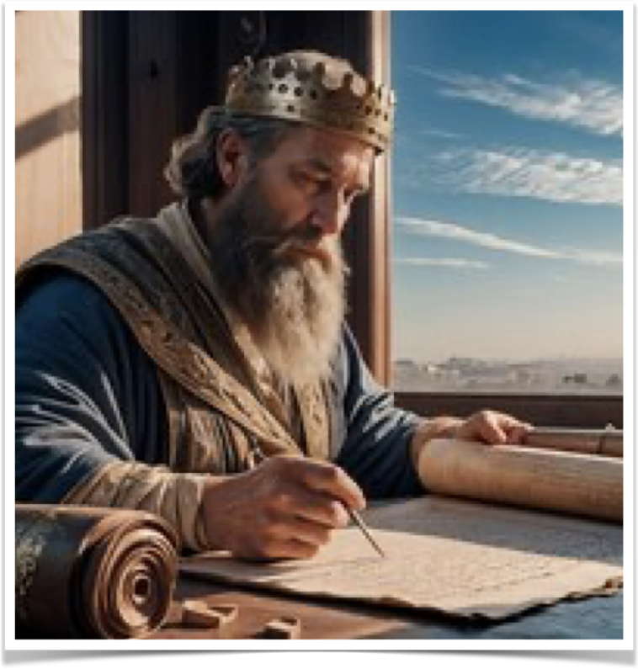


The Preacher’s Conclusion (12:8)
ALL IS VANITY when life is viewed solely from an earthly perspective (1:2,3; 12:8)
  Pleasure - 2:1
  Labor - 2:11,22-23; 4:4
  Wisdom - 2:15
  Difficulty in life - 2:17
  An inheritance - 2:18-21
  Riches - 4:7-8
  Loving wealth - 5:10
  Wandering desire - 6:9
  Foolish laughter - 7:6
  Injustice in life - 8:14
  Days of darkness - 11:8
  Childhood - 11:10
Ecclesiastes 12:8 (NKJV)
⁸ “Vanity of vanities,” says the Preacher, “All is vanity.”

Slide 9

The Preacher’s Conclusion (12:8)
ALL IS VANITY when life is viewed solely from an earthly perspective (1:2,3; 12:8)
  IF LIFE UNDER THE SUN IS ALL THERE IS - THEN LIFE IS MEANINGLESS - WITHOUT PURPOSE - WITHOUT HOPE.
  BUT LIFE UNDER THE SUN IS NOT ALL THERE IS!
Ecclesiastes 12:8 (NKJV)
⁸ “Vanity of vanities,” says the Preacher, “All is vanity.”

Slide 10
His Credentials to Speak (12:9)
He claims the gift of wisdom (12:9)
  The term wisdom (chakham) implies that which is from God.
  He taught “knowledge” — he pondered (i.e., carefully weighed, examined) and searched, and set in order (i.e., carefully arranged) many proverbs (1 Pet. 1:10,11; 2 Pet. 1:21).
Ecclesiastes 12:9 (NKJV)
⁹ And moreover, because the Preacher was wise, he still taught the people knowledge; yes, he pondered and sought out and set in order many proverbs.

Slide 11

His Claims about His Book (12:10–11)
He carefully sought to find: (12:10)
  Terms that were acceptable, appropriate and accurate to convey his message.
  Terms which best conveyed that which is “upright” (yosher), and “words of truth,” i.e., that which is objectively true (12:10).
Ecclesiastes 12:10 (NKJV)
¹⁰ The Preacher sought to find acceptable words; and what was written was upright—words of truth.

Slide 12
His Claims about His Book (12:10–11)
Koheleth classifies his book with other wisdom books (12:11)
  They are “goads.” — a rod with an iron spike, or sharpened at the end, used in driving oxen.
  Words of wisdom restrain from error and urge in the right direction. The pain truth inflicts is for our good and not for evil.
Ecclesiastes 12:11 (NKJV)
¹¹ The words of the wise are like goads, and the words of scholars are like well-driven nails, given by one Shepherd.

Slide 13
His Claims about His Book (12:10–11)
Koheleth classifies his book with other wisdom books (12:11)
  The words of the wise “are like well-driven nails.” — established, substantial, secure — Truth is NOT vacillating (Ps 19:7; Jn 10:33-38)
  The one shepherd is Yahweh — Solomon spoke the words of God (cf. Gen 48:15; Ps 23:1).
Ecclesiastes 12:11 (NKJV)
¹¹ The words of the wise are like goads, and the words of scholars are like well-driven nails, given by one Shepherd.

Slide 14
Admonition Regarding Study (12:12)
NOT ALL KNOWLEDGE IS BENEFICIAL (12:12)
  “But beyond this, my son, be warned:” (NASB) —
  “My son, beware of anything beyond these.” (ESV)
  Solomon warns us not to seek answers beyond those given by God (1 Corinthians 4:6)
Ecclesiastes 12:12 (NKJV)
¹² And further, my son, be admonished by these. Of making many books there is no end, and much study is wearisome to the flesh.

Slide 15
Admonition Regarding Study (12:12)
NOT ALL KNOWLEDGE IS BENEFICIAL (12:12)
  “making many books there is no end” - The endless works of man are unprofitable, contradictory and unreliable.
  We should make the word of God our chief object of study.
Ecclesiastes 12:12 (NKJV)
¹² And further, my son, be admonished by these. Of making many books there is no end, and much study is wearisome to the flesh.

Slide 16
Admonition Regarding Study (12:12)
NOT ALL KNOWLEDGE IS BENEFICIAL (12:12)
  “Much study is a weariness of the flesh.”
  One may weary his brain by protracted study of the “many books," but not gain any necessary insight into spiritual matters (12:12).
Ecclesiastes 12:12 (NKJV)
¹² And further, my son, be admonished by these. Of making many books there is no end, and much study is wearisome to the flesh.

Slide 17
Admonition Regarding Study (12:12)
“Matthew 6:9 says, ‘Our Father, which art in heaven,’ This ‘be thy name.’”
NBC NEWS - June 15, 2023
‘Jeopardy’ fans reel as ‘Lord’s Prayer’ question goes unanswered

Slide 18
KOHELETH’S CONCLUSION (12:13,14)
Ecclesiastes 12:13–14 (NKJV)
¹³ Let us hear the conclusion of the whole matter: Fear God and keep His commandments, For this is man’s all. ¹⁴ For God will bring every work into judgment, Including every secret thing, Whether good or evil.

Slide 19
KOHELETH’S CONCLUSION (12:13,14)
The teaching of the whole book of Ecclesiastes is now gathered up in two powerful sentences.
  They guard against the possible misconceptions some may draw from the book.
  They put everything into its proper perspective.
Ecclesiastes 12:13 (NKJV)
¹³ Let us hear the conclusion of the whole matter: Fear God and keep His commandments, For this is man’s all.

Slide 20
KOHELETH’S CONCLUSION (12:13,14)
The conclusion of the whole matter: (12:13)
  To "fear God” is, to revere God, to hold Him in awe, This is the beginning of wisdom and knowledge (Pro. 1:7; 9:10)
  Reverence grows out of faith in knowing WHO God is (Ezek. 1:26-28; Isa. 6:1-13)
Ecclesiastes 12:13 (NKJV)
¹³ Let us hear the conclusion of the whole matter: Fear God and keep His commandments, For this is man’s all.

Slide 21
KOHELETH’S CONCLUSION (12:13,14)
The conclusion of the whole matter: (12:13)
  This reverence will help keep us on the right track (Dt 6:2; 10:12; Prov. 10:27-29; 23:17,18; Mic. 6:8)
  OBEDIENCE is the REAL test of one’s respect for God (Deut 13:4; 30:16 ; Jn 14:15 ; 1Jn 2:3-4; 5:3; Luke 6:46).
Ecclesiastes 12:13 (NKJV)
¹³ Let us hear the conclusion of the whole matter: Fear God and keep His commandments, For this is man’s all.

Slide 22
KOHELETH’S CONCLUSION (12:13,14)
The conclusion of the whole matter: (12:13)
  “fear God and keep His commandments, because this applies to every person.” (NASB)
  To reverently obey God, "walking in the fear of the Lord" (Ac 9:31), is the whole purpose of EVERY human.
Ecclesiastes 12:13 (NKJV)
¹³ Let us hear the conclusion of the whole matter: Fear God and keep His commandments, For this is man’s all.

Slide 23
KOHELETH’S CONCLUSION (12:13,14)
The Final Judgment (12:14)
  The whole purpose of man in “fearing God and keeping His commandments” is grounded upon the solemn fact of the future judgment (12:14; 2 Cor. 5:10; Rom. 2:5-11; 2 Pet 3:10-14; 2 Thes. 1:7-9; Acts 17:30).
Ecclesiastes 12:14 (NKJV)
¹⁴ For God will bring every work into judgment, Including every secret thing, Whether good or evil.

Slide 24
KOHELETH’S CONCLUSION (12:13,14)
The Final Judgment (12:14)
  The inequities of life will be resolved & remedied in the final judgment under the eye of the sovereign, omniscient and unerring God, (Rom 2:16; 1 Cor 4:5; Heb. 4:13).
Ecclesiastes 12:14 (NKJV)
¹⁴ For God will bring every work into judgment, Including every secret thing, Whether good or evil.

Slide 25
KOHELETH’S CONCLUSION (12:13,14)
The Final Judgment (12:14)
Hebrews 4:11–13 (NKJV)
¹¹ Let us therefore be diligent to enter that rest, lest anyone fall according to the same example of disobedience. ¹² For the word of God is living and powerful, and sharper than any two-edged sword,
Ecclesiastes 12:14 (NKJV)
¹⁴ For God will bring every work into judgment, Including every secret thing, Whether good or evil.

Slide 26
KOHELETH’S CONCLUSION (12:13,14)
The Final Judgment (12:14)
Hebrews 4:11–13 (NKJV)
piercing even to the division of soul and spirit, and of joints and marrow, and is a discerner of the thoughts and intents of the heart. ¹³ And there is no creature hidden from His sight, but all things are naked and open to the eyes of Him to whom we must give account.
Ecclesiastes 12:14 (NKJV)
¹⁴ For God will bring every work into judgment, Including every secret thing, Whether good or evil.

Slide 27
KOHELETH’S CONCLUSION (12:13,14)
ON THAT DAY EVERY SECRET:
  Thing will be exposed (12:14).
  Work will be judged (Rom 2:16)
  Work of darkness will be exposed (1 Co. 4:5)
  Thing revealed, no hiding from our all knowing creator (Luke 12:1, 2.; Heb 4:13; 10:31
Ecclesiastes 12:14 (NKJV)
¹⁴ For God will bring every work into judgment, Including every secret thing, Whether good or evil.

Slide 28
FEAR GOD & KEEP HIS COMMANDMENTS!
¹³ Let us hear the conclusion of the whole matter: Fear God and keep His commandments, For this is man’s all. — ¹⁴ For God will bring every work into judgment, Including every secret thing, Whether good or evil.
Ecclesiastes 12:13,14 (NKJV)
Living life from an earthly perspective alone is truly vanity!
By fearing God and keeping His commandments, one can endure the vanities and perplexities of life, and enjoy the good things in life, and the world to come!
We will give an account to GOD!

Slide 29
2 Corinthians 6:2 (NKJV)
² For He says: “In an acceptable time I have heard you, And in the day of salvation I have helped you.” Behold, now is the accepted time; behold, now is the day of salvation.
HEAR / BELIEVE / REPENT / CONFESS / BE BAPTIZED / FOLLOW JESUS
Matthew 7:13,14

Slide 30
Don McClain
65th St church of Christ - Nov 14, 2004

Slide 31


“The WHOLE DUTY of MAN”
(Ecclesiastes 12:9-14)
Notes:
Turn! Turn! Turn!", sometimes known as "Turn! Turn! Turn! (To Everything There Is a Season)", is a song written by Pete Seeger in the late 1950s. The lyrics, except for the title, which is repeated throughout the song, and the final two lines, are adapted word-for-word from an English version of the first eight verses of the third chapter of the biblical Book of Ecclesiastes. The song was originally released in 1962 as "To Everything There Is a Season" on folk group the Limeliters' album Folk Matinee, and then some months later on Seeger's own The Bitter and the Sweet.[1]
The song became an international hit in late 1965 when it was adapted by the American folk rock group the Byrds. The single entered the U.S. chart at number 80 on October 23, 1965, before reaching number one on the Billboard Hot 100 chart on December 4, 1965. In Canada, it reached number 3 on November 29, 1965, and also peaked at number 26 on the UK Singles Chart.

Slide 32

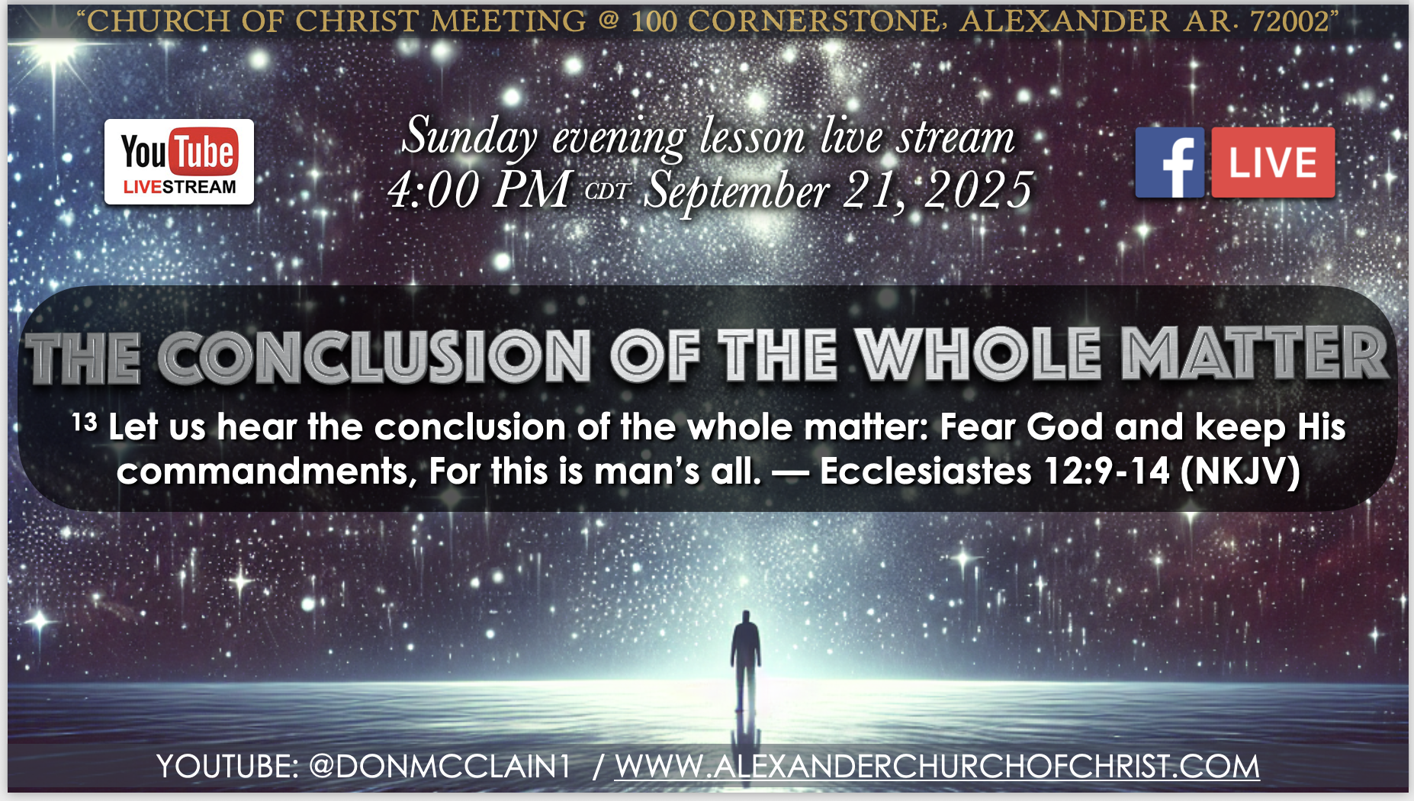
100 CORNERSTONE ALEXANDER AR, 72002
22
186
81
112
276
1024

Slide 33
Deuteronomy 10:12–17 (NKJV)
¹² “And now, Israel, what does the Lord your God require of you, but to fear the Lord your God, to walk in all His ways and to love Him, to serve the Lord your God with all your heart and with all your soul, ¹³ and to keep the commandments of the Lord and His statutes which I command you today for your good? ¹⁴ Indeed heaven and the highest heavens belong to the Lord your God, also the earth with all that is in it. ¹⁵ The Lord delighted only in your fathers, to love them; and He chose their descendants after them, you above all peoples, as it is this day. ¹⁶ Therefore circumcise the foreskin of your heart, and be stiff-necked no longer. ¹⁷ For the Lord your God is God of gods and Lord of lords, the great God, mighty and awesome, who shows no partiality nor takes a bribe.

