Slide 1

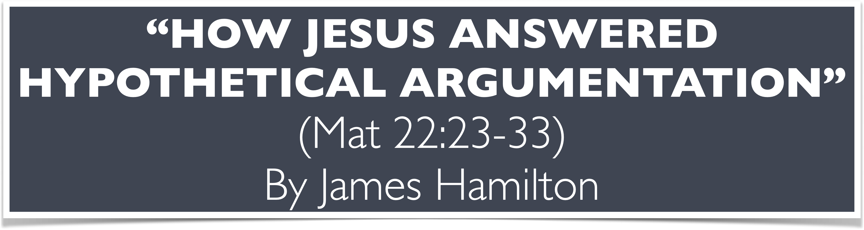
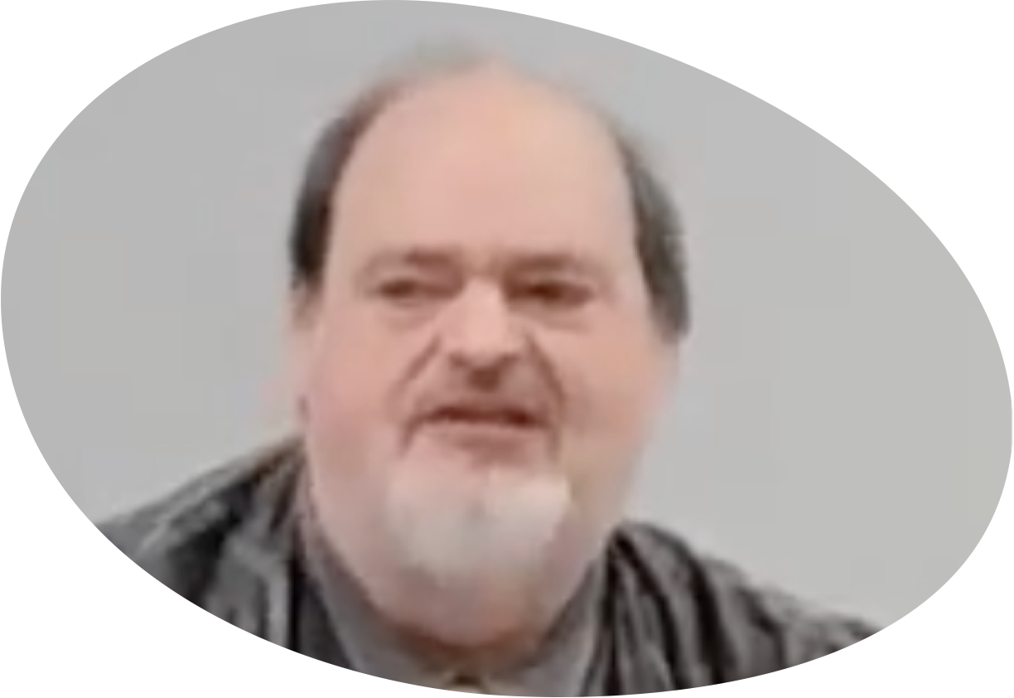
“Church of Christ MEETING @ 100 CORNERSTONE, Alexander AR. 72002”
TODAY’S LESSON
Sunday Morning Live Stream 10:30 AM ^{CT} September 28, 2025
https://www.youtube.com/user/donmcclain11/live / WWW.ALEXANDERCHURCHOFCHRIST.COM

Slide 2
HOW JESUS ANSWERED HYPOTHETICAL ARGUMENTATION
MATTHEW 22:23-33

Slide 3
THE AUTHORITY OF GOD’S WORD
“Great faith” = recognition that the authority of Christ is in the word of Christ Matt. 8:5-11

Slide 4
Matthew 8:5-10
⁵ Now when Jesus had entered Capernaum, a centurion came to Him, pleading with Him, ⁶ saying, “Lord, my servant is lying at home paralyzed, dreadfully tormented.”
⁷ And Jesus said to him, “I will come and heal him.”
⁸ The centurion answered and said, “Lord, I am not worthy that You should come under my roof. But only say the word, and my servant would be healed. ⁹ For I am a man under authority, having soldiers under me.

Slide 5
Matthew 8:5-10
“And I say to this one, ‘Go,’ and he goes; and to another, ‘Come,’ and he comes; and to my servant , ‘Do this,’ and he does it.’”
¹⁰ When Jesus heard it, He marveled, and said to those who followed, “Assuredly, I say to you, I have not found such great faith, not in Israel!”

Slide 6
THE AUTHORITY OF GOD’S WORD
“Great faith” = recognition that the authority of Christ is in the word of Christ Matt. 8:5-11

Slide 7
THE AUTHORITY OF GOD’S WORD
“Great faith” = recognition that the authority of Christ is in the word of Christ Matt. 8:5-11
The word of Christ is no more and no less than the scriptures which we call “The New Testament” John 16:12-13; Hebrews 2:3-4; 1 Corinthians 14:37; 2 Peter 1:12-15

Slide 8
John 16:12-13
¹² “I still have many things to say to you, but you cannot bear them now. ¹³ However, when He, the Spirit of truth, has come, He will guide you into ALL truth; for He will not speak on His own authority, but whatever He hears He will speak; and He will tell you things to come.

Slide 9
Hebrews 2:3-4
³ How shall we escape if we neglect so great a salvation, which at the first began to be spoken by the Lord, and was confirmed to us by those who heard Him, ⁴ God also bearing witness both with signs and wonders, with various miracles, and gifts of the Holy Spirit, according to His own will?

Slide 10
1 Corinthians 14:37
³⁷ If anyone thinks himself to be a prophet or spiritual, let him acknowledge that the things which I write to you are the commandments of the Lord.

Slide 11
2 Peter 1:12-15
¹² I will not be negligent to remind you always of these things, though you know and are established in the present truth. ¹³ Yes, I think it is right, as long as I am in this body, to stir you up by reminding you, ¹⁴ knowing that soon I will leave behind my body, just as our Lord Jesus Christ showed me. ¹⁵ Moreover I will make sure that you always have a reminder of these things after my death.

Slide 12
THE AUTHORITY OF GOD’S WORD
“Great faith” = recognition that the authority of Christ is in the word of Christ Matt. 8:5-11
The word of Christ is no more and no less than the scriptures which we call “The New Testament” John 16:12-13; Hebrews 2:3-4; 1 Corinthians 14:37; 2 Peter 1:12-15
CHRIST→HOLY SPIRIT→APOSTLES→WROTE→N.T.

Slide 13
Ephesians 3:3-5
³ By revelation He made known to me the mystery (as I have briefly written already, ⁴ by which, when you read, you may understand my knowledge in the mystery of Christ), ⁵ which in other ages was not made known to the sons of men, as it has now been revealed by the Spirit to His holy apostles and prophets

Slide 14
THE CLARITY OF GOD’S WORD
CHRIST→HOLY SPIRIT→APOSTLES→WROTE→N.T.→US
When we read, then we can know
Purpose for the New Testament Scriptures 1 John 1:1-4

Slide 15
1 John 1:1-4
¹ That which was from the beginning, which we have heard, which we have seen with our eyes, which we have looked upon, and our hands have handled, concerning the Word of life— ² the life was manifested, and we have seen, and bear witness, and declare to you that eternal life which was with the Father and was manifested to us— ³ that which we have seen and heard we declare to you, that you also may have fellowship with us; and truly our fellowship is with the Father and with His Son Jesus Christ. ⁴ And these things we write to you that your joy may be full.

Slide 16
THE CLARITY OF GOD’S WORD
CHRIST→HOLY SPIRIT→APOSTLES→WROTE→N.T.→US
When we read, then we can know
Purpose for the New Testament Scriptures 1 John 1:1-4

Slide 17
THE CLARITY OF GOD’S WORD
CHRIST→HOLY SPIRIT→APOSTLES→WROTE→N.T.→US
When we read, then we can know
Purpose for the New Testament Scriptures 1 John 1:1-4
We can know the truth that can save us John 8:31-34

Slide 18
John 8:31-32
³¹ Then Jesus said to those Jews who believed Him, “If you remain in My word, you are truly My disciples. ³² And you shall know the truth, and the truth shall make you free.”
33 They answered Him, “We are Abraham’s descendants, and have never been in bondage to anyone. How can You say, ‘You will be made free’?”
34 Jesus answered them, “Truly, I am telling you, whoever is committing sin is a slave of sin.”

Slide 19
THE CLARITY OF GOD’S WORD
CHRIST→HOLY SPIRIT→APOSTLES→WROTE→N.T.→US
When we read, then we can know
Purpose for the New Testament Scriptures 1 John 1:1-4
We can know the truth that can save us John 8:31-32
Truth liberates us!
Doubt nor skepticism cannot liberate us
Doubt, skepticism keep us enslaved in the dark
Enslaved in sin (the attraction of worldly wisdom)

Slide 20
THE LIBERATING POWER OF GOD’S WORD
Liberates us from sin John 8:31-34; Romans 6:16-18; 6:3-4

Slide 21
Romans 6:16-18
¹⁶ Do you not know that to whom you present yourselves slaves to obey, you are that one’s slaves whom you obey, whether of sin unto death, or of obedience unto righteousness? ¹⁷ But God be thanked that though you were slaves of sin, yet you obeyed from the heart that form of doctrine which was delivered to you. ¹⁸ And having been liberated from sin, you became slaves of righteousness.

Slide 22
Romans 6:3-4
³ Or do you not know that as many of us as were baptized into Christ Jesus were baptized into His death? ⁴ Therefore we were buried with Him through baptism into death, that just as Christ was raised from the dead by the glory of the Father, even so we also should walk in newness of life.

Slide 23
THE LIBERATING POWER OF GOD’S WORD
Liberates us from sin John 8:31-34; Romans 6:16-18; 6:3-4
Liberates us to love 1 John 4:16-18

Slide 24
1 John 4:16-18
¹⁶ And we have known and believed the love that God has for us. God is love, and he who abides in love abides in God, and God in him. ¹⁷ Love has been perfected among us in this: that we may have boldness in the day of judgment; because as He is, so are we in this world. ¹⁸ There is no fear in love; but perfect love casts out fear, because fear involves torment. But he who fears has not been made perfect in love.

Slide 25
THE LIBERATING POWER OF GOD’S WORD
Liberates us from sin John 8:31-34; Romans 6:16-18; 6:3-4
Liberates us to love 1 John 4:16-18
Liberates us from fear 1 John 4:18
Liberates us from the fear of death Matthew 22:23-33

Slide 26
Matthew 22:23-33
²³ The same day the Sadducees, who say there is no resurrection, came to Him and asked Him, ²⁴ saying: “Teacher, Moses said that if a man dies, having no children, his brother shall marry his wife and raise up offspring for his brother. ²⁵ Now there were with us seven brothers. The first died after he had married, and having no offspring, left his wife to his brother. ²⁶ Likewise the second also, and the third, even to the seventh. ²⁷ Last of all the woman died also. ²⁸ Therefore, in the resurrection, whose wife of the seven will she be? For they all had her.”

Slide 27
Matthew 22:23-33
²⁹ Jesus answered and said to them, “You are mistaken, not knowing the Scriptures nor the power of God. ³⁰ For in the resurrection they neither marry nor are given in marriage, but are like angels of God in heaven. ³¹ But concerning the resurrection of the dead, have you not read what was spoken to you by God, saying, ³² ‘I am the God of Abraham, the God of Isaac, and the God of Jacob’? God is not the God of the dead, but of the living.” ³³ And when the multitudes heard this, they were astonished at His teaching.

Slide 28
THE LIBERATING POWER OF GOD’S WORD
Liberates us from sin John 8:31-34; Romans 6:16-18; 6:3-4
Liberates us to love 1 John 4:16-18
Liberates us from fear 1 John 4:18
Liberates us from the fear of death Matthew 22:23-33

Slide 29
THE LIBERATING POWER OF GOD’S WORD
Liberates us from sin John 8:31-34; Romans 6:16-18; 6:3-4
Liberates us to love 1 John 4:16-18
Liberates us from fear 1 John 4:18
Liberates us from the fear of death Matthew 22:23-33
Liberates us from worldly wisdom 1 Cor. 1:20-25; Colossians 2:8-10

Slide 30
1 Corinthians 1:20-25
²⁰ Has not God made foolish the wisdom of this world? ²¹ For since, in the wisdom of God, the world through wisdom did not know God, it pleased God through the foolishness of the message preached to save those who believe. ²² For Jews request a sign, and Greeks seek after wisdom; ²³ but we preach Christ crucified, to the Jews a stumbling block and to the Greeks foolishness, ²⁴ but to those who are called, both Jews and Greeks, Christ the power of God and the wisdom of God. ²⁵ Because the foolishness of God is wiser than men, and the weakness of God is stronger than men.

Slide 31
Colossians 2:8-10
⁸ Beware lest anyone cheat you through philosophy and empty deceit, according to the tradition of men, according to the basic principles of the world, and not according to Christ. ⁹ For in Him dwells all the fullness of the Godhead bodily; ¹⁰ and you are complete in Him, who is the head of all principality and power.

Slide 32
THE LIBERATING POWER OF GOD’S WORD
Liberates us from sin John 8:31-34; Romans 6:16-18; 6:3-4
Liberates us to love 1 John 4:16-18
Liberates us from fear 1 John 4:18
Liberates us from the fear of death Matthew 22:23-33
Liberates us from worldly wisdom 1 Cor. 1:20-25; Colossians 2:8-10
Liberates us from things that don’t concern us Psalm 131; John 21:20-23

Slide 33
Psalm 131:1-3
¹ LORD, my heart is not haughty, nor my eyes lofty. Neither do I concern myself with great matters, nor with things too profound for me.
² Surely I have calmed and quieted my soul, like a weaned child with his mother; like a weaned child is my soul within me.
³ O Israel, hope in the LORD from this time forth and forever.

Slide 34
John 21:20-25
²⁰ Then Peter, turning around, saw the disciple whom Jesus loved following, who also had leaned on His breast at the supper, and said, “Lord, who is the one who betrays You?” ²¹ Peter, seeing him, said to Jesus, “But Lord, what about this man?”
²² Jesus said to him, “If I will that he remain till I come, what is that to you? You follow Me.”
²³ Then this saying went out among the brethren that this disciple would not die. Yet Jesus did not say to him that he would not die, but, “If I will that he remain till I come, what is that to you?”

Slide 35
“Church of Christ MEETING @ 100 CORNERSTONE, Alexander AR. 72002”
TODAY’S LESSON
Sunday Morning Live Stream 10:30 AM ^{CT} September 28, 2025
https://www.youtube.com/user/donmcclain11/live / WWW.ALEXANDERCHURCHOFCHRIST.COM

