Slide 1

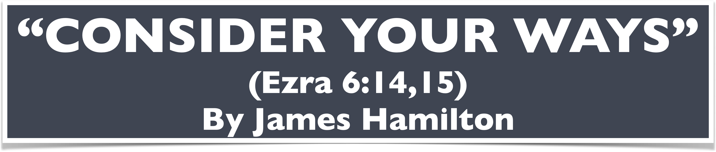
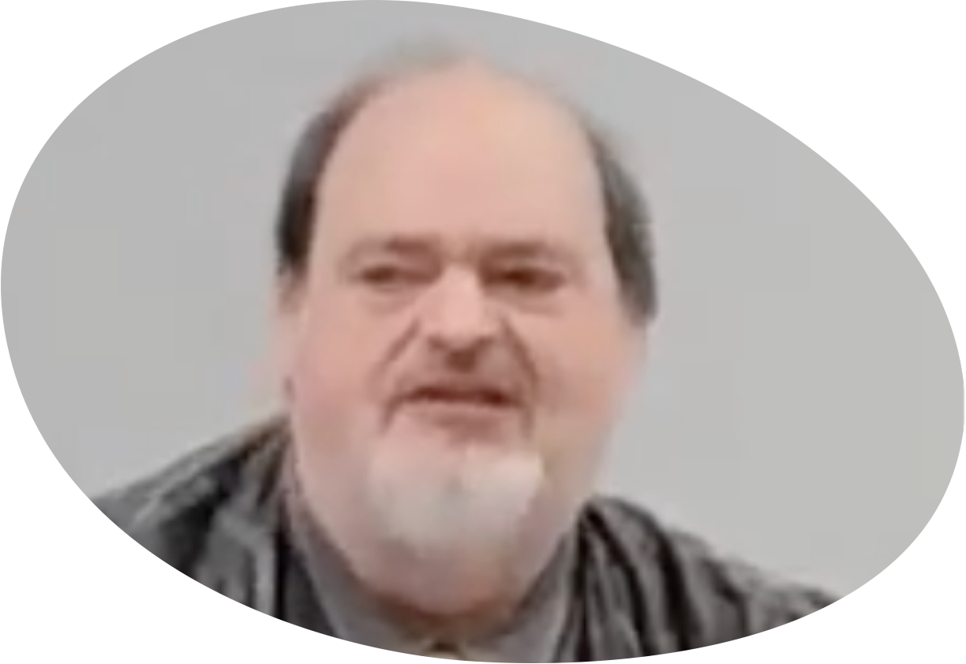
“Church of Christ MEETING @ 100 CORNERSTONE, Alexander AR. 72002”
TODAY’S LESSON
Sunday evening lesson live stream 4:00 PM ^{CDT} October 19, 2025
https://www.youtube.com/user/donmcclain11/live / WWW.ALEXANDERCHURCHOFCHRIST.COM

Slide 2
CONSIDER YOUR WAYS!
EZRA 6:14-15

Slide 3
WORK OF HAGGAI & ZECHARIAH
Haggai began on 6/1/520 B.C. Hg 1:1
Zechariah began on 8/1/520 B.C. Zech. 1:1
Told Zerubbabel governor (ruler) of Judah & Yeshua the High Priest: Build the house of the LORD! Hg 1:2-11
“The people say, ‘It’s not time to build the house of the LORD.’” v.2
God’s response: “Consider your ways!” v.3-6

Slide 4
Haggai 1:4-6
4 “‘Is it time for you yourselves to dwell in your paneled houses, and this house is in ruins?’” 5 Now therefore, thus says the LORD of armies: “‘Consider your ways!
6 “You have sown much, and bring in little;
You eat, but do not have enough;
You drink, but you are not filled with drink;
You clothe yourselves, but no one is warm;
And he who earns wages,
Earns wages to put into a bag with holes.”

Slide 5
WORK OF HAGGAI & ZECHARIAH
Haggai began on 6/1/520 B.C. Hg 1:1
Zechariah began on 8/1/520 B.C. Zech. 1:1
Told Zerubbabel governor (ruler) of Judah & Yeshua the High Priest: Build the house of the LORD! Hg 1:2-11
“The people say, ‘It’s not time to build the house of the LORD.’” v.2
God’s response: “Consider your ways!” v.3-6

Slide 6
WORK OF HAGGAI & ZECHARIAH
Haggai began on 6/1/520 B.C. Hg 1:1
Zechariah began on 8/1/520 B.C. Zech. 1:1
Told Zerubbabel governor (ruler) of Judah & Yeshua the High Priest: Build the house of the LORD! Hg 1:2-11
“The people say, ‘It’s not time to build the house of the LORD.’” v.2
God’s response: “Consider your ways!” v.3-6
Consider how your ways reveal your priority

Slide 7
WORK OF HAGGAI & ZECHARIAH
God’s response: “Consider your ways!” v.7-11
Consider the fruit of your ways

Slide 8
Haggai 1:7-11
7 “Thus says the LORD of armies: ‘Consider your ways! 8 Go up to the mountains and bring wood and build the house, that I may take pleasure in it and be glorified,’ says the LORD 9 ‘You looked for much, but it was actually little; and when you brought it to the house, I blew it away. Why?’ says the LORD of armies.

Slide 9
Haggai 1:7-11
9b “‘Because of My house that is ruins, while every one of you runs to his own house. 10 Therefore the heavens above you withhold the dew, and the land withholds its fruit. 11 For I called for a drought on the land and the mountains, on the grain and the new wine and the oil, on whatever the ground brings forth, on men and livestock, and on all the labor of your hands.’”

Slide 10
WORK OF HAGGAI & ZECHARIAH
God’s response: “Consider your ways!” v.7-11
Consider the fruit of your ways

Slide 11
WORK OF HAGGAI & ZECHARIAH
God’s response: “Consider your ways!” v.7-11
Consider the fruit of your ways
Israel’s response: they obeyed the voice of the Lord v.12-15

Slide 12
Haggai 1:12-14
12 Then Zerubbabel the son of Shealtiel, and Joshua the son of Jehozadak, the high priest, with all the remnant of the people, obeyed the voice of the LORD their God, and the words of Haggai the prophet, as the LORD their God had sent him; and the people feared the presence of the LORD. 13 Then Haggai, the LORD’s messenger, spoke the LORD’s message to the people by saying, “I am with you, says the LORD.” 14 This is how the LORD stirred up the spirit of Zerubbabel the son of Shealtiel, governor of Judah, and the spirit of Joshua the son of Jehozadak, the high priest, and the spirit of all the remnant of the people; and they came and worked on the house of the LORD of armies, their God. 6/24/520 B.C.

Slide 13
WORK OF HAGGAI & ZECHARIAH
God’s response: “Consider your ways!” v.7-11
Consider the fruit of your ways
Israel’s response: they obeyed the voice of the Lord v.12-15

Slide 14
WORK OF HAGGAI & ZECHARIAH
God’s response: “Consider your ways!” v.7-11
Consider the fruit of your ways
Israel’s response: they obeyed the voice of the Lord v.12-15 led by their leaders

Slide 15
WORK OF HAGGAI & ZECHARIAH
God’s response: “Consider your ways!” v.7-11
Consider the fruit of your ways
Israel’s response: they obeyed the voice of the Lord v.12-15 led by their leaders
Heard → Feared → Obeyed → God Blessed them
We are to glorify God v.8; Ephesians 4:11-16
Consider our ways daily v.3,7; Matthew 6:11-10 2 Corinthians 13:5; 3:18; Hebrews 12:3; Jm 4:17
Be doers of the word, not just hearers Jm 1:22

Slide 16
Why The Jews Must Build The Temple Haggai 2:1-23
Overcoming pessimism 2:1-5

Slide 17
Haggai 2:2-5
2 “Speak now to Zerubbabel the son of Shealtiel, governor of Judah, and to Joshua the son of Jehozadak, the high priest, and to the remnant of the people, saying: 3 ‘Who is left among you who saw this temple in its former glory? And how do you see it now? In comparison with it, is this not in your eyes as nothing? 4 Yet now be strong, Zerubbabel,’ says the LORD ; ‘and be strong, Joshua, son of Jehozadak, the high priest; and be strong, all you people of the land,’ says the LORD, ‘and work; for I am with you,’ says the LORD of armies. 5 ‘According to the word that I covenanted with you when you came out of Egypt, so My Spirit remains among you; do not fear!’”

Slide 18
Why The Jews Must Build The Temple Haggai 2:1-23
Overcoming pessimism 2:1-5
God is at work through our obedience v.5; 1 Cor. 3:6-7; 15:11; Philippians 2:12-13
Obedience opens doors for great results v.6-9 Phil. 1:12-18; 1 Cor. 16:8-9

Slide 19
Why The Jews Must Build The Temple Haggai 2:1-23
Overcoming pessimism 2:1-5
God is at work through our obedience v.5; 1 Cor. 3:6-7; 15:11; Philippians 2:12-13
Obedience opens doors for great results v.6-9 Phil. 1:12-18; 1 Cor. 16:8-9

Slide 20
Haggai 2:6-9
6 “For thus says the LORD of armies: ‘Once more (it is a little while) I will shake heaven and earth, the sea and dry land; 7 and I will shake all nations, and they shall come to the Desire of All Nations, and I will fill this temple with glory,’ says the LORD of armies. 8 ‘The silver is Mine, and the gold is Mine,’ gold is Mine,’ says the LORD of armies. 9 ‘The glory of this latter temple shall be greater than the former,’ says the LORD of armies. ‘And in this place I will give peace,’ says the LORD of armies.”

Slide 21
Why The Jews Must Build The Temple Haggai 2:1-23
Overcoming pessimism 2:1-5
God is at work through our obedience v.5; 1 Cor. 3:6-7; 15:11; Philippians 2:12-13
Obedience opens doors for great results v.6-9 Phil. 1:12-18; 1 Cor. 16:8-9

Slide 22
Why The Jews Must Build The Temple Haggai 2:1-23
Overcoming pessimism 2:1-5
God is at work through our obedience v.5; 1 Cor. 3:6-7; 15:11; Philippians 2:12-13
Obedience opens doors for great results v.6-9 Phil. 1:12-18; 1 Cor. 16:8-9
God may reward obedience quickly v.10-19 or after patient endurance Galatians 6:9
The sign of Zurubbabel → Jesus Christ Zech. 4 Matt. 1:1,12; 16:18

Slide 24
“Church of Christ MEETING @ 100 CORNERSTONE, Alexander AR. 72002”
TODAY’S LESSON
Sunday evening lesson live stream 4:00 PM ^{CDT} October 19, 2025
https://www.youtube.com/user/donmcclain11/live / WWW.ALEXANDERCHURCHOFCHRIST.COM

