Slide 1


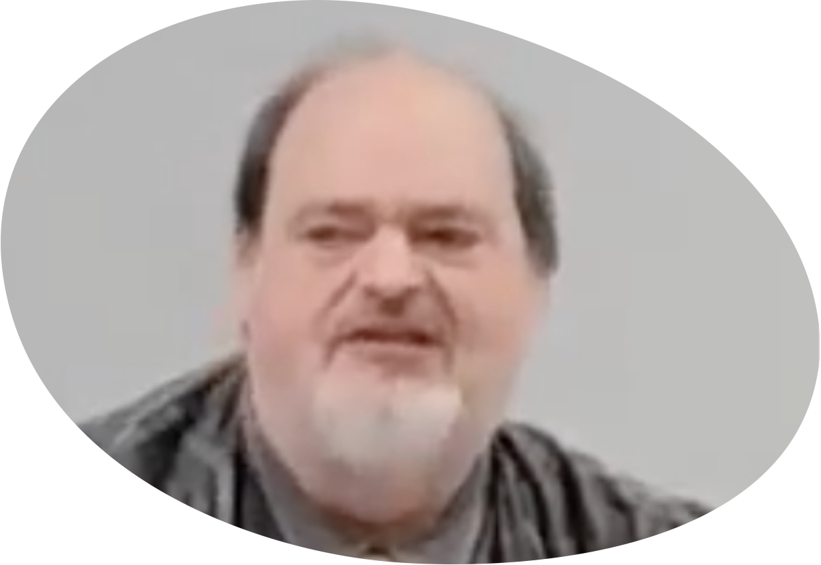
“Church of Christ MEETING @ 100 CORNERSTONE, Alexander AR. 72002”
TODAY’S LESSON
Sunday Morning Live Stream 10:30 AM ^{CT} October 26, 2025
https://www.youtube.com/user/donmcclain11/live / WWW.ALEXANDERCHURCHOFCHRIST.COM

Slide 2
WE MUST FULFILL THE PURPOSE OF CHRIST
MATTHEW 5:14-16

Slide 3
Matthew 5:14–16 (NKJV)
¹⁴ “You are the light of the world. A city that is set on a hill cannot be hidden. ¹⁵ Nor do they light a lamp and put it under a basket, but on a lampstand, and it gives light to all who are in the house. ¹⁶ Let your light so shine before men, that they may see your good works and glorify your Father in heaven.

Slide 4
Jesus Had (and Still Has) A Strong Sense of Purpose
He knew where He came from John 8:14

Slide 5
Jesus Had (and Still Has) A Strong Sense of Purpose
He knew where He came from John 8:14
Jesus answered and said to them, “Even if I bear witness of Myself, My testimony is true, for I know where I came from and where I am going; but you do not know where I come from and where I am going.

Slide 6
Jesus Had (and Still Has) A Strong Sense of Purpose
He knew where He came from John 8:14

Slide 7
Jesus Had (and Still Has) A Strong Sense of Purpose
He knew where He came from John 8:14
He knew where He was going to go

Slide 8
Jesus Had (and Still Has) A Strong Sense of Purpose
He knew where He came from John 8:14
He knew where He was going to go
He knew what He was going to do John 6:38,51

Slide 9
Jesus Knew What He Was Going To Do John 6:38,51
38 “For I have come down from heaven, not to do My own will, but the will of Him who sent Me...”
^{51 “}I am the living bread which came down from heaven. If anyone eats of this bread, he will live forever; and the bread that I shall give is My flesh, which I shall give for the life of the world.”

Slide 10
Jesus Had (and Still Has) A Strong Sense of Purpose
He knew where He came from John 8:14
He knew where He was going to go
He knew what He was going to do John 6:38,51

Slide 11
Jesus Had (and Still Has) A Strong Sense of Purpose
He knew where He came from John 8:14
He knew where He was going to go
He knew what He was going to do John 6:38,51
He knew to completely depend on God the Father John 8:14,21-29

Slide 12
Jesus Had (and Still Has) A Strong Sense of Purpose
He knew where He came from John 8:14
He knew where He was going to go
He knew what He was going to do John 6:38,51
He knew to completely depend on God the Father John 8:14,21-29
He succeeded! John 16:28-17:5; 19:30
Hebrews 12:1-3

Slide 13
Jesus Fulfilled His Purpose Hebrews 12:1-3
1 Therefore we also, since we are surrounded by so great a cloud of witnesses, let us lay aside every weight, and the sin which so easily ensnares, and let us run with endurance the race that is set before us, 2 looking unto Jesus, the author and finisher of the faith, who for the joy that was set before Him endured the cross, despising the shame, and has sat down at the right hand of the throne of God. 3 For consider Him who endured such hostility from sinners against Himself, lest you become weary and discouraged in your souls.

Slide 14
We Must Fulfill His Purpose For Us Romans 8:28-30
28 And we know that all things work together for good to those who are loving God, to those who are being called according to His purpose. 29 For whom He foreknew, He also chose those that are conformed to the image of His Son, that His Son might be the firstborn among many brothers. 29 Furthermore, He called those whom He predestined, then He justified them, then He glorified them.

Slide 15
God Has A Purpose For Us Romans 8:28-30
God created us

Slide 16
God Has A Purpose For Us Romans 8:28-30
God created us for His purpose

Slide 17
God Has A Purpose For Us Romans 8:28-30
God created us for His purpose
God is love 1 John 4:16
God created us to share His love with us
We ruined that relationship by sinning against God Romans 3:23
Jesus came to give His life for us, proving God’s stedfast love for us Romans 5:6
Faith in God’s love draws us to God John 12:32; 1 John 4:16

Slide 18
God Has A Purpose For Us Romans 8:28-30
God calls us through the gospel 1 Th. 2:13-14
13 But we are bound to give thanks to God always for you, brothers beloved by the Lord, because God from the beginning chose you for salvation through sanctification by the Spirit and belief in the truth, 14 to which He called you by our gospel, for the obtaining of the glory of our Lord Jesus Christ.

Slide 19
God Has A Purpose For Us Romans 8:28-30
God calls us through the gospel 1 Th. 2:13-14
We respond to God’s gospel call by believing and obeying the gospel call Romans 10:8-17
Gospel (good news) of God’s goodness should lead us to repent Romans 2:4
We receive God’s gospel call by calling on the name of the Lord Rom. 10:13
Faith, repentance, confession of the Lord Jesus, being baptized in water in His name for remission of sins Acts 2:21,36-41; 10:47-48; 22:16

Slide 20
“Church of Christ MEETING @ 100 CORNERSTONE, Alexander AR. 72002”
TODAY’S LESSON
Sunday Morning Live Stream 10:30 AM ^{CT} October 26, 2025
https://www.youtube.com/user/donmcclain11/live / WWW.ALEXANDERCHURCHOFCHRIST.COM

