Slide 1
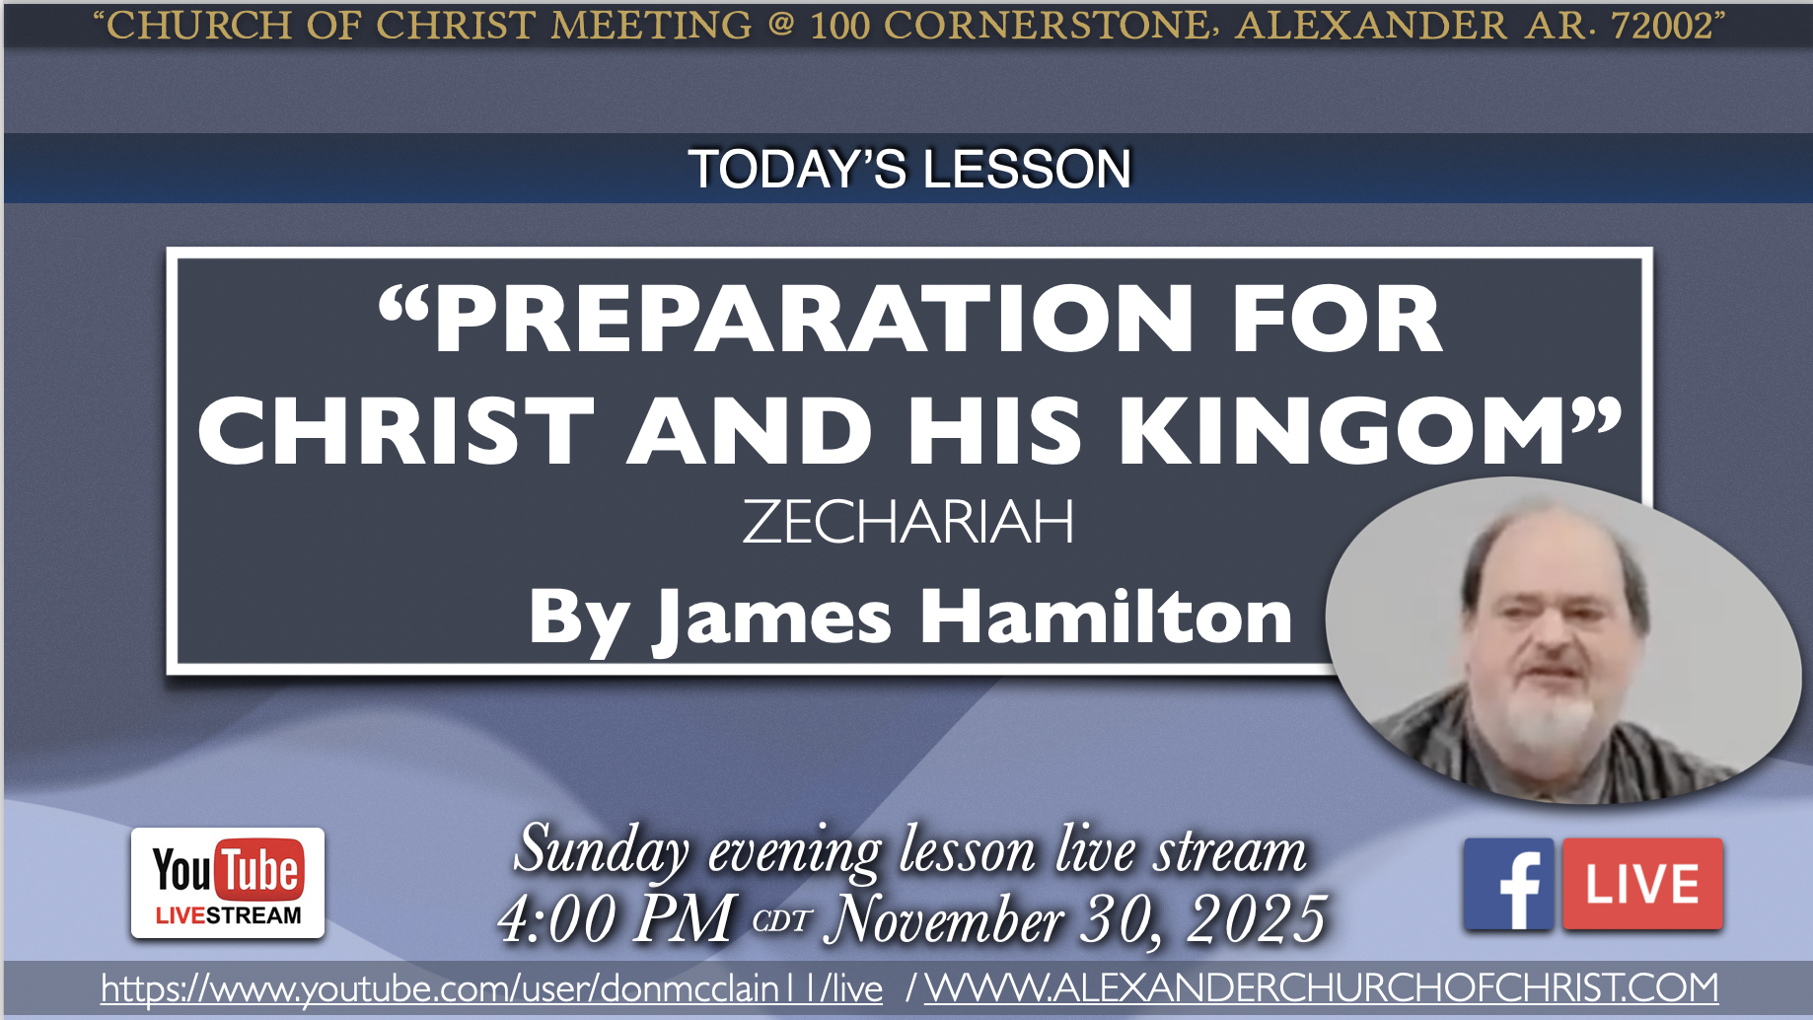

Slide 2
PREPARATION FOR CHRIST AND HIS KINGOM
ZECHARIAH

Slide 3
What Jesus Said in Luke 24:44-47
44 Then He said to them, “These are the words which I spoke to you while I was still with you, that all things must be fulfilled which were written in the Law of Moses and Prophets and Psalms concerning Me.” 45 And He opened their understanding, that they might comprehend the Scriptures.
46 Then He said to them, “Thus it is written, and thus it was necessary for the Christ to suffer and to rise from the dead the third day, 47 and that repentance and remission of sins should be preached in His name to all nations, beginning at Jerusalem.”

Slide 4
Zechariah Outline
Call to repentance and Judah’s response 1:1-6
Eight Visions & Their Meanings 1:7-6:8
Zechariah’s Task & Its Meaning 6:9-15
Fasting Question & God’s Answer: Repent 7-8
Burden Against Hadrach (nations) 9:1-11:3
Zechariah’s Task & Its Meaning 11:4-17
Burden Against Israel (Israel’s King will come but Israel will reject Him) 12-14

Slide 5
The Eight Visions in Zechariah 1:7-6:8
Vision of the Horses 1:7-17 Jerusalem will enjoy peace for a while
Vision of the Four Horns and Craftsmen 1:18-21 The historic enemies of Israel will not bother Israel or Judah
Vision of the Measuring Line 2:1-13 Jerusalem will be too full to measure; Jews encouraged to return because Christ will be there v.8-9,10-13
Vision of Joshua (YESHUA) the High Priest 3:1-10 priesthood restored; points to Jesus John 1:29-2:12

Slide 6
The Eight Visions in Zechariah 1:7-6:8
Vision of the Lampstand and The Two Olive Trees 4:1-14 Zerubbabel a sign that Jesus will come to the temple and will be a sign John 2:13-25
Vision of the Flying Scroll 5:1-4 The Scroll of Judgment against liars and thieves in the land
Vision of the Woman in a Basket 5:5-11 Wickedness is removed from Israel and returned to its source (Babylon)
Vision of The Four Chariots 6:1-8 no more invasions from the north (matches 1st vision)

Slide 7
Zechariah’s Task & Its Meaning Zechariah 6:9-15
Take gold and silver from returning Jews v.9-10
Make a crown with it v.11a
Put the crown on Yehoshua the High Priest v.11b
Yeshua is a type of the BRANCH (Messiah)
He will build the temple 2 Samuel 7:12-17
He will be a priest on His throne Psalm 110:1-4
Zech. 3:9 + 4:9-10 = 6:13-15 = John 1:19-2:25; 6,8…

Slide 8
The Question About Fasting
Zechariah 7-8
The Question: Should we fast over the destruction of the temple if we rebuild it? v.1-3
God’s Answer: Rebuke for selfish fasting v.4-7
Reminder why temple was destroyed v.8-14
Prophecy of God’s care for Jerusalem 8:1-23
Prophecy of the church v.3-5; Hebrews 12:22-23
“these days” remnant to build the temple v.6-13, restore godly behavior v.14-17, influence nations to go to Jerusalem v.20-23; Lk 24:47; Acts 2,11,15…

Slide 9
The Burden of the Word of the LORD Against Hadrach – Zechariah 9:1-11:3
And other former enemies of Israel 9:1-8
Messianic promise/prophecy 9:9-10
More physical/spiritual fulfillment in remnant/church 9:11-17
How God will use the physical remnant to prepare the world for Christ; type of spiritual remnant in Christ 10:1-12, especially v.3-4
Jews exist as enemies become history 11:1-3

Slide 10
Zechariah’s Task & Its Meaning Zechariah 11:4-17
Feed the flock for slaughter v.4
Bad shepherds selfishly destroy sheep v.5-6
Zechariah focused on the poor v.7 (Matt. 11:5)
Two staves: Beauty and Bonds (Grace and Unity)
Three worthless shepherds hired and fired v.8; Christ identified them in John 8:37-58; 9:35-10:18
Wages for Zechariah: 30 pieces of silver v.12
Went to the potter via the temple v.13; Matt. 27:1-10
God’s prophecy of the blind hirelings v.15-17

Slide 11
The Burden of the Word of the LORD Against Israel – Zechariah 12-14
Burden almost always a bad thing (consequences for actions) Isaiah 13-23, especially chapter 17
Verb used in Numbers 14:33 cause and effect
Israel’s historic enemies punished by the same ones God used to punish Israel and Judah 1-8
The ones God used to punish Jews were also destroyed by Persia 1-6
The nations that opposed Christ will be judged 9-11, including unbelieving Jews 12-14
Spiritual Israel’s (Galatians 6:16) enemies punished by Christ Matthew 23:1-24:35; 24:35-25:46

Slide 12
The Burden of the Word of the LORD Against Israel – Zechariah 12-14
The LORD would send the Spirit 12:10
Spiritual remnant mourn for Christ whom the physical remnant (v.11-14) pierced v.10 (only son, firstborn son)
Israel had Christ pierced by the Romans 12:10; John 19:34-37; Psalm 22:16; John 18:28-40; 12:33; Galatians 3:8-14
In that day 13:1 a fountain for sin and uncleanness will be opened up

Slide 13
The Burden of the Word of the LORD Against Israel – Zechariah 12-14
In that day 13:2-6 prophecy and idolatry will be removed from the land 1 Cor. 13:8-13
Jesus the Good Shepherd John 10 would be smitten by the LORD’s plan 13:7; Isaiah 53:4-12
Majority of Jews will reject Him, perish 13:8
The remnant will believe Him and endure persecution 13:8; 1 Peter 1:6-9; Psalm 34
The effect of events in Zech. 13 is in Zech. 14

Slide 14
The Burden of the Word of the LORD Against Israel – Zechariah 12-14
Jerusalem will be destroyed! 14:1-2; Matt. 24
Those that destroyed Jerusalem would then attack the heavenly Jerusalem, the church 14:3-9; Gal. 4:24-26; Heb. 12:22-23; Rev. 12-14
The LORD is Jesus Christ who stood on Mount Olivet 14:3-4; Philippians 2:9-11 and divided the people Matt. 10:21-23,34-39
Jewish terminology spiritually applied 14:10-21; Rom. 12:1-2 sacrifices; every thing is holy

Slide 15
Everything is Holy
Under the New Covenant
OLD
NEW
ISRAEL Exodus 19
natural birth Neh. 7:64
HEBREW language
MALES OF HOUSE OF AARON Numbers 18
LINEN EPHOD Ex. 28
TEMPLE Deut. 12
HOLY NATION 1 Pt 2:9
Water & Spirit John 3:5
ALL TONGUES Acts 2:8
ALL CHRISTIANS 1 Pt 2:9 Gal. 3:29
CHRIST Gal. 3:27
THE CHURCH 1 Cor. 3:9

Slide 16


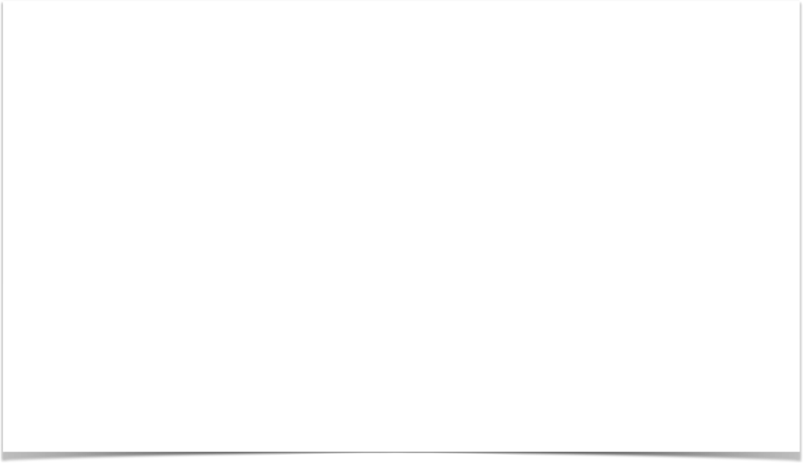
100 CORNERSTONE ALEXANDER AR, 72002
22
314
506
550
294
387

