Slide 1

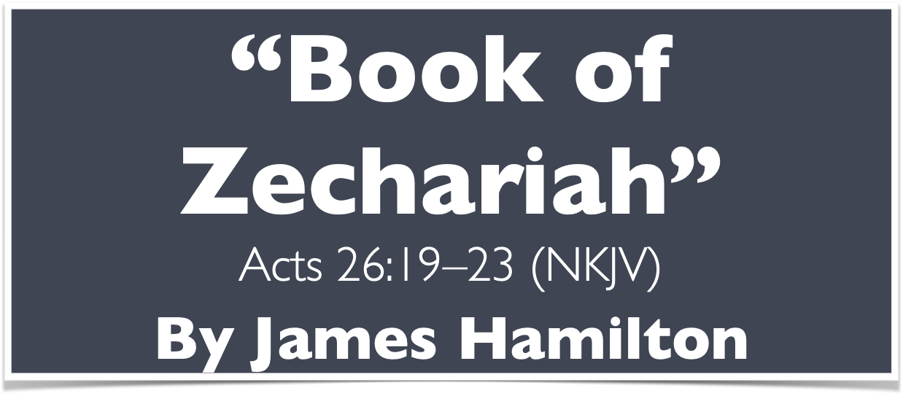
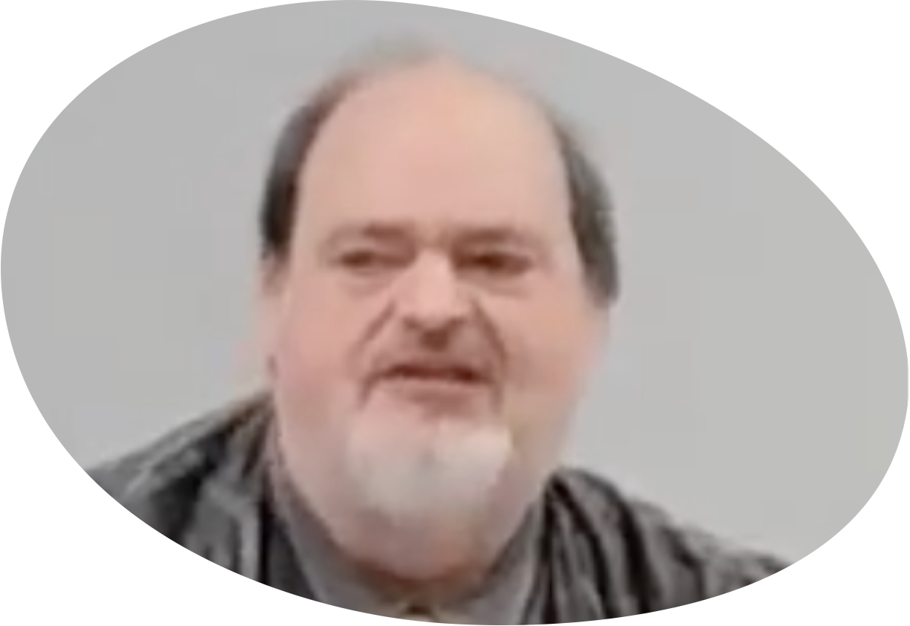
“Church of Christ MEETING @ 100 CORNERSTONE, Alexander AR. 72002”
TODAY’S LESSON
Sunday evening lesson live stream 4:00 PM ^{CDT} November 16, 2025
https://www.youtube.com/user/donmcclain11/live / WWW.ALEXANDERCHURCHOFCHRIST.COM

Slide 2
PREPARATION FOR THE KINGOM OF GOD
ACTS 26:22-23

Slide 3
Themes of Prophecy – Acts 26:22-23
22 Therefore, having obtained help from God, to this day I stand, witnessing both to small and great, saying no other things than those which the prophets and Moses said would come— 23 that the Christ would suffer, that He would be the first to rise from the dead, and would proclaim light to the Jewish people and to the Gentiles.”

Slide 4
What Jesus Said in Luke 24:44-47
44 Then He said to them, “These are the words which I spoke to you while I was still with you, that all things must be fulfilled which were written in the Law of Moses and Prophets and Psalms concerning Me.” 45 And He opened their understanding, that they might comprehend the Scriptures.
46 Then He said to them, “Thus it is written, and thus it was necessary for the Christ to suffer and to rise from the dead the third day, 47 and that repentance and remission of sins should be preached in His name to all nations, beginning at Jerusalem.”

Slide 5
The Book of Zechariah
Prophecies in 521-518 B.C. to encourage the construction of the temple Ezra 6:14-15
So the elders of the Jews built, and they prospered through the prophesying of Haggai the prophet and Zechariah the son of Iddo. And they built and finished it, according to the commandment of the God of Israel, and according to the command of Cyrus, Darius, and Artaxerxes king of Persia. Now the temple was finished on the third day of the month of Adar, which was in the sixth year of the reign of King Darius.

Slide 6
The Book of Zechariah
Prophecies in 521-518 B.C. to encourage the construction of the temple Ezra 6:14-15
The construction of the temple was a key step in preparing the world for Christ to come at the perfect time in history Romans 10:4; Galatians 4:4
Christ is the end of the law to everyone who believes
But when the fullness of the time had come, God sent forth His Son, born of a woman, born under the law

Slide 7
The Book of Zechariah
Prophecies in 521-518 B.C. to encourage the construction of the temple Ezra 6:14-15
The construction of the temple was a key step in preparing the world for Christ to come at the perfect time in history Romans 10:4; Galatians 4:4

Slide 8
The Book of Zechariah
Prophecies in 521-518 B.C. to encourage the construction of the temple Ezra 6:14-15
The construction of the temple was a key step in preparing the world for Christ to come at the perfect time in history Romans 10:4; Galatians 4:4
Zechariah’s prophecies are about God’s preparation of the world for the arrival of Christ and His impact on the world

Slide 9
Zechariah Outline
Call to repentance and Judah’s response 1:1-6
Eight Visions & Their Meanings 1:7-6:8
Zechariah’s Task & Its Meaning 6:9-15
Fasting Question & God’s Answer: Repent 7-8
Burden Against Hadrach (nations) 9:1-11:3
Zechariah’s Task & Its Meaning 11:4-17
Burden Against Israel (Israel’s King will come but Israel will reject Him) 12-14

Slide 10
Three Persons Typify Christ in Zechariah
Yeshua the High Priest 3:1-10; 6:1-15
Zerubabbel the Governor 4:1-14
Zechariah the Prophet 11:4-17

Slide 11
Three Persons Typify Christ in Zechariah
Joshua (YESHUA) the High Priest 3:1-10
Restoration of the Aaronic priesthood v.1-5
Shadow of Jesus’ (YESHUA’s) priesthood 6-10
v.6 does not apply to Joshua’s offspring (John 11:47-53) but to Jesus (Matt. 21:33-44; Psalm 118:22-25; Matt.22:41-45; Psalm 110:1-4)
Companions, sign, stone, seven-eye stone, I will remove iniquity in one day, under vine & fig tree v.8-10 (John 1:29-2:11; Revelation 5:5-7)

Slide 12
Three Persons Typify Christ in Zechariah
Joshua (YESHUA) the High Priest 6:9-15
Take silver and gold from 3 captives that returned from Babylon v.10
Make a crown with the silver and gold v.11
Put the crown on Yeshua (salvation) son of Jehozadak (righteous LORD)
Meaning in v.12-13: The BRANCH will build the temple of the LORD; will bear the glory
The BRANCH will be king and priest
His counsel is peace

Slide 13
Three Persons Typify Christ in Zechariah
Zerubbabel the Governor 4:1-14; Matt. 1:12-16
Vision of lampstand and two olive trees v.1-5
Message for Zerubbabel v.6-7
By God’s Spirit not human power v.6
Zerubbabel will complete temple with “Grace” v.7 (had started 15 years earlier Ezra 1-6)
Meaning of the vision v.8-14
Zerubbabel’s success a sign that the LORD sent Christ v.8-9 (LORD of hosts sent the LORD)
Seven eyes again 3:9 + 4:10 = 6:13 = 4:14

Slide 14
Three Persons Typify Christ in Zechariah
Zechariah the Prophet 11:4-17; John 9:35-10:39
Feed the flock for slaughter v.4
Bad shepherds selfishly destroy sheep v.5-6
Zechariah focused on the poor v.7 (Matt. 11:5)
Two staves: Beauty and Bonds (Grace and Unity)
Three worthless shepherds hired and fired v.8; Matt. 21:33-46; John 8:37-58
Wages for Zechariah: 30 pieces of silver v.12
Went to the potter via the temple v.13; Matt. 27:1-10
God’s prophecy of the blind hirelings v.15-17

Slide 15
Zechariah
Encouraged building the temple 8:9,13
Typified Jesus as a faithful servant 11:4-17
Foresaw hand of the LORD in preparing the world for the King of Zion 1-8; 9:9
Foresaw Zerubbabel is proof that God sent Christ 4:8-9; 2:10-11; 6:14-15
Foresaw Christ as King and Priest 6:9-15
Foresaw the blessings that Christ would bring the world through His suffering 9-14

