Slide 1
Daniel 1; 3; 6
THE NEED FOR UNCOMPROMISING FAITH
How To Stand Strong When Pressured To Do Wrong?

Slide 2
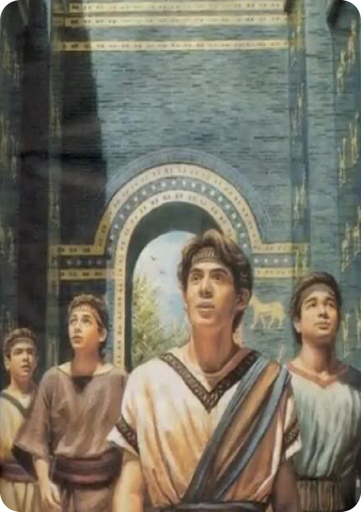
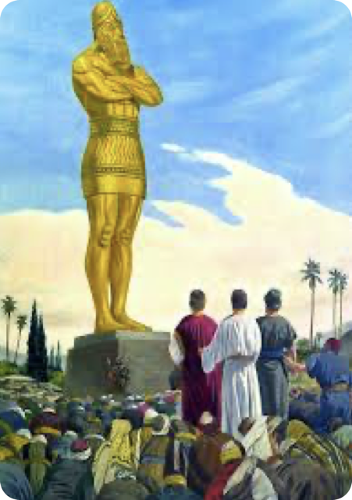
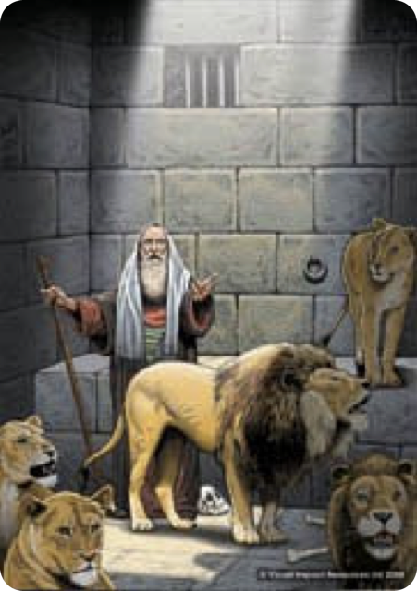
THE NEED FOR UNCOMPROMISING FAITH
How To Stand Strong When Pressured To Do Wrong?
DANIEL CHAPTERS 1; 3; 6
Daniel, Hananiah, Mishael, and Azariah . . . Four young men pressured to compromise their faith but refused to do so!
DANIEL 1
DANIEL 3
DANIEL 6

Slide 3
THE NEED FOR UNCOMPROMISING FAITH
How To Stand Strong When Pressured To Do Wrong?
What gave these young men their strength to defy a king, even in the face of death?
DANIEL 1
DANIEL 3
DANIEL 6

Slide 4
Daniel 1:6–9 (NKJV)
⁶ Now from among those of the sons of Judah were Daniel, Hananiah, Mishael, and Azariah. ⁷ To them the chief of the eunuchs gave names: he gave Daniel the name Belteshazzar; to Hananiah, Shadrach; to Mishael, Meshach; and to Azariah, Abed-Nego. ⁸ But Daniel purposed in his heart that he would not defile himself with the portion of the king’s delicacies, nor with the wine which he drank; therefore he requested of the chief of the eunuchs that he might not defile himself. ⁹ Now God had brought Daniel into the favor and goodwill of the chief of the eunuchs.

Slide 5
Daniel 3:16–18 (NKJV)
¹⁶ Shadrach, Meshach, and Abed-Nego answered and said to the king, “O Nebuchadnezzar, we have no need to answer you in this matter. ¹⁷ If that is the case, our God whom we serve is able to deliver us from the burning fiery furnace, and He will deliver us from your hand, O king. ¹⁸ But if not, let it be known to you, O king, that we do not serve your gods, nor will we worship the gold image which you have set up.”

Slide 6
Daniel 6:10,16 (NKJV)
¹⁰ Now when Daniel knew that the writing was signed, he went home. And in his upper room, with his windows open toward Jerusalem, he knelt down on his knees three times that day, and prayed and gave thanks before his God, as was his custom since early days. … ¹⁶ So the king gave the command, and they brought Daniel and cast him into the den of lions. But the king spoke, saying to Daniel, “Your God, whom you serve continually, He will deliver you.”

Slide 7

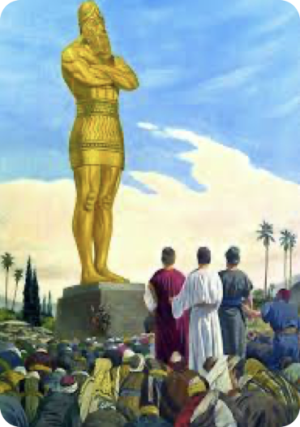

THE NEED FOR UNCOMPROMISING FAITH
How To Stand Strong When Pressured To Do Wrong?
Reverence For God & His Word
They feared God while the one over them feared the king (1:8-10)
Refused to bow down to the kings image (3:16-18)
Prayed to God regardless of what men may do (6:10-11)
DANIEL 1
DANIEL 3
DANIEL 6

Slide 8
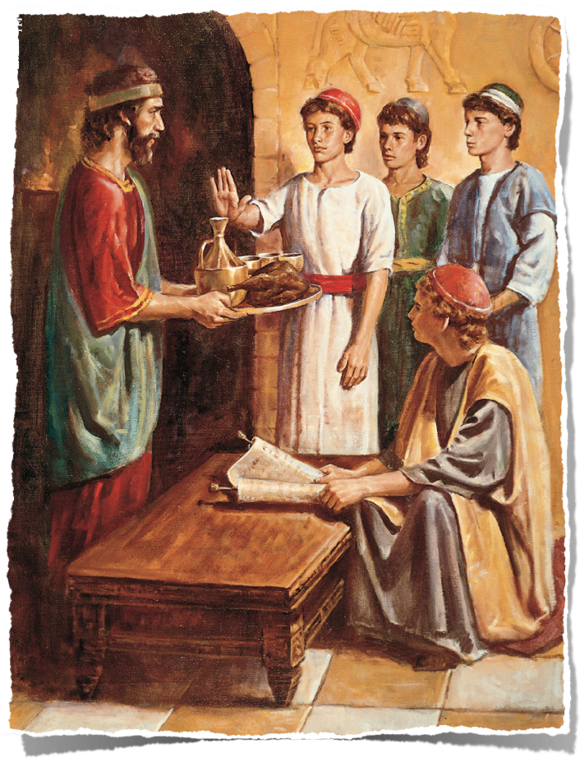
THE NEED FOR UNCOMPROMISING FAITH
How To Stand Strong When Pressured To Do Wrong?
Reverence For God & His Word
Deuteronomy 10:12-13 (NKJV) ¹² "And now, Israel, what does the Lord your God require of you, but to fear the Lord your God, to walk in all His ways and to love Him, to serve the Lord your God with all your heart and with all your soul, ¹³ and to keep the commandments of the Lord and His statutes which I command you today for your good?

Slide 9
THE NEED FOR UNCOMPROMISING FAITH
How To Stand Strong When Pressured To Do Wrong?
Reverence For God & His Word
Proverbs 1:7 (NKJV) ⁷ The fear of the Lord is the beginning of knowledge, But fools despise wisdom and instruction.

Slide 10
THE NEED FOR UNCOMPROMISING FAITH
How To Stand Strong When Pressured To Do Wrong?
Reverence For God & His Word
Psalms 111:10 (NKJV) ¹⁰ The fear of the Lord is the beginning of wisdom; A good understanding have all those who do His commandments. His praise endures forever.

Slide 11
THE NEED FOR UNCOMPROMISING FAITH
How To Stand Strong When Pressured To Do Wrong?
Reverence For God & His Word
Ecclesiastes 12:13-14 (NKJV) ¹³ Let us hear the conclusion of the whole matter: Fear God and keep His commandments, For this is man's all. ¹⁴ For God will bring every work into judgment, Including every secret thing, Whether good or evil.

Slide 12
THE NEED FOR UNCOMPROMISING FAITH
How To Stand Strong When Pressured To Do Wrong?
Reverence For God & His Word
Matthew 10:28 (NKJV)
²⁸ And do not fear those who kill the body but cannot kill the soul. But rather fear Him who is able to destroy both soul and body in hell.

Slide 13
THE NEED FOR UNCOMPROMISING FAITH
How To Stand Strong When Pressured To Do Wrong?
Reverence For God & His Word
Acts 4:19–20 (NKJV)
¹⁹ But Peter and John answered and said to them, “Whether it is right in the sight of God to listen to you more than to God, you judge. ²⁰ For we cannot but speak the things which we have seen and heard.”

Slide 14
THE NEED FOR UNCOMPROMISING FAITH
How To Stand Strong When Pressured To Do Wrong?
Reverence For God & His Word
Acts 5:5,11 (NKJV)
⁵ Then Ananias, hearing these words, fell down and breathed his last. So great fear came upon all those who heard these things. … ¹¹ So great fear came upon all the church and upon all who heard these things.

Slide 15

THE NEED FOR UNCOMPROMISING FAITH
How To Stand Strong When Pressured To Do Wrong?
Reverence For God & His Word
Standing firm against the pressures to compromise our faith requires a healthy fear of God! (Acts 5:11; Mat 10:28)
People who compromise with evil demonstrate they lack a healthy fear of the Lord! (Job 28:28; Jer 32:40)

Slide 16
THE NEED FOR UNCOMPROMISING FAITH
How To Stand Strong When Pressured To Do Wrong?
Purpose / Resolve To Please God
Daniel purposed in his heart he would not defile himself (1:8)
Will NOT serve your gods, nor worship the image (3:16-18)
Daniel prayed knowingly violating the law (6:10-11)
DANIEL 1
DANIEL 3
DANIEL 6

Slide 17
THE NEED FOR UNCOMPROMISING FAITH
How To Stand Strong When Pressured To Do Wrong?
Purpose / Resolve To Please God
Psalm 119:105–106 (NKJV)
¹⁰⁵ Your word is a lamp to my feet And a light to my path. ¹⁰⁶ I have sworn and confirmed That I will keep Your righteous judgments.

Slide 18
THE NEED FOR UNCOMPROMISING FAITH
How To Stand Strong When Pressured To Do Wrong?
Purpose / Resolve To Please God
Psalm 119:111–112 (NKJV)
¹¹¹ Your testimonies I have taken as a heritage forever, For they are the rejoicing of my heart. ¹¹² I have inclined my heart to perform Your statutes Forever, to the very end.

Slide 19
THE NEED FOR UNCOMPROMISING FAITH
How To Stand Strong When Pressured To Do Wrong?
Purpose / Resolve To Please God
Joshua 24:15 (NKJV)
¹⁵ And if it seems evil to you to serve the Lord, choose for yourselves this day whom you will serve, whether the gods which your fathers served that were on the other side of the River, or the gods of the Amorites, in whose land you dwell. But as for me and my house, we will serve the Lord.”

Slide 20
THE NEED FOR UNCOMPROMISING FAITH
How To Stand Strong When Pressured To Do Wrong?
Purpose / Resolve To Please God
Acts 11:23 (NKJV)
²³ When he came and had seen the grace of God, he was glad, and encouraged them all that with purpose of heart they should continue with the Lord.

Slide 21

THE NEED FOR UNCOMPROMISING FAITH
How To Stand Strong When Pressured To Do Wrong?
Purpose / Resolve To Please God
We will not resist the worlds pull without purpose & resolve (Job 31:1; Ps 119:106,112, 115; Jos 24:15; Acts 11:23)
We will not accidentally get to heaven (Mt 7:13,14; 2 Pt 1:5-10)
Not merely good intentions, but intentional obedience (Jos. 24:15)
God will help (1 Cor. 10:13)

Slide 22
THE NEED FOR UNCOMPROMISING FAITH
How To Stand Strong When Pressured To Do Wrong?
Purpose / Resolve To Please God
Hebrews 6:11–12 (NKJV)
¹¹ And we desire that each one of you show the same diligence to the full assurance of hope until the end, ¹² that you do not become sluggish, but imitate those who through faith and patience inherit the promises.

Slide 23
THE NEED FOR UNCOMPROMISING FAITH
How To Stand Strong When Pressured To Do Wrong?
Purpose / Resolve To Please God
Hebrews 10:35–36 (NKJV)
³⁵ Therefore do not cast away your confidence, which has great reward. ³⁶ For you have need of endurance, so that after you have done the will of God, you may receive the promise:

Slide 24
THE NEED FOR UNCOMPROMISING FAITH
How To Stand Strong When Pressured To Do Wrong?
Understand The Seriousness of Sin
Willing to face the punishment of men than be defiled (1:8,13)
Willing to face a fiery furnace than worship false Gods (3:16-18)
Willing to be thrown to lions than not pray to God (6:10-11)
DANIEL 1
DANIEL 3
DANIEL 6

Slide 25
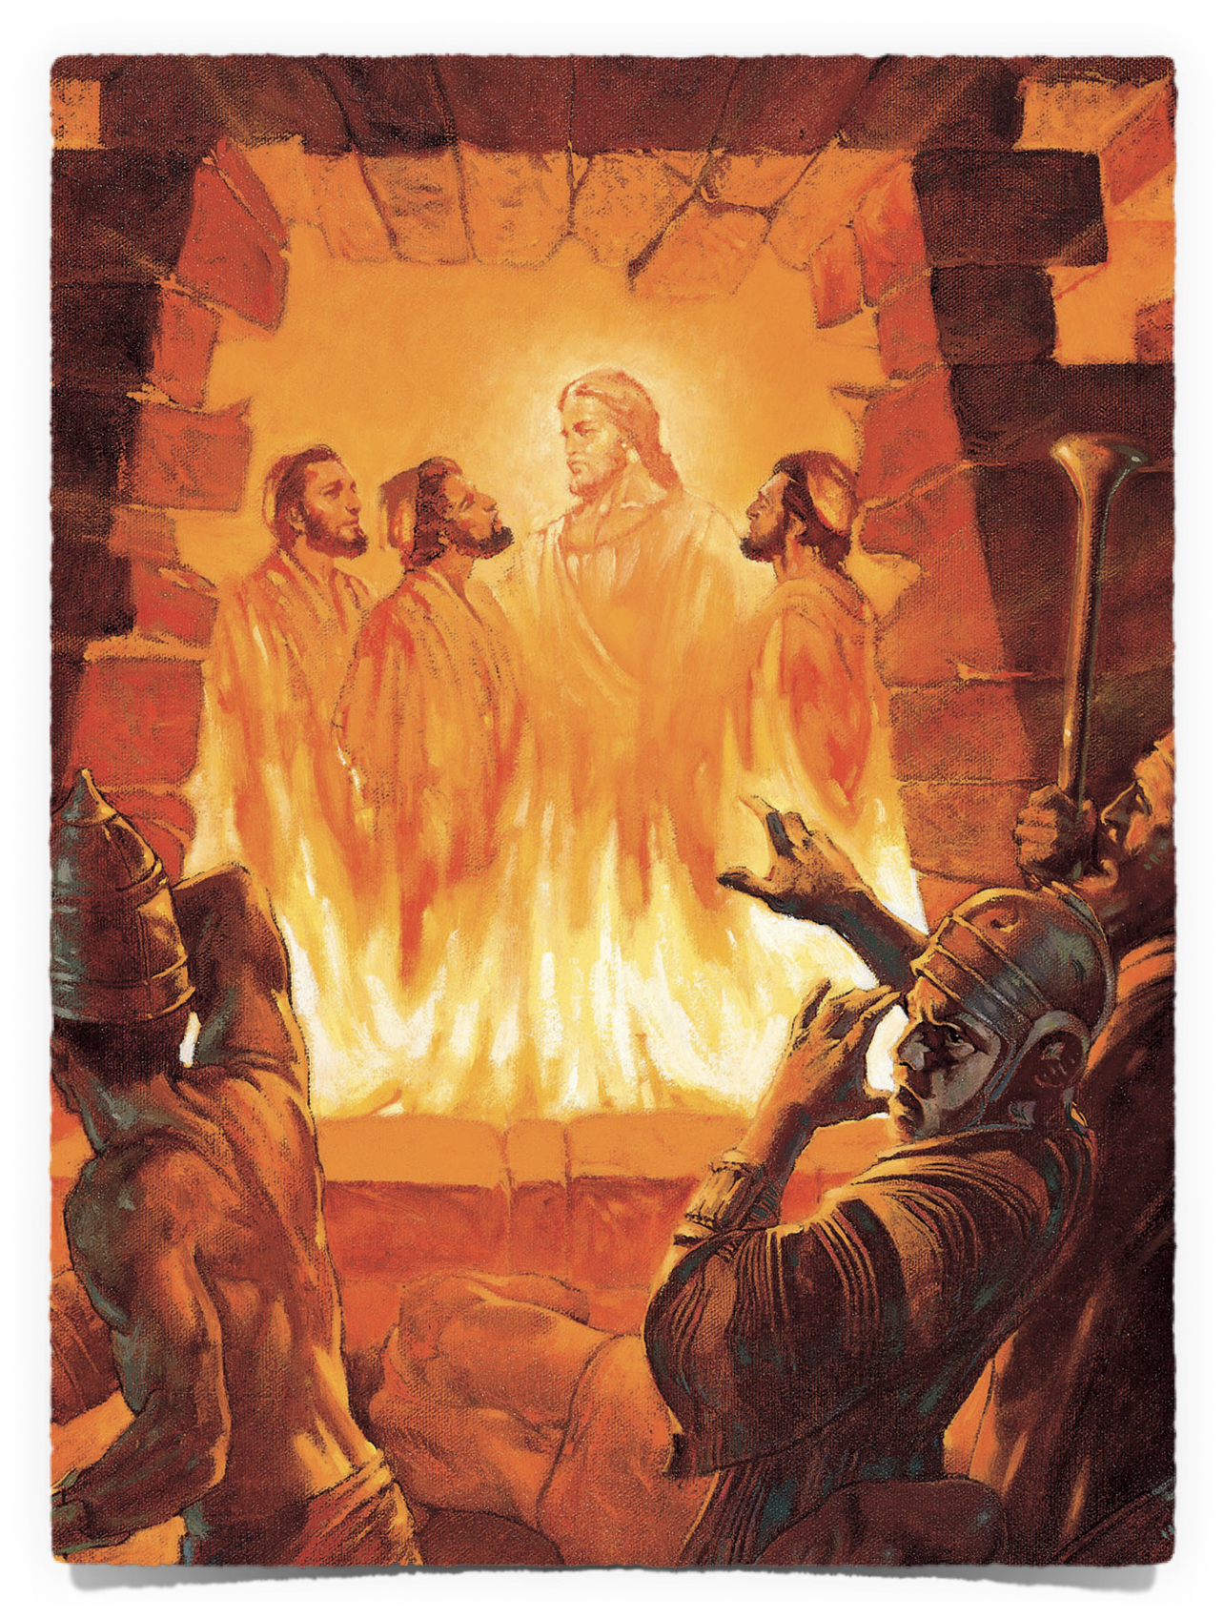
THE NEED FOR UNCOMPROMISING FAITH
How To Stand Strong When Pressured To Do Wrong?
Understand The Seriousness of Sin
We will not successfully resist temptation if we MINIMIZE the seriousness of it!
Genesis 3:6 (NKJV)
⁶ So when the woman saw that the tree was good for food, that it was pleasant to the eyes, and a tree desirable to make one wise, she took of its fruit and ate. She also gave to her husband with her, and he ate.

Slide 26
THE NEED FOR UNCOMPROMISING FAITH
How To Stand Strong When Pressured To Do Wrong?
Understand The Seriousness of Sin
We will not successfully resist temptation if we MINIMIZE the seriousness of it!
Matthew 5:29–30 (NKJV)
²⁹ If your right eye causes you to sin, pluck it out and cast it from you; for it is more profitable for you that one of your members perish, than for your whole body to be cast into hell. ³⁰ And if your right hand causes you to sin, cut it off and cast it from you; for it is more profitable for you that one of your members perish, than for your whole body to be cast into hell.

Slide 27
THE NEED FOR UNCOMPROMISING FAITH
How To Stand Strong When Pressured To Do Wrong?
Understand The Seriousness of Sin
We will not successfully resist temptation if we MINIMIZE the seriousness of it!
Hebrews 2:1–3 (NKJV)
¹ Therefore we must give the more earnest heed to the things we have heard, lest we drift away. ² For if the word spoken through angels proved steadfast, and every transgression and disobedience received a just reward, ³ how shall we escape if we neglect so great a salvation, …

Slide 28
THE NEED FOR UNCOMPROMISING FAITH
How To Stand Strong When Pressured To Do Wrong?
Understand The Seriousness of Sin
We will not successfully resist temptation if we MINIMIZE the seriousness of it!
James 1:14–15 (NKJV)
¹⁴ But each one is tempted when he is drawn away by his own desires and enticed. ¹⁵ Then, when desire has conceived, it gives birth to sin; and sin, when it is full-grown, brings forth death.

Slide 29
THE NEED FOR UNCOMPROMISING FAITH
How To Stand Strong When Pressured To Do Wrong?
Understand The Seriousness of Sin
We will not successfully resist temptation if we MINIMIZE the seriousness of it!
Sin is against God (Psalm 51:4)
Separates from God (Isaiah 59:1-3; 1 John 1:5-2:2)
Hurts & destroys others (Genesis 3; Joshua 7; 1 Corinthians 5)
Brings eternal death (Romans 6:23; James 1:13-16; Revelation 21:8)

Slide 30
THE NEED FOR UNCOMPROMISING FAITH
How To Stand Strong When Pressured To Do Wrong?
Trust The Lord & His Word
Daniel trusted in the Lord’s way & His protection (1:8,11-13)
God will deliver us . . . but if not . . . (3:16-18)
Daniel prayed despite threats, just as he had always done (6:10-11)
DANIEL 1
DANIEL 3
DANIEL 6

Slide 31
THE NEED FOR UNCOMPROMISING FAITH
How To Stand Strong When Pressured To Do Wrong?
Trust The Lord & His Word
A compromised faith exposes a weak faith (Hebrews 3:16-19; John 6:53-66)
God will do what He has said! (Romans 4:19-21; Acts 27:25; 2 Timothy 1:12)
The strength of our faith is directly related to our knowledge of God’s word (Romans 10:17; Hos. 4:6; Eph. 6:16)
There is a direct correlation between our HOPE and our FAITHFULNESS (1 John 3:3; 2 Cor 7:1; 2 Pet 3:14; Heb. 11:6,26)

Slide 32
THE NEED FOR UNCOMPROMISING FAITH
How To Stand Strong When Pressured To Do Wrong?
Strengthened By Each Victory
Daniel, Hananiah, Mishael, and Azariah refused to be defiled
Hananiah, Mishael, and Azariah would bow ONLY to God
Prayed ONLY to God as was his custom since his early days!
DANIEL 1
DANIEL 3
DANIEL 6

Slide 33
THE NEED FOR UNCOMPROMISING FAITH
How To Stand Strong When Pressured To Do Wrong?
Strengthened By Each Victory
Those faithful in small matters will be faithful in larger matters (Luke 16:10,11; 19:17; Matthew 25:21)
How can I face the big battles if I have failed to be victorious in the smaller ones? (Jeremiah 12:5)
Temptations will come!! Begin now to develop a strong faith. Establish habits that will enable your spiritual growth!

Slide 34
THE NEED FOR UNCOMPROMISING FAITH
How To Stand Strong When Pressured To Do Wrong?
Strengthened By Each Victory
Are we dedicated enough to the Lord that we refuse to compromise? (even in areas we may deem small?)
Satan is fine with small victories - but remember if you give him an inch … Romans 13:14

Slide 35
THE NEED FOR UNCOMPROMISING FAITH
How To Stand Strong When Pressured To Do Wrong?
APPLICATIONS
We live in a world where we are pressured to “compromise”
To tolerate evil / accept wickedness / never speak out against sin or error / keep our faith to ourselves
DANIEL 1
DANIEL 3
DANIEL 6

Slide 36
THE NEED FOR UNCOMPROMISING FAITH
How To Stand Strong When Pressured To Do Wrong?
APPLICATIONS
LET US NEVER COMPROMISE THE TRUTH
THE NATURE OF GOD / THE WORD OF GOD / FIGHTING AGAINST SIN
DANIEL 1
DANIEL 3
DANIEL 6

Slide 37
THE NEED FOR UNCOMPROMISING FAITH
How To Stand Strong When Pressured To Do Wrong?
APPLICATIONS
LET US NEVER COMPROMISE THE TRUTH
THE ONLY WAY OF SALVATION / THE PATTERN FOR THE CHURCH, TRUE WORSHIP & SERVICE
DANIEL 1
DANIEL 3
DANIEL 6
Notes:
Who God Is (sovereignty / love / just / holy)
Who Jesus is (Savior / Lord / High Priest / Judge)
The Bible being God’s complete, sufficient, authoritative and only revelation to man (2 Tim. 3:16,17)
Salvation is ONLY in JESUS (John 14:6; Acts 4:12)
The plan of salvation as taught in the Bible (John 8:24; Mk 16:16; Acts 2:21-47; 8:5-16, 27-39; Rom. 10:9-17; etc.)
What the Bible teaches about right and wrong / moral and immoral / obedience and sin (1 Cor. 6:9-11; 1 Jn 3:4)
What constitutes true worship (Jn 4:23,24; Acts 20:7; 1 Cor. 11:17-34; 14:26; Col. 3:16,17)
The nature, organization and work of the church as taught in the Bible (Eph. 5:22-25; Phil. 1:1; 1 Tim. 3:1-13)

Slide 38
Fear God
Hate sin
Purpose to please God
Trust God
One victory at a time
Daniel 1; 3; 6
THE NEED FOR UNCOMPROMISING FAITH
How To Stand Strong When Pressured To Do Wrong?

Slide 39
HEAR THE TRUTH
BELIEVE IN JESUS
CONFESS JESUS
REPENT FROM SIN TO JESUS
BE BAPTIZED INTO JESUS FOR SALVATION
BE FAITHFUL TO JESUS
Daniel 1; 3; 6
THE NEED FOR UNCOMPROMISING FAITH
How To Stand Strong When Pressured To Do Wrong?

Slide 40
If you are a Christian but guilty of compromising your your faith - repent, confess & pray TODAY!
Daniel 1; 3; 6
THE NEED FOR UNCOMPROMISING FAITH
How To Stand Strong When Pressured To Do Wrong?

Slide 42
Daniel 1; 3; 6
Charts by Don McClain
Preached October 4, 2020 West 65th Street church of Christ
Preached December 27,2 025 Alexander church of Christ
Phone — 501-568-1062 — Email – donmcclain@sbcglobal.net
Prepared using Keynote / More Keynote, PPT & Audio Sermons:
www.alexanderchurchofchrist.com
THE NEED FOR UNCOMPROMISING FAITH
How To Stand Strong When Pressured To Do Wrong?

Slide 43
SCRIPTURE READING SUNDAY, DECEMBER 28, AM
Colossians 1:21–23 (NKJV)
²¹ And you, who once were alienated and enemies in your mind by wicked works, yet now He has reconciled ²² in the body of His flesh through death, to present you holy, and blameless, and above reproach in His sight—²³ if indeed you continue in the faith, grounded and steadfast, and are not moved away from the hope of the gospel which you heard, which was preached to every creature under heaven, of which I, Paul, became a minister.

Slide 44
THE NEED FOR UNCOMPROMISING FAITH
How To Stand Strong When Pressured To Do Wrong?
Daniel 1; 3; 6

