Slide 1


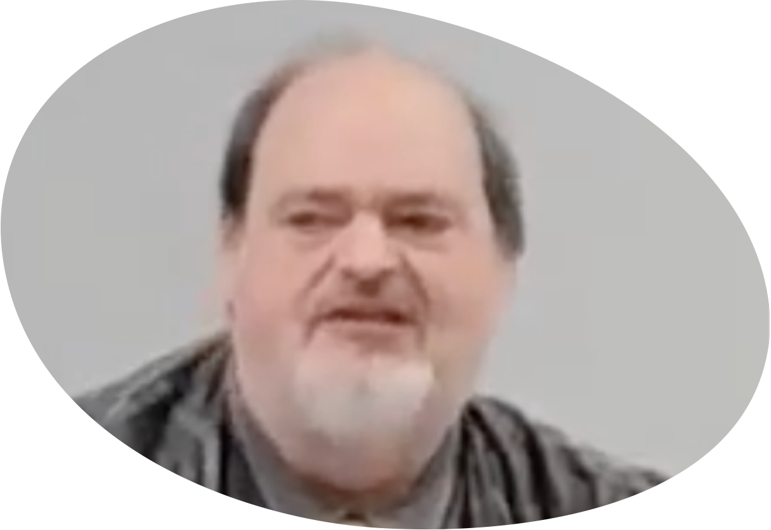
“Church of Christ MEETING @ 100 CORNERSTONE, Alexander AR. 72002”
TODAY’S LESSON
Sunday evening lesson live stream 4:00 PM ^{CDT} September 21, 2025
https://www.youtube.com/user/donmcclain11/live / WWW.ALEXANDERCHURCHOFCHRIST.COM

Slide 2
VICTORY IN JESUS
2 CORINTHIANS 2:14-17

Slide 3
2 Corinthians 2:14-17
14 Now thanks be to God who always leads us in triumph in Christ, and through us diffuses the fragrance of His knowledge in every place. 15 For we are to God the fragrance of Christ among those who are being saved and among those who are perishing. 16 To the one we are the aroma of death leading to death, and to the other the aroma of life leading to life. And who is sufficient for these things? 17 For we are not, as so many, selling the word of God; but as of sincerity, but as from God, we speak in the sight of God in Christ.

Slide 4
2 Corinthians 2:14-17
Gospel is announcing the victory of Christ
For the victorious believer,
it is the sweet smell of victory (life)
For the perishing unbeliever,
it is the smell of condemnation (death)
Here is the most important point:
Jesus is already victorious!

Slide 5
John 12:31-36
.
31 “Now is the judgment of this world; now the ruler of this world will be cast out. 32 And I, if I am lifted up from the earth, will draw all peoples to Myself.” 33 This He said, signifying by what death He would die. 34 The people answered Him, “We have heard from the law that the Christ remains forever; and how can You say, ‘The Son of Man must be lifted up’? Who is this Son of Man?”

Slide 6
John 12:31-36
.
35 Then Jesus said to them, “A little while longer the light is with you. Walk while you have the light, lest darkness overtake you; he who walks in darkness does not know where he is going. 36 While you have the light, believe in the light, that you may become sons of light.” These things Jesus spoke, and departed, and was hidden from them.

Slide 7
John 12:31-33
Satan would be cast out v.31
Jesus would suffer & die v.32-33
It is the “judgment of this world” (i.e., the turning point of world history)
“Judgment” from Greek KRISIS (crisis)
Jews understood He said that He would be crucified v.34-36

Slide 8
Genesis 3:14-15
14 And the Word became flesh and tabernacled among us, and we beheld His glory, the glory as of the only begotten of the Father, full of grace and truth.
¹⁵ John bore witness of Him and cried out, saying, “This was He of whom I said, ‘He who comes after me is greater than I because He was before me.’” ¹⁶ And of His fullness we have all received, and grace for grace. ¹⁷ For the law was given through Moses; grace and truth came through Jesus Christ. ¹⁸ No one has seen God at any time. The one-of-a-kind Son, who is in the bosom of the Father, He has fully explained Him.

Slide 9
Genesis 3:14-15
First prophecy!
Three points of prophecy:
There will be CONFLICT serpent vs. woman; Satan’s seed vs. the seed of woman (Jesus born of a virgin Isaiah 7:14; Matthew 1:18-23
Jesus would SUFFER
Satan would BE DEFEATED

Slide 10
Revelation 12:7-12
7 And war broke out in heaven: Michael and his angels fought with the dragon; and the dragon and his angels fought, 8 but they did not prevail, nor was a place found for them in heaven any longer. 9 So the great dragon was cast out, that serpent of old, called the Devil and Satan, who is deceiving the whole world; he was cast to the earth, and his angels were cast out with him.

Slide 11
Revelation 12:7-12
10 Then I heard a loud voice saying in heaven, “Now salvation, and strength, and the kingdom of our God, and the power of His Christ have come, for the accuser of our brethren, who accused them before our God day and night, has been cast down. 11 And they overcame him by the blood of the Lamb and by the word of their testimony, and they did not love their lives to the death. 12 Therefore rejoice, O heavens, and you who dwell in them! Woe to the inhabitants of the earth and the sea! For the devil has come down to you, having great wrath, because he knows that he has a short time.”

Slide 12
Revelation 12:7-11
War in Heaven v.7
Satan lost and was cast down to earth v.8-9
Jesus suffered and died v.11
Salvation
Strength
Kingdom
Power of Christ have already come v.10

Slide 13
Satan Defeated But Not Yet Destroyed
Woe to the earth v.12
Satan is still at work
Still a battle for us to fight
Still must be vigilant to survive
Rev. 2:7, 10-11 etc.

Slide 14
Tactics
Jesus came to Satan’s “turf” and defeated him
Satan had supposed he had succeeded when Jesus was crucified
His overconfidence & pride was his undoing
O.T. battle tactics Joshua 8; Judges 16; 20
N.T. battle tactics John 1:14-18; 12:30-34: Jesus

Slide 15
John 1:14-18
14 And the Word became flesh and tabernacled among us, and we beheld His glory, the glory as of monogenesis of the Father, full of grace and truth. 15 John bore witness of Him and cried out, saying, “This was He of whom I said, ‘He who comes after me is greater than I because He was before me.’” 16 And of His fullness we have all received, and grace for grace. 17 For the law was given through Moses; grace and truth came through Jesus Christ. 18 No one has seen God at any time. The one-of-a-kind Son, who is in the bosom of the Father, He has fully explained Him.

Slide 16
Tactics
Jesus came to Satan’s “turf” and defeated him
Satan had supposed he had succeeded when Jesus was crucified
His overconfidence & pride was his undoing
O.T. battle tactics Joshua 8; Judges 16; 20
N.T. battle tactics John 1:14-18; 12:20-34: Jesus
John 17; Apostles v.13-18

Slide 17
John 17:13-18
13 But now I come to You, and these things I speak in the world, that they may have My joy fulfilled in themselves. 14 I have given them Your word; and the world has hated them because they are not of the world, just as I am not of the world. 15 I do not pray that You should take them out of the world, but that You should keep them from the evil one. 16 They are not of the world, just as I am not of the world. Sanctify them by Your truth. Your word is truth. 18 As You sent Me into the world, I also have sent them into the world.

Slide 18
Tactics
Jesus came to Satan’s “turf” and defeated him
Satan had supposed he had succeeded when Jesus was crucified
His overconfidence & pride was his undoing
O.T. battle tactics Joshua 8; Judges 16; 20
N.T. battle tactics John 1:14-18; 12:20-34: Jesus
John 17; Apostles v.13-18

Slide 19
Tactics
Jesus came to Satan’s “turf” and defeated him
Satan had supposed he had succeeded when Jesus was crucified
His overconfidence & pride was his undoing
O.T. battle tactics Joshua 8; Judges 16; 20
N.T. battle tactics John 1:14-18; 12:20-34: Jesus
John 17; Apostles v.13-18
2 Corinthians 2:14-17; 10:3-6; Ephesians 6:10-20 Us

Slide 20
2 Corinthians 10:3-6
3 For though we walk in the flesh, we do not war according to the flesh. 4 For the weapons of our warfare are not carnal but mighty in God for pulling down strongholds, 5 casting down arguments and every high thing that exalts itself against the knowledge of God, bringing every thought into captivity to the obedience of Christ, 6 and being ready to punish all disobedience when your obedience is fulfilled.

Slide 21
Ephesians 6:10-20
10 Finally, my brethren, be strong in the Lord and in the power of His might.11 Put on the whole armor of God, that you may be able to stand against the wiles of the devil.12 For we do not wrestle against flesh and blood, but against principalities, against powers, against the rulers of the darkness of this age, against spiritual hosts of wickedness in the heavenly places.13 Therefore take up the whole armor of God, that you may be able to withstand in the evil day, and having done all, to stand.

Slide 22
Ephesians 6:10-20
14 Stand therefore, having girded your waist with truth, having put on the breastplate of righteousness, 15 and having shod your feet with the preparation of the gospel of peace; 16 above all, taking the shield of faith with which you will be able to quench all the fiery darts of the wicked one. 17 And take the helmet of salvation, and the sword of the Spirit, which is the word of God; in the evil day, and having done all, to stand.

Slide 23
Ephesians 6:10-20
18 praying praying always with all prayer and supplication in the Spirit, being watchful to this end with all perseverance and supplication for all the saints— 19 and for me, that utterance may be given to me, that I may open my mouth boldly to make known the mystery of the gospel, 20 for which I am an ambassador in chains; that in it I may speak boldly, as I ought to speak.

Slide 24
Ephesians 6:10-20
Put on the whole armor of God v.11
Every piece relates to God’s word v.14-17
Spiritual enemies still exist
Fight to survive spiritually
After doing all v.13; 2 Timothy 4:7
Pray v.18-20
Obey the gospel while it is day. Believe in Jesus, follow His word, repent and turn from sin, confess the Lord Jesus and be baptized into His death for remission of sins Rm 10:9; Acts 2:38

Slide 26
“Church of Christ MEETING @ 100 CORNERSTONE, Alexander AR. 72002”
TODAY’S LESSON
Sunday evening lesson live stream 4:00 PM ^{CDT} September 21, 2025
https://www.youtube.com/user/donmcclain11/live / WWW.ALEXANDERCHURCHOFCHRIST.COM

