Slide 1
2 CorInthians 12:7-10
Notes:
Why Me" was recorded by Kristofferson in 1972, featuring backing vocals by soon-to-be wife Rita Coolidge and up-and-coming singer-songwriter Larry Gatlin.
Songwriter, Kris Kristofferson, wrote a song after he attended a church service with a friend.
The lyrics he wrote tell the story of his life-changing experience. This particular song is unique from the many other songs he wrote because it is a conversational prayer.
One usually asks, “Why me, LORD?” expressing grief or anger toward God. Kristofferson asks the question as a desperate plea for help to understand why he is worthy to become a follower of Jesus Christ.
I believe the song is valuable enough for me to share with you as a devotional.
Why me Lord, what have I ever done, To deserve even one Of the pleasures I've known
Tell me Lord, what did I ever do That was worth loving You Or the kindness You've shown
Lord help me Jesus, I've wasted it
So help me Jesus, I know what I am, Now that I know that I've needed you, So help me Jesus, my soul's in your hand
Tell me LORD, if you think there's a way I can try to repay All I've taken from You
Maybe Lord, I can show someone else What I've been through myself
On my way back to You
Jesus, my soul’s in Your hand
~Kris Kristofferson
Are you struggling today while living a life alone with no spiritual connection?
Jesus Christ doesn’t offer a perfect or trouble-free life, but He promises to come alongside all who invite Him into their heart. He loves you and came to earth to offer you redemption and eternal life. Click on the link below to worship while you hear the story and song of a changed man

Slide 2

Suffering (sickness, disease, tragedy and death)
Relational problems (Marriage, Children, Parents, friends)
Financial Challenges (poverty, financial insecurity, loss property, unemployment)
Church problems (strife, division, indifference . . .)
Sin is the first and greatest problem.
Job 14:1 (NKJV)
¹ “Man who is born of woman Is of few days and full of trouble.
Notes:
- **Health Issues**
- Physical illnesses and injuries
- Mental health struggles (e.g., anxiety, depression)
- **Financial Challenges**
- Poverty and lack of resources
- Debt and financial insecurity
- Unemployment or underemployment
- **Relationships**
- Conflict with family and friends
- Romantic relationship issues (e.g., breakups, divorce)
- Loneliness and social isolation
- **Personal Development**
- Lack of self-esteem and confidence
- Difficulty in achieving goals and ambitions
- Fear of failure or rejection
- **Work and Career**
- Job dissatisfaction or burnout
- Work-life balance challenges
- Career uncertainty and transitions
- **Societal Issues**
- Discrimination and inequality
- Political unrest and instability
- Environmental concerns and climate change
- **Existential Concerns**
- Questions about purpose and meaning in life
- Fear of death and the unknown
- Coping with grief and loss
- **Lifestyle and Choices**
- Substance abuse and addiction
- Poor lifestyle choices (e.g., diet, exercise)
- Time management and procrastination

Slide 3
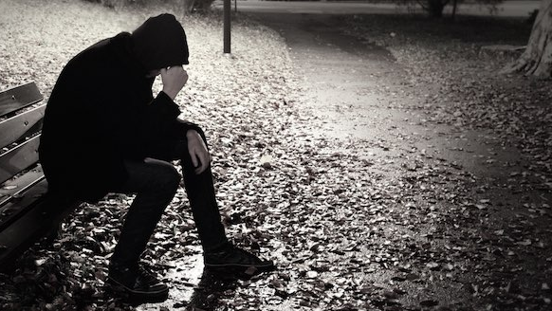
“Why did God let this happen?”
“Why am I being punished?”
“What have I done to deserve this?”
Job 14:1 (NKJV)
¹ “Man who is born of woman Is of few days and full of trouble.
Notes:
- **Health Issues**
- Physical illnesses and injuries
- Mental health struggles (e.g., anxiety, depression)
- **Financial Challenges**
- Poverty and lack of resources
- Debt and financial insecurity
- Unemployment or underemployment
- **Relationships**
- Conflict with family and friends
- Romantic relationship issues (e.g., breakups, divorce)
- Loneliness and social isolation
- **Personal Development**
- Lack of self-esteem and confidence
- Difficulty in achieving goals and ambitions
- Fear of failure or rejection
- **Work and Career**
- Job dissatisfaction or burnout
- Work-life balance challenges
- Career uncertainty and transitions
- **Societal Issues**
- Discrimination and inequality
- Political unrest and instability
- Environmental concerns and climate change
- **Existential Concerns**
- Questions about purpose and meaning in life
- Fear of death and the unknown
- Coping with grief and loss
- **Lifestyle and Choices**
- Substance abuse and addiction
- Poor lifestyle choices (e.g., diet, exercise)
- Time management and procrastination

Slide 4
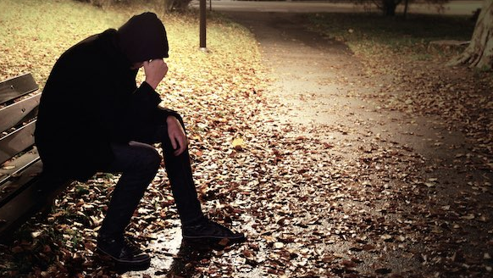
Seldom do we ask:
“Why not me?”
“Why me?” when we SO are blessed?
(MATERIALLY / RELATIONALLY / SPIRITUALLY)
Job 14:1 (NKJV)
¹ “Man who is born of woman Is of few days and full of trouble.
Notes:
- **Health Issues**
- Physical illnesses and injuries
- Mental health struggles (e.g., anxiety, depression)
- **Financial Challenges**
- Poverty and lack of resources
- Debt and financial insecurity
- Unemployment or underemployment
- **Relationships**
- Conflict with family and friends
- Romantic relationship issues (e.g., breakups, divorce)
- Loneliness and social isolation
- **Personal Development**
- Lack of self-esteem and confidence
- Difficulty in achieving goals and ambitions
- Fear of failure or rejection
- **Work and Career**
- Job dissatisfaction or burnout
- Work-life balance challenges
- Career uncertainty and transitions
- **Societal Issues**
- Discrimination and inequality
- Political unrest and instability
- Environmental concerns and climate change
- **Existential Concerns**
- Questions about purpose and meaning in life
- Fear of death and the unknown
- Coping with grief and loss
- **Lifestyle and Choices**
- Substance abuse and addiction
- Poor lifestyle choices (e.g., diet, exercise)
- Time management and procrastination

Slide 5

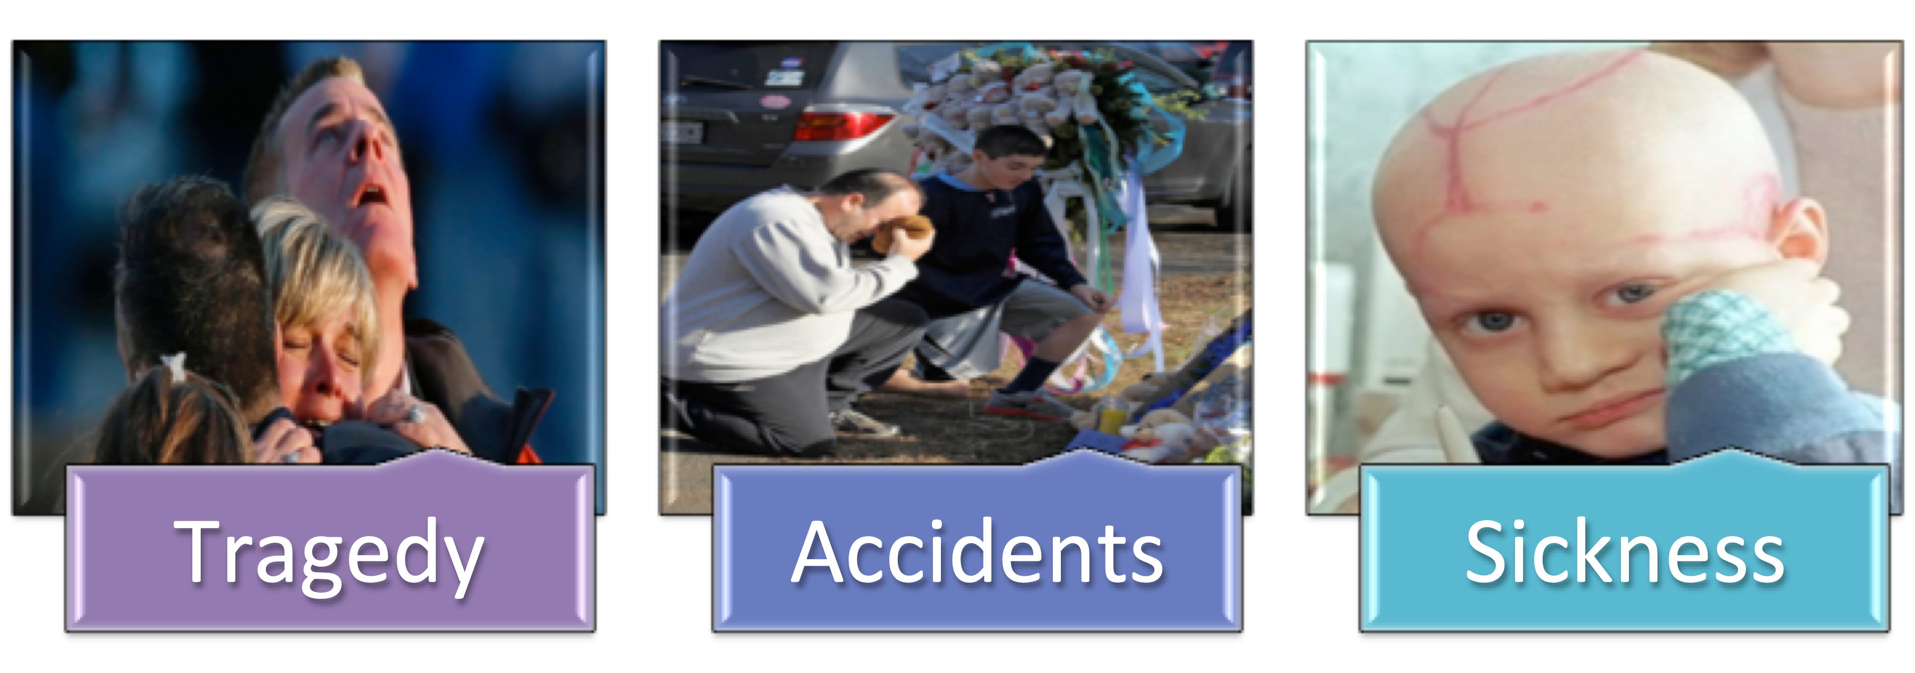

Slide 6
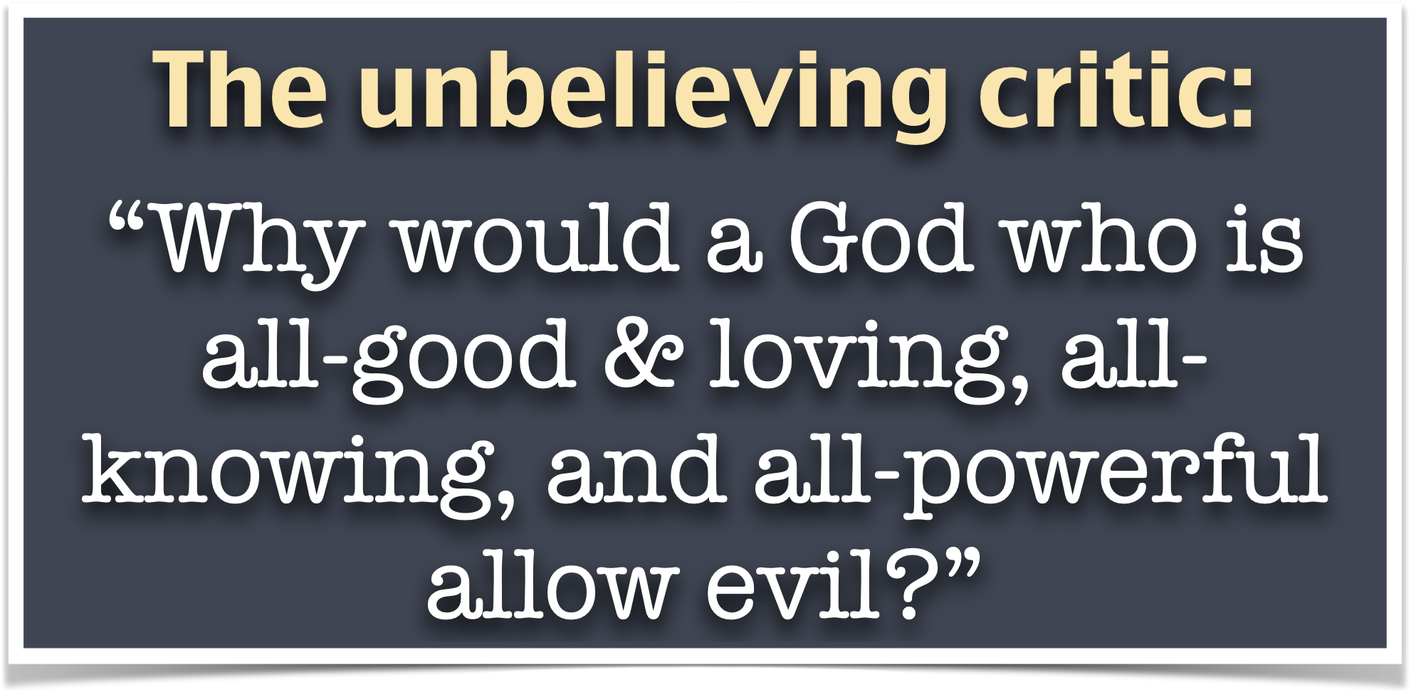
UNBELIEF
IGNORANCE
REBELLION
PRIDE

Slide 7
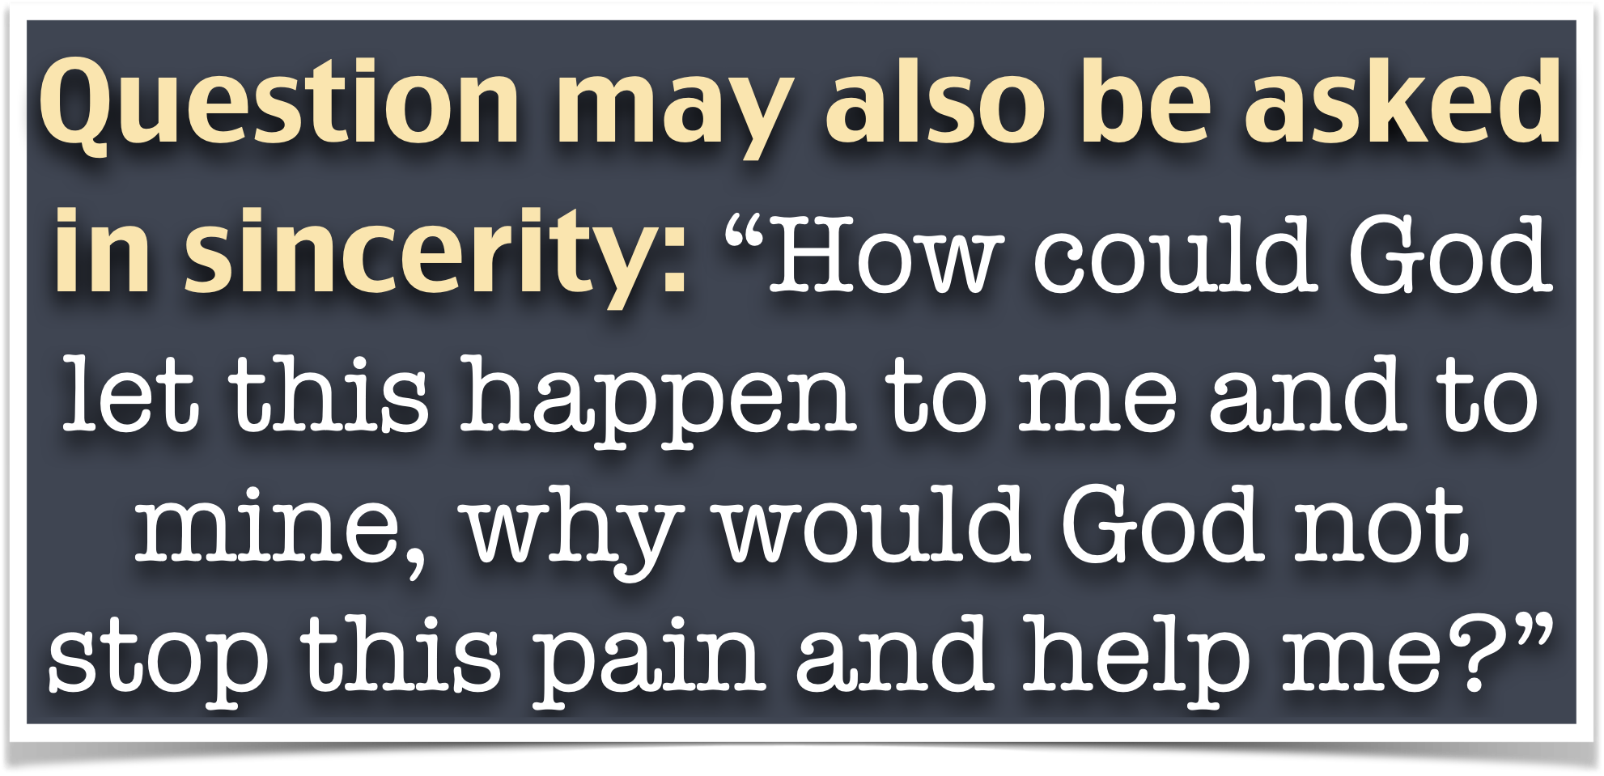
Why did I get this disease? Why is He not healing me?
Why did this tragedy happen to me? Does He not care …?
Why is God not removing my THORN?

Slide 8
2 Corinthians 12:7–10 (NKJV)
⁷ And lest I should be exalted above measure by the abundance of the revelations, a thorn in the flesh was given to me, a messenger of Satan to buffet me, lest I be exalted above measure. ⁸ Concerning this thing I pleaded with the Lord three times that it might depart from me. ⁹ And He said to me, “My grace is sufficient for you,

Slide 9
2 Corinthians 12:7–10 (NKJV)
for My strength is made perfect in weakness.” Therefore most gladly I will rather boast in my infirmities, that the power of Christ may rest upon me. ¹⁰ Therefore I take pleasure in infirmities, in reproaches, in needs, in persecutions, in distresses, for Christ’s sake. For when I am weak, then I am strong.

Slide 10
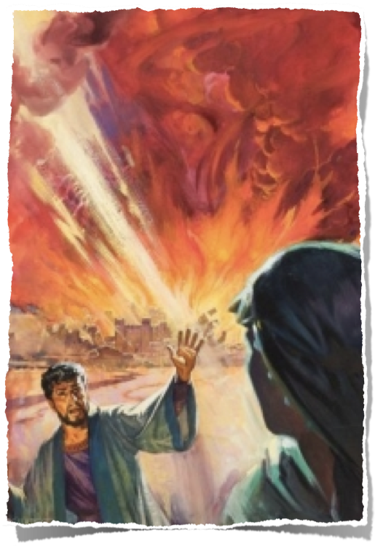

The Wicked Suffer
Sodom & Gomorrah - (Gen 19:1-29; Eze 16:49-50; Leviticus 18:22-25; Jude vss.7-8)
Judah - the sins of Manasseh - 2 Chron 33:1-9; cf 2 Kings 21:1-18
Gehazi - 2 Kings 5:26-27 / Ahab & Jezebel - 1 Kings 22:34-37; 9:33-37 / Herod - Acts 12:21-23 / etc.
Edom; Egypt; Tyre & Sidon; Syria; Babylon; Jerusalem; Rome …

Slide 11
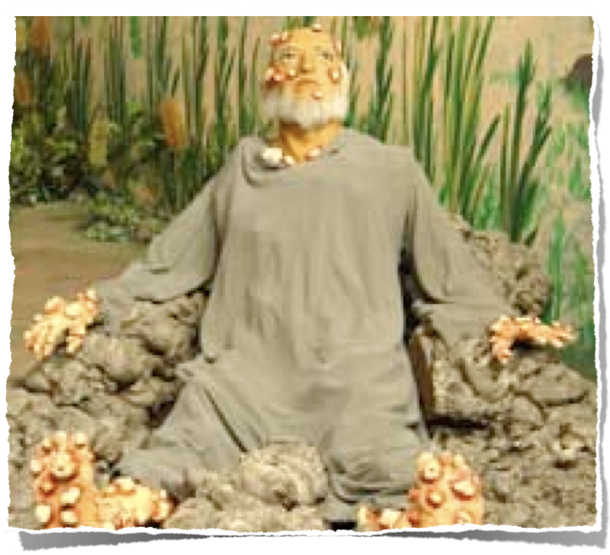
Matthew 5:45 (NKJV)
“that you may be sons of your Father in heaven; for He makes His sun rise on the evil and on the good, and sends rain on the just and on the unjust.”
The Righteous Suffer

Slide 12
Ecclesiastes 8:14 (NKJV)
¹⁴ There is a vanity which occurs on earth, that there are just men to whom it happens according to the work of the wicked; again, there are wicked men to whom it happens according to the work of the righteous. I said that this also is vanity.
(cf. 2 Timothy 3:12)
The Righteous Suffer

Slide 13
Able (Gen 4)
Job (Job 1:20-22; 2:10; 13:15; James 5:11)
Joseph (Gen 37:23-36; 39:1-41:14)
Paul (2:Cor. 11:22-30; 12:7-10)
Jesus! (Phili 2:5-9)
The Righteous Suffer

Slide 14
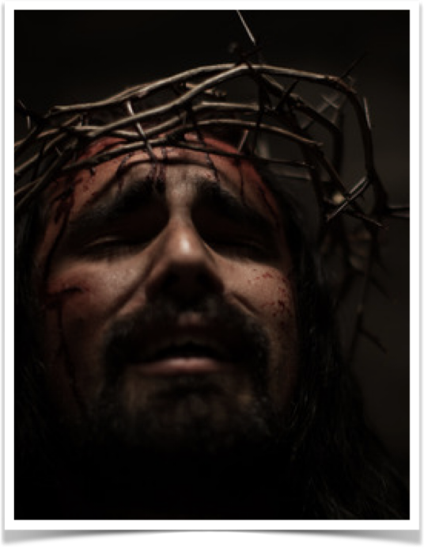
Isaiah 53:5 (NKJV)
⁵ But He was wounded for our transgressions, He was bruised for our iniquities; The chastisement for our peace was upon Him, And by His stripes we are healed.
Wounded: (lit. pierced - Ps. 22:16)
Bruised: severely oppressed, strongest term for suffering (Isa. 3:15; Mt 27:32)
Chastised: Jesus received punishment due a criminal, condemnation judged by the rulers (Act 3:17,18; 1 Cor 2:8; 2 Cor 3:14).
Stripes: prophetical of His being scourged (Mt 27:26; 1Pe 2:24)

Slide 15

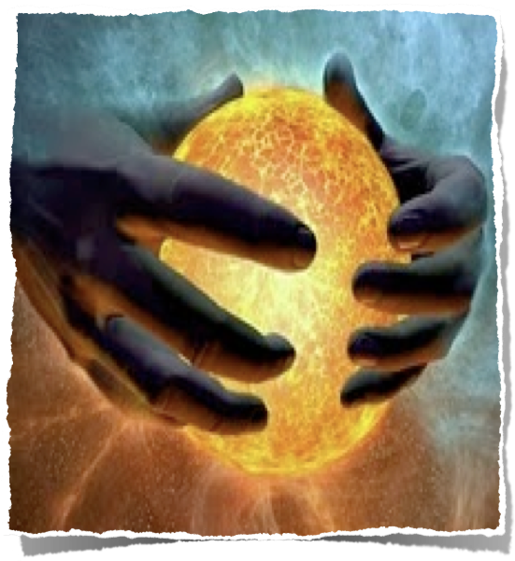

Everything God made was pronounced “very good” (Gen 1:31).
  Eden was an incomparable paradise (no sickness, disease, pathogens, genetic flaws, etc.)
  Natural laws were implemented for man’s good (No harm could come to them as long as they didn’t violate God’s law).

Slide 16
When Adam & Eve sinned, everything changed, (Gen 3:14-19).
  Humanity was subject to the sweat of toil, the pain of thorns, & death - “till thou return unto the ground” (Gen 3:17–19, 22–24; Rom 5:12; Heb 9:27; Eccl 12:1-6; Ps. 90:10; James 4:13-16)
  Entropy began when man sinned.

Slide 17
Why did Adam & Eve suffer? (Gen 3:17-19; 4:1-8)
David’s sins had devastating consequences (2 Sam 12:7-14)
We are all blessed with the ability to choose good or evil (Josh 24:15; Rom 6:16-18).

Slide 18
We reap what we sow - for every action there is a related consequence (Deut 30:15-20; Gal 6:7-9)!
Some more evident than others - (Crime / immorality / alcohol & drug abuse /gossip / envy / etc.)

Slide 19


Much pain in this world is collateral.
  Israel (Numbers 14; Joshua 7:10-12)
  Jonah’s rebellion (Jonah 1:14).
  Herod left a whole village to grieve (Matthew 2:16–18).

Slide 20
Decent people have always suffered because others choose greed, lust, hate, addiction, and selfishness.
People are killed on highways every day by drunk & careless drivers.
Slander & gossip have ruined reputations & lives - James 3:5,6

Slide 21
Children suffer because a parent is addicted to gambling, drugs, alcohol . . .
Divorce is a treacherous act that brings pain & suffering (Malachi 2:13-16)
Parents suffer when their children choose the path of sin & rebellion.
We do not sin in a vacuum (Romans 14:7)

Slide 22

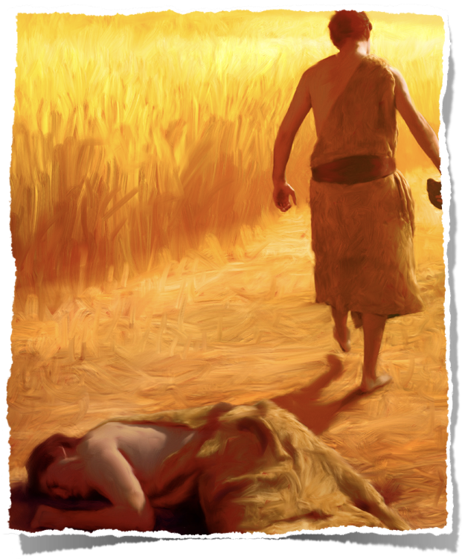
Free will means we can choose evil -
  When Cain’s anger turned violent (Genesis 4:5–8), God did not stop him.
  The antediluvian world was filled with violence (Gen 6:5,11)
  God will eventually right the scales of justice at the final tribunal (Mt. 25:31–33; Hb. 10:31).

Slide 23
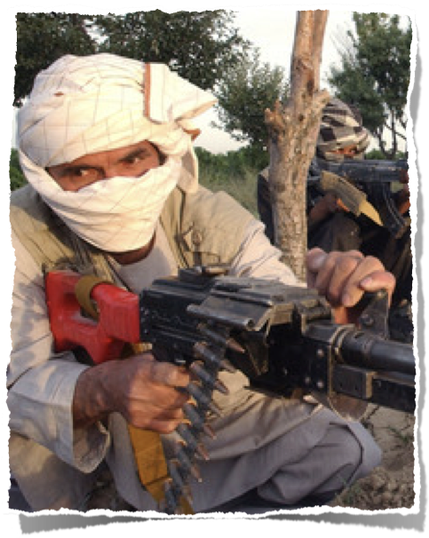
Free will means we can choose evil -
  Terrorists …
  Violence of cowards with weapons …
  Drug addicts steal & kill . . .
  Rapists traumatize their victims . . .
  Greedy businessmen, Identity thieves .

Slide 24
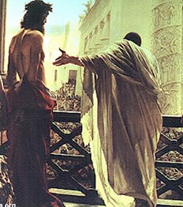
Those In Darkness Hate Those In The Light
John 3:19-20 (NKJV)
¹⁹ And this is the condemnation, that the light has come into the world, and men loved darkness rather than light, because their deeds were evil. ²⁰ For everyone practicing evil hates the light and does not come to the light, lest his deeds should be exposed.
Matthew 27:25 (NKJV)
And all the people answered and said, "His blood be on us and on our children."

Slide 25
Those In Darkness Hate Those In The Light
Christians suffered in the NT at the hands of their enemies
  Jesus was executed (Mat 27:35).
  His followers would also suffer in this world (Jn 16:33; 2 Tim. 3:12).
Matthew 27:25 (NKJV)
And all the people answered and said, "His blood be on us and on our children."

Slide 26
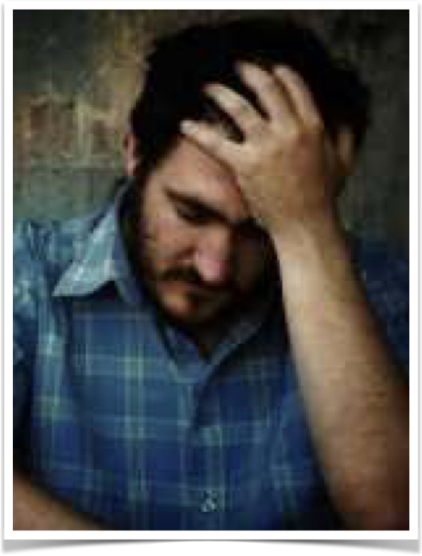
Sin is the Problem - Not God
Those who mock God & reject Him, are part of the problem (Isa. 59:1,2; Jer. 5:25; Deut. 31:17-19; Mat. 13:15)
The existence of evil & evil people does not mean God is weak or unconcerned - but rather an extension of His loving kindness & mercy (Eccl 8:11; Rom 2:2-4; Mat 13:24-30)

Slide 27
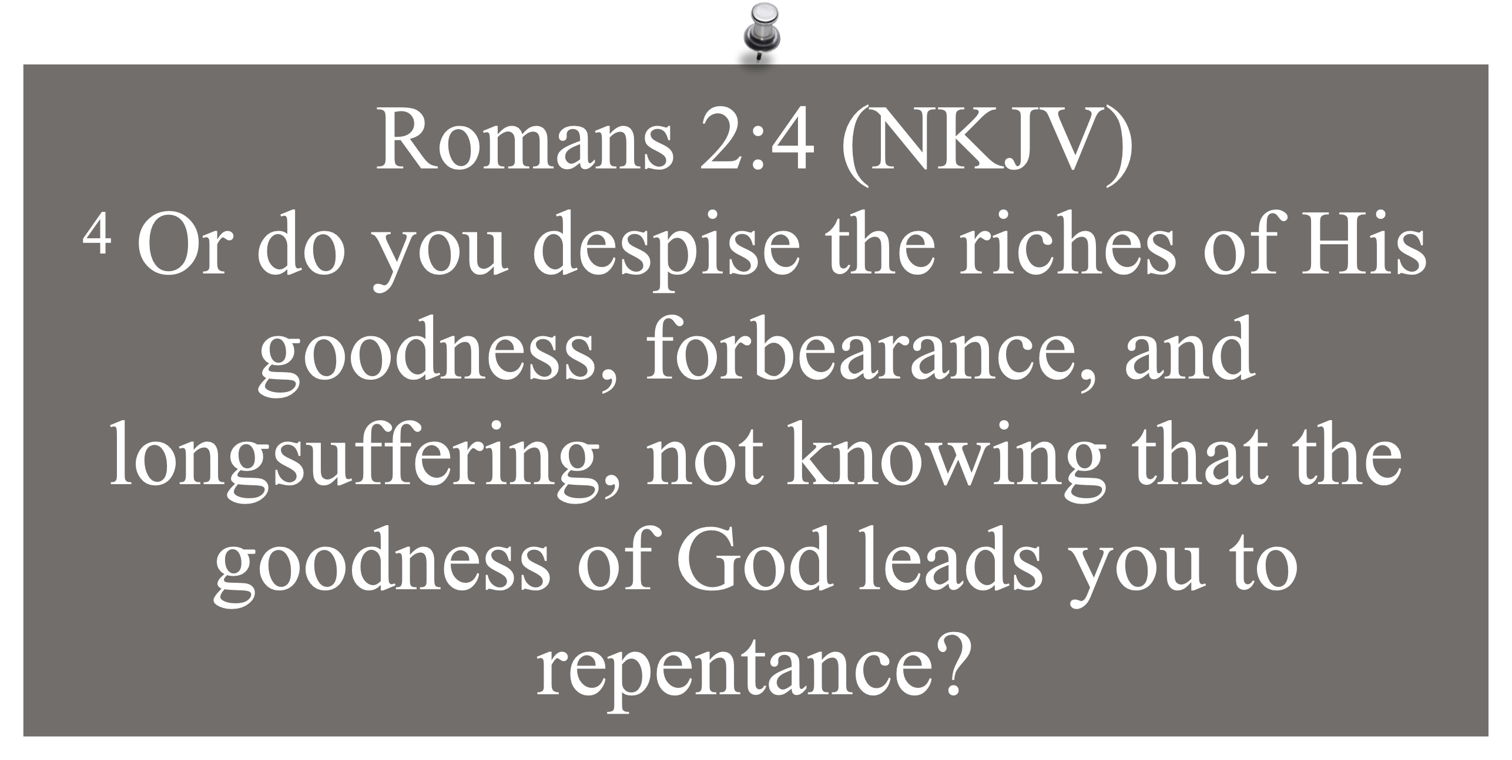
Sin is the Problem - Not God

Slide 28
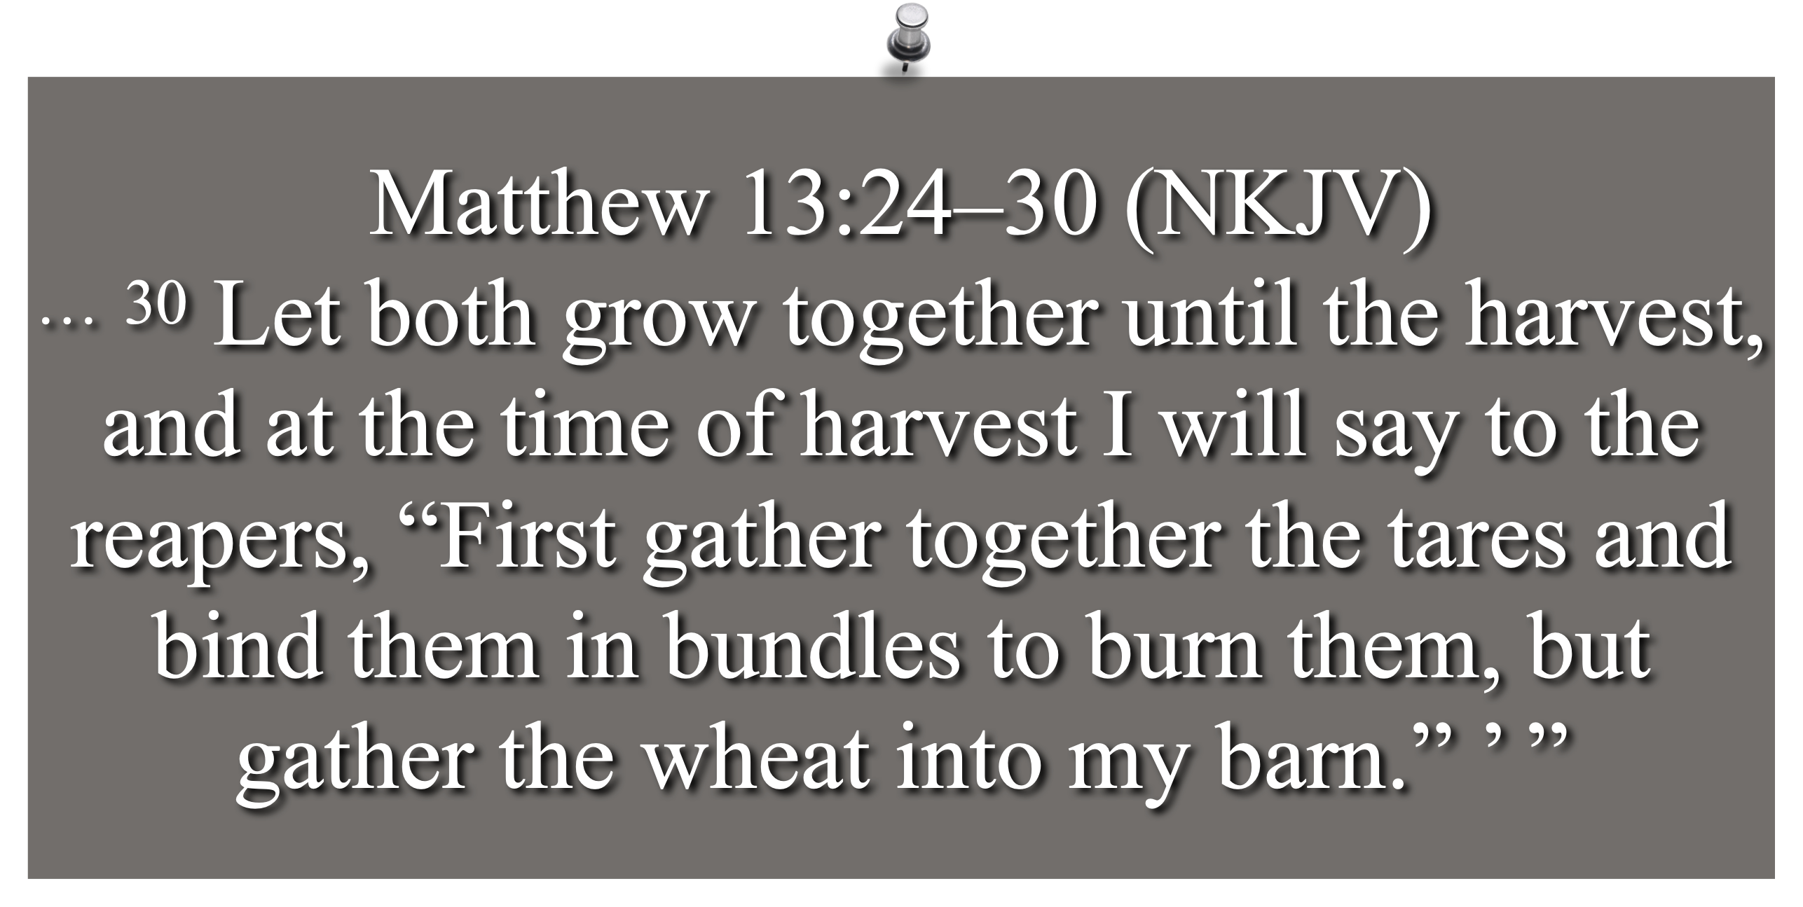
Sin is the Problem - Not God

Slide 29
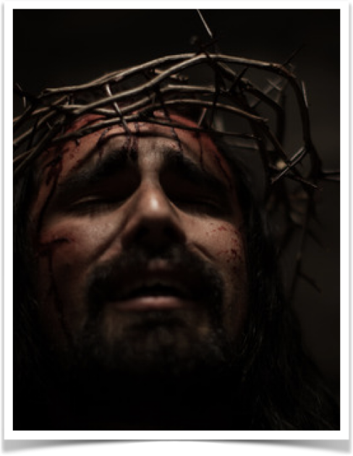
Sin is the Problem - Not God
God has provided a remedy for evil (Jno. 3:16; Acts 17:30; Rom 5:8-10; 8:18-28; Tit 3:1-5)
  What if Adam & Eve had chosen not to sin? What if all chose Jesus & righteousness?
Righteousness exalts a nation - sin destroys - Proverbs 14:34
Righteousness cannot be forced!

Slide 30
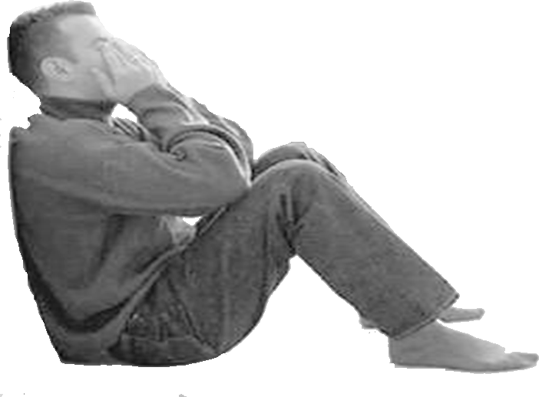
Staying Strong When Things Go Wrong
We are sojourners, pilgrims through a world full of hardship & trouble (the troubles of this life should prompt us to seek something better) (Heb 11:13-16; 1 Pet 2:11,12).
We should realize that EVERYTHING in this world is temporary (including its troubles) (1 John 2:15-17; 2 Cor 4:8-9,16-18).

Slide 31
Staying Strong When Things Go Wrong
Understanding the purpose of trials (James 1:2-16; 5:13-18; 1 Pet 5:6-10).
Prepare For Storms before they come! (Mat. 7:24-27; Luke 21:36; 2 Pet. 1:5-10).
Guard against anxiety / worry (Mat. 6:25-34; Phili. 4:4-13; 1 Cor. 10:13)
Enjoy the good times & be thankful! (Eccl. 5:18; 1 Tim 6:17; James 1:17)

Slide 32
Staying Strong When Things Go Wrong
We have three choices …
We can let it define us -
Let it destroy us -
Let it strengthen & perfect us (James 1:2-12; 1 Pet 1:3-9; 5:6-10)

Slide 33
Staying Strong When Things Go Wrong
Fully surrender to God and TRUST HIM (Romans 8:31)
Put on Christ (Romans 13:14)
Be a part of the solution (1 Peter 2:12)
Have patience / endurance
(James 5:7-11)
I will answer for myself (1 Peter 4:12-19)

Slide 34

Concluding thoughts
As long as the world stands, there will be evil, injustice and corruption.
But God has prepared a better world for the righteous (Heb 11:13-16)

Slide 35

Concluding thoughts
1 Peter 5:6-10 (NKJV)
⁶ Therefore humble yourselves under the mighty hand of God, that He may exalt you in due time, ⁷ casting all your care upon Him, for He cares for you.

Slide 36
Concluding thoughts
Psalm 46:1–3 (NKJV)
¹ God is our refuge and strength, A very present help in trouble. ² Therefore we will not fear, Even though the earth be removed, And though the mountains be carried into the midst of the sea; ³ Though its waters roar and be troubled, Though the mountains shake with its swelling. Selah

Slide 37
Concluding thoughts
James 1:16-17 (NKJV)
¹⁶ Do not be deceived, my beloved brethren. ¹⁷ Every good gift and every perfect gift is from above, and comes down from the Father of lights, with whom there is no variation or shadow of turning.

Slide 38

GOD WILL TAKE VENGEANCE
Every wrong will be punished & the righteous will be rewarded
Mat. 25:31-46; Acts 17:31; Rom. 2:5-10; 2 Pet. 3:10-14; 2 Thes. 1:7-9; John 5:28,29; 12:48; Rev. 21:8

Slide 39
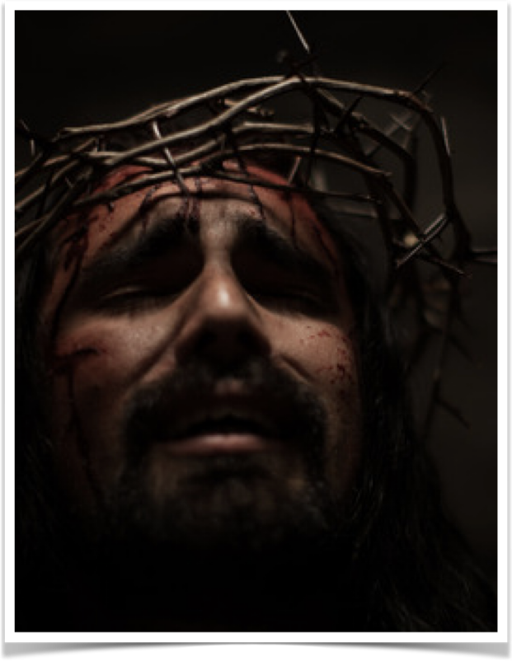
“An obedient faith in Jesus Christ does not guarantee a trouble free life, but a perfect eternity.”

Slide 40


Slide 41
Romans 8:18 (NKJV)
¹⁸ For I consider that the sufferings of this present time are not worthy to be compared with the glory which shall be revealed in us.
WHY DID YOU SEND YOUR SON TO DIE FOR ME?
WHY DID YOU PROVIDE SALVATION FROM SIN AND THE HOPE OF OF ETERNAL LIFE WITH YOU?
WHY NOT NOW?
Notes:
- **Health Issues**
- Physical illnesses and injuries
- Mental health struggles (e.g., anxiety, depression)
- **Financial Challenges**
- Poverty and lack of resources
- Debt and financial insecurity
- Unemployment or underemployment
- **Relationships**
- Conflict with family and friends
- Romantic relationship issues (e.g., breakups, divorce)
- Loneliness and social isolation
- **Personal Development**
- Lack of self-esteem and confidence
- Difficulty in achieving goals and ambitions
- Fear of failure or rejection
- **Work and Career**
- Job dissatisfaction or burnout
- Work-life balance challenges
- Career uncertainty and transitions
- **Societal Issues**
- Discrimination and inequality
- Political unrest and instability
- Environmental concerns and climate change
- **Existential Concerns**
- Questions about purpose and meaning in life
- Fear of death and the unknown
- Coping with grief and loss
- **Lifestyle and Choices**
- Substance abuse and addiction
- Poor lifestyle choices (e.g., diet, exercise)
- Time management and procrastination

Slide 43
Charts by Don McClain
Preached @ West 65th Street September 2006
Preached @ Alexander church of Christ November 16, 2025
donmcclain@sbcglobal.net
www.alexanderchurchofchrist.com
Job 14:1 (NKJV)
¹ “Man who is born of woman Is of few days and full of trouble.
Notes:
- **Health Issues**
- Physical illnesses and injuries
- Mental health struggles (e.g., anxiety, depression)
- **Financial Challenges**
- Poverty and lack of resources
- Debt and financial insecurity
- Unemployment or underemployment
- **Relationships**
- Conflict with family and friends
- Romantic relationship issues (e.g., breakups, divorce)
- Loneliness and social isolation
- **Personal Development**
- Lack of self-esteem and confidence
- Difficulty in achieving goals and ambitions
- Fear of failure or rejection
- **Work and Career**
- Job dissatisfaction or burnout
- Work-life balance challenges
- Career uncertainty and transitions
- **Societal Issues**
- Discrimination and inequality
- Political unrest and instability
- Environmental concerns and climate change
- **Existential Concerns**
- Questions about purpose and meaning in life
- Fear of death and the unknown
- Coping with grief and loss
- **Lifestyle and Choices**
- Substance abuse and addiction
- Poor lifestyle choices (e.g., diet, exercise)
- Time management and procrastination

