Slide 1
1 Peter 1:13–17; 2:9–10; Titus 2:11–14; 2 Corinthians 6:17–7:1; Romans 12:1–2

Slide 2
1 Peter 2:9–10 (NKJV)
⁹ But you are a chosen generation, a royal priesthood, a holy nation, His own special people, that you may proclaim the praises of Him who called you out of darkness into His marvelous light; ¹⁰ who once were not a people but are now the people of God, who had not obtained mercy but now have obtained mercy.

Slide 3
Titus 2:11–14 (NKJV)
¹¹ For the grace of God that brings salvation has appeared to all men, ¹² teaching us that, denying ungodliness and worldly lusts, we should live soberly, righteously, and godly in the present age, ¹³ looking for the blessed hope and glorious appearing of our great God and Savior Jesus Christ, ¹⁴ who gave Himself for us, that He might redeem us from every lawless deed and purify for Himself His own special people, zealous for good works.

Slide 4
2 Corinthians 6:17–7:1 (NKJV)
¹⁷ Therefore “Come out from among them And be separate, says the Lord. Do not touch what is unclean, And I will receive you.” ¹⁸ “I will be a Father to you, And you shall be My sons and daughters, Says the Lord Almighty.” ¹ Therefore, having these promises, beloved, let us cleanse ourselves from all filthiness of the flesh and spirit, perfecting holiness in the fear of God.

Slide 5
Romans 12:1–2 (NKJV)
¹ I beseech you therefore, brethren, by the mercies of God, that you present your bodies a living sacrifice, holy, acceptable to God, which is your reasonable service. ² And do not be conformed to this world, but be transformed by the renewing of your mind, that you may prove what is that good and acceptable and perfect will of God.

Slide 6
1 Peter 1:13–17 (NKJV)
¹³ Therefore gird up the loins of your mind, be sober, and rest your hope fully upon the grace that is to be brought to you at the revelation of Jesus Christ; ¹⁴ as obedient children, not conforming yourselves to the former lusts, as in your ignorance; ¹⁵ but as He who called you is holy, you also be holy in all your conduct, ¹⁶ because it is written, “Be holy, for I am holy.” ¹⁷ And if you call on the Father, who without partiality judges according to each one’s work, conduct yourselves throughout the time of your stay here in fear.

Slide 7
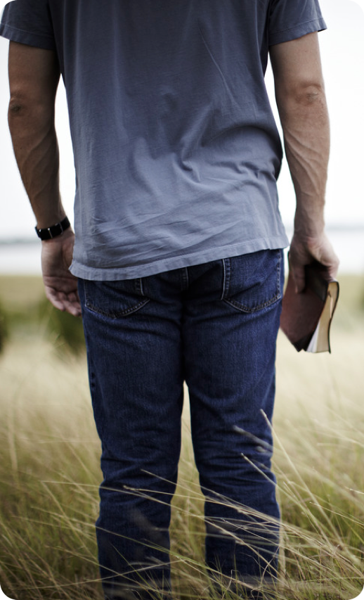
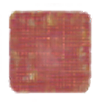
We are to be DIFFERENT (1 Pet 1:13-16; 2:9-12; 2 Cor. 6:14-7:1; Titus 2:11-14).
Not to be “conformed” but “transformed” (Rom. 12:1,2; Col. 2:8,9; Eph 2:2).
Affections should not be on “worldly” things, but the things of Jesus (1 John 2:15-17; Col. 3:1,2; James 4:4).
We can only have one master at a time (Mat. 6:24; John 8:34).

Slide 8
Not a matter of being different just to be different (a thing is NOT wrong because the world or denomination does it).
Our distinctiveness is in following God’s pattern, obeying His word, transforming our minds, attitudes, and deeds to be in harmony with God’s will (Rom 12:1,2; John 15:3; 17:17; 1 Pet. 1:13-17)

Slide 9
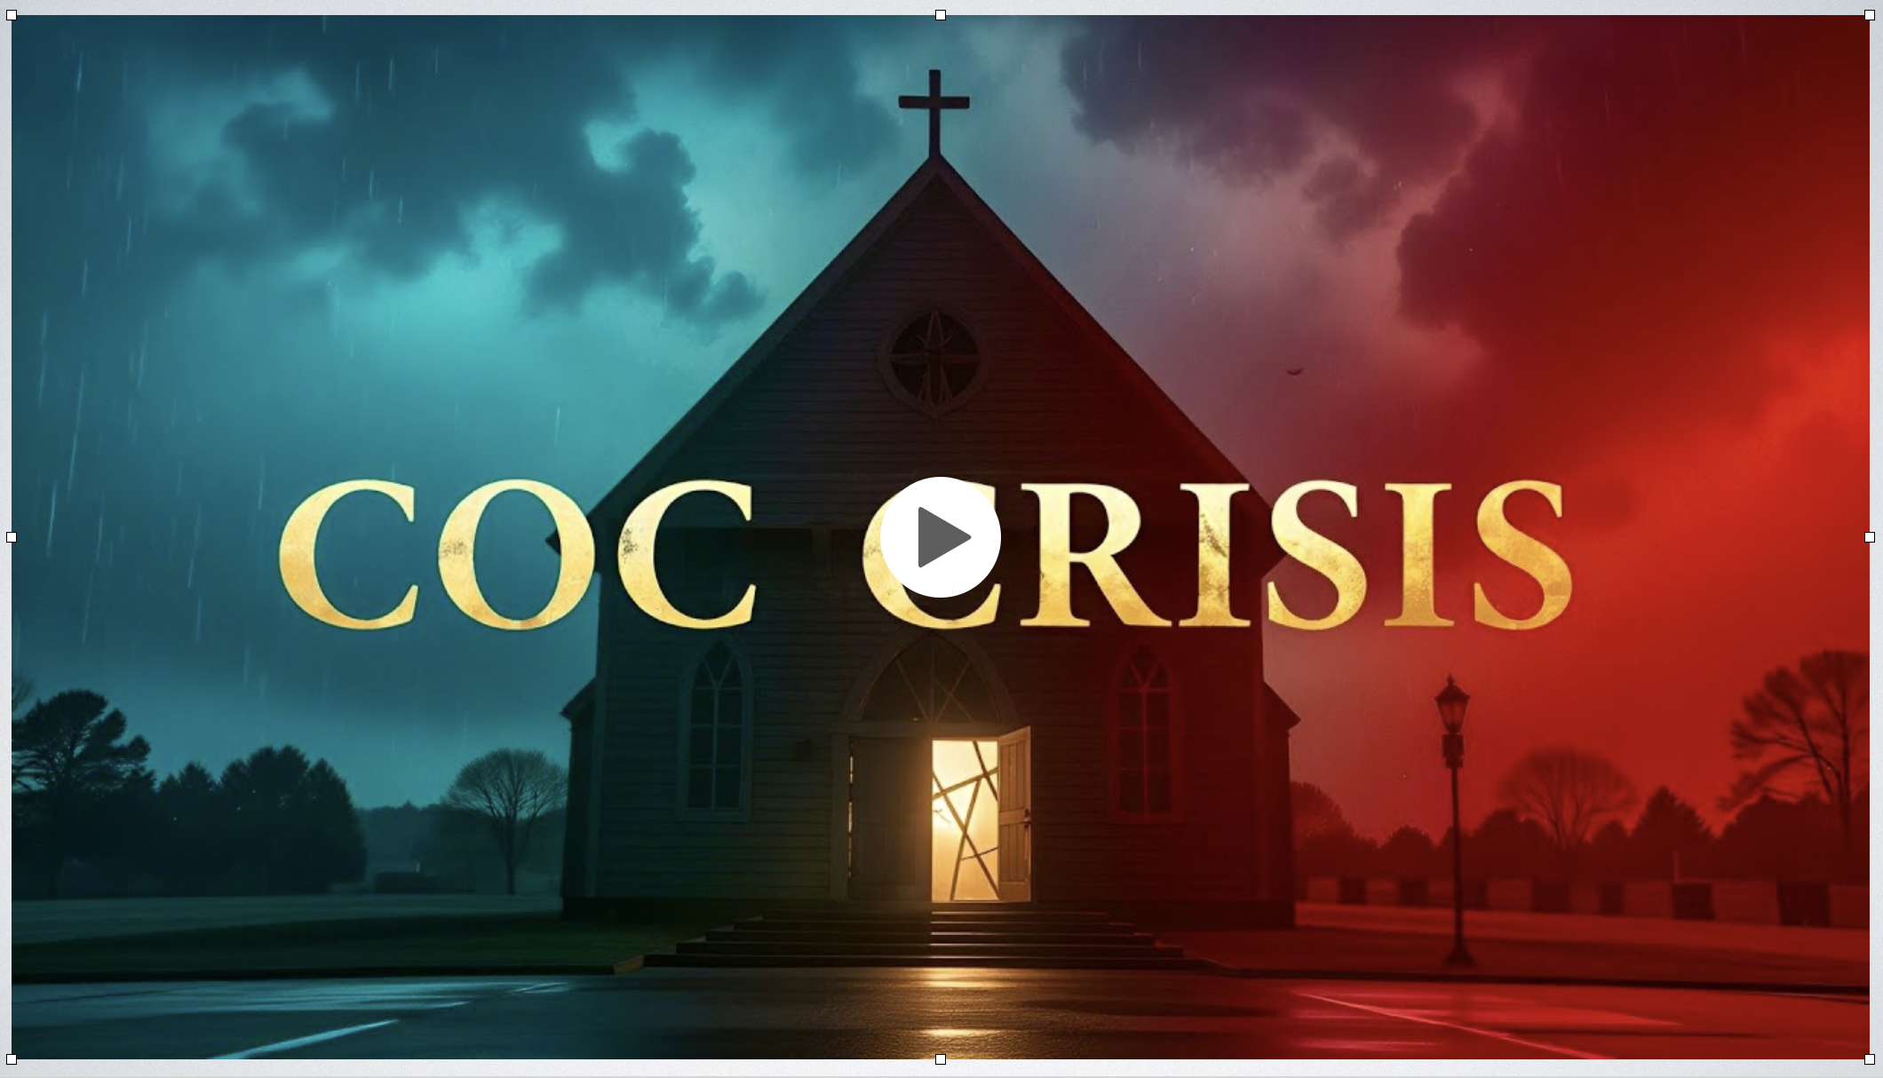
The video claims that the “church” is in decline BECAUSE of ITS DISTINCTIVE TEACHINGS AND PRACTICES.
STANDARD: “Devoted to a Biblical pattern, … Opposed to all manmade traditions … No Creed but Christ, no book but the Bible”
ORGANIZATION: “no organizational structure … local church autonomy”
ONE BODY: “Exclusive salvation … only churches of Christ are saved”
ONE BAPTISM: “Baptism, immersion in water in obedience to Jesus’s authority, is essential for salvation … all other forms of baptism are wrong.”
WORSHIP: “The Lord’s supper is to be observed every Sunday” / “A cappella singing only, because musical instruments are not specifically authorized.”
Notes:
https://youtu.be/FoeXNAPK0V8?si=FA3szfrOcyJdxQ8J

Slide 10
THE DISTINCTIVE STANDARD

Slide 11
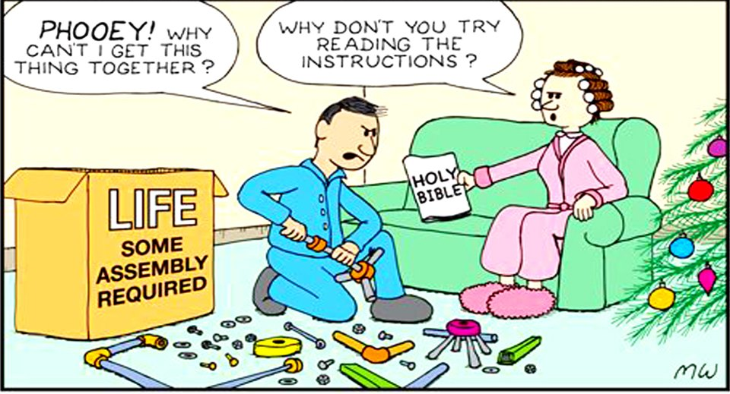
THE DISTINCTIVE STANDARD
Proverbs 14:12 (NKJV)
¹² There is a way that seems right to a man, But its end is the way of death.

Slide 12
THE DISTINCTIVE STANDARD
Jeremiah 10:23 (NKJV)
²³ O Lord, I know the way of man is not in himself; It is not in man who walks to direct his own steps.

Slide 13

THE DISTINCTIVE STANDARD
2 Timothy 1:13 (NKJV)
¹³ Hold fast the pattern of sound words which you have heard from me, in faith and love which are in Christ Jesus.
Titus 1:9 (NKJV)
⁹ holding fast the faithful word as he has been taught, that he may be able, by sound doctrine, both to exhort and convict those who contradict.

Slide 14

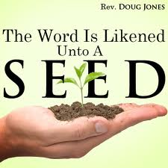
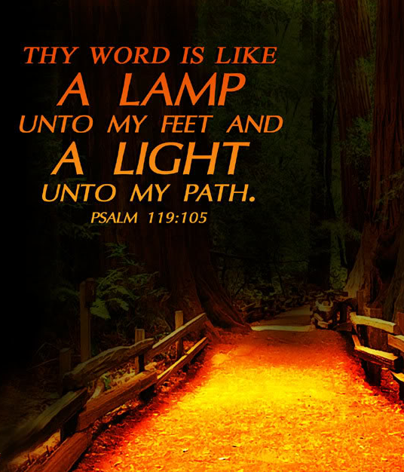
THE DISTINCTIVE STANDARD
2 Timothy 1:13
Luke 8:11-15
Psalm 119:105

Slide 15
THE DISTINCTIVE STANDARD
2 Timothy 3:14–17 (NKJV)
¹⁴ But you must continue in the things which you have learned and been assured of, knowing from whom you have learned them, ¹⁵ and that from childhood you have known the Holy Scriptures, which are able to make you wise for salvation through faith which is in Christ Jesus.

Slide 16
THE DISTINCTIVE STANDARD
2 Timothy 3:14–17 (NKJV)
¹⁶ All Scripture is given by inspiration of God, and is profitable for doctrine, for reproof, for correction, for instruction in righteousness, ¹⁷ that the man of God may be complete, thoroughly equipped for every good work.

Slide 17
THE DISTINCTIVE STANDARD
We cannot know the mind of God except through revelation
1 Cor 2:10, 11,14
Eph 3:3-5
Isaiah 55:8,9
God has revealed everything He wants us to know & do –
2 Pet 1:3;
2 Tim 3:16,17
Jude 3
Faith comes by hearing the word of CHRIST
ROMANS 10:17
Walking by faith means walking by what God has said
2 Cor. 5:7; 1 Cor. 4:6; Gal. 1:6-9

Slide 18

THE DISTINCTIVE STANDARD
THE WORD OF GOD IS THE STANDARD BY WHICH OUR EVERY WORD AND DEED IS TO BE MEASURED.
ORGANIZATION
IDENTITY
SOTERIOLOGY
WORSHIP
WORK

Slide 19
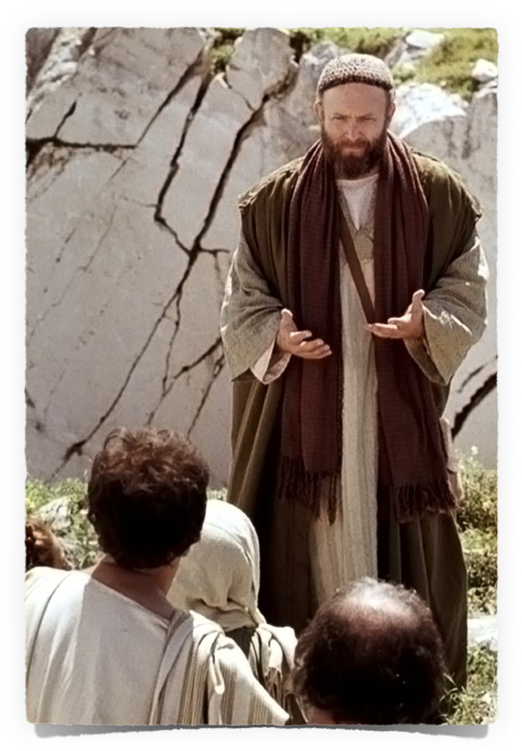
THE DISTINCTIVE PREACHING
In stressing the importance of distinctiveness, we are referring NOT to style, but to substance (Acts 18:24; 1 Cor. 1:17; 2:1; 2 Cor. 10:10; 11:6; 1 Cor. 3:5-9).
Gospel preachers are to proclaim the word of God (2 Tim 4:2; Acts 20:20; 1 Peter 4:11)

Slide 20
THE DISTINCTIVE PREACHING
Preaching & teaching must be clear, precise, understandable, unambiguous, and unmistakably rooted in the Word of God (1 Cor. 14:6-12, esp. vv. 7-8; Jer. 6:16-19; Ezek. 3:16-19).
The TRUTH must be spoken in LOVE (Eph 4:15; 1 Cor. 8:1; Acts 8:4)

Slide 21
As the chosen people of God, we are to be DIFFERENT (1 Pet 1:13-16; 2:9-12; 2 Cor. 6:14-7:1; Titus 2:11-14).
We are not to be “conformed” by the world in our thinking, teaching or deeds (Rom. 12:1,2; Col. 2:8,9; Eph 2:2).
Our distinctiveness comes from following God’s pattern, obeying His word, transforming our minds and deeds to be in harmony with God’s will (Rom 12:1,2; John 15:3; 17:17; 1 Pet 1:13-17).

Slide 22
Have you purified your souls in obeying the truth? (1 Pet 1:22, Acts 2:38)
Are you living a holy life in service to God? (Rom 12:1,2; Eph 4:21-24)
If the answer to either of these questions is no — receive the cleansing the blood of Christ provides, and begin living your life for Jesus, who died for you (Romans 6:3-19; Colossians 2:12,13; 3:1,2)

Slide 24
as He who called you is holy, you also be holy in all your conduct
Charts by Don McClain
Preached March 22, 2020 Alexander church of Christ
501-568-1062
Prepared using Keynote
Email – donmcclain@sbcglobal.net
More Keynote, PPT & Audio Sermons: www.alexanderchurchofchrist.com

Slide 25
1 Peter 2:4–12 (NKJV)
⁴ Coming to Him as to a living stone, rejected indeed by men, but chosen by God and precious, ⁵ you also, as living stones, are being built up a spiritual house, a holy priesthood, to offer up spiritual sacrifices acceptable to God through Jesus Christ. ⁶ Therefore it is also contained in the Scripture, “Behold, I lay in Zion A chief cornerstone, elect, precious, And he who believes on Him will by no means be put to shame.”

Slide 26
1 Peter 2:4–12 (NKJV)
⁷ Therefore, to you who believe, He is precious; but to those who are disobedient, “The stone which the builders rejected Has become the chief cornerstone,” ⁸ and “A stone of stumbling And a rock of offense.” They stumble, being disobedient to the word, to which they also were appointed. ⁹ But you are a chosen generation, a royal priesthood, a holy nation, His own special people, that you may proclaim the praises of Him who called you out of darkness into His marvelous light;

Slide 27
1 Peter 2:4–12 (NKJV)
¹⁰ who once were not a people but are now the people of God, who had not obtained mercy but now have obtained mercy. ¹¹ Beloved, I beg you as sojourners and pilgrims, abstain from fleshly lusts which war against the soul, ¹² having your conduct honorable among the Gentiles, that when they speak against you as evildoers, they may, by your good works which they observe, glorify God in the day of visitation.

