Slide 1
(Ephesians 3:1-13)

Slide 2
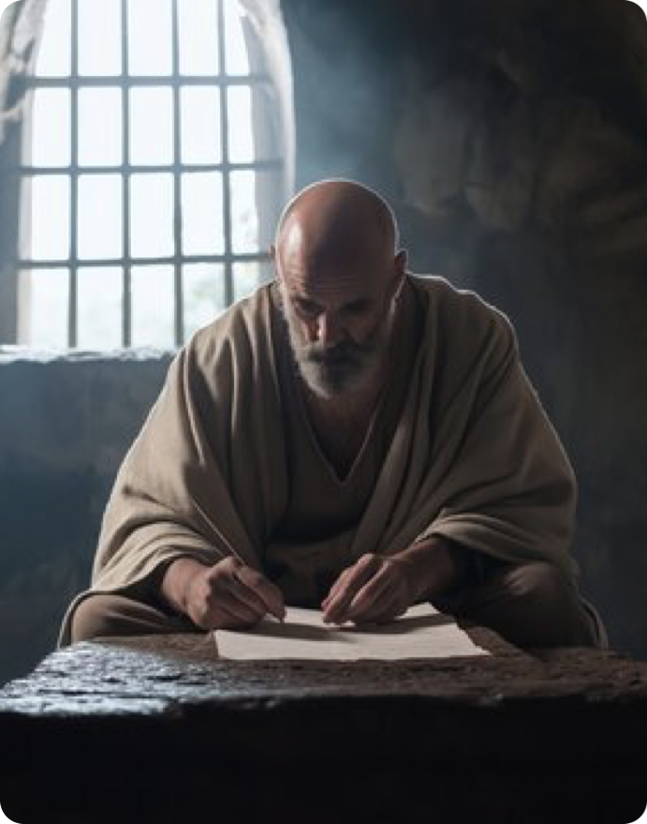

All spiritual blessings in Christ (1:3-16)
Paul’s prayer for them (1:17-23).
Saved By Grace Through Faith (2:1-10)
God’s saving work in Christ has abolished the dividing wall between Jew and Gentile and constituted a new, unified people — the church — as God’s dwelling (2:11–22).

Slide 3
Paul explains his unique stewardship of the “mystery” of Christ (3:1-7).
Paul reveals God’s eternal purpose was accomplished by Jesus for both Jew and Gentile, and is made known “through the church” (3:8-13).
Paul prays for their strength and security, that they fully experience the knowledge of God’s love, and they participate in all God provides in Christ, in the church (3:14-21).

Slide 4
Ephesians 3:1–21 (NKJV)
¹ For this reason I, Paul, the prisoner of Christ Jesus for you Gentiles—² if indeed you have heard of the dispensation of the grace of God which was given to me for you, ³ how that by revelation He made known to me the mystery (as I have briefly written already, ⁴ by which, when you read, you may understand my knowledge in the mystery of Christ), ⁵ which in other ages was not made known to the sons of men, as it has now been revealed by the Spirit to His holy apostles and prophets: ⁶ that the Gentiles should be fellow heirs, of the same body, and partakers of His promise in Christ through the gospel, ⁷ of which I became a minister according to the gift of the grace of God given to me by the effective working of His power.

Slide 5
Ephesians 3:1–21 (NKJV)
⁸ To me, who am less than the least of all the saints, this grace was given, that I should preach among the Gentiles the unsearchable riches of Christ, ⁹ and to make all see what is the fellowship of the mystery, which from the beginning of the ages has been hidden in God who created all things through Jesus Christ; ¹⁰ to the intent that now the manifold wisdom of God might be made known by the church to the principalities and powers in the heavenly places, ¹¹ according to the eternal purpose which He accomplished in Christ Jesus our Lord, ¹² in whom we have boldness and access with confidence through faith in Him. ¹³ Therefore I ask that you do not lose heart at my tribulations for you, which is your glory.

Slide 6
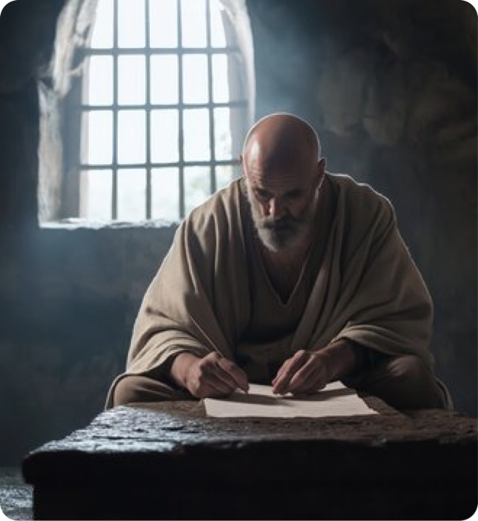

Paul’s calling and stewardship of the mystery (3:1,2)
“For this reason” Paul ties this section back to 2:11–22 (unity of Jew and Gentile in Christ).
“The prisoner of Christ Jesus for you Gentiles” — Paul’s imprisonment in Rome (cf. 4:1; 2 Tim. 1:8; Phile. 1, 9), as the apostle to the Gentiles (2 Tim. 1:11–12), due to Jewish opposition.
Ephesians 3:1 (NKJV)
¹ For this reason I, Paul, the prisoner of Christ Jesus for you Gentiles—

Slide 7
Paul’s calling and stewardship of the mystery (3:1,2)
“the dispensation of the grace of God” — An explanation of this “administration of God’s grace” is given in verses 3–12.
“dispensation” (oikonomia; v. 9) I.e., stewardship (1 Cor. 9:17, Col. 1:25, NKJV) a trust to be dispensed.
Paul was to function as a trustee to dispense God’s grace to the Gentiles (Gal. 2:7; Eph. 3:8).
Ephesians 3:2 (NKJV)
² if indeed you have heard of the dispensation of the grace of God which was given to me for you,

Slide 8
The revelation of the mystery (3:3–5)
Ephesians 3:3–4 (NKJV)
³ how that by revelation He made known to me the mystery (as I have briefly written already, ⁴ by which, when you read, you may understand my knowledge in the mystery of Christ),
“By revelation He made known to me the mystery” — to unveil, to make known (cf. 2 Cor. 12:7) — God “revealed” what had previously been kept a secret (cf. vs. 5; 6:19; Gal. 1:12; Rom. 16:25; Col. 1:26; 4:3).
How can "we" come to know this “mystery?” — “when you read, you may understand …” (3:4–5).

Slide 9
The revelation of the mystery (3:3–5)
“in other ages was not made known …” — There were many things given in the OT that were concealed, but uncovered in the NT (1 Peter 1:10-12)
“has now been revealed by the Spirit” — Paul’s “insight” was not his own; it was revealed by God (2 Tim. 3:16,17; 1 Pt. 1:11.12; 2 Pt. 1:20)
Not ONLY to Paul (cf. 2:20; 4:11).
Ephesians 3:5 (NKJV)
⁵ which in other ages was not made known to the sons of men, as it has now been revealed by the Spirit to His holy apostles and prophets:

Slide 10

Paul’s explanation of the mystery (3:6–13)
Paul states that both Gentile believers and Jewish believers are:
“fellow heirs,” — heirs together (cf. 2:11-18; Gal. 3:28, 29) of God’s blessings and promises (1:3–14),
“of the same body” (cf. 2:16; 4:15, 16; 5:30; 1 Co. 12:12, 27; Col. 2:19),
“partakers of His promise in Christ …” (Gen. 12:3; Gal. 3:8, 26-29)
Ephesians 3:6 (NKJV)
⁶ that the Gentiles should be fellow heirs, of the same body, and partakers of His promise in Christ through the gospel,

Slide 11
Paul’s explanation of the mystery (3:6–13)
Paul describes himself as a “minister” (diakonos) according to the gift of God’s grace (3:6,7; Acts 9:15; Rom. 11:13; 15:16).
Paul’s service was by “the gift of God’s grace” and continued by “the effective working of His power” (dynameōs) (Rom. 1:5; 15:18).
God works through us as we serve.
Ephesians 3:7 (NKJV)
⁷ of which I became a minister according to the gift of the grace of God given to me by the effective working of His power.

Slide 12
Paul’s explanation of the mystery (3:6–13)
“less than the least of all the saints” (3:8; 1 Cor. 15:9; 1 Tim. 1:12-16)
God called and enabled Him to “preach among the Gentiles the unsearchable riches of Christ” (Col. 1:27), the hope of glory, (Col. 2:2,3).
This Paul did, even in letters like this one to the Ephesians as we saw in Ep 1:3-14.
Ephesians 3:8 (NKJV)
⁸ To me, who am less than the least of all the saints, this grace was given, that I should preach among the Gentiles the unsearchable riches of Christ,

Slide 13
Paul’s explanation of the mystery (3:6–13)
Paul was to “make all see what is the fellowship of the mystery,” — Paul was especially designated as the apostle “to the Gentiles” [nations], (Rom. 11:13; Gal. 1:16; 2:7–8).
This secret had been hidden in God (cf. v. 5), Who had in mind this wonderful truth as part of His eternal plan (cf. 1:4, 11).
Ephesians 3:9–10 (NKJV)
⁹ and to make all see what is the fellowship of the mystery, which from the beginning of the ages has been hidden in God who created all things through Jesus Christ;

Slide 14
Paul’s explanation of the mystery (3:6–13)
The purpose of Paul’s ministry was that … “the manifold wisdom of God might be made known.”
The Church is the evidence displaying God’s wisdom to all creation (6:12; cf. 1:21; (1Pe 1:10-12).
Ephesians 3:9–10 (NKJV)
¹⁰ to the intent that now the manifold wisdom of God might be made known by the church to the principalities and powers in the heavenly places,

Slide 15
Paul’s explanation of the mystery (3:6–13)
The purpose of Paul’s ministry was that … “the manifold wisdom of God might be made known.”
The Church is the evidence displaying God’s wisdom to all creation (6:12; cf. 1:21; (1Pe 1:10-12).
This plan was God’s eternal intent which He accomplished in Christ Jesus our Lord (v. 11).
Ephesians 3:11 (NKJV)
¹¹ according to the eternal purpose which He accomplished in Christ Jesus our Lord,

Slide 16
Paul’s explanation of the mystery (3:6–13)
Ephesians 3:12–13 (NKJV)
¹² in whom we have boldness and access with confidence through faith in Him. ¹³ Therefore I ask that you do not lose heart at my tribulations for you, which is your glory.
Paul assures believers that through faith in Christ, they have boldness and access to God (2 Cor. 3:4; Heb. 4:16; 10:19, 35; [1 John 2:28; 3:21])
Paul did not want his imprisonment to be a source of concern - Because in imprisonment Paul was "an ambassador in chains” (Ep 6:19-20), accomplishing much good.

Slide 17
Paul fulfilled his calling (3:1-7) — We have a purpose — Are we as dedicated to fulfilling it as Paul?
God’s eternal purpose is made known “through the church” (3:8-13), — How are we fitting in to this purpose?
Paul’s prayer for them, (3:14-21), would only be accomplished if they believed, and applied the teachings of the Spirit to their lives — The same is true for us.

Slide 18
May we be STRENGTHENED by the Spirit in the INNER man.
May Christ dwell in our hearts by FAITH, that we be rooted and grounded in LOVE.
May we thereby possess and participate in all that God has and is giving those in Christ.

Slide 19
Saved by grace through faith …
Baptized Into
Rom. 6:3-6
Gal. 3:26,27
Acts 2:38,47
HAS HOPE
Christ’S CHURCH
ALL spiritual blessings
Chosen
A child of God
Accepted
Redeemed
Forgiven
A Heavenly Inheritance
Outside Christ
Lost Without Hope
NO spiritual blessings
NOT chosen
NOT children of God
NOT accepted
NO redemption
NO forgiveness
NO heavenly Inheritance

Slide 21
(Ephesians 3:1-13)
Charts by Don McClain /
Preached January 18, 2026 PM Alexander church of Christ
501-568-1062 / Email – donmcclain@sbcglobal.net
www.alexanderchurchofchrist.com

Slide 22
Colossians 1:24–29 (NKJV)
²⁴ I now rejoice in my sufferings for you, and fill up in my flesh what is lacking in the afflictions of Christ, for the sake of His body, which is the church, ²⁵ of which I became a minister according to the stewardship from God which was given to me for you, to fulfill the word of God, ²⁶ the mystery which has been hidden from ages and from generations, but now has been revealed to His saints. ²⁷ To them God willed to make known what are the riches of the glory of this mystery among the Gentiles: which is Christ in you, the hope of glory. ²⁸ Him we preach, warning every man and teaching every man in all wisdom, that we may present every man perfect in Christ Jesus. ²⁹ To this end I also labor, striving according to His working which works in me mightily.

