Slide 1
(Ephesians 3:14-21)

Slide 2

All spiritual blessings in Christ (1:3-16)
Paul’s 1st prayer for them (1:17-23).
Saved By Grace Through Faith (2:1-10)
Jew and Gentile constitute a new, unified people — the church — as God’s dwelling (2:11–22).

Slide 3
Paul explains his unique stewardship of the “mystery” of Christ (3:1-7).
Paul reveals God’s eternal purpose was accomplished by Jesus for both Jew and Gentile, and is made known “through the church” (3:8-13).

Slide 4
Paul prays for their strength and security, that they fully experience the knowledge of God’s love, and they participate in all God provides in Christ, in the church, making known God’s eternal purpose (3:14-21).

Slide 5
Ephesians 3:14–21 (NKJV)
¹⁴ For this reason I bow my knees to the Father of our Lord Jesus Christ, ¹⁵ from whom the whole family in heaven and earth is named, ¹⁶ that He would grant you, according to the riches of His glory, to be strengthened with might through His Spirit in the inner man, ¹⁷ that Christ may dwell in your hearts through faith; that you, being rooted and grounded in love, ¹⁸ may be able to comprehend with all the saints what is the width and length and depth and height—¹⁹ to know the love of Christ which passes knowledge; that you may be filled with all the fullness of God. ²⁰ Now to Him who is able to do exceedingly abundantly above all that we ask or think, according to the power that works in us, ²¹ to Him be glory in the church by Christ Jesus to all generations, forever and ever. Amen.

Slide 6
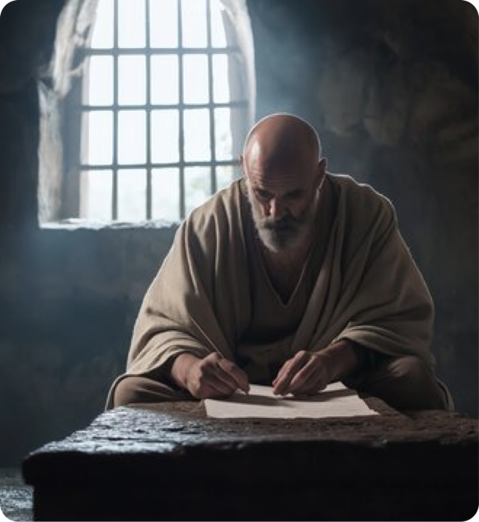

Paul’s Prayer For Them (3:14–21)
Paul prays to the Father, “from whom the whole family in heaven and earth is named” — He is saying that we have a common Father, whether Jew or Gentile (6:7).
Ephesians 3:14–15 (NKJV)
¹⁴ For this reason I bow my knees to the Father of our Lord Jesus Christ, ¹⁵ from whom the whole family in heaven and earth is named,

Slide 7
PRAYER FOR STRENGTH (3:16b-17a)
Paul prays to the Father, “from whom the whole family in heaven and earth is named” — He is saying that we have a common Father, whether Jew or Gentile (6:7).
The glory (doxēs) of God is seen in His very nature (Eph. 1:6,17); grace (1:2,6; 2:7-8); love (1:5; 2:4); mercy (2:4); power (1:19; 3:7); and His wisdom (3:10).
Ephesians 3:16 (NKJV)
¹⁶ that He would grant you, according to the riches of His glory, to be strengthened with might through His Spirit in the inner man,

Slide 8
PRAYER FOR STRENGTH (3:16b-17a)
“Strengthened” (krataiōthēnai, be strong to overcome resistance,”
“with might” (dynamis, dynamic living power; cf. 3:20)
“through His Spirit” — the Holy Spirit is the intermediate agent through Whom this strength and power is provided (cf. 1 Cor. 2:10; Rom 8:11).
Ephesians 3:16 (NKJV)
¹⁶ that He would grant you, according to the riches of His glory, to be strengthened with might through His Spirit in the inner man,

Slide 9
PRAYER FOR STRENGTH (3:16b-17a)
The Holy Spirit is the Spirit of wisdom and revelation (John 1:17).
He revealed all truth to, and through the apostles (John 16:13)
He instructs, reveals, and feeds by having made known the mind of God in scripture (1 Cor. 2:9-13).
We receive the Spirit by the hearing of faith (Rom. 1:17; 10:17; Gal. 3:2).
Ephesians 3:16 (NKJV)
¹⁶ that He would grant you, according to the riches of His glory, to be strengthened with might through His Spirit in the inner man,

Slide 10
PRAYER FOR STRENGTH (3:16b-17a)
“strengthened with might … in the inner man” — fortified inner empowerment—spiritual resilience and Christlike character, (1 Pe. 3:4; Col. 1:11; 2 Co. 12:9).
The “Inner man” points to the renewed heart/new self (cf. 4:23–24), the center of spiritual transformation, (cf. 2 Cor. 4:16-18).
Ephesians 3:16 (NKJV)
¹⁶ that He would grant you, according to the riches of His glory, to be strengthened with might through His Spirit in the inner man,

Slide 11
PRAYER FOR STRENGTH (3:16b-17a)
Christ dwelling (3:17) — The indwelling of Christ is by FAITH, (Rom. 10:17) and indicates a deep, abiding relationship.
When Christ dwells in our hearts, we have stability in love, (“rooted and grounded in love”).
Love is both the foundation and source of spiritual growth and stability in the believer’s life (Col. 2:7).
Ephesians 3:17 (NKJV)
¹⁷ that Christ may dwell in your hearts through faith; that you, being rooted and grounded in love,

Slide 12
COMPREHENSION OF CHRIST’S LOVE (3:17b-19a)
Ephesians 3:18–19a (NKJV)
¹⁸ may be able to comprehend with all the saints what is the width and length and depth and height—¹⁹ to know the love of Christ which passes knowledge;
Paul prays they may grasp the breadth, length, height, and depth of Christ’s love— indicating vastness beyond rational limits.

Slide 13
FILLED WITH THE FULLNESS OF GOD (3:19b)
Paul prays they may grasp the breadth, length, height, and depth of Christ’s love— indicating vastness beyond rational limits.
The end goal is to be filled with the fullness of God (pleroma)— i.e., to share in all God gives to those in Christ (1:23; Col. 2:9,10).
Ephesians 3:19 (NKJV)
that you may be filled with all the fullness of God.

Slide 14
THE POWER OF GOD (3:20–21)
Ephesians 3:20–21 (NKJV)
²⁰ Now to Him who is able to do exceedingly abundantly above all that we ask or think, according to the power that works in us, ²¹ to Him be glory in the church by Christ Jesus to all generations, forever and ever. Amen.
The doxology frames God’s capacity as overflowing—transcending human petition.
The ultimate purpose of the mystery being revealed, Paul’s stewardship, and his prayer for them, is to the glory of God, which is displayed in and through the church by Christ Jesus for all generations.

Slide 15
God’s eternal purpose is made known “through the church” (3:8-13),
Their success would only be accomplished as they were motivated and empowered by God’s will, (Spirit), His love, (Jesus), and filled with His provisions, (Himself).
How are we fitting in to this purpose?

Slide 16
Paul’s prayer for them, would only be accomplished if they believed, and applied the teachings of the Spirit to their lives.
The same is true for us.

Slide 17
May we be STRENGTHENED by the Spirit in the INNER man.
May Christ dwell in our hearts by FAITH, that we be rooted and grounded in LOVE.
May we thereby possess and participate in all that God has and is giving those in Christ.

Slide 18
Saved by grace through faith …
Baptized Into
Rom. 6:3-6
Gal. 3:26,27
Acts 2:38,47
HAS HOPE
Christ’S CHURCH
ALL spiritual blessings
Chosen
A child of God
Accepted
Redeemed
Forgiven
A Heavenly Inheritance
Outside Christ
Lost Without Hope
NO spiritual blessings
NOT chosen
NOT children of God
NOT accepted
NO redemption
NO forgiveness
NO heavenly Inheritance

Slide 20
Charts by Don McClain /
Preached February 1, 2026 PM Alexander church of Christ
501-568-1062 / Email – donmcclain@sbcglobal.net
www.alexanderchurchofchrist.com

Slide 21
Colossians 1:9–12 (NASB95)
⁹ For this reason also, since the day we heard of it, we have not ceased to pray for you and to ask that you may be filled with the knowledge of His will in all spiritual wisdom and understanding, ¹⁰ so that you will walk in a manner worthy of the Lord, to please Him in all respects, bearing fruit in every good work and increasing in the knowledge of God; ¹¹ strengthened with all power, according to His glorious might, for the attaining of all steadfastness and patience; joyously ¹² giving thanks to the Father, who has qualified us to share in the inheritance of the saints in Light.

