Slide 1
(Ephesians 4:1-21)

Slide 2

All spiritual blessings in Christ (1:3-16)
Paul’s 1st prayer for them (1:17-23).
Saved By Grace Through Faith (2:1-10)
Jew and Gentile constitute a new, unified people — the church — as God’s dwelling (2:11–22).

Slide 3
Paul explains his unique stewardship of the “mystery” of Christ (3:1-7).
Paul reveals God’s eternal purpose was accomplished by Jesus for both Jew and Gentile, and is made known “through the church” (3:8-13).

Slide 4
Paul prays for their strength and security, that they fully experience the knowledge of God’s love, and they participate in all God provides in Christ, in the church, making known God’s eternal purpose (3:14-21).

Slide 5
Ephesians 4:1–6 (NKJV)
¹ I, therefore, the prisoner of the Lord, beseech you to walk worthy of the calling with which you were called, ² with all lowliness and gentleness, with longsuffering, bearing with one another in love, ³ endeavoring to keep the unity of the Spirit in the bond of peace. ⁴ There is one body and one Spirit, just as you were called in one hope of your calling; ⁵ one Lord, one faith, one baptism; ⁶ one God and Father of all, who is above all, and through all, and in you all.

Slide 6
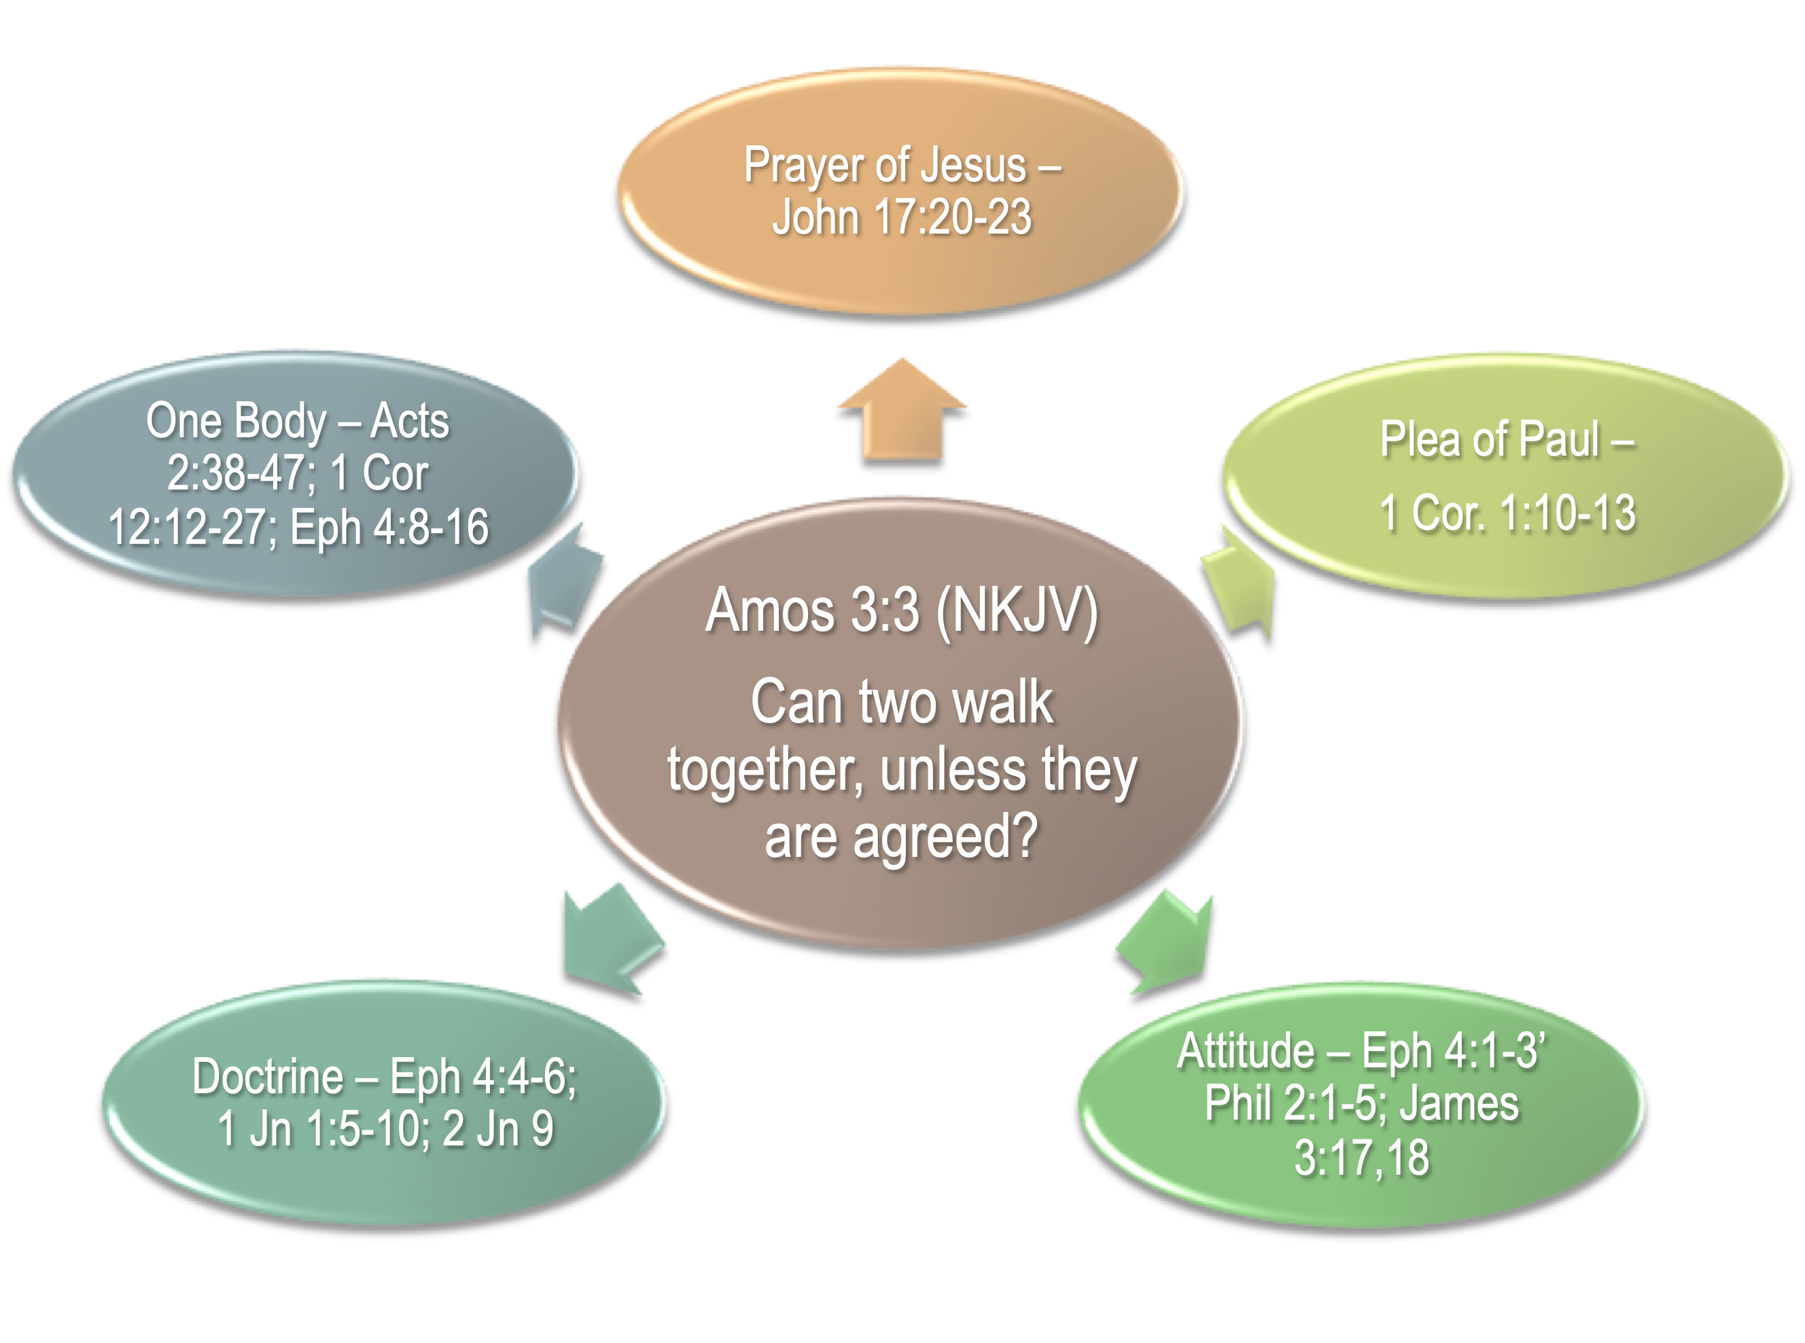

Slide 7

Early Disciples / Judaizers - Acts 15
The church In Corinth / Carnality - 1 Cor. 1:10-13
Walking In Truth / Gnostics - 1 John
Faithful / Unfaithful - Rev 2,3
Strong / Weak - Romans 14
²⁵ But Jesus knew their thoughts, and said to them: “Every kingdom divided against itself is brought to desolation, and every city or house divided against itself will not stand. — Matthew 12:25 (NKJV)

Slide 10
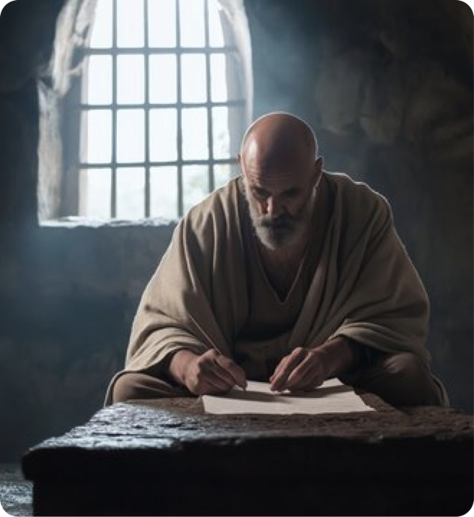

OUR DUTY IN VIEW OF THE GOSPEL (4:1)
“I, therefore,” (οὖν) — logical link to prior theological argument.
“the prisoner of the Lord,” (ὁ͂ δὲ ἐγὼ δεσμώτης ᾿κυρίῳ) — Paul’s self‑designation: literal imprisonment
“beseech you” — urge/implore (παρακαλῶ) — hortatory, pastoral appeal; not merely commanding but persuasive.
Ephesians 4:1 (NKJV)
¹ I, therefore, the prisoner of the Lord, beseech you to walk worthy of the calling with which you were called,

Slide 11
OUR DUTY IN VIEW OF THE GOSPEL (4:1)
“to walk” (περιπατεῖν) — metaphor for conduct/life‑style (cf. Eph 2:2; 5:2); continuous aspect.
“worthy of the calling” (ἄξιαv τῆς κλήσεως) — worthiness implies conduct congruent with the dignity and demands of the gospel.
“with which you were called” (ἐφʼ ἥν ἐκλήθητε) — The gospel is the means / links identity and duty.
Ephesians 4:1 (NKJV)
¹ I, therefore, the prisoner of the Lord, beseech you to walk worthy of the calling with which you were called,

Slide 12
OUR DUTY IN VIEW OF THE GOSPEL (4:1)
STANDARD — Called by means of the SAME GOSPEL / FAITH– 2 Thes 2:12,13; Gal 1:6-9; Jude 1:3
HOLINESS — The SAME holy calling of God in Christ Jesus (2 Tim 1:9)
    SUBMISSION — Unto God’s kingdom & glory – 1 Thes 2:12; Col. 1:13
DUTY — Out of darkness into God’s light (5:8; 1 Pet 2:9; 1 John 1:5-8)
Our walk MUST correspond with our calling

Slide 13
Corporate virtues that preserve unity (4:2)
“with all lowliness” - ταπεινοφροσύνη (humility) — lowliness of mind; attitude of deference and self‑emptying.
“and gentleness” - πραΰτης (meekness) — power under control, non‑retaliatory demeanor.
“long-suffering” μακροθυμία — forbearance under provocation; patience, endurance.
Ephesians 4:2 (NKJV)
² with all lowliness and gentleness, with longsuffering, bearing with one another in love,

Slide 14
Corporate virtues that preserve unity (4:2)
“bearing with one another” — ἀνεχόμενοι ἑαυτοῖς — present participle denoting mutual, ongoing tolerance; to endure patiently.
“in love,” ἐν ἀγάπῃ — agape, actively seeking that which is in the best interest of others, grounds for bearing.
Ephesians 4:2 (NKJV)
² with all lowliness and gentleness, with longsuffering, bearing with one another in love,

Slide 15
Corporate virtues that preserve unity (4:2)
Lowliness – putting others above self – Phili 2:1-5; James 3:15-18
Gentleness – strength under God’s control – Mat 5:5; Gal 6:1
With longsuffering, - Self-restraint which does not hastily retaliate a wrong —Gal 5:22; Col 1:3:12
Bearing with one another In love – Patient with others foibles, faults, and infirmities, because I love - 1 Cor 13:4
Ephesians 4:2 (NKJV)
² with all lowliness and gentleness, with longsuffering, bearing with one another in love,

Slide 16
EFFORT REQUIRED TO MAINTAIN PEACE AND UNITY (4:3)
“endeavoring to keep” - ζηλῶτες— active, intentional effort to preserve unity; zeal as positive.
“unity of the Spirit” — ἑνότητα τοῦ πνεύματος ties unity not to human organization but to the Spirit’s work; Spirit as source and sustainer.
“in the bond of peace” — ἐν τῷ συνδέσμῳ τῆς εἰρήνης — peace as social glue and fruit of Spirit.
Mutuality, Ongoing Practice.
Ephesians 4:3 (NKJV)
³ endeavoring to keep the unity of the Spirit in the bond of peace.

Slide 17
EFFORT REQUIRED TO MAINTAIN PEACE AND UNITY (4:3)
Mutuality, Ongoing Practice.
Our practice proceeds from our doctrinal beliefs.
Our sentiments, desires, affections, and attitudes are based on the teachings of Christ revealed through the Spirit - the mind of Christ.
Our DUTY is to maintain unity by submitting to the TRUTH and developing the proper ATTITUDES.
Ephesians 4:3 (NKJV)
³ endeavoring to keep the unity of the Spirit in the bond of peace.

Slide 18
³ endeavoring to keep the unity of the Spirit in the bond of peace.
PEACE AND UNITY will not come naturally or easily – much effort is required - vs. 3
2 Pet 1:5-10

Slide 19
³ endeavoring to keep the unity of the Spirit in the bond of peace.
PEACE AND UNITY will not come naturally or easily – much effort is required - vs. 3
2 Pet 1:5-10

Slide 20
³ endeavoring to keep the unity of the Spirit in the bond of peace.
PEACE AND UNITY will not come naturally or easily – much effort is required - vs. 3
2 Pet 1:5-10

Slide 21

FOUNDATION OF UNITY IS THE TRUTH (4:4-6)
“There is one body” — εἷς σῶμα, εἷς πνεῦμα — categorical unity: ecclesial unity (body = church)
Jesus built one (Mat. 16:16-18)
Jesus is the head over His church (Eph 1:22,23; 5:23)
The church is the saved, and Jesus its Savior (Acts 2:47, Eph. 5:23)
Ephesians 4:4 (NKJV)
⁴ There is one body and one Spirit, just as you were called in one hope of your calling;

Slide 22
FOUNDATION OF UNITY IS THE TRUTH (4:4-6)
“and one Spirit” singularity of source and guide, (one source of spiritual life, and one revealer of all truth).
The Holy Spirit guided apostles into ALL truth (John 16:13; Eph 3:3-5)
The Holy Spirit uses the means of His instructions to regenerate, and sanctify the obedient (1 Cor. 12:13; John 3:5; Titus 3:5; Eph. 5:26)
Ephesians 4:4 (NKJV)
⁴ There is one body and one Spirit, just as you were called in one hope of your calling;

Slide 23
FOUNDATION OF UNITY IS THE TRUTH (4:4-6)
“called in one hope of your calling” — calling to a shared eschatological expectation; shapes identity.
Our only hope is in Jesus, through the gospel (John 14:6; Acts 4:12; Rom. 1:16)
The Christian’s one hope is heaven (1 Thes 5:8; Acts 23:6; Col 1:5)
Our Hope affects our lives (1 Jn. 3:3)
Ephesians 4:4 (NKJV)
⁴ There is one body and one Spirit, just as you were called in one hope of your calling;

Slide 24
FOUNDATION OF UNITY IS THE TRUTH (4:4-6)
“one Lord” — εἷς κύριος — Jesus as Lord (κυριος) — confession of Christ‑Lordship as unity locus.
Jesus has all authority (Mat. 28:18; Acts 4:12; John 12:48)
Jesus MUST be obeyed (Heb. 5:8,9; Luke 6:46; Mat. 7:21-23; John 15:10).
MUST confess His Lordship in word and deed (Rom. 10:9,10; Col. 3:17)
Ephesians 4:5 (NKJV)
⁵ one Lord, one faith, one baptism;

Slide 25
FOUNDATION OF UNITY IS THE TRUTH (4:4-6)
“one faith” εἷς πίστις — one shared faith/creedal objective content - the gospel.
One body of truth to be believed, taught, practiced & defended (2 Tim 1:13; Rom 10:8; Jude 3)
There is but one standard, and those who follow the same standard will be united (1 Co. 1:10).
Ephesians 4:5 (NKJV)
⁵ one Lord, one faith, one baptism;

Slide 26
FOUNDATION OF UNITY IS THE TRUTH (4:4-6)
“one baptism” εἷς βάπτισμα — baptism as unifying point of entry.
Commanded by Jesus & the apostles (Mat. 28:19; Mark 16:16; Acts 2:38; 8:12-35-39; 10:48)
When God forgives our sins (Acts 2:38; Col. 2:12,13; 1 Pet. 3:21)
One enters the body of Christ (Rom 6:3,4; 1 Cor. 12:13; Gal. 3:26,27).
Ephesians 4:5 (NKJV)
⁵ one Lord, one faith, one baptism;

Slide 27
FOUNDATION OF UNITY IS THE TRUTH (4:4-6)
“one God and Father of all” — εἷς θεὸς καὶ πατὴρ πάντων — God as ultimate source and father of all.
“Who is above all, and through all, and in you all” — ὁ ἐπὶ πάντων, καὶ διὰ πάντων, καὶ ἐν πᾶσιν — threefold prepositional ascription — God’s sovereign, instrumental, and immanent relation to the all that is.
Ephesians 4:6 (NKJV)
⁶ one God and Father of all, who is above all, and through all, and in you all.

Slide 28
There Is Great Power In UNITY
Division Brings Weakness
Matthew 12:25

Slide 33

Are you willing to lay aside, or at least NOT bind your opinions upon others for the sake of unity?
Superficial approaches to division will never solve the problem - ONLY by truly conforming our hearts to the Lord’s teaching will we ever truly achieve unity!!!!

Slide 35
Charts by Don McClain /
Preached February 15, 2026 PM Alexander church of Christ
501-568-1062 / Email – donmcclain@sbcglobal.net
www.alexanderchurchofchrist.com

Slide 36
John 17:20–26 (NKJV)
²⁰ “I do not pray for these alone, but also for those who will believe in Me through their word; ²¹ that they all may be one, as You, Father, are in Me, and I in You; that they also may be one in Us, that the world may believe that You sent Me. ²² And the glory which You gave Me I have given them, that they may be one just as We are one: ²³ I in them, and You in Me; that they may be made perfect in one, and that the world may know that You have sent Me, and have loved them as You have loved Me. ²⁴ “Father, I desire that they also whom You gave Me may be with Me where I am, that they may behold My glory which You have given Me; for You loved Me before the foundation of the world. ²⁵ O righteous Father! The world has not known You, but I have known You; and these have known that You sent Me. ²⁶ And I have declared to them Your name, and will declare it, that the love with which You loved Me may be in them, and I in them.”

