Slide 1
(Ephesians 4:17-32)

Slide 2
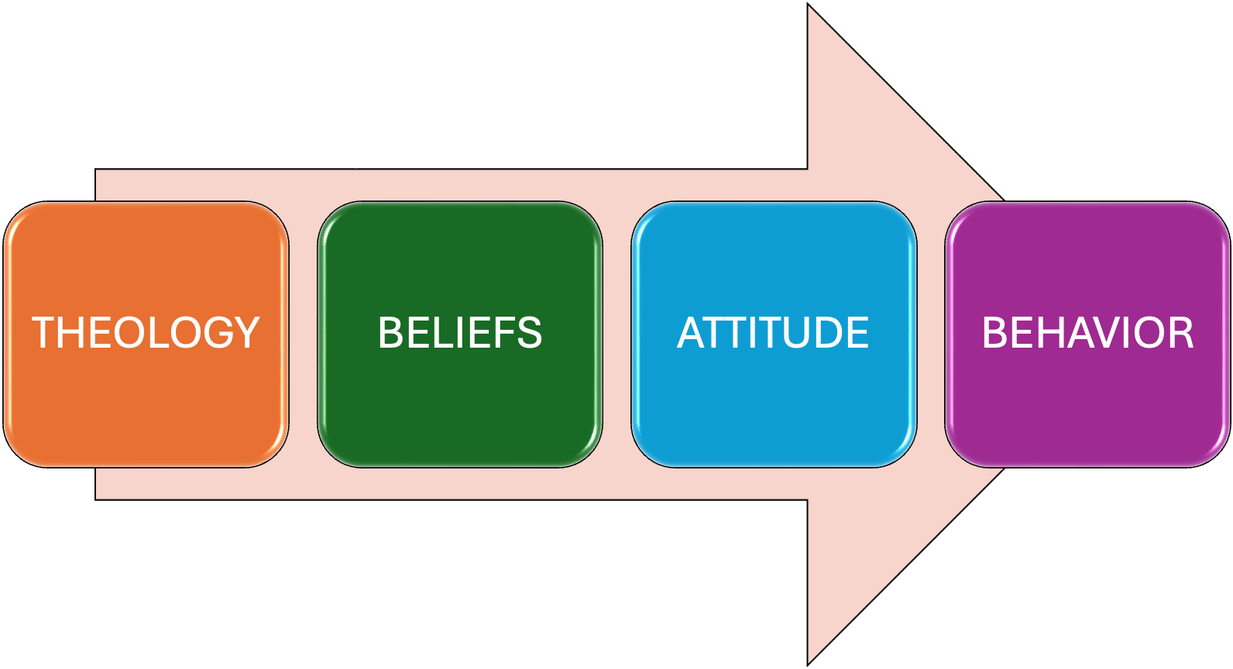
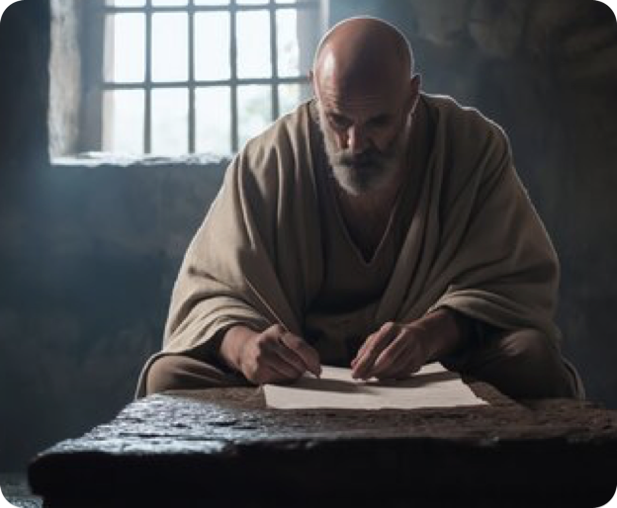
TRANSITIONING FROM DOCTRINAL > PRACTICAL
Our practice proceeds from our doctrinal beliefs.
Our sentiments, desires, affections, & attitudes are formed by the teachings of Jesus revealed through the Spirit - the mind of Christ.
Our DUTY is to maintain unity by developing the proper ATTITUDES and LIVING our lives according to the TRUTH.

Slide 3
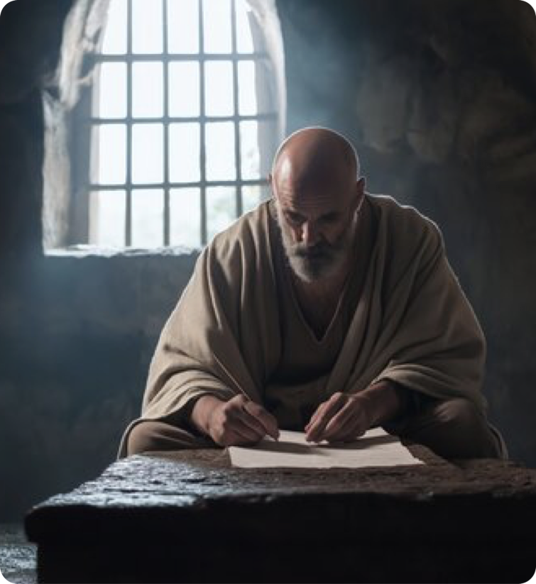

Living a life worthy of our calling
With godly attitudes (4:1-3).
United upon the truth (4:4-6).
Using Christ’s gifts to grow together (4:7-16).
Walking in true righteousness and holiness by putting of the old man with his evil deeds, and putting on the new man (4:17-32; cf. ; 1 Thes. 2:12).
Ephesians 4:1 (NKJV)
¹ I, therefore, the prisoner of the Lord, beseech you to walk worthy of the calling with which you were called,

Slide 4
Ephesians 4:17–32 (NKJV)
¹⁷ This I say, therefore, and testify in the Lord, that you should no longer walk as the rest of the Gentiles walk, in the futility of their mind, ¹⁸ having their understanding darkened, being alienated from the life of God, because of the ignorance that is in them, because of the blindness of their heart; ¹⁹ who, being past feeling, have given themselves over to lewdness, to work all uncleanness with greediness. ²⁰ But you have not so learned Christ, ²¹ if indeed you have heard Him and have been taught by Him, as the truth is in Jesus: ²² that you put off, concerning your former conduct, the old man which grows corrupt according to the deceitful lusts, ²³ and be renewed in the spirit of your mind, ²⁴ and that you put on the new man which was created according to God, in true righteousness and holiness.

Slide 5
Ephesians 4:17–32 (NKJV)
²⁵ Therefore, putting away lying, “Let each one of you speak truth with his neighbor,” for we are members of one another. ²⁶ “Be angry, and do not sin”: do not let the sun go down on your wrath, ²⁷ nor give place to the devil. ²⁸ Let him who stole steal no longer, but rather let him labor, working with his hands what is good, that he may have something to give him who has need. ²⁹ Let no corrupt word proceed out of your mouth, but what is good for necessary edification, that it may impart grace to the hearers. ³⁰ And do not grieve the Holy Spirit of God, by whom you were sealed for the day of redemption. ³¹ Let all bitterness, wrath, anger, clamor, and evil speaking be put away from you, with all malice. ³² And be kind to one another, tenderhearted, forgiving one another, even as God in Christ forgave you.

Slide 6

WALK IN THE LIGHT, NOT DARKNESS (4:17-24)
FORMER CORRUPTION (17-19)
“This I say, therefore” — Paul emphasizes the importance, urgency, and authority behind the charge he is about to give.
"and testify in the Lord” Paul calls Jesus Himself as witness to the truthfulness of these instructions, (1 Thes. 4:1, 2; 1 Tim. 5:21; 6:13; 2 Tim. 4:1).
Ephesians 4:17 (NKJV)
¹⁷ This I say, therefore, and testify in the Lord, that you should no longer walk as the rest of the Gentiles walk, in the futility of their mind,

Slide 7
WALK IN THE LIGHT, NOT DARKNESS (4:17-24)
FORMER CORRUPTION (17-19)
“that you should no longer walk…” — Cannot live like the nations who don’t know God (Eph. 2:2; 4:22).
“in the futility of their mind,” — the worthlessness of the thoughts and plans of those who do not know God (Ps. 94:8–11; Acts 14:15; Rom. 1:21; 8:20; Pet. 2:18).
Ephesians 4:17 (NKJV)
¹⁷ This I say, therefore, and testify in the Lord, that you should no longer walk as the rest of the Gentiles walk, in the futility of their mind,

Slide 8
WALK IN THE LIGHT, NOT DARKNESS (4:17-24)
FORMER CORRUPTION (17-19)
IF our thoughts are not based on God’s truth, what will our understanding produce? (Isa. 44:18–20; 46:5–8; Ac. 17:30; Rom. 1:21–23, 28; 2 Col. 4:4. Gal. 4:8).
The world’s darkness alienates us from the life God gives in Jesus (ch. 2:12. Ro. 8:7, 8. Ga. 4:8. Col. 1:21. 1 Thes. 4:5; John 8:32).
Ephesians 4:18 (NKJV)
¹⁸ having their understanding darkened, being alienated from the life of God, because of the ignorance that is in them, because of the blindness of their heart;

Slide 9
WALK IN THE LIGHT, NOT DARKNESS (4:17-24)
FORMER CORRUPTION (17-19)
“because of the ignorance that is in them (Hos. 4:6; Ro 1:19-21; 10:3)
“because of the blindness of their heart” (Rom. 1:21-23; Mat. 13:13-15; Isa. 6:9,10; Eze. 12:2).
Because they had “given themselves over to lewdness, to work all uncleanness with greediness” (vs. 19; Rom. 1:24-32)
Why was their understanding darkened, and thus alienated from God?

Slide 10
WALK IN THE LIGHT, NOT DARKNESS (4:17-24)
FORMER CORRUPTION (17-19)
"who, being past feeling," — Refers to losing all sensitivity to sin, shame, or right/wrong — spiritual apathy, having lost the ability to feel conviction, or shame for their immoral actions (1 Timothy 4:1-2).
Results from rejecting the truth in favor of lies, hypocrisy, and ignoring God’s call to repent.
Ephesians 4:19 (NKJV)
¹⁹ who, being past feeling, have given themselves over to lewdness, to work all uncleanness with greediness.

Slide 11
WALK IN THE LIGHT, NOT DARKNESS (4:17-24)
BE RENEWED IN YOUR MIND (20-24)
"But you did not learn Christ in this way” [NASB]
“if indeed you have heard Him and have been taught by Him”— must learn of Christ / Must obey Christ / become like Him (cf. Mat. 11:29; 28:19-20; Rom. 10:13-17)
“as the truth is in Jesus” (cf. John 8:31-32, 14:6).
Ephesians 4:20–21 (NKJV)
²⁰ But you have not so learned Christ, ²¹ if indeed you have heard Him and have been taught by Him, as the truth is in Jesus:

Slide 12
WALK IN THE LIGHT, NOT DARKNESS (4:17-24)
Ephesians 4:22-24 (NKJV)
²² that you put off, concerning your former conduct, the old man which grows corrupt according to the deceitful lusts, ²³ and be renewed in the spirit of your mind, ²⁴ and that you put on the new man which was created according to God, in true righteousness and holiness.
BE RENEWED IN YOUR MIND (20-24)
“that you put off … the old man” (former sinful conduct, which promises much, but delivers only corruption and ruin (cf. Col. 3:5-9)
"be renewed in the spirit of your mind” (cf. Rom. 12:1-2)
"put on the new man … in true righteousness and holiness” (cf. Col. 2:12,13; 3:10-17)

Slide 13
WHAT THE NEW MAN LOOKS LIKE (4:25-32)
NOT LIES, BUT TRUTH (25)
Old Man: As long as we are under Satan’s control, we will lie. The greatest lies are the lies we tell ourselves, (John 8:44; Acts 5:3; 13:10; 2 Cor. 11:3, 13–15).
New Man: Speaks truth to neighbors (Eph. 4:15, Col. 3:9), his “yes, is yes, and his no is no.” (Matthew 5:37; James 5:12)
Ephesians 4:25 (NKJV)
²⁵ Therefore, putting away lying, “Let each one of you speak truth with his neighbor,” for we are members of one another.

Slide 14

WHAT THE NEW MAN LOOKS LIKE (4:25-32)
NOT WRATH, BUT CONTROL (26)
Old Man: Lingers in anger or lets it control him / bitterness / hatred / vengeance (Eccl. 7:9; Jam. 1:19)
New Man: Resolves anger quickly, avoids sin (Psalm 4:4).
Anger, in itself is not sin (John 2:13-17), but we need to recognize the danger in anger?(Prov. 14:29; 16:32)
Ephesians 4:26–27 (NKJV)
²⁶ “Be angry, and do not sin”: do not let the sun go down on your wrath, ²⁷ nor give place to the devil.

Slide 15
WHAT THE NEW MAN LOOKS LIKE (4:25-32)
NOT STEALING, BUT WORKING (28)
Old Man: Willing to steal, and willing to justify his stealing, (Jno. 12:6), but God says do not steal (Ex. 20:15; Lev. 19:11; Deut. 5:19)
New Man: Works to provide for himself and help others in need as Jesus teaches (Acts 20:35; Rom. 13:9; 1 Cor. 4:12; Gal. 6:10; 1 Thes. 4:11,12; 2 Thes. 3:6–8,11,12).
Ephesians 4:28 (NKJV)
²⁸ Let him who stole steal no longer, but rather let him labor, working with his hands what is good, that he may have something to give him who has need.

Slide 16
WHAT THE NEW MAN LOOKS LIKE (4:25-32)
NOT CORRUPT WORDS, BUT WHOLESOME WORDS (29)
Old Man: Evil words, dirty words, careless words, hurtful words, useless words (Matt. 12:34; Eph. 5:4; Col. 3:8)
New Man: Speaks what is good, to uplift and edify — to IMPART GRACE to others (4:15; 1 Thess. 4:18; 5:11; Col. 3:16; 4:6).
Ephesians 4:29 (NKJV)
²⁹ Let no corrupt word proceed out of your mouth, but what is good for necessary edification, that it may impart grace to the hearers.

Slide 17
WHAT THE NEW MAN LOOKS LIKE (4:25-32)
Why This Matters (30-32)
Acting like the "old man" grieves the Holy Spirit (v. 30; cf. “Is it a small thing for you to weary men, but will you weary my God also?” Is 7:13; Eze 18:32; 33:11; 2 Pet 3:9)
We are sealed, (marked for identification / secured), by the Spirit for redemption (cf. 1:13-14; Ro. 8:11, 23; 2 Co. 1:22; 2 Ti. 2:19)
Ephesians 4:30 (NKJV)
³⁰ And do not grieve the Holy Spirit of God, by whom you were sealed for the day of redemption.

Slide 18
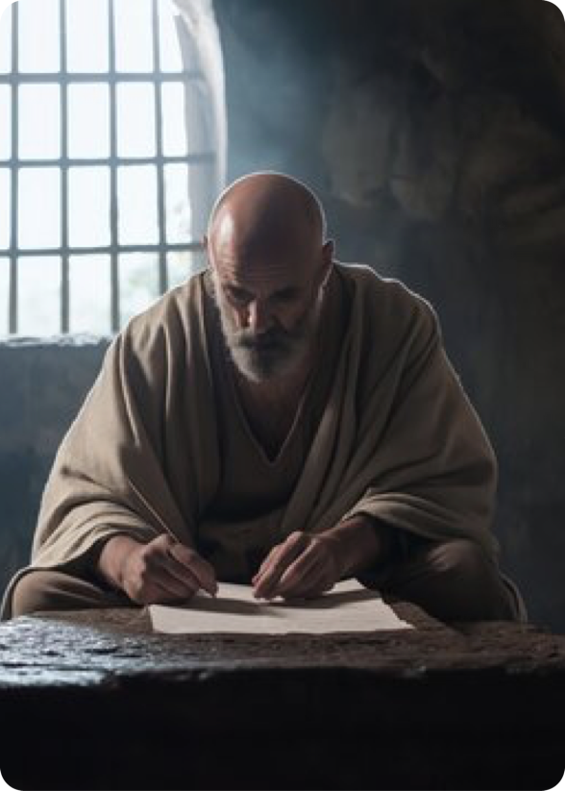

WHAT THE NEW MAN LOOKS LIKE (4:25-32)
PUT OFF
PUT ON
Ephesians 4:31 (NKJV)
³¹ Let all bitterness, wrath, anger, clamor, and evil speaking be put away from you, with all malice.
Ephesians 4:32 (NKJV)
³² And be kind to one another, tenderhearted, forgiving one another, even as God in Christ forgave you.

Slide 19
WHAT THE NEW MAN LOOKS LIKE (4:25-32)
PUT OFF
Colossians 3:9–10 (NKJV)
⁹ …since you have put off the old man with his deeds, ¹⁰ and have put on the new man who is renewed in knowledge according to the image of Him who created him,
Colossians 3:5–11 (NKJV)
⁵ Therefore put to death your members which are on the earth: fornication, uncleanness, passion, evil desire, and covetousness, which is idolatry. ⁶ Because of these things the wrath of God is coming upon the sons of disobedience, ⁷ in which you yourselves once walked when you lived in them. ⁸ But now you yourselves are to put off all these: anger, wrath, malice, blasphemy, filthy language out of your mouth. ⁹ Do not lie to one another, …

Slide 20
WHAT THE NEW MAN LOOKS LIKE (4:25-32)
PUT ON
Colossians 3:9–10 (NKJV)
⁹ …since you have put off the old man with his deeds, ¹⁰ and have put on the new man who is renewed in knowledge according to the image of Him who created him,
Colossians 3:12–15 (NKJV)
¹² Therefore, as the elect of God, holy and beloved, put on tender mercies, kindness, humility, meekness, longsuffering; ¹³ bearing with one another, and forgiving one another, if anyone has a complaint against another; even as Christ forgave you, so you also must do. ¹⁴ But above all these things put on love, which is the bond of perfection. ¹⁵ And let the peace of God rule in your hearts, to which also you were called in one body; and be thankful.

Slide 21

Conclusion – Impact of Walking in Truth and Holiness
Be salt of the earth and light of the world (Matt. 5:13-16, Phil. 2:14-16)
HUMILITY
UNITY
TRUTH
LOVE
Be Salt and Light
We should stand out as "a city on a hill" (Mat. 5:14-16)
We cannot influence the world if we are like the world (2 Cor. 6:14-7:1)
As a "holy temple," we must be different (1 Pet. 1:13-2:12)

Slide 22
Conclusion – Impact of Walking in Truth and Holiness
Be salt of the earth and light of the world (Matt. 5:13-16, Phil. 2:14-16)
HUMILITY
UNITY
TRUTH
LOVE
Be Salt and Light
What “old man” behaviors do I need to “put off?”
How can I actively “put on” the “new man” in my daily life?
WHAT DO I NEED TO CHANGE?
IN WHAT WAY WILL I LIVE DIFFERENTLY THIS WEEK?

Slide 23

HAVE YOU died to sin and PUT JESUS ON IN BAPTISM? (Acts 2:38; Romans 6:3-6; 19:1-5; Colossians 2:12,13; Galatians 3:26,27; 1 Peter 3:21)
IS THERE SIN IN YOUR LIFE YOU NEED TO PUBLICLY CONFESS? (1 John 1:7-9; Acts 8:18-24)

Slide 25
“Only let your conduct be worthy of the gospel of Christ, so that whether I come and see you or am absent, I may hear of your affairs, that you stand fast in one spirit, with one mind striving together for the faith of the gospel,”
Philippians 1:27 (NKJV)
Charts by Don McClain
Preached March 29, 2026 - Alexander church of Christ -
- Phone — 501-568-1062 — Email – donmcclain@sbcglobal.net
Prepared using Keynote / More Keynote, PPT & Audio Sermons:
www.alexanderchurchofchrist.com

Slide 26
Romans 12:1–3 (NKJV)
¹ I beseech you therefore, brethren, by the mercies of God, that you present your bodies a living sacrifice, holy, acceptable to God, which is your reasonable service. ² And do not be conformed to this world, but be transformed by the renewing of your mind, that you may prove what is that good and acceptable and perfect will of God. ³ For I say, through the grace given to me, to everyone who is among you, not to think of himself more highly than he ought to think, but to think soberly, as God has dealt to each one a measure of faith.

