Slide 1
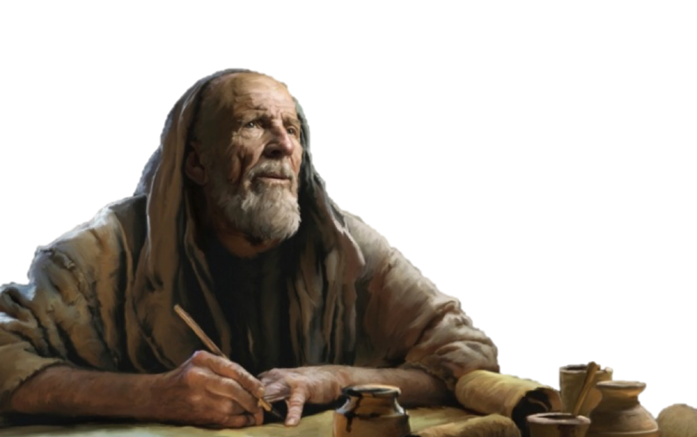


What Books Belong In The Bible?

Slide 2
What Books Belong In The Bible?
The question of how the canon of Scripture was formed is foundational to understanding the authority of the Bible.
This process, known as canonization, refers to the historical recognition by the church of which books were inspired by God and thus authoritative for the faith.

Slide 3
What Books Belong In The Bible?
INSPIRATION: Definition / Extent / Application
PRESERVATION: Manuscripts / Textual Criticism / Answering Critics
TRANSMISSION: Autographs / Copies / Canonization / Translations
EXTERNAL EVIDENCE: Historical & Archaeological testimony
INTERNAL EVIDENCE: Prophecy / Accuracy / Harmony

Slide 4
The BIBLE is by far the best attested book of antiquity!
Psalm 119:160 (NKJV)
¹⁶⁰ The entirety of Your word is truth, And every one of Your righteous judgments endures forever.

Slide 5
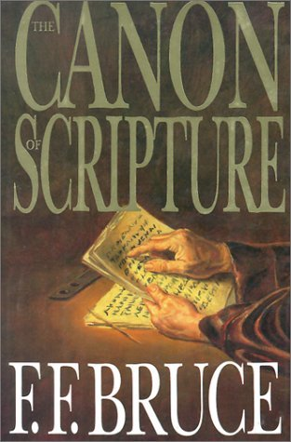
Canonization
QANAH (Hebrew) - a “reed, rod” (cf. Ezekiel 40: 3-8; 42:16-19).
KANNA (Greek) - “a straight rod used as a measuring rule,” thus qualifying it to be a KANON (Greek): “a rule, standard” (cp. Galatians 6:16).
CANON (Latin > English) - As applied to the Bible: “the list of sacred books acknowledged to be the rule (standard) of faith and practice”

Slide 6
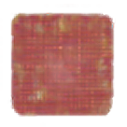
Canonization
CANON: a measuring rod.
SCRIPTURE: The list of books recognized as inspired and binding for faith and practice.
INCLUSION: Recognized over centuries as writings were composed, received, copied, read in worship, tested, and either kept or set aside.

Slide 7

The Old Testament Canon
The Hebrew Canon
24 Books divided into three sections
The Law, Prophets, & Writings
Same, identical content!
The Protestant Canon
39 Books divided into five sections
The Law, History, Poetry, Major Prophets, & Minor Prophets

Slide 8
The Old Testament Canon
While roughly 99% of the Old Testament was written in ancient Hebrew, 268 verses were originally written in Aramaic (Daniel 2:4b-7:28; Ezra 4:8–6:18 and 7:12–26; Jeremiah 10:11; Genesis 31:47).
By the 1st century A.D., Hebrew scripture was already widely circulated as a complete unit and found in synagogues throughout the Roman world.

Slide 9
The Old Testament Canon
They came to a close during the time of Artaxerxes.
Established among the Jews well before the time of Christ.
God entrusted the Jews with His word (Romans 3:2).
They knew what belonged in the Hebrew canon.

Slide 10
The Old Testament Canon
The Roman Catholic Bible contains 7 more books for a total of 46:
Wisdom of Solomon, Sirach, Baruch, (Epistle of Jeremiah), Additions to Daniel (Susanna, Bel and the Dragon), Tobit, Judith, Additions to Esther, First & Second Macabees,

Slide 11
The Old Testament Canon
From the 3rd century BCE, Jews in Egypt translated Scripture into Greek.
The Septuagint—included the Hebrew books plus additional writings circulating in Greek.
The mainstream Jewish communities in antiquity did not generally view the additional LXX books as divinely inspired.

Slide 12
The Old Testament Canon
“We do not possess myriads of inconsistent books… Our books, those which are justly accredited, are but twenty-two… five are the books of Moses… from the death of Moses until Artaxerxes the prophets wrote in thirteen books. The remaining four contain hymns to God and precepts for human life.
From Artaxerxes to our own time history has been written, but has not been deemed worthy of equal credit… because of the failure of the exact succession of the prophets.”
This quote is from Against Apion (Book 1, Paragraph 8 / Sections 37–42).

Slide 13
The Old Testament Canon
He spoke of it as one unit:
Matthew 22:37–40 (NKJV)
³⁷ Jesus said to him, “ ‘You shall love the Lord your God with all your heart, with all your soul, and with all your mind.’ ³⁸ This is the first and great commandment. ³⁹ And the second is like it: ‘You shall love your neighbor as yourself.’ ⁴⁰ On these two commandments hang all the Law and the Prophets.”

Slide 14
The Old Testament Canon
He spoke of it as one unit:
Luke 24:44–45 (NKJV)
⁴⁴ Then He said to them, “These are the words which I spoke to you while I was still with you, that all things must be fulfilled which were written in the Law of Moses and the Prophets and the Psalms concerning Me.” ⁴⁵ And He opened their understanding, that they might comprehend the Scriptures.

Slide 15
The Old Testament Canon
Jesus referred to the OT as an identifiable body of text (Matthew 5:17; 7:12; 11:13; 22:40; 26:56; Luke 16:16,29,31; 24:27,44; John 5:45-47; 7:19).
Jesus did not quote from every OT book, but He did quote from all three divisions – The Law, [Torah], The Prophets, [Nebhiim], The Writings, [Kethubhim].

Slide 16
The Old Testament Canon
Jesus did not dispute the books of the Hebrew canon with the Jews.
In fact he urged them to read, believe, and follow the Scriptures they had as authoritative for truth.

Slide 17
The Old Testament Canon
He used the authoritative phrase, “It is written” (Matthew 4:4,7,10; 21:13; 26:24,31; Mark 7:6; 9:12,13; 11:17; 14:21,27; Luke 4:4,8; 7:27; 10:26; 18:31; 19:46; 20:17; 21:22; 22:37; 24:44,46; John 6:45; 8:17; 10:34; 15:25).
He rebuked the Jews for their ignorance when they did not know the scriptures (Matthew 22:29-32).

Slide 18
The Old Testament Canon
Jesus referenced the following books: Genesis, Exodus, Leviticus, Numbers, Deuteronomy, 1 Samuel, 1 Kings, 2 Kings, 2 Chronicles, Psalms, Isaiah, Jeremiah, Daniel, Hosea, Joel, Jonah, Micah, Zechariah, and Malachi.
He referred to the Hebrew Scriptures at least 82 times

Slide 19
The Old Testament Canon
He spoke of these Old Testament people by name: Adam, Eve, Abel, Noah, Abraham, Isaac, Jacob, Lot’s wife, Moses, David, Solomon, Elijah, Elisha, Jonah, Isaiah, Zechariah, Daniel.
He spoke of the prophets as a group of inspired men.

Slide 20

The Old Testament Canon
Paul acknowledged the Hebrew canon as:
Written for our learning
(Romans 15:4)
Written for our admonition
(1 Corintians 10:11)
Profitable for doctrine
(2 Timothy 3:14-17)

Slide 21

The Old Testament Canon
The apostles and New Testament writers frequently quoted the LXX, but their quotes were from the books found in the Hebrew canon
Books “MOST” Quoted in the NT:
Isaiah, 419 in 23 books.
Psalms, 414 times in 23 books
Genesis, 260 times in 21 books.
Exodus, 250 times in 19 books.
Deuteronomy, 208 times in 21 books.
Ezekiel, 141 times in 15 books.
Daniel, 133 times in 17 books.
Jeremiah, 125 times in 17 books.
Leviticus, 107 times in 15 books
Numbers, 73 times in 4 books.

Slide 22
What About The Apocrypha
Apocrypha (“hidden”) — usual Protestant term (Athanasius — “apocrypha” means heretical forgeries).
Deuterocanonical (“second canon”) — Catholic term, meaning second in time of universal reception, not second in dignity in official Catholic teaching.

Slide 23
What About The Apocrypha
Apocrypha Book | Type / Theme or Content | App. date
Tobit | Pious story: almsgiving, angels, marriage | 200 B.C.
Judith | Tale of a heroine who saves Israel | 150 B.C.
Wisdom of Solomon | Greek wisdom theology | 30 B.C.
Sirach (Ecclesiasticus) | Hebrew wisdom, translated into Greek | 132 B.C
Baruch + Letter of Jeremiah | Prayer and polemic against idols | 150-50 B.C.
1 & 2 Maccabees | History of the Jewish revolt / Theological history; prayers for the dead | 110 B.C.
Additions to Esther | Greek expansions (10:4-16:24) | 140-130 B.C.
Additions to Daniel | Prayer of Azariah, Song of the Three, (3:24-90); Susanna, (13); Bel and the Dragon (14) | 100 B.C.
Prayer of Manasseh | Prayer of deep repentance, request for divine mercy. | 100 B.C.

Slide 24
What About The Apocrypha

Slide 25
What About The Apocrypha
Why Reject The Apocrypha:
Never sanctioned or quoted by Jesus, the apostles, nor any NT writer.
Never part of the Hebrew canon; They were not in the collection Josephus treated as uniquely authoritative, nor in the rabbinic Tanakh. “The Jews were entrusted with the oracles of God” (Romans 3:2).
Recognized as works of men, not God.

Slide 26
What About The Apocrypha
Why Reject The Apocrypha:
Rejected by the early “church fathers.”
It wasn’t until the fourth century A.D. that the apocryphal books were placed alongside canonical books as books helpful to read, (397), but not considered equal to Scripture.
The Roman Catholic church elevated them to canonicity during the Council of Trent (1546).
They contain historical inaccuracies and teachings inconsistent with God’s word.

Slide 27
What About The Apocrypha
Why Reject The Apocrypha:
Their inclusion provided the Catholic church with texts to support their false doctrines which lacked support in (and contradicted by) the other books.
Realizing all of this, we must do what so many have done (including many Catholics in the past) and reject these extra books as uninspired works of men (cf. Revelation 22:18-19).

Slide 28
The Criteria For Canonical Books
OLD TESTAMENT
Recognition within Israel as sacred Scripture.
Origin in the period when prophecy was understood to be active (Josephus’s “succession of prophets”).
Acknowledged by Jesus and the apostles as being from God
Consistency with already recognized Scripture.

Slide 29
The Criteria For Canonical Books
An inspired book should reflect the characteristics of God, (omniscient, omnipotent, omnipresent) in such ways as fulfilled prophecy and accurate statements with regard to geography, astronomy, science, math, psychology, and all areas of knowledge to the extent that it makes reference to these.
If God is the Creator of both the world and man, He could not make an inaccurate statement about them.

Slide 30
The Criteria For Canonical Books
Written by an inspired man.
For the purpose of instructing the people of God.
Recognized by the people of God as authoritative at the time.
Inherent and true.
Preserved by the providence of God.

Slide 31
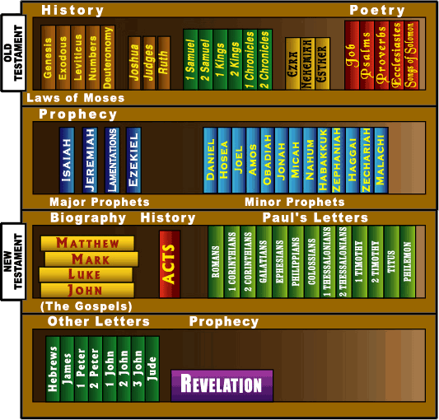

Slide 32
Don McClain
W. 65th St church of Christ - 8/14/2005

Slide 33
What Books Belong In The Bible?
Preached November 18, 2012 West 65th Street church of Christ
Preached September 27, 2026, Alexander church of Christ
501-568-1062
Prepared using PPT 2010
Email – donmcclain@sbcglobal.net
More PPT & Audio Sermons:
www.alexanderchurchofchrist.com
00H_WHAT_BOOKS_BELONG_IN_THE_BIBLE.key

