Slide 1
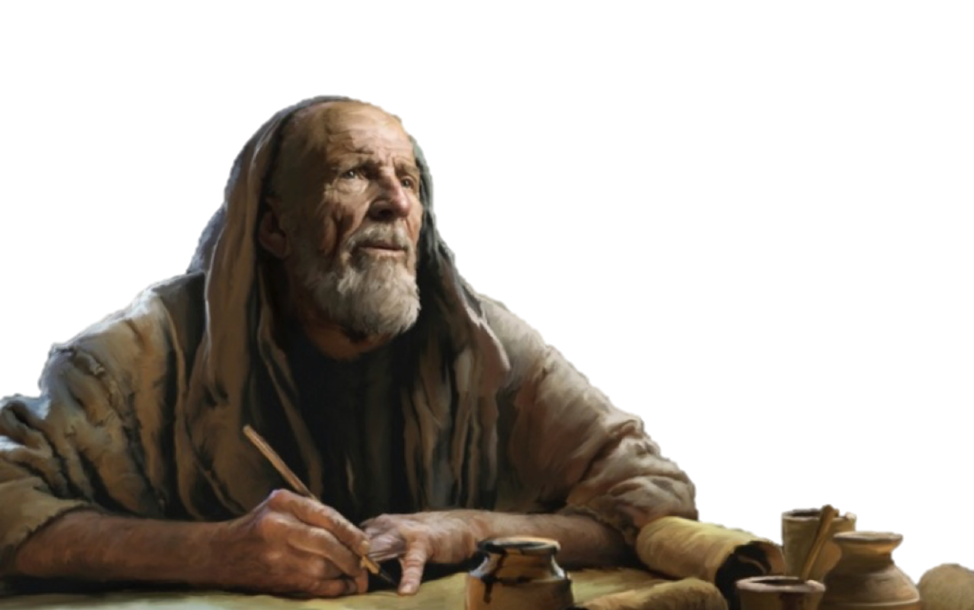


What Books Belong In The Bible?

Slide 2
What Books Belong In The Bible?
The question of how the canon of Scripture was formed is foundational to understanding the authority of the Bible.
This process, known as canonization, refers to the historical recognition by the church of which books were inspired by God and thus authoritative for the faith.

Slide 3
What Books Belong In The Bible?
INSPIRATION: Definition / Extent / Application
PRESERVATION: Manuscripts / Textual Criticism / Answering Critics
TRANSMISSION: Autographs / Copies / Canonization / Translations
EXTERNAL EVIDENCE: Historical & Archaeological testimony
INTERNAL EVIDENCE: Prophecy / Accuracy / Harmony

Slide 4



The Bible Under Attack
  Education
  Naturalistic materialism rules the day in academia.
  Incapable of true reason & logic due to the acceptance of pseudo “reason” and “logic.”
  A populace conditioned to reject traditional values and “FAITH.”

Slide 5
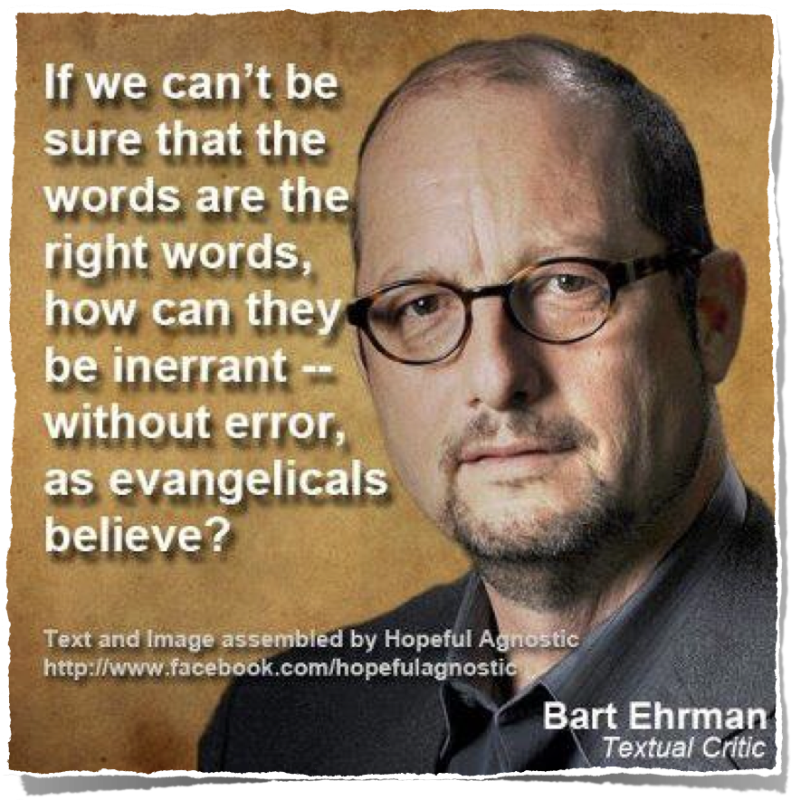
The Bible Under Attack
  The growing militance of the modern skeptic
  Technology / spread & availability of information / saturation of false & skewed information

Slide 6
The BIBLE is by far the best attested book of antiquity!
Psalm 119:160 (NKJV)
¹⁶⁰ The entirety of Your word is truth, And every one of Your righteous judgments endures forever.

Slide 7
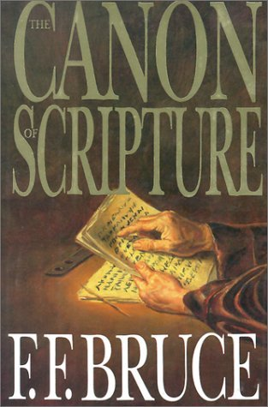
Canonization
QANAH (Hebrew) - a “reed, rod” (cf. Ezekiel 40: 3-8; 42:16-19).
KANNA (Greek) - “a straight rod used as a measuring rule,” thus qualifying it to be a KANON (Greek): “a rule, standard” (cp. Galatians 6:16).
CANON (Latin > English) - As applied to the Bible: “the list of sacred books acknowledged to be the rule (standard) of faith and practice”

Slide 8
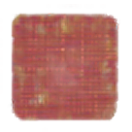
Canonization
CANON: a measuring rod.
SCRIPTURE: The list of books recognized as inspired and binding for faith and practice.
INCLUSION: Recognized over centuries as writings were composed, received, copied, read in worship, tested, and either kept or set aside.

Slide 9

The Old Testament Canon
The Hebrew Canon
24 Books divided into three sections
The Law, Prophets, & Writings
Same, identical content!
The Protestant Canon
39 Books divided into five sections
The Law, History, Poetry, Major Prophets, & Minor Prophets

Slide 10
The Old Testament Canon
While roughly 99% of the Old Testament was written in ancient Hebrew, 268 verses were originally written in Aramaic (Daniel 2:4b-7:28; Ezra 4:8–6:18 and 7:12–26; Jeremiah 10:11; Genesis 31:47).
By the 1st century A.D., Hebrew scripture was already widely circulated as a complete unit and found in synagogues throughout the Roman world.

Slide 11
The Old Testament Canon
They came to a close during the time of Artaxerxes.
Established among the Jews well before the time of Christ.
God entrusted the Jews with His word (Romans 3:2).
They knew what belonged in the Hebrew canon.

Slide 12
The Old Testament Canon
The Roman Catholic Bible contains 7 more books for a total of 46:
Wisdom of Solomon, Sirach, Baruch, (Epistle of Jeremiah), Additions to Daniel (Susanna, Bel and the Dragon), Tobit, Judith, Additions to Esther, First & Second Macabees,

Slide 13
The Old Testament Canon
From the 3rd century BCE, Jews in Egypt translated Scripture into Greek.
The Septuagint—included the Hebrew books plus additional writings circulating in Greek.
The mainstream Jewish communities in antiquity did not generally view the additional LXX books as divinely inspired.

Slide 14
The Old Testament Canon
“We do not possess myriads of inconsistent books… Our books, those which are justly accredited, are but twenty-two… five are the books of Moses… from the death of Moses until Artaxerxes the prophets wrote in thirteen books. The remaining four contain hymns to God and precepts for human life.
From Artaxerxes to our own time history has been written, but has not been deemed worthy of equal credit… because of the failure of the exact succession of the prophets.”
This quote is from Against Apion (Book 1, Paragraph 8 / Sections 37–42).

Slide 15
The Old Testament Canon
He spoke of it as one unit:
Matthew 22:37–40 (NKJV)
³⁷ Jesus said to him, “ ‘You shall love the Lord your God with all your heart, with all your soul, and with all your mind.’ ³⁸ This is the first and great commandment. ³⁹ And the second is like it: ‘You shall love your neighbor as yourself.’ ⁴⁰ On these two commandments hang all the Law and the Prophets.”

Slide 16
The Old Testament Canon
He spoke of it as one unit:
Luke 24:44–45 (NKJV)
⁴⁴ Then He said to them, “These are the words which I spoke to you while I was still with you, that all things must be fulfilled which were written in the Law of Moses and the Prophets and the Psalms concerning Me.” ⁴⁵ And He opened their understanding, that they might comprehend the Scriptures.

Slide 17
The Old Testament Canon
Jesus referred to the OT as an identifiable body of text (Matthew 5:17; 7:12; 11:13; 22:40; 26:56; Luke 16:16,29,31; 24:27,44; John 5:45-47; 7:19).
Jesus did not quote from every OT book, but He did quote from all three divisions – The Law, [Torah], The Prophets, [Nebhiim], The Writings, [Kethubhim].

Slide 18
The Old Testament Canon
Jesus did not dispute the books of the Hebrew canon with the Jews.
In fact he urged them to read, believe, and follow the Scriptures they had as authoritative for truth.

Slide 19
The Old Testament Canon
He used the authoritative phrase, “It is written” (Matthew 4:4,7,10; 21:13; 26:24,31; Mark 7:6; 9:12,13; 11:17; 14:21,27; Luke 4:4,8; 7:27; 10:26; 18:31; 19:46; 20:17; 21:22; 22:37; 24:44,46; John 6:45; 8:17; 10:34; 15:25).
He rebuked the Jews for their ignorance when they did not know the scriptures (Matthew 22:29-32).

Slide 20
The Old Testament Canon
Jesus referenced the following books: Genesis, Exodus, Leviticus, Numbers, Deuteronomy, 1 Samuel, 1 Kings, 2 Kings, 2 Chronicles, Psalms, Isaiah, Jeremiah, Daniel, Hosea, Joel, Jonah, Micah, Zechariah, and Malachi.
He referred to the Hebrew Scriptures at least 82 times

Slide 21
The Old Testament Canon
He spoke of these Old Testament people by name: Adam, Eve, Abel, Noah, Abraham, Isaac, Jacob, Lot’s wife, Moses, David, Solomon, Elijah, Elisha, Jonah, Isaiah, Zechariah, Daniel.
He spoke of the prophets as a group of inspired men.

Slide 22

The Old Testament Canon
Paul acknowledged the Hebrew canon as:
Written for our learning
(Romans 15:4)
Written for our admonition
(1 Corintians 10:11)
Profitable for doctrine
(2 Timothy 3:14-17)

Slide 23

The Old Testament Canon
The apostles and New Testament writers frequently quoted the LXX, but their quotes were from the books found in the Hebrew canon
Books “MOST” Quoted in the NT:
Isaiah, 419 in 23 books.
Psalms, 414 times in 23 books
Genesis, 260 times in 21 books.
Exodus, 250 times in 19 books.
Deuteronomy, 208 times in 21 books.
Ezekiel, 141 times in 15 books.
Daniel, 133 times in 17 books.
Jeremiah, 125 times in 17 books.
Leviticus, 107 times in 15 books
Numbers, 73 times in 4 books.

Slide 24
What About The Apocrypha
Apocrypha (“hidden”) — usual Protestant term (Athanasius — “apocrypha” means heretical forgeries).
Deuterocanonical (“second canon”) — Catholic term, meaning second in time of universal reception, not second in dignity in official Catholic teaching.

Slide 25
What About The Apocrypha
Apocrypha Book | Type / Theme or Content | App. date
Tobit | Pious story: almsgiving, angels, marriage | 200 B.C.
Judith | Tale of a heroine who saves Israel | 150 B.C.
Wisdom of Solomon | Greek wisdom theology | 30 B.C.
Sirach (Ecclesiasticus) | Hebrew wisdom, translated into Greek | 132 B.C
Baruch + Letter of Jeremiah | Prayer and polemic against idols | 150-50 B.C.
1 & 2 Maccabees | History of the Jewish revolt / Theological history; prayers for the dead | 110 B.C.
Additions to Esther | Greek expansions (10:4-16:24) | 140-130 B.C.
Additions to Daniel | Prayer of Azariah, Song of the Three, (3:24-90); Susanna, (13); Bel and the Dragon (14) | 100 B.C.
Prayer of Manasseh | Prayer of deep repentance, request for divine mercy. | 100 B.C.

Slide 26
What About The Apocrypha

Slide 27
What About The Apocrypha
Why Reject The Apocrypha:
Never sanctioned or quoted by Jesus, the apostles, nor any NT writer.
Never part of the Hebrew canon; They were not in the collection Josephus treated as uniquely authoritative, nor in the rabbinic Tanakh. “The Jews were entrusted with the oracles of God” (Romans 3:2).
Recognized as works of men, not God.

Slide 28
What About The Apocrypha
Why Reject The Apocrypha:
Rejected by the early “church fathers.”
It wasn’t until the fourth century A.D. that the apocryphal books were placed alongside canonical books as books helpful to read, (397), but not considered equal to Scripture.
The Roman Catholic church elevated them to canonicity during the Council of Trent (1546).
They contain historical inaccuracies and teachings inconsistent with God’s word.

Slide 29
What About The Apocrypha
Why Reject The Apocrypha:
Their inclusion provided the Catholic church with texts to support their false doctrines which lacked support in (and contradicted by) the other books.
Realizing all of this, we must do what so many have done (including many Catholics in the past) and reject these extra books as uninspired works of men (cf. Revelation 22:18-19).

Slide 30
The Criteria For Canonical Books
OLD TESTAMENT
Recognition within Israel as sacred Scripture.
Origin in the period when prophecy was understood to be active (Josephus’s “succession of prophets”).
Acknowledged by Jesus and the apostles as being from God
Consistency with already recognized Scripture.

Slide 31
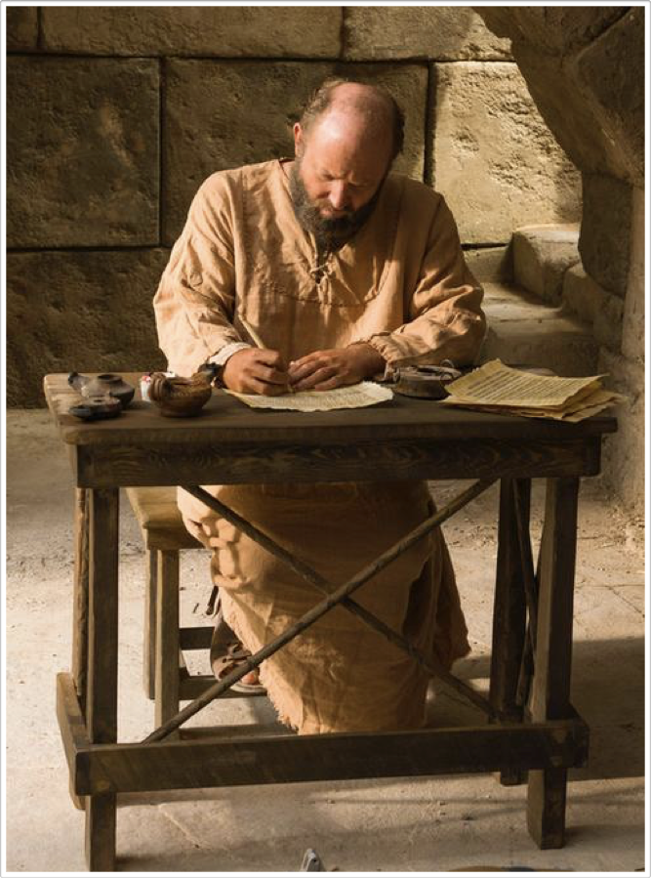
The New Testament Canon
Liberal scholars claim much of the NT wasn’t written until the late second or early third century A.D.
Assertion that the Roman Catholic Church decided the legitimacy of the NT books in the late fourth century A.D.
After each book of the NT was written, it was circulated and read among Christians and considered authoritative (Col 4:16; 1 Thes 5:27).

Slide 32
Manuscript | Date | Contents
John Rylands | 125-130 in Egypt | John 18:31-33,37
Bodmer Papyrus | 150-200 | First 14 chapters of John
Chester Beaty Papyri | 200 | Major portions of N.T. Matthew-Acts, Epistles of Paul to churches, Hebrews, Revelation
Codex Vaticanus | 325-350 | Most N.T. through Hebrews
Codex Sinaiticus | 350 | Entire N.T. & large portions of Greek O.T.
Codex Alexandrinus | 400 | Greek O.T. & most of N.T.

Slide 33
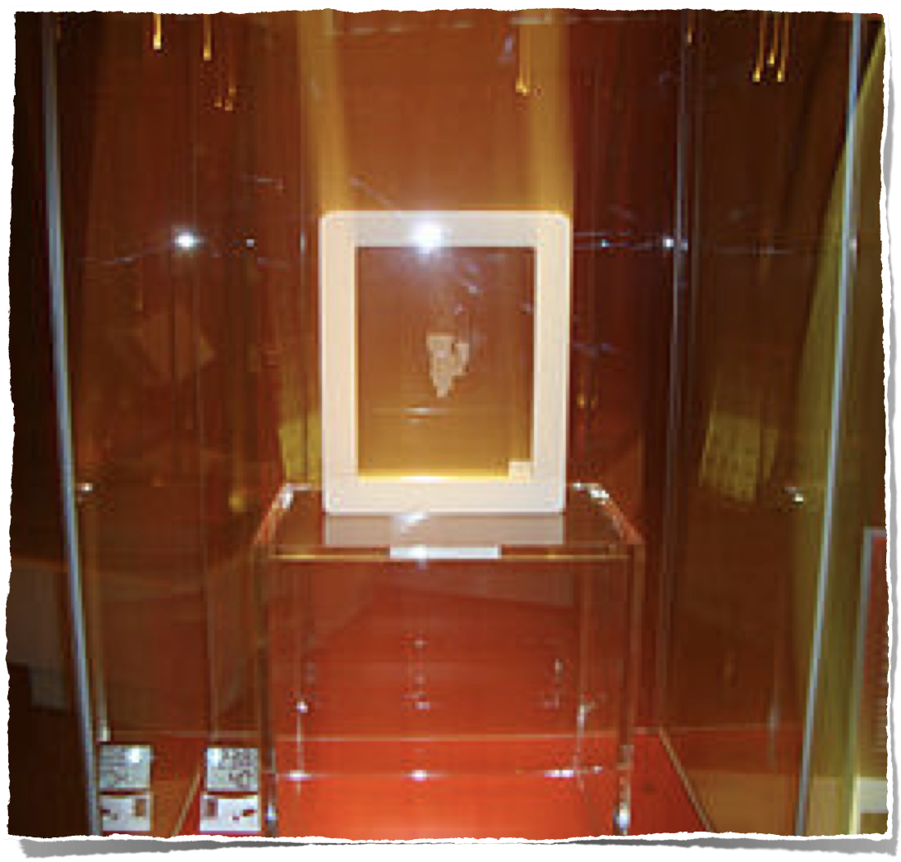
The New Testament Canon
Rylands Library Papyrus P52, also known as the St. John's fragment - 125-130 AD - Egypt
http://en.wikipedia.org/wiki/Rylands_Library_Papyrus_P52

Slide 34
Gospel of John 18:31-33 (recto)
ΟΙ ΙΟΥΔΑΙΟΙ ΗΜΕIΝ ΟΥΚ ΕΞΕΣΤΙΝ ΑΠΟΚΤΕΙΝΑΙ
OYΔΕΝΑ ΙΝΑ Ο ΛΟΓΟΣ ΤΟΥ ΙΗΣΟΥ ΠΛΗΡΩΘΗ ΟΝ ΕΙ-
ΠΕΝ ΣHΜΑΙΝΩΝ ΠΟΙΩ ΘΑΝΑΤΩ ΗΜΕΛΛΕΝ ΑΠΟ-
ΘΝHΣΚΕΙΝ ΙΣΗΛΘΕΝ ΟΥΝ ΠΑΛΙΝ ΕΙΣ ΤΟ ΠΡΑΙΤΩ-
ΡΙΟΝ Ο ΠIΛΑΤΟΣ ΚΑΙ ΕΦΩΝΗΣΕΝ ΤΟΝ ΙΗΣΟΥΝ
ΚΑΙ ΕΙΠΕΝ ΑΥΤΩ ΣΥ ΕΙ O ΒΑΣΙΛΕΥΣ ΤΩΝ ΙΟΥ-
ΔAΙΩN
the Jews, "For us it is not permitted to kill
anyone," so that the word of Jesus might be fulfilled, which he sp-
oke signifying what kind of death he was going to
die. Entered therefore again into the Praeto-
rium Pilate and summoned Jesus
and said to him, "Thou art king of the
Jews?"
http://en.wikipedia.org/wiki/Rylands_Library_Papyrus_P52

Slide 35
Gospel of John 18:37-38 (verso)
ΒΑΣΙΛΕΥΣ ΕΙΜΙ ΕΓΩ ΕΙΣ TOΥΤΟ ΓΕΓΕΝΝΗΜΑΙ
ΚΑΙ (ΕΙΣ ΤΟΥΤΟ) ΕΛΗΛΥΘΑ ΕΙΣ ΤΟΝ ΚΟΣΜΟΝ ΙΝΑ ΜΑΡΤY-
ΡΗΣΩ ΤΗ ΑΛΗΘΕΙΑ ΠΑΣ Ο ΩΝ EΚ ΤΗΣ ΑΛΗΘΕI-
ΑΣ ΑΚΟΥΕΙ ΜΟΥ ΤΗΣ ΦΩΝΗΣ ΛΕΓΕΙ ΑΥΤΩ
Ο ΠΙΛΑΤΟΣ ΤΙ ΕΣΤΙΝ ΑΛΗΘΕΙΑ ΚAΙ ΤΟΥΤO
ΕΙΠΩΝ ΠΑΛΙΝ ΕΞΗΛΘΕΝ ΠΡΟΣ ΤΟΥΣ ΙΟΥ-
ΔΑΙΟΥΣ ΚΑΙ ΛΕΓΕΙ ΑΥΤΟΙΣ ΕΓΩ ΟΥΔEΜΙΑΝ
ΕΥΡΙΣΚΩ ΕΝ ΑΥΤΩ ΑΙΤΙΑΝ
a King I am. For this I have been born
and (for this) I have come into the world so that I would test-
ify to the truth. Everyone who is of the truth
hears of me my voice." Said to him
Pilate, "What is truth?" and this
having said, again he went out unto the Jews
and said to them, "I find not one
fault in him."
http://en.wikipedia.org/wiki/Rylands_Library_Papyrus_P52

Slide 36

The New Testament Canon
  Church "Fathers" – ca. 36,000 citations –
  Apologists and text critics claim that we can reconstruct approximately 60% to 70% of the New Testament text from the first four centuries alone.

Slide 37
Writer | Gospels | Acts | Pauline Epistles | General Epistles | Revelation | Total
Justin Martyr | 268 | 10 | 43 | 6 | 3 | 330
Irenaeus | 1,038 | 194 | 499 | 23 | 65 | 1,819
Clement Alex. | 1,017 | 44 | 1,127 | 207 | 11 | 2,406
Origen | 9,231 | 349 | 7,778 | 399 | 165 | 17,922
Tertullian | 3,822 | 502 | 2,609 | 120 | 205 | 7,258
Hippolytus | 734 | 42 | 387 | 27 | 188 | 1,378
Eusebius | 3,258 | 211 | 1,592 | 88 | 27 | 5,176
Totals | 19,368 | 1,352 | 14,035 | 870 | 664 | 36,289

Slide 38
The New Testament Canon
The New Testament canon did not emerge from a single council vote.
It emerged from the recognition of writings that were already functioning as Scripture in the churches for 200 + years.
By the middle of the second century a solid core was widely known and used.
By the late fourth century the precise 27-book collection had become the common list of most of the church.

Slide 39
The New Testament Canon
Clement of Rome (ca. A.D. 30-100).
Ignatius of Antioch (ca. A.D. 30-115).
Polycarp (ca. A.D. 69-155)
Papias (ca. A.D. 70-140)
Marcion [Gnostic] (ca. A.D. 144)
Justin Martyr (ca. A.D. 100-165)
The Muratorian Canon (A.D. 170)
Theophilus (ca. A.D. 115-188)
First and Second Century witnesses to the spreading of the written word:

Slide 40
The New Testament Canon
Irenaeus (ca. A.D. 140-203)
Tertullian (ca. A.D. 150-222)
Clement of Alexander (ca. A.D. 155-215).
Origen (ca. A.D. 185-254)
Second and Third Century witnesses to the spreading of the written word:
Their testimony shows that the NT books were widely circulated, read, and in general use among churches not long after they were written.

Slide 41
The New Testament Canon
Date | Event
45-96 A.D. | Books of the New Testament written
2nd century | Codex (modern form factor) of books developed
110 A.D. | Papias refers to the Gospels of Mark & Matthew
125 A.D. | Earliest extant fragment of N.T. (John 18:38)
140 A.D. | Gnostic Marcion attempts first canonical list
150 A.D. | Justin Martyr refers to Christians gathering together and "the memoirs of the Apostles or the writings of the prophets are read, as time permits"

Slide 42
The New Testament Canon
Date | Event
160 A.D. | Tatian compiles a "harmony" of the four gospels, called the "Diatessaron"
180 A.D. | Christian prisoners in Scilla, Libya, refer to "the books, and letters of a just man, one Paul" as their defense
200 A.D. | Muratori Canon compiled
324 A.D. | Constantine becomes undisputed emperor of the Roman Empire

Slide 43
The New Testament Canon
Date | Event
325 A.D. | Council of Nicea; Eusebius writes his Church History
332 A.D. | Bishop Eusebius of Caesarea is ordered by Constantine to create 50 volumes "on prepared parchment" of the Holy Scriptures.
325 - 350 A.D. | Codex Vaticanus created; contains the complete New Testament as we have it today.
350 A.D. | Codex Sinaiticus written; (now in the British Museum) contains most of modern day New Testament, plus the Shepherd of Hermas, and the Letter of Barnabas.

Slide 44
The New Testament Canon
Date | Event
367 A.D. | Athanasius, Bishop of Alexandria, writes his Paschal letter, listing the modern day New Testament canon
393 A.D. | Council of Hippo affirms modern day canon
397 A.D. | Council of Carthage affirms modern day canon
400 A.D. | Jerome (A.D. 346-420) translates Bible into common Latin (the "Vulgate"), using the list of Athanasius

Slide 45
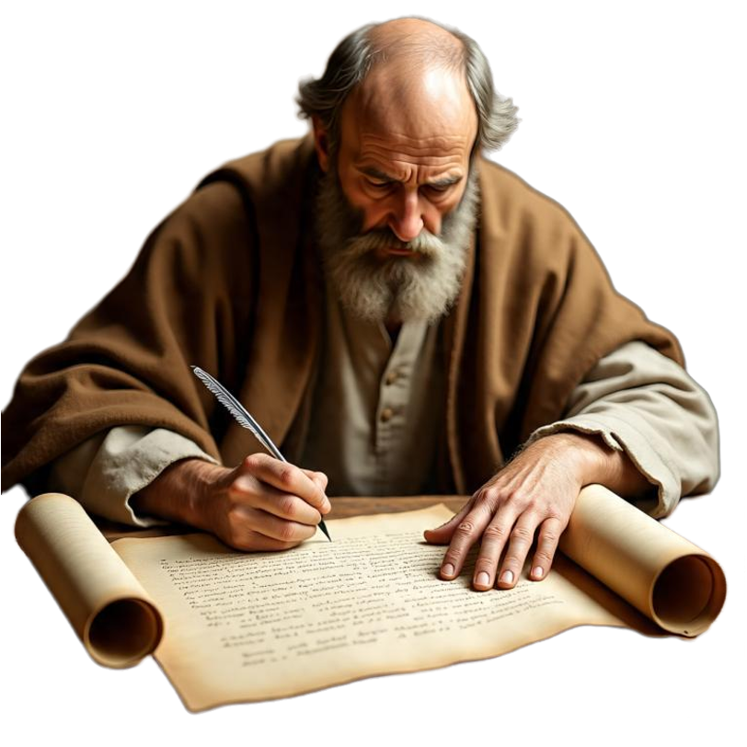
The undisputed core (very widespread by 150–180 AD.)
The four Gospels
Acts of the Apostles
13 Pauline letters (Romans–Philemon)
1 Peter
1 John

Slide 46
The undisputed core (very widespread by 150–180 AD.)
These books were known, copied, read in worship, and treated as Scripture across major centers (Rome, Asia Minor, Egypt, North Africa, Syria)
Their is widespread evidence they were universally accepted well before any formal list.

Slide 47
The undisputed core (very widespread by 150–180 AD.)
Evidence of circulation and authority
Justin Martyr (c. 150–160) the “memoirs of the apostles” being read publicly.
Irenaeus (c. 180) insists there must be exactly 4 Gospels / cites most of the later New Testament as Scripture.
The Muratorian Fragment (commonly dated c. 170–200) lists the 4 Gospels, Acts, thirteen Pauline letters, Jude, two letters of John, and Revelation.

Slide 48

Undisputed Core (universal / scripture / 150–180 AD.)
Evidence of circulation and authority
Early manuscripts confirm physical circulation:
P52 (John 18), Egypt, c. 125–150
P46 (Pauline letters + Hebrews), Egypt, c. 175–225
P45 (four Gospels + Acts), Egypt, early-to-mid 3rd century

Slide 49
Peripheral Books (known & used but not yet universal)
These books were not unknown.
Origen (early–mid 3rd century) knows and cites all of them, while frankly noting that some churches still question James, 2 Peter, 2–3 John, and (in places) Revelation.
Eusebius (c. 325) classifies them as “disputed, but familiar to the majority.”

Slide 50
The New Testament Canon
Eusebius’s categories (Ecclesiastical History 3.25, c. 325)
Homologoumena (universally acknowledged): 4 Gospels, Acts, Pauline letters, 1 John, 1 Peter; Revelation “if it seem proper.”
Antilegomena (disputed but known to most): James, Jude, 2 Peter, 2 & 3 John.
Spurious / rejected: Shepherd of Hermas, Barnabas, Apocalypse of Peter, Acts of Paul, Gospel of Peter, Gospel of Thomas, etc.

Slide 51
The New Testament Canon
The antilegomena were never placed in the same category as the heretical or clearly non-apostolic books.
Churches that accepted them treated them as Scripture; churches that hesitated usually did so because of questions of authorship or limited local attestation, not because of doctrinal deviation.

Slide 52
Figure / Document | Approx. Date | Core Already Authoritative | Peripheral Status | Key Contribution
Clement of Rome | ~95 | Paul (1 Cor), Jesus’ sayings, Hebrews | — | Earliest use of Pauline letter as authoritative
Ignatius | ~110 | Matthew, John, Paul | — | Dense allusions against heresy
Polycarp | ~110–140 | Paul, 1 John, 1 Peter, Gospels | — | Explicit use of apostolic writings as standard
Papias | ~120–140 | Mark (via Peter), Matthew | — | Earliest external Gospel origins tradition
Marcion | ~140 | Edited Luke + 10 Paul | Rejects rest | Forces clearer definition of fuller collection
Justin Martyr | ~150 | Gospels (“memoirs”) read in worship | — | Liturgical use of Gospels as Scripture
Muratorian Fragment | ~170–200 | 4 Gospels, Acts, Paul, Jude, 2 John, Rev | Some edges missing | Earliest surviving annotated list
Theophilus | ~180 | John named as Scripture, Synoptics, Paul | — | Explicit citation of John 1
Irenaeus | ~180 | Nearly all 27; exactly 4 Gospels | Few short letters | First strong four-Gospel + broad NT use
Tertullian | ~200 | 4 Gospels, Acts, Paul, 1 Pet, 1 John, Jude, Rev | James, 2 Pet, 2–3 John soft | Western near-complete collection
Clement of Alexandria | ~200 | Almost all NT books | Still cites extra books | Core fixed; edges still porous
Origen | ~230–250 | Essentially the full 27 | Notes remaining local doubts | Explicit awareness of acknowledged vs. disputed

Slide 53
The peripheral books (known, but not yet universal)
Book | Main issues | Early reception pattern
Hebrews | Anonymous; style unlike Paul | Accepted early in the East (Alexandria, Syria); slower in the West
James | Limited early citation; perceived tension with Paul | Used in many places; disputed by some
2 Peter | Style differs from 1 Peter; late external attestation | Most weakly attested of the Universal Epistles
2 & 3 John | Very short; limited circulation; authorship questions | Known but not universally cited
Jude | Use of 1 Enoch | Accepted by many (Clement, Tertullian, Origen) but questioned by some
Revelation | Apocalyptic style; chiliastic readings; use by Montanists | Strong in the West early; more resistance in the East

Slide 54

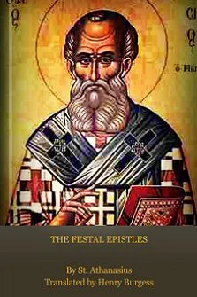
The New Testament Canon
Athanasius, 39th Festal Letter — First extant list that names exactly today’s 27 NT books as “canonized.”
“In these alone is proclaimed the doctrine of godliness. Let no man add to these, neither let him take ought from these.”

Slide 55
The New Testament Canon
INCORRECT VIEW | CORRECT VIEW
The church is the determiner of the Canon | The church is the discoverer of the canon
The church is the mother of the Canon | The church continues via the canon
The church is the magistrate of the canon | The church is the minister of the canon.
The church is the regulator of the canon | The church is the recognizer of the canon.
The church is the judge of the canon | The church is the witness if the canon.
The church is the master of the canon | The church is the servant if the canon.

Slide 56

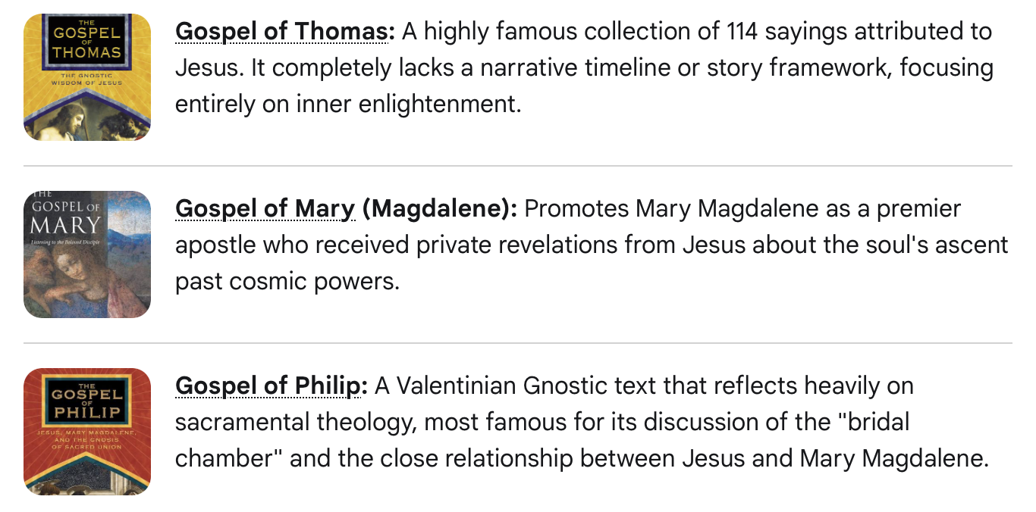

Slide 57
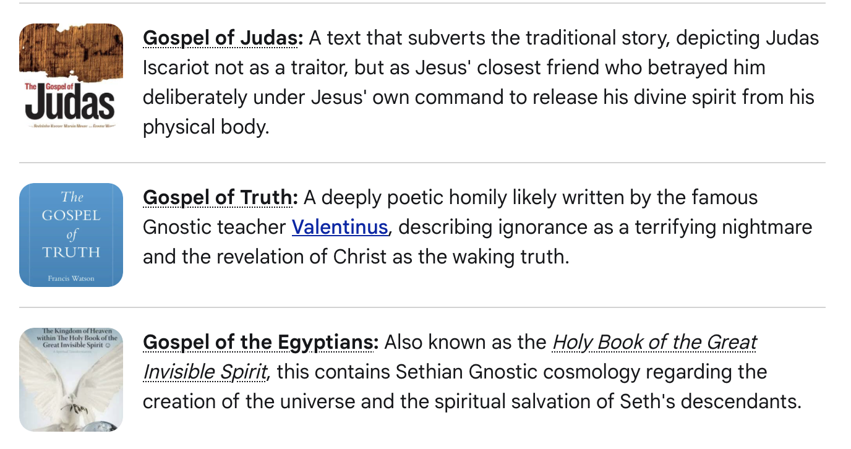

Slide 58
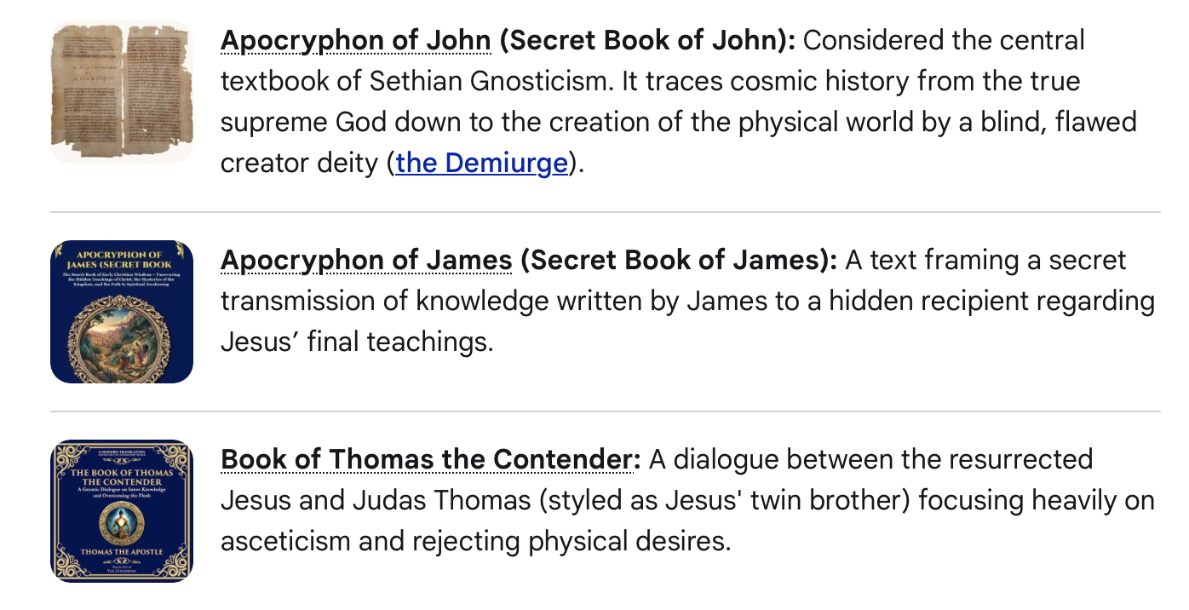

Slide 62
 | Catholic Deuterocanon | 1 Enoch / Jubilees | Gnostic gospels
Date | 300 BC–100 AD | 300 BC–100 AD | Mostly 300-400 AD
Home tradition | Greek Jewish / early church liturgy | Qumran + Ethiopia | Sectarian Christian / Gnostic schools
Relation to apostolic faith | Debated; same God, same people | Same God; expanded myth | Often another god, another salvation
Why disputed | Hebrew vs Greek OT | Authorship + Hebrew canon | Authorship + contrary gospel
Use today | Scripture (Catholic/Orthodox) / edifying intertestamental (Protestant) | Historical / theological background | Historical evidence of later alternatives

Slide 63
The Criteria For Canonical Books
An inspired book should reflect the characteristics of God, (omniscient, omnipotent, omnipresent) in such ways as fulfilled prophecy and accurate statements with regard to geography, astronomy, science, math, psychology, and all areas of knowledge to the extent that it makes reference to these.
If God is the Creator of both the world and man, He could not make an inaccurate statement about them.

Slide 64
The Criteria For Canonical Books
Written by an inspired man.
For the purpose of instructing the people of God.
Recognized by the people of God as authoritative at the time.
Inherent and true.
Preserved by the providence of God.

Slide 65
Author | Time Written | Earliest Copy | Time Span | Manuscripts
Caesar | 100-44 B.C. | A.D. 900 | 1000 | 10
Josephus, War | A.D. 80 | A.D. 950 | 870 | 9
Plato (Tetralogies) | A.D. 427-347 | A.D. 900 | 1200 | 7
Tacticus (Annals) | A.D. 100 | A.D. 1000 | 900 | 1
Pliny the Younger (History) | A.D. 61-113 | A.D. 850 | 750 | 1
Sophocles | 496-406 B.C. | A.D. 1000 | 1400 | 193
Euripides | 480-406 B.C. | A.D. 1100 | 1500 | 9
Demosthenes | 383-322 B.C. | A.D. 1100 | 1300 | 200
Aristotle | 384-322 B.C. | A.D. 1100 | 1400 | 49
New Testament | A.D. 45-100 | A.D. 125 | 25-250 | 5900

Slide 66
The New Testament Canon
How does the New Testament compare to other books of antiquity?
The New Testament is the best attested book of antiquity by far!
(Matthew 24:35)

Slide 67
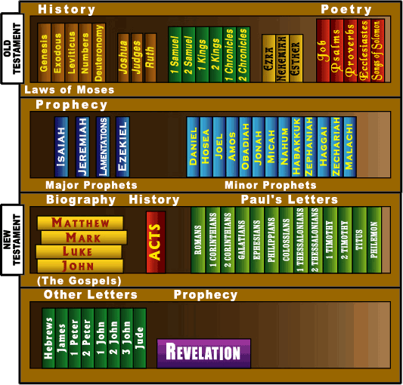

Slide 68

Matthew 24:35 (NKJV)
35 Heaven and earth will pass away, but My words will by no means pass away.

Slide 69
1 Peter 1:23–25 (NKJV)
…. “All flesh is as grass, And all the glory of man as the flower of the grass. The grass withers, And its flower falls away, 25 But the word of the Lord endures forever.” Now this is the word which by the gospel was preached to you.

Slide 70
Romans 15:4 (NKJV)
4 For whatever things were written before were written for our learning, that we through the patience and comfort of the Scriptures might have hope.

Slide 71
Do you accept the Bible as God’s word & tremble (Isaiah 66:2)

Slide 72
God’s word will judge us -
Are You Ready? (John 12:48)

Slide 73

HEAR (Rom 10:17)
BELIEVE (Jn 8:24)
CONFESS (Rom. 10:9,10)
REPENT (Acts 17:30)
BE BAPTIZED (Acts 22:16)
WALK IN TRUTH (1 Jn. 1:7-9; 2 Jn 4)
DO YOU BELIEVE THE BIBLE?

Slide 74
Don McClain
W. 65th St church of Christ - 8/14/2005

Slide 75
What Books Belong In The Bible?
Preached November 18, 2012 West 65th Street church of Christ
Preached October 11, 2026, Alexander church of Christ
501-568-1062
Prepared using PPT 2010
Email – donmcclain@sbcglobal.net
More PPT & Audio Sermons:
www.alexanderchurchofchrist.com
00H_WHAT_BOOKS_BELONG_IN_THE_BIBLE.key

