Slide 1
(Ephesians 5:1-21)

Slide 2

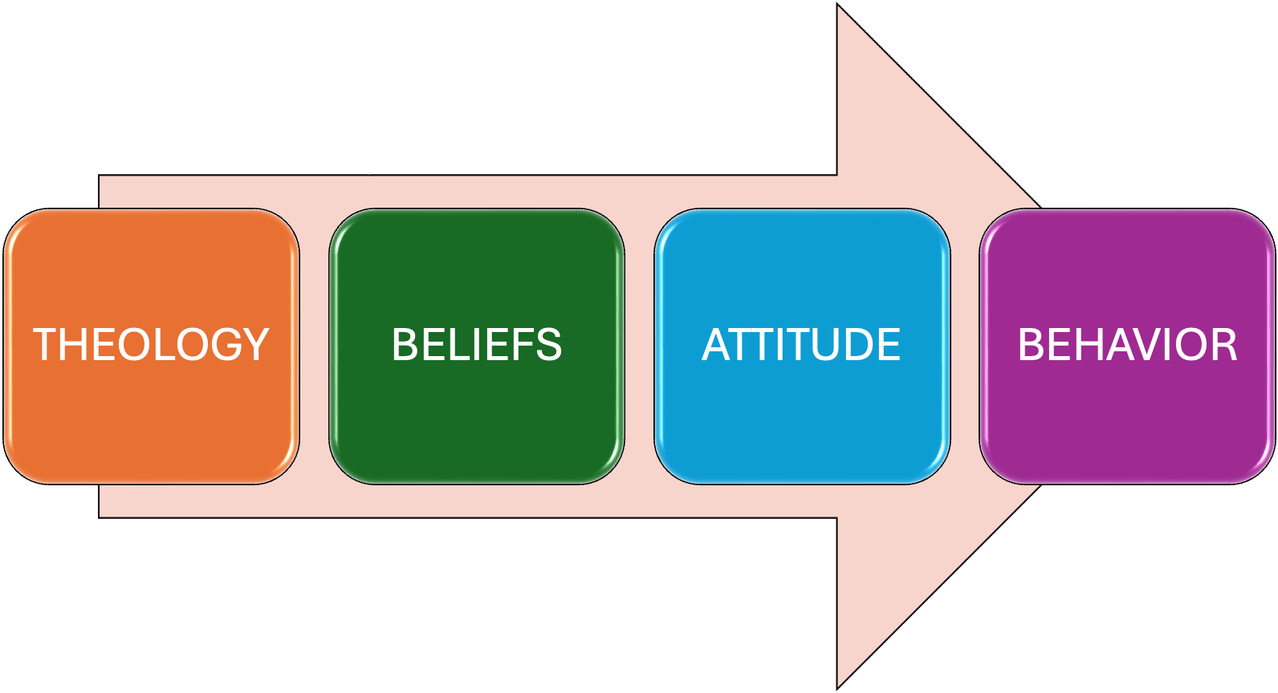
TRANSITIONING FROM DOCTRINAL > PRACTICAL

Slide 3
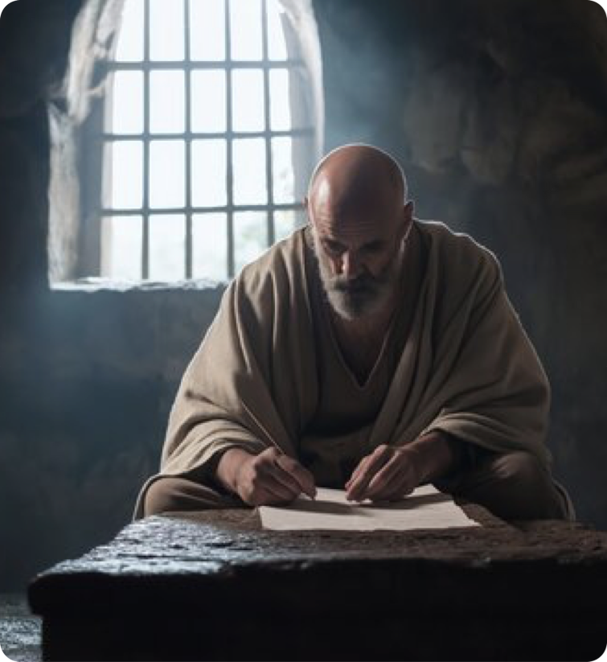
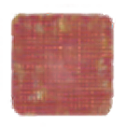
Living a life worthy of our calling
With godly attitudes (4:1-3).
United upon the truth (4:4-6).
Using Christ’s gifts to grow together (4:7-16).
Walking in true righteousness and holiness by putting of the old man with his evil deeds, and putting on the new man (4:17-32; cf. ; 1 Thes. 2:12).
Ephesians 4:1 (NKJV)
¹ I, therefore, the prisoner of the Lord, beseech you to walk worthy of the calling with which you were called,

Slide 4
Ephesians 5:1–21 (NKJV)
¹ Therefore be imitators of God as dear children. ² And walk in love, as Christ also has loved us and given Himself for us, an offering and a sacrifice to God for a sweet-smelling aroma. ³ But fornication and all uncleanness or covetousness, let it not even be named among you, as is fitting for saints; ⁴ neither filthiness, nor foolish talking, nor coarse jesting, which are not fitting, but rather giving of thanks. ⁵ For this you know, that no fornicator, unclean person, nor covetous man, who is an idolater, has any inheritance in the kingdom of Christ and God. ⁶ Let no one deceive you with empty words, for because of these things the wrath of God comes upon the sons of disobedience.

Slide 5
Ephesians 5:1–21 (NKJV)
⁷ Therefore do not be partakers with them. ⁸ For you were once darkness, but now you are light in the Lord. Walk as children of light ⁹ (for the fruit of the Spirit is in all goodness, righteousness, and truth), ¹⁰ finding out what is acceptable to the Lord. ¹¹ And have no fellowship with the unfruitful works of darkness, but rather expose them. ¹² For it is shameful even to speak of those things which are done by them in secret. ¹³ But all things that are exposed are made manifest by the light, for whatever makes manifest is light.

Slide 6
Ephesians 5:1–21 (NKJV)
¹⁴ Therefore He says: “Awake, you who sleep, Arise from the dead, And Christ will give you light.” ¹⁵ See then that you walk circumspectly, not as fools but as wise, ¹⁶ redeeming the time, because the days are evil. ¹⁷ Therefore do not be unwise, but understand what the will of the Lord is. ¹⁸ And do not be drunk with wine, in which is dissipation; but be filled with the Spirit, ¹⁹ speaking to one another in psalms and hymns and spiritual songs, singing and making melody in your heart to the Lord, ²⁰ giving thanks always for all things to God the Father in the name of our Lord Jesus Christ, ²¹ submitting to one another in the fear of God.

Slide 7
LIVING IN A CORRUPT WORLD
PASSAGE | WALK IN | DO NOT WALK IN
Ephesians 5:1-7 | LOVE | unloving sins
Ephesians 5:8-14 | LIGHT | darkness (ignorance)
Ephesians 5:15-21 | WISDOM | foolishness

Slide 8

WALK IN LOVE, NOT UNLOVING SIN (5:1-7)
IMITATING OUR FATHER as dear children (1; 1 John 4:7,8)
IMITATING JESUS:
Who also has loved us and given Himself for us (5:2,25)
Offered Himself to His Father by obeying Him (Heb. 5:7-9)
Includes our OBEDIENCE (1 John 5:2-4; John 14:15, 21-24)
Ephesians 5:1–2 (NKJV)
¹ Therefore be imitators of God as dear children. ² And walk in love, as Christ also has loved us and given Himself for us, an offering and a sacrifice to God for a sweet-smelling aroma.

Slide 9
WALK IN LOVE, NOT UNLOVING SIN (5:1-7)
Means loving one another the way Jesus loved us (John 13:34,35; 15:17; 1 John 3:14-16; Phili 2:1-10)
Character of love (1 Cor. 13:4–8)
Ephesians 5:1–2 (NKJV)
¹ Therefore be imitators of God as dear children. ² And walk in love, as Christ also has loved us and given Himself for us, an offering and a sacrifice to God for a sweet-smelling aroma.
LOVE IS / DOES | IS NOT / DOES NOT
suffers long and is kind, … ⁶ … rejoices in the truth; ⁷ bears all things, believes all things, hopes all things, endures all things. | does not envy; love does not parade itself, is not puffed up; ⁵ does not behave rudely, does not seek its own, is not provoked, thinks no evil; ⁶ does not rejoice in iniquity,

Slide 10
WALK IN LOVE, NOT UNLOVING SIN (5:1-7)
ALL SIN is UNLOVING (5:3-7)
Fornication
Uncleanness
Covetousness
Filthiness
Foolish Talking
Course Jesting
These sins are essentially selfish, destructive acts that corrupt relationships and violate the self-sacrificial, purity of committed marriage.
Ephesians 5:3–4 (NKJV)
³ But fornication and all uncleanness or covetousness, let it not even be named among you, as is fitting for saints; ⁴ neither filthiness, nor foolish talking, nor coarse jesting, which are not fitting, but rather giving of thanks.

Slide 11

WALK IN LOVE, NOT UNLOVING SIN (5:1-7)
Ephesians 5:5–6 (NKJV)
⁵ For this you know, that no fornicator, unclean person, nor covetous man, who is an idolater, has any inheritance in the kingdom of Christ and God. ⁶ Let no one deceive you with empty words, for because of these things the wrath of God comes upon the sons of disobedience.
ALL SIN is UNLOVING (5:3-7)
Fornication
Uncleanness
Covetousness
Filthiness
Foolish Talking
Course Jesting
No inheritance
Receive God’s wrath
⁷ “Do not be partakers”

Slide 12
WALK IN LIGHT, NOT DARKNESS (5:8-14)
Fruit of the spirit (9) (All goodness, righteousness & truth; cf. Gal. 5:22,23 love, joy, peace, longsuffering, kindness, goodness, faithfulness, ²³ gentleness, self-control)
Finding out what is acceptable (10) (examining; testing; cf. 1 The. 5:21; 2 Tim. 2:15; 3:16,17)
Ephesians 5:8–10 (NKJV)
⁸ For you were once darkness, but now you are light in the Lord. Walk as children of light ⁹ (for the fruit of the Spirit is in all goodness, righteousness, and truth), ¹⁰ finding out what is acceptable to the Lord.

Slide 13
WALK IN LIGHT, NOT DARKNESS (5:8-14)
“Having no fellowship with the unfruitful works of darkness” (11; 2 Cor. 6:14-7:2; 1 Pet. 1:13-16)
Exposing those in darkness (11,12; calling sin sin is not a loveless act)
Ephesians 5:11,12 (NKJV)
¹¹ And have no fellowship with the unfruitful works of darkness, but rather expose them. ¹² For it is shameful even to speak of those things which are done by them in secret.

Slide 14
WALK IN LIGHT, NOT DARKNESS (5:8-14)
When light exposes evil deeds, they become visible, manifest for what they really are (13; Jn 3:20,21; Rom. 12:1-3)
“Awake, you who sleep, Arise from the dead, And Christ will give you light.” (13-14; Isa. 26:19; 60:1; Rom. 13:11; cf. “awake unto righteousness and do not sin” 1 Co. 15:34; Rom. 6:1-23; 1 Jn 1:5-7)
Ephesians 5:13,14 (NKJV)
¹³ But all things that are exposed are made manifest by the light, for whatever makes manifest is light. ¹⁴ Therefore He says: “Awake, you who sleep, Arise from the dead, And Christ will give you light.”

Slide 15
WALK IN WISDOM, NOT IN FOOLISHNESS (5:15-21)
Walking carefully, cautiously, with confidence (15; cf. vs. 10; 2 Cor. 5:7; Proverbs 4:18-27)
Making proper use of our time, (16; Col. 4:5; Ro. 13:11; Ga. 6:10).
Do we see the use of our time as an investment? (Mat. 25:14-46).
Can’t get it back, but we can start today using it properly.
Ephesians 5:15–16 (NKJV)
¹⁵ See then that you walk circumspectly, not as fools but as wise, ¹⁶ redeeming the time, because the days are evil.

Slide 16
WALK IN WISDOM, NOT IN FOOLISHNESS (5:15-21)
“Understand what the will of the Lord is” — knowledge is not the same as proper application and use (2 Tim 2:15; Col. 1:9).
Those who "walk as fools" delight in being filled with wine, those who "walk as wise" will endeavor to be filled with the Spirit (17,18; with what the Spirit gives; cf. Col. 3:16,17; Gal. 5:22,23)
Ephesians 5:17–18 (NKJV)
¹⁷ Therefore do not be unwise, but understand what the will of the Lord is. ¹⁸ And do not be drunk with wine, in which is dissipation; but be filled with the Spirit,

Slide 17
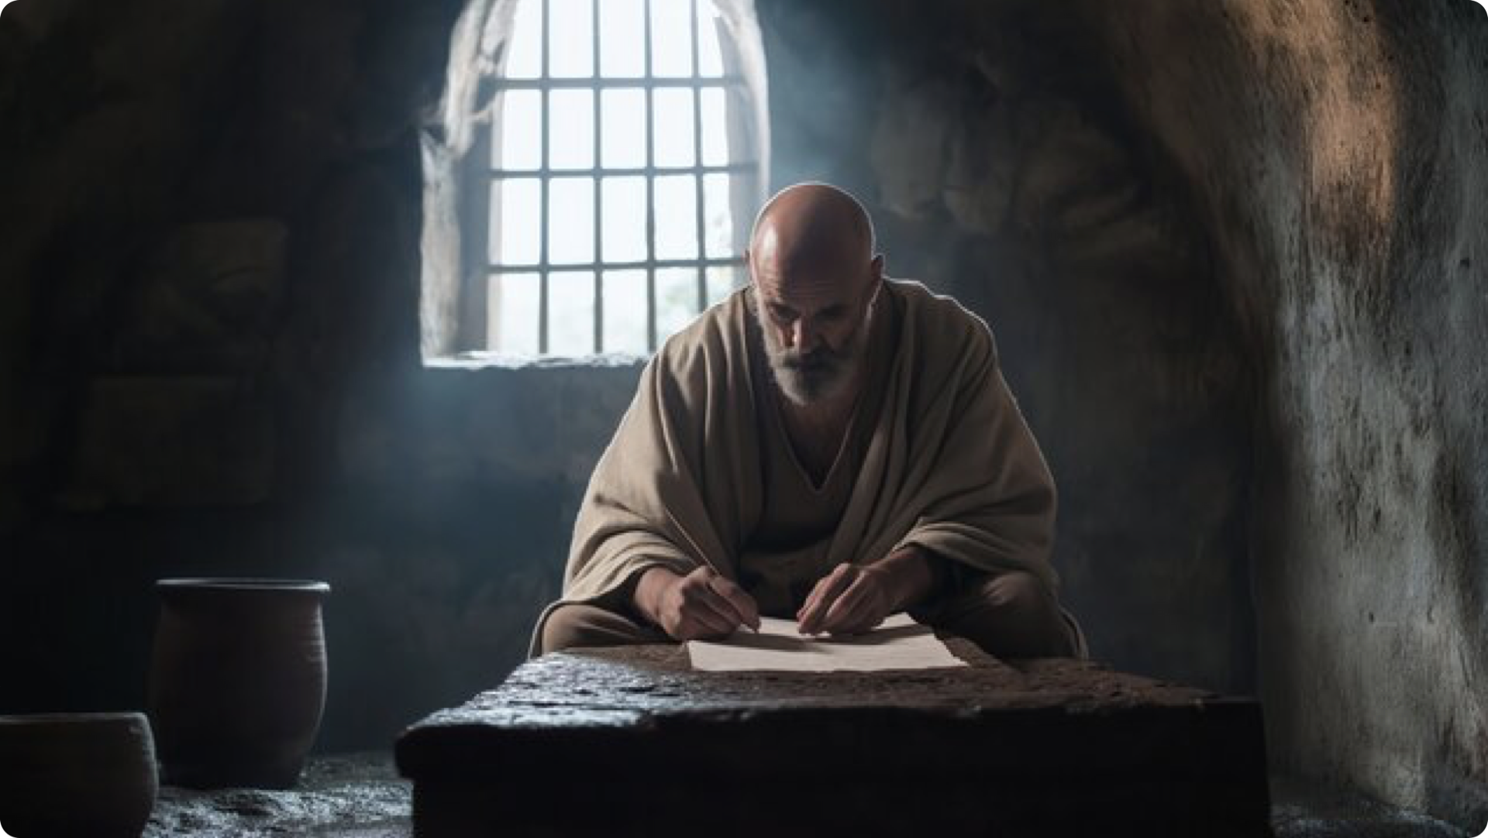

WALK IN WISDOM, NOT IN FOOLISHNESS (5:15-21)
Ephesians 5:18–19 (NKJV)
¹⁸ And do not be drunk with wine, in which is dissipation; but be filled with the Spirit, ¹⁹ speaking to one another in psalms and hymns and spiritual songs, singing and making melody in your heart to the Lord,
Colossians 3:16 (NKJV)
¹⁶ Let the word of Christ dwell in you richly in all wisdom, teaching and admonishing one another in psalms and hymns and spiritual songs, singing with grace in your hearts to the Lord.

Slide 18
WALK IN WISDOM, NOT IN FOOLISHNESS (5:15-21)
Ephesians 5:19–21 (NKJV)
¹⁹ speaking to one another in psalms and hymns and spiritual songs, singing and making melody in your heart to the Lord, ²⁰ giving thanks always for all things to God the Father in the name of our Lord Jesus Christ, ²¹ submitting to one another in the fear of God.
What evidence is there that one is "filled with the Spirit”?
Singing praises — “psalms and hymns and spiritual songs …” (5:19; cf. Col. 3:16)
Giving thanks (5:20; cf. Col. 3:17; 1 Thes. 5:18; He. 13:15)
Submitting to one another in the fear of God (5:21; Ga. 5:22,23)

Slide 19
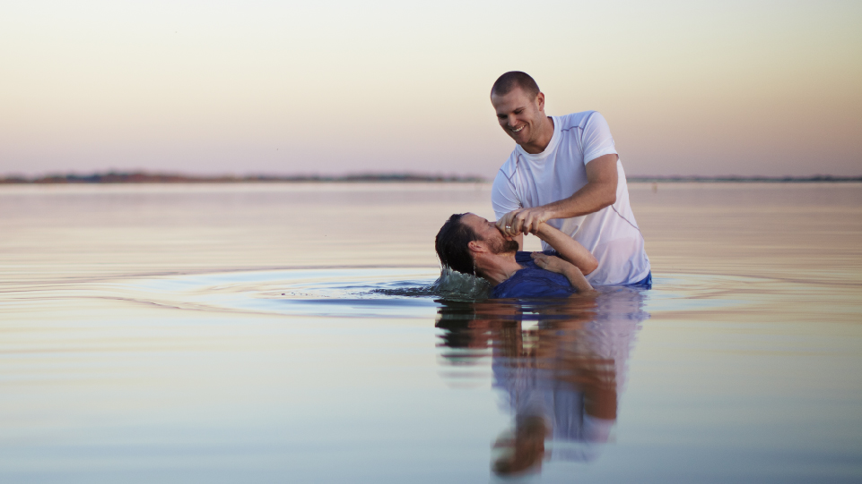
Walk in LOVE – not in unloving sin (5:1-7)
Walk in LIGHT – not in darkness (5:8-14)
Walk in WISDOM – not in foolishness (5:15-21)

Slide 21
“Only let your conduct be worthy of the gospel of Christ, so that whether I come and see you or am absent, I may hear of your affairs, that you stand fast in one spirit, with one mind striving together for the faith of the gospel,”
Philippians 1:27 (NKJV)
Charts by Don McClain
Preached April 12, 2026 - Alexander church of Christ -
- Phone — 501-568-1062 — Email – donmcclain@sbcglobal.net
Prepared using Keynote / More Keynote, PPT & Audio Sermons:
www.alexanderchurchofchrist.com

Slide 22
Colossians 3:12–17 (NKJV)
¹² Therefore, as the elect of God, holy and beloved, put on tender mercies, kindness, humility, meekness, longsuffering; ¹³ bearing with one another, and forgiving one another, if anyone has a complaint against another; even as Christ forgave you, so you also must do. ¹⁴ But above all these things put on love, which is the bond of perfection. ¹⁵ And let the peace of God rule in your hearts, to which also you were called in one body; and be thankful. ¹⁶ Let the word of Christ dwell in you richly in all wisdom, teaching and admonishing one another in psalms and hymns and spiritual songs, singing with grace in your hearts to the Lord. ¹⁷ And whatever you do in word or deed, do all in the name of the Lord Jesus, giving thanks to God the Father through Him.

