Slide 1

(Ephesians 6:1-4)

Slide 2
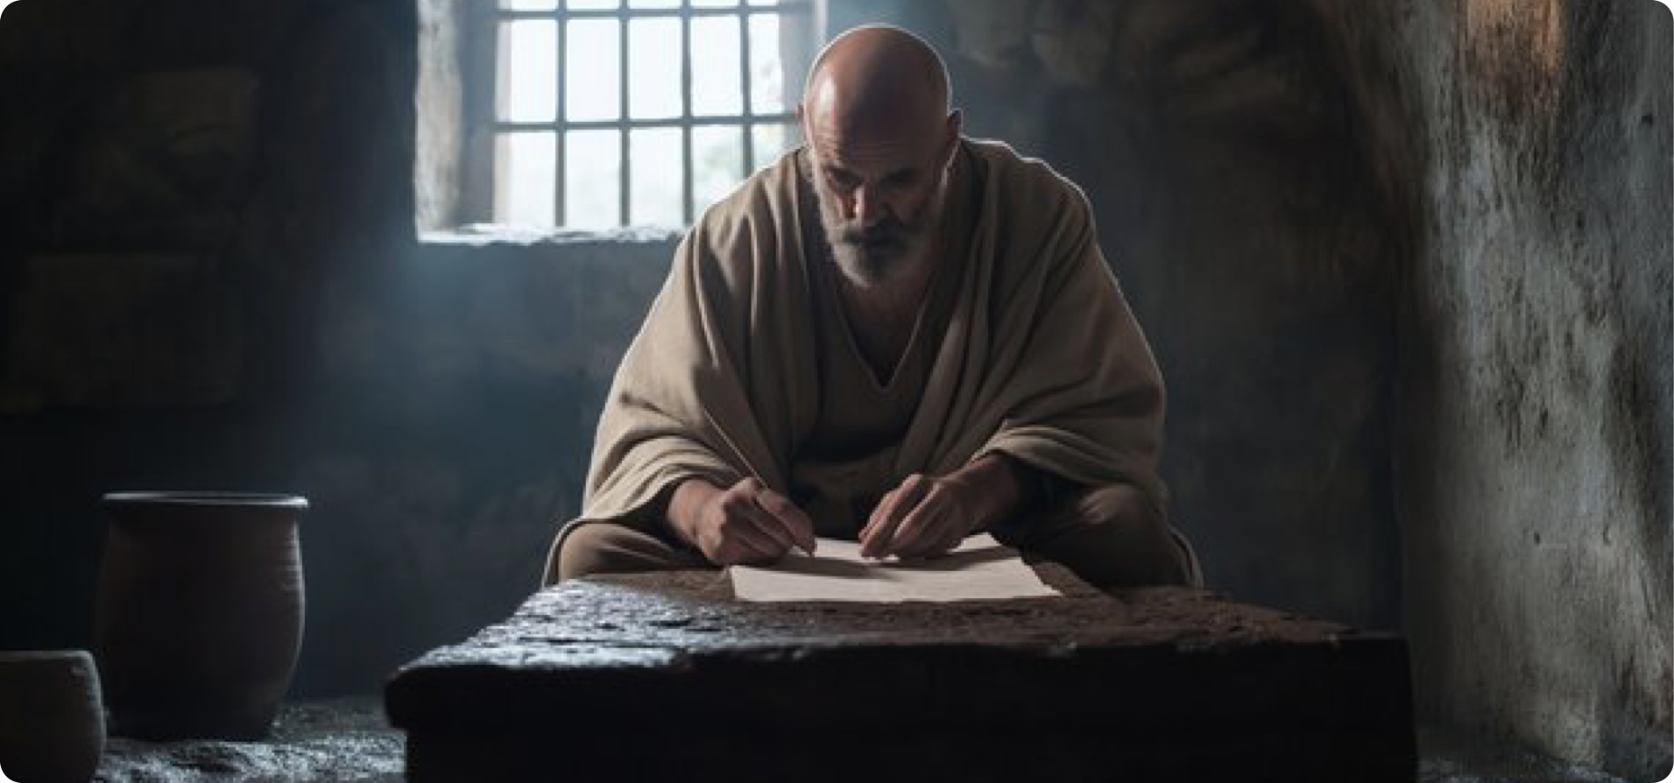
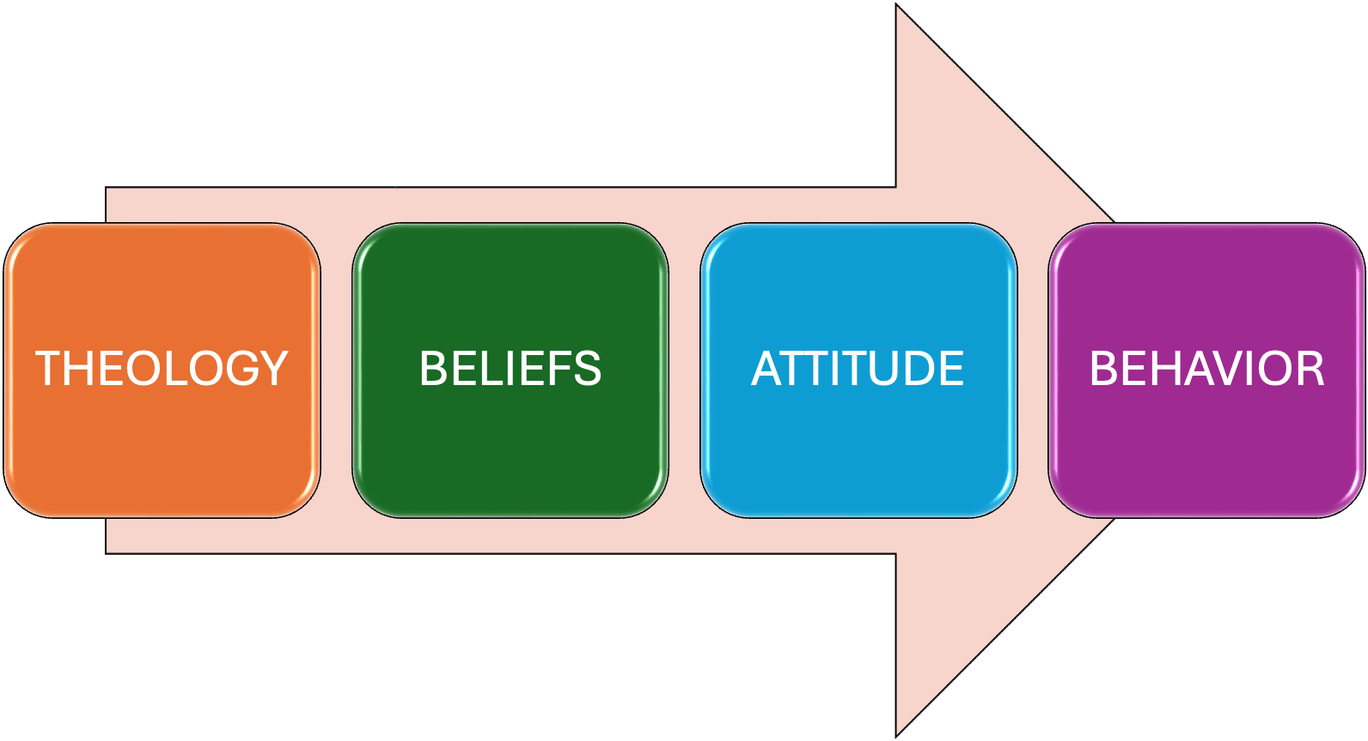
DOCTRINAL TRUTH > PRACTICAL APPLICATION

Slide 3
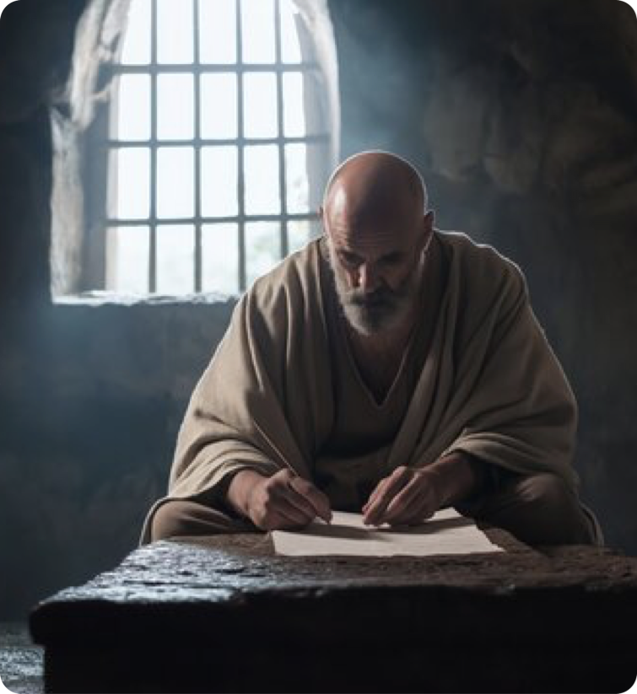
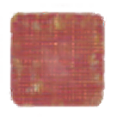
Living a life worthy of our calling
With godly attitudes (4:1-3).
United upon the truth (4:4-6).
Using Christ’s gifts to grow together (4:7-16).
Walking in true righteousness and holiness by putting of the old man with his evil deeds, and putting on the new man (4:17-32; cf. ; 1 Thes. 2:12).
Ephesians 4:1 (NKJV)
¹ I, therefore, the prisoner of the Lord, beseech you to walk worthy of the calling with which you were called,

Slide 4
Living a life worthy of our calling
PASSAGE | WALK IN | DO NOT WALK IN
Ephesians 5:1-7 | LOVE | unloving sins
Ephesians 5:8-14 | LIGHT | darkness (ignorance)
Ephesians 5:15-21 | WISDOM | foolishness

Slide 5


MARRIAGE
THE MOST IMPORTANT AND SIGNIFICANT RELATIONSHIP
Notes:
Marriage is no longer merely a social institution; it is a Christological icon.

Slide 6
Ephesians 6:1–4 (NKJV)
¹ Children, obey your parents in the Lord, for this is right. ² “Honor your father and mother,” which is the first commandment with promise: ³ “that it may be well with you and you may live long on the earth.” ⁴ And you, fathers, do not provoke your children to wrath, but bring them up in the training and admonition of the Lord.

Slide 7








Slide 8
Proverbs 22:6 (NKJV)
⁶ Train up a child in the way he should go, And when he is old he will not depart from it.

Slide 9
Your acceptance or rejection of your duties as a parent will be your real legacy –
Parenting in today’s world is not easy - it is hard!
If we do NOT train our children – the world will!

Slide 10
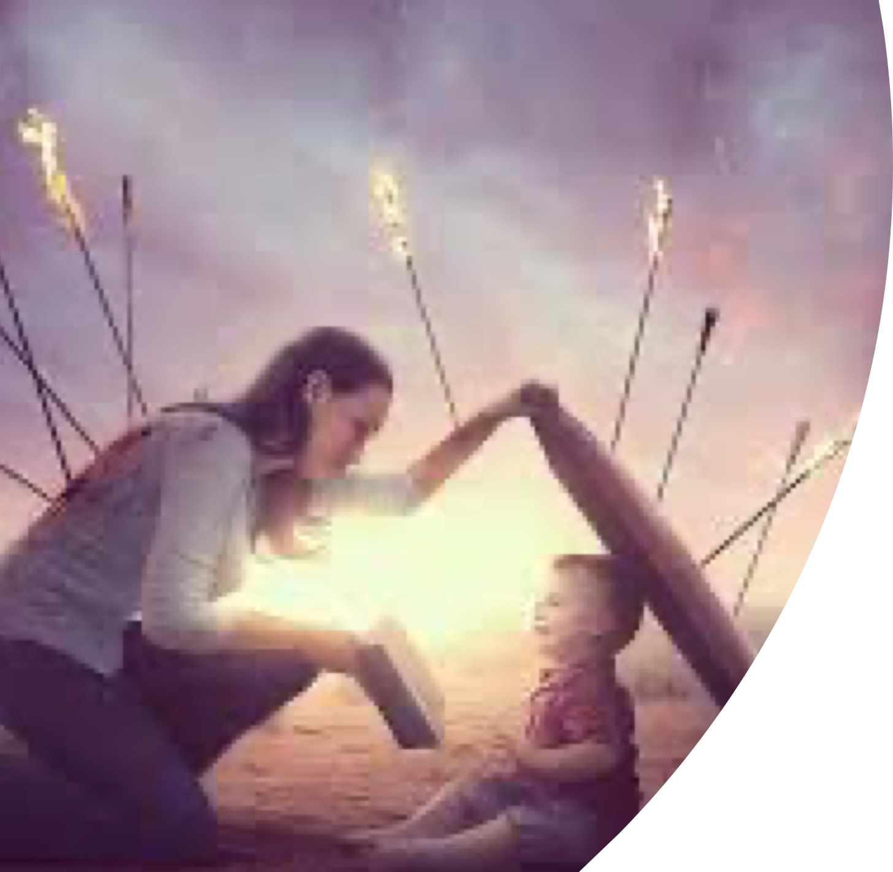
Entertainment :(movies, sitcoms, cartoons, music, etc.)
Society : (radical individualism; post modernism; rank immorality; anger; discontent; etc.)
Education : (natural evolution; immorality; humanism; etc.)

Slide 11
HOME UNDER ATTACK
Distractions - Busy mom’s and dad’s
Marriage not respected
Unfaithfulness in marriage is accepted
M.D.R. has become acceptable & normal
The increasing push to normalize the L.G.B.T.Q. agenda.

Slide 12
Romans 12:2 (NKJV)
² And do not be conformed to this world, but be transformed by the renewing of your mind, that you may prove what is that good and acceptable and perfect will of God.

Slide 13
Children are a heritage of the Lord (Ps. 127:3)
Stewardship implies responsibility (1 Sam 2:29, 31-34; 3:13)
Being a good steward takes effort (Luke 12:42,43)
Too many parents live with the regret and pain of failing their children! (1 Sam. 2:22-24)

Slide 14

Deuteronomy 6:6–9 (NKJV)
⁶ “And these words which I command you today shall be in your heart. ⁷ You shall teach them diligently to your children, and shall talk of them when you sit in your house, when you walk by the way, when you lie down, and when you rise up. ⁸ You shall bind them as a sign on your hand, and they shall be as frontlets between your eyes. ⁹ You shall write them on the doorposts of your house and on your gates.

Slide 15
Judges 2:10–13 (NKJV)
¹⁰ When all that generation had been gathered to their fathers, another generation arose after them who did not know the Lord nor the work which He had done for Israel. ¹¹ Then the children of Israel did evil in the sight of the Lord, and served the Baals;

Slide 16
Judges 2:10–13 (NKJV)
¹² and they forsook the Lord God of their fathers, who had brought them out of the land of Egypt; and they followed other gods from among the gods of the people who were all around them, and they bowed down to them; and they provoked the Lord to anger. ¹³ They forsook the Lord and served Baal and the Ashtoreths.

Slide 17
Ephesians 6:1–4 (NKJV)
¹ Children, obey your parents in the Lord, for this is right. ² “Honor your father and mother,” which is the first commandment with promise: ³ “that it may be well with you and you may live long on the earth.” ⁴ And you, fathers, do not provoke your children to wrath, but bring them up in the training and admonition of the Lord.

Slide 18



Slide 19




Teach Them How To Love By Loving (Deut. 6:4,5; Titus 2:4)
Value them – seek their best interest (our true values will be seen in what we seek for our children) (Jn 3:16; 1 Cor 13:8-10).
Teach them to love God – by loving God (Deut 6:4,5; Mk 12:29-30; Rom. 8:28; 1 Jn 5:4)
Teach them to love others (brethren / neighbor / less fortunate / enemies (Jn 13:34; Ep. 5:2; Mk 12:31; Mat 25: 40; 5:44)

Slide 20


Teach Them God’s Word
(Deut. 6:6-9; Eph. 3:5; 1 Pet 2:2)
Begin early (2 Tim 3:15)
“Diligently” – keeping it before them at all times (Deut 6:7,8)
How to apply scriptures correctly (2 Tim. 2:15)
Help them develop their own faith (evidences / history / etc. )(Rom. 10:17)
By living it (Dt 6:7-9; Gen 18:19; Mat 5:13-16)

Slide 21


Discipline Them Properly (Eph. 6:4; Prov. 13:24; 19:18; 22:15; 23:13)
Positive teaching and training (teaching them to respect authority – especially God’s / teach them how to work and serve) (Psalm 34:11-14; Prov 3:1-7; Ecc 12:13)
How to think correctly (discerning right from wrong / develop godly attitude) (Prov 4:1-27)
Punish disobedience (Prov. 13:24; 22:15; 23:13,14; 29:15,17; Heb 12:7-9)

Slide 22


Teach Them To WORSHIP God
(John 4:24; Hebrews 12:25-29)
To REVERENCE God - the importance of following God’s instructions as given (Lev 10:3; Col. 3:17; Heb 12:28; 2 Jn 9)
The value and importance of assembling with the saints (Psalm 122:1; Heb 10:24,25)
The importance and value of godliness in every aspect of life (Ro. 12:1,2; 2 Cor. 6:14-7:1; 1 The 5:17)

Slide 23
Teach Them To WORSHIP God
(John 4:24; Hebrews 12:25-29)
By consistently attending every service possible — Prioritize / Prepare / Punctual
Teaching them to quietly listen to the lessons – to stay seated, attentive, and focused.
Teaching them to participate in the worship (singing / praying / listening, etc.)
Training them to take part in the work of the church / to serve / to pray / lead …

Slide 24

Regulate Their Friends
(Prov. 13:20; 1 Cor. 15:33)
Do not be deceived into thinking that worldly friends will not negatively influence your child (Prov. 1:10-15; 4:14; Ps. 1:1; 1 Cor 15:33)
Children may see it as intrusive, especially in the teenage years, but it is necessary – it is your duty to protect them (same principle as in 1 Cor. 5, a little leaven leavens the whole) (Eph. 5:11; 2 Cor. 6:14)

Slide 25

Teach them DANGER of sin / error
(Prov. 5:1-11, 21-23; Isa. 9:16)
Sin has its consequences (Gal. 6:7-9; Gen. 3; Prov. 5; 7:6-27; Rom. 6:23)
Children must learn that sin and false doctrine is often appealing and always deceitful (Gen. 3; He. 3:12,13; Mt 7:15)
MANY warnings of how sin & false teachers operate (1 Cor. 10:1-13; 2 Pet. 2; 3:1618)

Slide 26
Teach Them How To HONOR Christ
(Mat. 5:13-16; Phili. 2:14-16)
Consistent godly living (word / deed / appearance) (Phil. 2:14-16; Rom 2:17-24)
Kindness, goodness, mercy, obedience, LOVE (Ti. 2:14; Co. 3:12-16; Gal. 5:22,23)
Patient and faithful in trials and suffering (Acts 4:8-13; 5:29-31; 1 Pet 3:13-17; Jam. 1:3-17)
Teaching others by both deed and in word (Act 8:4; 1 Thes. 1:8)

Slide 27
LOVE — Love God and them.
KNOWLEDGE — Teach them.
DISCIPLINE — Mold them.
REVERENCE — Show them.
PROTECTION — Guard them.
WISDOM — Prepare / Equip them.
HONOR — Train them.

Slide 28
Help them develop their mind, attitude & character according to godliness –
Help them to develop a desire to please and serve God –
Help them to develop a strong faith in God and His word –

Slide 29
We cannot teach our children that which we do not do, do not know, and do not have!
Do we love and serve the Lord as we should?
If your children follow in your steps - where will they be for eternity?

Slide 31
(Ephesians 6:1-4)
Charts by Don McClain
Preached March 21, 2021 / West 65th Street church of Christ
Preached May 8, 2026 / Alexander church of Christ
Phone: 501-568-1062
Email – donmcclain@sbcglobal.net
More Keynote, PPT & Audio Sermons
www.alexanderchurchofchrist.com

Slide 32
Deuteronomy 11:18–21 (NKJV)
¹⁸ “Therefore you shall lay up these words of mine in your heart and in your soul, and bind them as a sign on your hand, and they shall be as frontlets between your eyes. ¹⁹ You shall teach them to your children, speaking of them when you sit in your house, when you walk by the way, when you lie down, and when you rise up. ²⁰ And you shall write them on the doorposts of your house and on your gates, ²¹ that your days and the days of your children may be multiplied in the land of which the Lord swore to your fathers to give them, like the days of the heavens above the earth.

