Slide 1
(Ephesians 6:5-9)

Slide 2
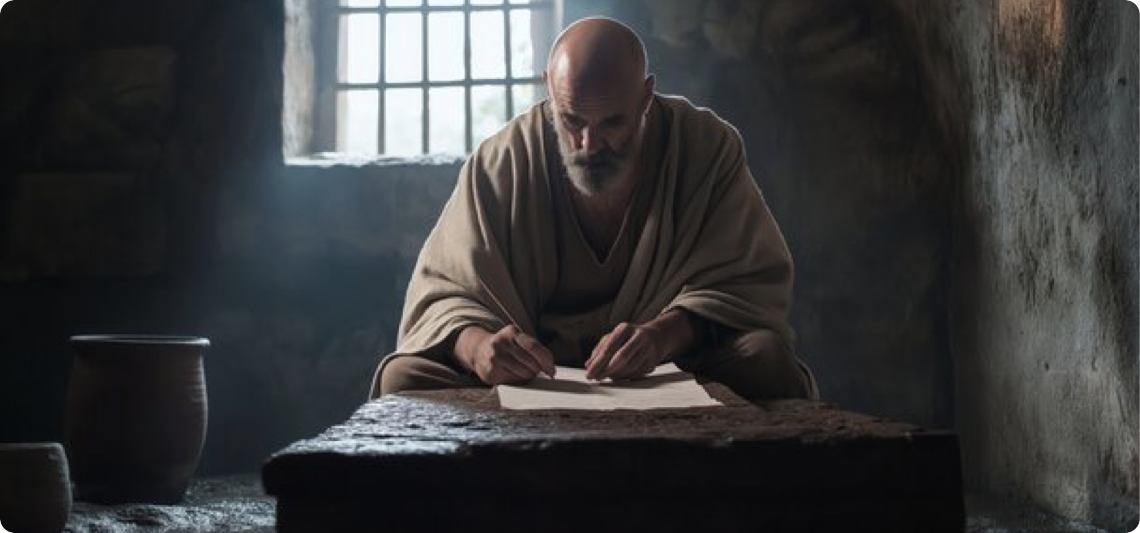
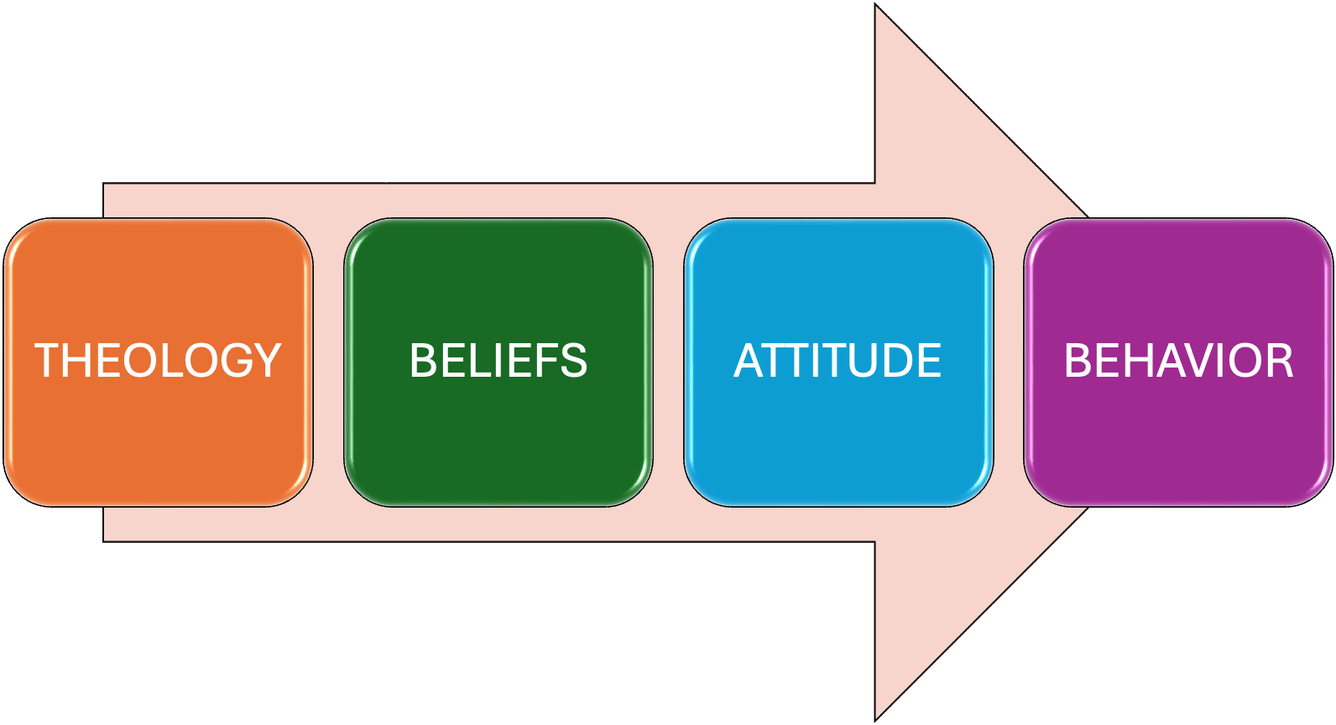
DOCTRINAL TRUTH > PRACTICAL APPLICATION

Slide 3
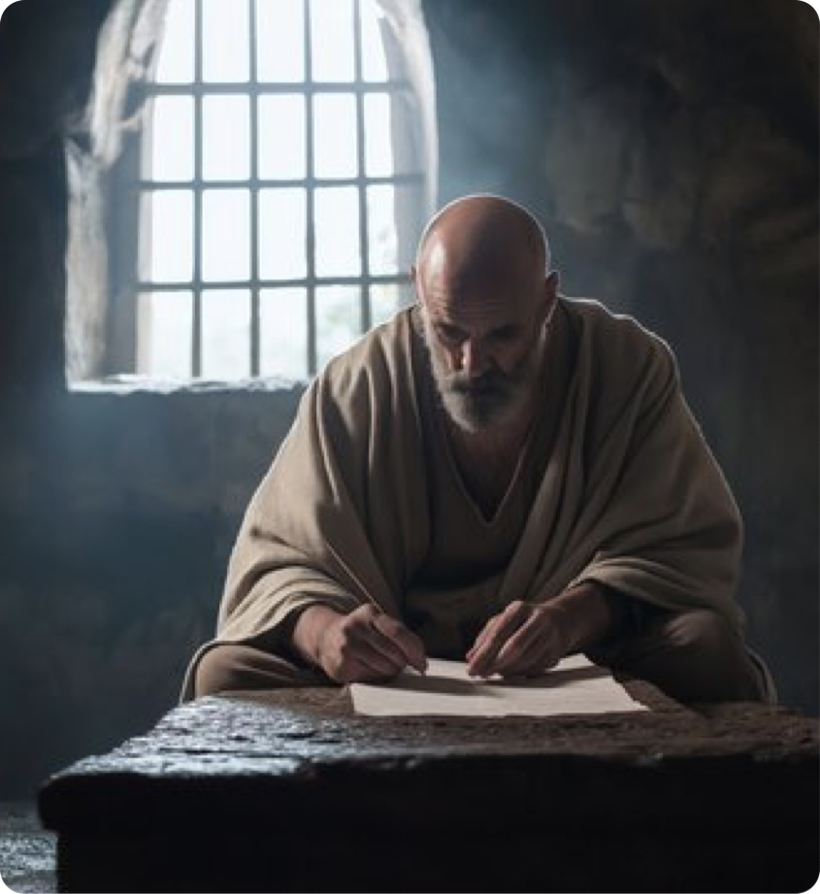
Living a life worthy of our calling:
Walking in LOVE, LIGHT, and WISDOM (5:1-21)
In our Marriages (5:22-33)
As children and parents (6:1-4)
Ephesians 4:1 (NKJV)
¹ I, therefore, the prisoner of the Lord, beseech you to walk worthy of the calling with which you were called,

Slide 4
Ephesians 6:5–9 (NKJV)
⁵ Bondservants, be obedient to those who are your masters according to the flesh, with fear and trembling, in sincerity of heart, as to Christ; ⁶ not with eyeservice, as men-pleasers, but as bondservants of Christ, doing the will of God from the heart, ⁷ with goodwill doing service, as to the Lord, and not to men, ⁸ knowing that whatever good anyone does, he will receive the same from the Lord, whether he is a slave or free. ⁹ And you, masters, do the same things to them, giving up threatening, knowing that your own Master also is in heaven, and there is no partiality with Him.

Slide 5

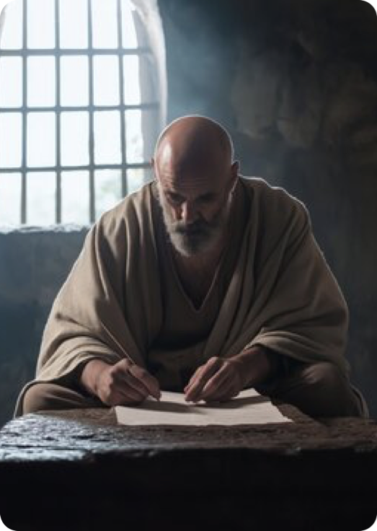

Ephesians 6:5 (NKJV)
⁵ Bondservants, be obedient to those who are your masters according to the flesh, with fear and trembling, in sincerity of heart, as to Christ;
BONDSMAN: doulos (δου̂λος, 1401), from deo, “to bind,” “a slave,” originally the lowest term in the scale of servitude, came also to mean “one who gives himself up to the will of another,” e.g., 1 Cor. 7:23; Rom. 6:17, 20, and became the most common and general word for “servant,” as in Matt. 8:9, without any idea of bondage. (Vine, W. E., Unger, M. F., & White, W., Jr. (1996). In Vine’s Complete Expository Dictionary of Old and New Testament Words. T. Nelson.

Slide 6
SERVANT: 1. doulos (δου̂λος, 1401), an adjective, signifying “in bondage,” Rom. 6:19 (neuter plural, agreeing with mele, “members”), is used as a noun, and as the most common and general word for “servant,” frequently indicating subjection without the idea of bondage; it is used (a) of natural conditions, e.g., Matt. 8:9; 1 Cor. 7:21, 22 (1st part); Eph. 6:5; Col. 4:1; 1 Tim. 6:1; (Vine, W. E., Unger, M. F., & White, W., Jr. (1996). In Vine’s Complete Expository Dictionary of Old and New Testament Words. T. Nelson.
Ephesians 6:5 (NKJV)
⁵ Bondservants, be obedient to those who are your masters according to the flesh, with fear and trembling, in sincerity of heart, as to Christ;

Slide 7
Ephesians 6:5 (NKJV)
⁵ Bondservants, be obedient to those who are your masters according to the flesh, with fear and trembling, in sincerity of heart, as to Christ;
Bondservants (Greek: douloi) made up a large portion of the Roman Empire’s population. This type of slavery was not primarily race-based but resulted from debt, war, or birth.
Many served in households as domestic workers, tutors, or laborers. Some were highly educated; others endured harsh conditions.
Their lives were entirely under the authority of their master, however long they were bound.

Slide 8

Ephesians 6:5 (NKJV)
⁵ Bondservants, be obedient to those who are your masters according to the flesh, with fear and trembling, in sincerity of heart, as to Christ;
Bondservants are commanded to:
Obey; hupakouo (ὑπακούω, 5219), “to listen, attend” (as in Acts 12:13), and so, “to submit, to obey,” is used of “obedience” … (h) to masters by servants, Eph. 6:5; Col. 3:22; …
“with fear and trembling” — not cringing fear, but reverent respect.
“in sincerity of heart, as to Christ;” singleness of heart, genuine, generosity.

Slide 9
Ephesians 6:6–7 (NKJV)
⁶ not with eyeservice, as men-pleasers, but as bondservants of Christ, doing the will of God from the heart, ⁷ with goodwill doing service, as to the Lord, and not to men,
Bondservants are commanded to:
Avoid “eye-service” (working hard only when watched) and people-pleasing.
Obey “as bondservants of Christ,” where your ultimate loyalty lies, not earthly masters.
Serve “from the heart,” doing God’s will with good will, trusting God for ultimate justice. The Lord sees and will reward faithful service.

Slide 10
Bondservants Should Know:
The Lord will judge and reward those who do good (Jn 5:28,29; Rom 2:5-11).
The Lord will accurately and impartially judge everyones performance and motivation (cf. Col. 3:25; 1 Peter 1:17).
Christian slaves were to be the best slaves — honest, diligent, respectful, and trustworthy.
Ephesians 6:8 (NKJV)
⁸ knowing that whatever good anyone does, he will receive the same from the Lord, whether he is a slave or free.

Slide 11
Colossians 3:22–25 (NKJV)
²² Bondservants, obey in all things your masters according to the flesh, not with eyeservice, as men-pleasers, but in sincerity of heart, fearing God. ²³ And whatever you do, do it heartily, as to the Lord and not to men, ²⁴ knowing that from the Lord you will receive the reward of the inheritance; for you serve the Lord Christ. ²⁵ But he who does wrong will be repaid for what he has done, and there is no partiality.

Slide 12
1 Peter 2:18–21 (NKJV)
¹⁸ Servants, be submissive to your masters with all fear, not only to the good and gentle, but also to the harsh. ¹⁹ For this is commendable, if because of conscience toward God one endures grief, suffering wrongfully. ²⁰ For what credit is it if, when you are beaten for your faults, you take it patiently? But when you do good and suffer, if you take it patiently, this is commendable before God. ²¹ For to this you were called, because Christ also suffered for us, leaving us an example, that you should follow His steps:

Slide 13
Philippians 2:5–9 (NKJV)
⁵ Let this mind be in you which was also in Christ Jesus, ⁶ who, being in the form of God, did not consider it robbery to be equal with God, ⁷ but made Himself of no reputation, taking the form of a bondservant, and coming in the likeness of men. ⁸ And being found in appearance as a man, He humbled Himself and became obedient to the point of death, even the death of the cross. ⁹ Therefore God also has highly exalted Him and given Him the name which is above every name,

Slide 14
WE ARE BONDSERVANTS OF JESUS:
Paul frequently identifies himself as a “bondservant of Christ Jesus” (Rom 1:1, Gal 1:10, and Tt 1:1).
In Romans 6, we were once “slaves to sin” but are now “slaves to righteousness.”
Our identity is not defined by earthly status but by our relationship and faithful service to Jesus Christ (I Cor. 3:23; 6:19b, 20).
Ephesians 6:8 (NKJV)
⁸ knowing that whatever good anyone does, he will receive the same from the Lord, whether he is a slave or free.

Slide 15
WE ARE BONDSERVANTS OF JESUS:
We MUST obey Jesus, and submit to His authority in all things (Col. 3:17)
Our LIVES are to be offered wholly to the service of Jesus Christ (Rom. 12:1,2).
Excellence and integrity should mark you, even when no one is watching, for the Lord sees all (Hebrews 4:13).
Ephesians 6:8 (NKJV)
⁸ knowing that whatever good anyone does, he will receive the same from the Lord, whether he is a slave or free.

Slide 16
WE ARE BONDSERVANTS OF JESUS:
Even in unjust situations, you are called to follow Christ’s example of patient endurance (1 Peter 2:21-25; 1 John 2:6).
God sees your faithfulness and will reward it, and punish those who are not (Romans 2:5-11; Col. 3:25).
Yes - we are His slaves, but yet free from sin, fear, and condemnation (Rom. 8:1,2).
Ephesians 6:8 (NKJV)
⁸ knowing that whatever good anyone does, he will receive the same from the Lord, whether he is a slave or free.

Slide 17

Ephesians 6:9 (NKJV)
⁹ And you, masters, do the same things to them, giving up threatening, knowing that your own Master also is in heaven, and there is no partiality with Him.
“And you, masters,” — Paul places greater responsibility on those in positions of authority (Luke 12:48).
Masters are to:
Treat their bondservants with the same sincerity and fairness they expect.
Stop threatening and harsh treatment.
Remember they have a Master in heaven who shows no favoritism.

Slide 18
Ephesians 6:9 (NKJV)
⁹ And you, masters, do the same things to them, giving up threatening, knowing that your own Master also is in heaven, and there is no partiality with Him.
Colossians 4:1 (NKJV) ¹ Masters, give your bondservants what is just and fair, knowing that you also have a Master in heaven.
In the Roman world, this was radical. Masters held absolute power. The gospel confronted that power with the truth that both master and servant stand equally before the ultimate Master — Jesus Christ.

Slide 19
Ephesians 6:9 (NKJV)
⁹ And you, masters, do the same things to them, giving up threatening, knowing that your own Master also is in heaven, and there is no partiality with Him.
The letter to Philemon shows this principle in action.
Paul urges Philemon to receive his runaway slave Onesimus back “no longer as a bondservant but more than a bondservant, as a beloved brother” (Phile 16).
Authority is to be exercised with justice, humility, mercy, and recognition of our shared humanity before our judge (2 Cor. 5:10).

Slide 20
Key Points for Those in Authority Today:
Authority is a stewardship from God, not a license for selfishness or harshness.
Leaders must reject manipulation, favoritism, and intimidation, and become servants.
You will give an account to the Lord for how you treat those under your care.
True leadership reflects the servant-heart of Christ (John 13:3-17; Phili 2:5-10).

Slide 21

Paul says we are “bondservants of Christ” (v. 6).
Here is the great leveling truth of the passage: Both bondservants and masters are bondservants of Christ (Rom. 14:7-13).
This identity transcends every earthly role, regardless of position or condition - we are to serve Christ wherever we are. (Acts 10:34; Gal. 3:26-29).
Ephesians 6:6–7 (NKJV)
⁶ not with eyeservice, as men-pleasers, but as bondservants of Christ, doing the will of God from the heart, ⁷ with goodwill doing service, as to the Lord, and not to men,

Slide 22
APPLICATIONS:
Ultimate Loyalty — Christ is our true Master. Earthly bosses, leaders, or authorities are secondary. We serve them as unto the Lord (Acts 5:29).
Heart-Level Obedience — God is not satisfied with external performance. He desires service “from the heart” motivated by love our love for Him (Mark 12:29-32).

Slide 23
APPLICATIONS:
Eternal Perspective and Reward — God sees both the good and bad, and God will judge - God rewards the righteous. This truth sustains us in difficult seasons (Rom. 2:5-11).
Equality and Dignity Before God — There is “no partiality” with God (v. 9; Rom 2:11). Social status does not determine our worth in Christ (Gal. 3:26-29).

Slide 24
APPLICATIONS:
Humility in Authority and Submission — Those in leadership must lead as servants, and those under authority must serve with excellence and respect (Matthew 20:24-28).
Hope in Suffering — When treated unjustly, we follow Christ’s example (1 Peter 2). Our suffering is not meaningless — it can display the gospel (1 Pet. 3:1-6).

Slide 25
APPLICATIONS:
Transformed Character — The gospel does not change an individual’s earthy status, or position; it transforms our character, and how we relate to one another (Matthew 20:24-28; Luke 22:27,28; John 13:13, 14; Phil. 2:7).
The story of Philemon and Onesimus shows that in Christ, masters and slaves are to be brothers (Philemon).

Slide 26
If you are a Christian, whether you are an employee, employer, student, teacher, parent, child, or in any position of influence or submission — your primary duty is the same:
You belong to Jesus.
You represent Jesus.
You honor, or dishonor Jesus by your actions and how you treat others.

Slide 27
If you are a Christian:
Serve with sincerity, as to the Lord.
Lead with justice and kindness, remembering your Master in heaven.
Treat every person with the dignity of one for whom Christ died.
Follow the example of Jesus, who humbled Himself as a servant.

Slide 28
If you are NOT a Christian:
You are a SLAVE of Satan, of SIN, Guilt, and CONDEMNATION (John 8:31-35).
JESUS CAN SET YOU FREE from sin and death (John 8:36 ³⁶ Therefore if the Son makes you free, you shall be free indeed).
We are free to choose (Romans 6:16-18; Matthew 11:28,29; Acts 2:38-41)

Slide 30
(Ephesians 6:5-9)
Charts by Don McClain
Preached May 24, 2026 / Alexander church of Christ
Phone: 501-568-1062
Email – donmcclain@sbcglobal.net
More Keynote, PPT & Audio Sermons
www.alexanderchurchofchrist.com

Slide 31
1 Timothy 6:1–5 (NKJV)
¹ Let as many bondservants as are under the yoke count their own masters worthy of all honor, so that the name of God and His doctrine may not be blasphemed. ² And those who have believing masters, let them not despise them because they are brethren, but rather serve them because those who are benefited are believers and beloved. Teach and exhort these things.

Slide 32
1 Timothy 6:1–5 (NKJV)
³ If anyone teaches otherwise and does not consent to wholesome words, even the words of our Lord Jesus Christ, and to the doctrine which accords with godliness, ⁴ he is proud, knowing nothing, but is obsessed with disputes and arguments over words, from which come envy, strife, reviling, evil suspicions, ⁵ useless wranglings of men of corrupt minds and destitute of the truth, who suppose that godliness is a means of gain. From such withdraw yourself.

