Slide 1


2 Peter 1:1–11

Slide 2



THE VALUE OF
October 6, 2024
⁷ But reject profane and old wives’ fables, and exercise yourself toward godliness. ⁸ For bodily exercise profits a little, but godliness is profitable for all things, having promise of the life that now is and of that which is to come. (1 Timothy 4:6–11)

Slide 3
THE VALUE OF
October 6, 2024
1 Peter 4:17–18 (NKJV)
¹⁷ For the time has come for judgment to begin at the house of God; and if it begins with us first, what will be the end of those who do not obey the gospel of God? ¹⁸ Now “If the righteous one is scarcely saved, Where will the ungodly and the sinner appear?”

Slide 4


Not merely “doing good.”
Not merely “doing what is right.”
Not exactly “Godlikeness”
Opposite of Ungodliness.
An Attitude directed towards pleasing God, resulting in a way of life.
Titus 2:11–12 (NKJV)
¹¹ For the grace of God that brings salvation has appeared to all men, ¹² teaching us that, denying ungodliness and worldly lusts, we should live soberly, righteously, and godly in the present age,

Slide 5
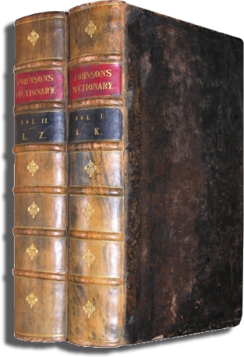
Thayer: “Reverence. Respect; in the Bible everywhere piety towards God.”
W.E. Vine: “That piety which, characterized by a Godward attitude, does that which is well pleasing to Him.”

Slide 6
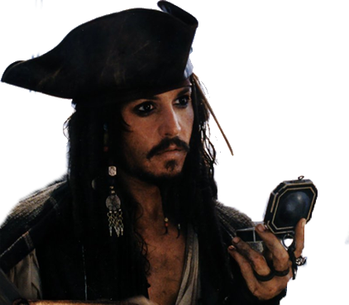
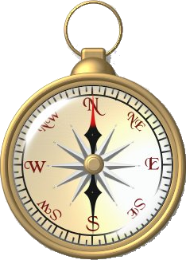
Jack Sparrow’s compass always pointed to what he wanted most
A properly functioning compass always points NORTH.

Slide 7
GOD
RELIGION
LEISURE
FAMILY
PROFESSION

Slide 8
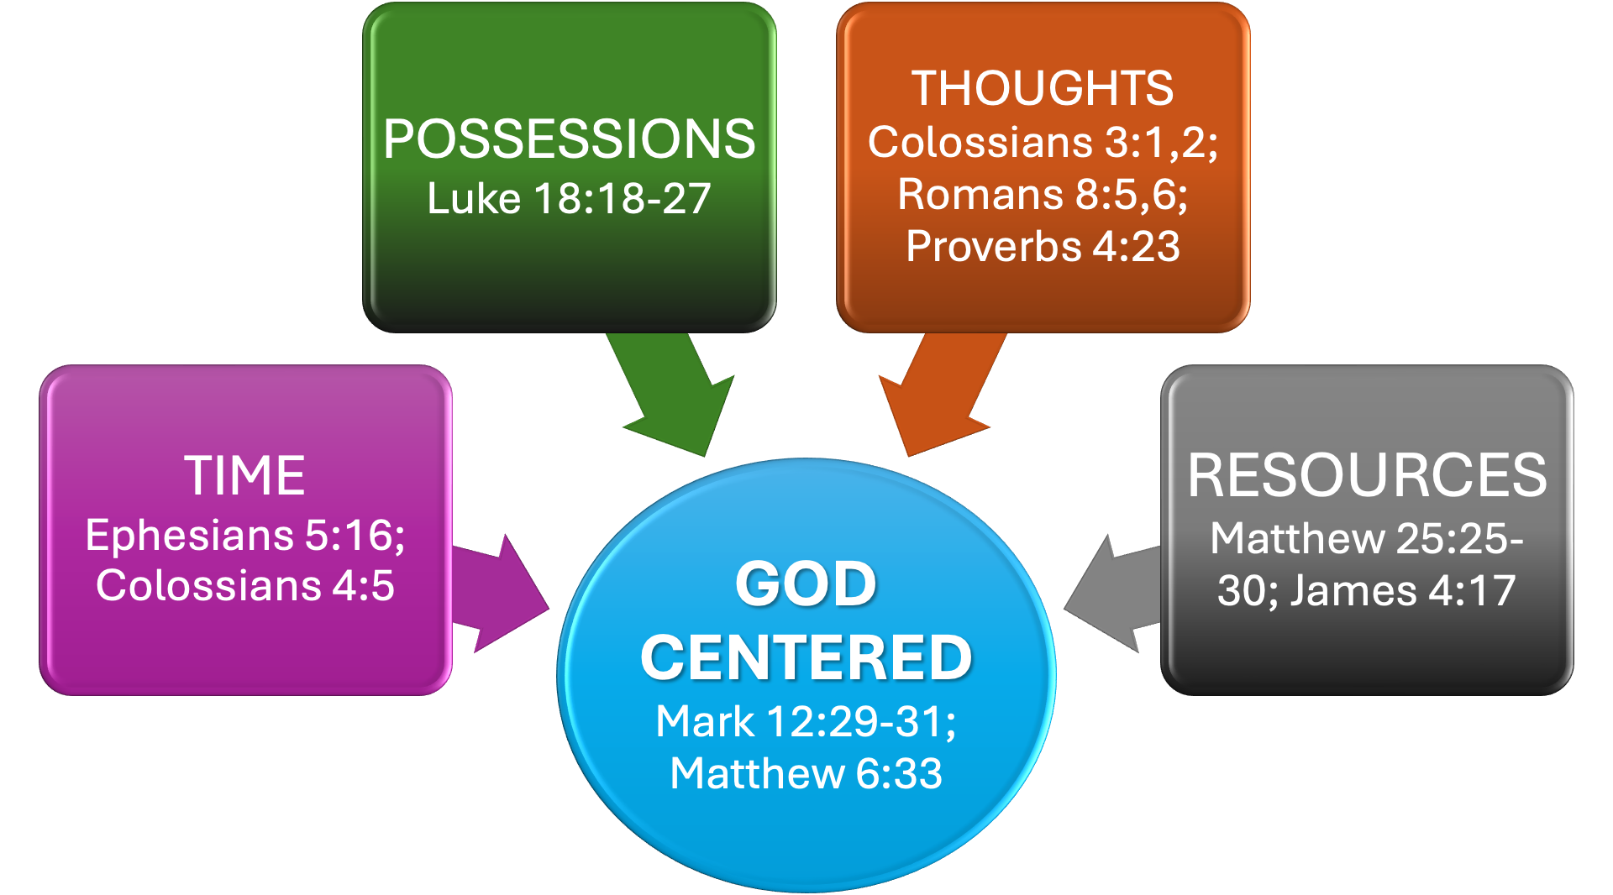

Slide 9


2 Peter 1:1–11

Slide 10




⁷ But reject profane and old wives’ fables, and exercise yourself toward godliness. — 1 Timothy 4:7 (NKJV)
2 Peter 1:1–11

Slide 11
2 Peter 1:1–11 (NKJV)
¹ Simon Peter, a bondservant and apostle of Jesus Christ, To those who have obtained like precious faith with us by the righteousness of our God and Savior Jesus Christ: ² Grace and peace be multiplied to you in the knowledge of God and of Jesus our Lord, ³ as His divine power has given to us all things that pertain to life and godliness, through the knowledge of Him who called us by glory and virtue, ⁴ by which have been given to us exceedingly great and precious promises, that through these you may be partakers of the divine nature, having escaped the corruption that is in the world through lust.

Slide 12
2 Peter 1:1–11 (NKJV)
⁵ But also for this very reason, giving all diligence, add to your faith virtue, to virtue knowledge, ⁶ to knowledge self-control, to self-control perseverance, to perseverance godliness, ⁷ to godliness brotherly kindness, and to brotherly kindness love. ⁸ For if these things are yours and abound, you will be neither barren nor unfruitful in the knowledge of our Lord Jesus Christ.

Slide 13
2 Peter 1:1–11 (NKJV)
⁹ For he who lacks these things is shortsighted, even to blindness, and has forgotten that he was cleansed from his old sins. ¹⁰ Therefore, brethren, be even more diligent to make your call and election sure, for if you do these things you will never stumble; ¹¹ for so an entrance will be supplied to you abundantly into the everlasting kingdom of our Lord and Savior Jesus Christ.

Slide 14


2 Peter 1:2–3 (NKJV)
² Grace and peace be multiplied to you in the knowledge of God and of Jesus our Lord, ³ as His divine power has given to us all things that pertain to life and godliness, through the knowledge of Him who called us by glory and virtue, … ⁸ For if these things are yours and abound, you will be neither barren nor unfruitful in the knowledge of our Lord Jesus Christ.

Slide 15
John 4:22–24 (NKJV)
²² You worship what you do not know; we know what we worship, for salvation is of the Jews. ²³ But the hour is coming, and now is, when the true worshipers will worship the Father in spirit and truth; for the Father is seeking such to worship Him. ²⁴ God is Spirit, and those who worship Him must worship in spirit and truth.”

Slide 16
Acts 17:22–23 (NKJV)
²² Then Paul stood in the midst of the Areopagus and said, “Men of Athens, I perceive that in all things you are very religious; ²³ for as I was passing through and considering the objects of your worship, I even found an altar with this inscription: TO THE UNKNOWN GOD Therefore, the One whom you worship without knowing, Him I proclaim to you:

Slide 17
Romans 10:1–3 (NKJV)
¹ Brethren, my heart’s desire and prayer to God for Israel is that they may be saved. ² For I bear them witness that they have a zeal for God, but not according to knowledge. ³ For they being ignorant of God’s righteousness, and seeking to establish their own righteousness, have not submitted to the righteousness of God.

Slide 18

“Made the world and everything in it…”
“Lord of heaven and earth”
“Does not dwell in temples made with hands”
“Not worshiped with men’s hands…”
“Made from one blood every nation of men…”
“Determined man’s times and the boundaries”
“He is not far from each of us”
“In Him we live and move and have our being.”
“Spirit – Divine Nature”
“Now commands all to REPENT”
“Will judge us by His Son, Jesus Christ”
Acts 17:21–34

Slide 19
Creator – Ps. 95:6; 1 Pet.4:19
Omnipotent – Rev.19:6; Acts 26:8
Omnipresent – Jer. 23:23; Ps.23:4
Omniscient – Prov 15:3; Heb 4:13
All-wise – Rom. 11:33; 1 Cor. 1:25
Holy – 1 Peter 1:15,16; 1 Thes 4:3-7
Impartial - Acts 10:34; 1 Pet. 1:17
Love – John 3:16; 1 John 4:8,19; 5:3
Jealous – Ex. 20:5; 34:14; Mt. 4:10
Goodness, Severity – Ro.11:22, Heb.12:28
Acts 17:21–34

Slide 20


2 Peter 1:1 (NKJV)
¹ Simon Peter, a bondservant and apostle of Jesus Christ, To those who have obtained like precious faith with us by the righteousness of our God and Savior Jesus Christ: … ⁵ But also for this very reason, giving all diligence, add to your faith

Slide 21
Hebrews 11:6 (NKJV)
⁶ But without faith it is impossible to please Him, for he who comes to God must believe that He is, and that He is a rewarder of those who diligently seek Him.

Slide 22
John 8:23–24 (NKJV)
²³ And He said to them, “You are from beneath; I am from above. You are of this world; I am not of this world. ²⁴ Therefore I said to you that you will die in your sins; for if you do not believe that I am He, you will die in your sins.”

Slide 23
Acts 2:36–37 (NKJV)
³⁶ “Therefore let all the house of Israel know assuredly that God has made this Jesus, whom you crucified, both Lord and Christ.” ³⁷ Now when they heard this, they were cut to the heart, and said to Peter and the rest of the apostles, “Men and brethren, what shall we do?”

Slide 24
Luke 6:46–47 (NKJV)
⁴⁶ “But why do you call Me ‘Lord, Lord,’ and not do the things which I say? ⁴⁷ Whoever comes to Me, and hears My sayings and does them, I will show you whom he is like:

Slide 25
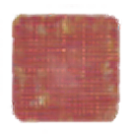
Who He Is (John 1:1,2; 17:5)
Savior – 1 John 4:14
The Son of God – Mat 17:5; Jn 3:16
The Lord of lords and King of kings – Acts 2:36; Phili 2:9-11; 1 Tim 6:15; Rev 19:16
Head – Eph 1:22,23; Col 1:18

Slide 26
What He Has Done For Us : Became flesh “to taste death for everyman” / Was raised to sit on David’s throne (John 1:1,2,14; Heb 2:9-18; Acts 2:36; Phili 2:5-11)
What He Is Doing For Us : High Priest / Mediator (Heb 8:1; 1 Tim. 2:5).
What He will do : Judge the world in righteousness (John 5:28,29; 1 Thes. 4:13-18; 2 Th. 1:7–10; 2 Co. 5:10).

Slide 27
⁴ by which have been given to us exceedingly great and precious promises, (2 Peter 1:4).
¹¹ for so an entrance will be supplied to you abundantly into the everlasting kingdom of our Lord and Savior Jesus Christ (2 Peter 1:10–11).

Slide 28
1 Peter 1:3–5 (NKJV)
³ Blessed be the God and Father of our Lord Jesus Christ, who according to His abundant mercy has begotten us again to a living hope through the resurrection of Jesus Christ from the dead, ⁴ to an inheritance incorruptible and undefiled and that does not fade away, reserved in heaven for you, ⁵ who are kept by the power of God through faith for salvation ready to be revealed in the last time.

Slide 29
Titus 1:1–3 (NKJV)
¹ Paul, a bondservant of God and an apostle of Jesus Christ, according to the faith of God’s elect and the acknowledgment of the truth which accords with godliness, ² in hope of eternal life which God, who cannot lie, promised before time began, ³ but has in due time manifested His word through preaching, which was committed to me according to the commandment of God our Savior;

Slide 30
Philippians 1:19–21 (NKJV)
¹⁹ For I know that this will turn out for my deliverance through your prayer and the supply of the Spirit of Jesus Christ, ²⁰ according to my earnest expectation and hope that in nothing I shall be ashamed, but with all boldness, as always, so now also Christ will be magnified in my body, whether by life or by death. ²¹ For to me, to live is Christ, and to die is gain.

Slide 31
1 John 3:2–3 (NKJV)
² Beloved, now we are children of God; and it has not yet been revealed what we shall be, but we know that when He is revealed, we shall be like Him, for we shall see Him as He is. ³ And everyone who has this hope in Him purifies himself, just as He is pure.

Slide 32
2 Peter 1:5–7 (NKJV)
⁵ But also for this very reason, giving all diligence, add to your faith virtue, to virtue knowledge, ⁶ to knowledge self-control, to self-control perseverance, to perseverance godliness, ⁷ to godliness brotherly kindness, and to brotherly kindness love.

Slide 33
The bond of perfection (Col. 3:14)
And now abide faith, hope, love, these three; but the greatest of these is love. (1 Cor 13:13)
Must Love God Supremely (Mark 12:29-31; John 14:15,23; 1 John 5:1-3)
Love God’s Word (Ps 119:97-104)
God is love – Those who possess a Godward attitude – will seek to love as He loves (1 John 5:1; 1 Pet 1:22; 1 John 4:20)

Slide 34
⁷ But reject profane and old wives’ fables, and exercise yourself toward godliness. — 1 Timothy 4:7 (NKJV)
2 Peter 1:1–11

Slide 35
Is The Only Thing That Will Matter To You In The End
ROMANS 6
DIE TO SIN / BE BURIED WITH CHRIST / LIVE FOR CHRIST

Slide 37
Charts by Don McClain
Preached June 28, 2026 / Alexander church of Christ
Phone: 501-568-1062
Email – donmcclain@sbcglobal.net
More Keynote, PPT & Audio Sermons
www.alexanderchurchofchrist.com

Slide 38
1 Timothy 4:6–11 (NKJV)
⁶ If you instruct the brethren in these things, you will be a good minister of Jesus Christ, nourished in the words of faith and of the good doctrine which you have carefully followed. ⁷ But reject profane and old wives’ fables, and exercise yourself toward godliness. ⁸ For bodily exercise profits a little, but godliness is profitable for all things, having promise of the life that now is and of that which is to come. ⁹ This is a faithful saying and worthy of all acceptance. ¹⁰ For to this end we both labor and suffer reproach, because we trust in the living God, who is the Savior of all men, especially of those who believe. ¹¹ These things command and teach.

