Slide 1


James 1:26,27; John 4:19-24

Slide 2


Not merely “doing good.”
Not merely “doing what is right.”
Not exactly “Godlikeness”
Opposite of Ungodliness.
An Attitude directed towards pleasing God, resulting in a way of life.
Titus 2:11–12 (NKJV)
¹¹ For the grace of God that brings salvation has appeared to all men, ¹² teaching us that, denying ungodliness and worldly lusts, we should live soberly, righteously, and godly in the present age,

Slide 3

Thayer: “Reverence. Respect; in the Bible everywhere piety towards God.”
W.E. Vine: “That piety which, characterized by a Godward attitude, does that which is well pleasing to Him.”

Slide 4

GOD
RELIGION
LEISURE
FAMILY
PROFESSION

Slide 5






⁷ But reject profane and old wives’ fables, and exercise yourself toward godliness. — 1 Timothy 4:7 (NKJV)
2 Peter 1:1–11

Slide 6

James 1:26–27 (NKJV)
²⁶ If anyone among you thinks he is religious, and does not bridle his tongue but deceives his own heart, this one’s religion is useless. ²⁷ Pure and undefiled religion before God and the Father is this: to visit orphans and widows in their trouble, and to keep oneself unspotted from the world.

Slide 7
John 4:19–24 (NKJV)
¹⁹ The woman said to Him, “Sir, I perceive that You are a prophet. ²⁰ Our fathers worshiped on this mountain, and you Jews say that in Jerusalem is the place where one ought to worship.” ²¹ Jesus said to her, “Woman, believe Me, the hour is coming when you will neither on this mountain, nor in Jerusalem, worship the Father. ²² You worship what you do not know; we know what we worship, for salvation is of the Jews. ²³ But the hour is coming, and now is, when the true worshipers will worship the Father in spirit and truth; for the Father is seeking such to worship Him. ²⁴ God is Spirit, and those who worship Him must worship in spirit and truth.”

Slide 8
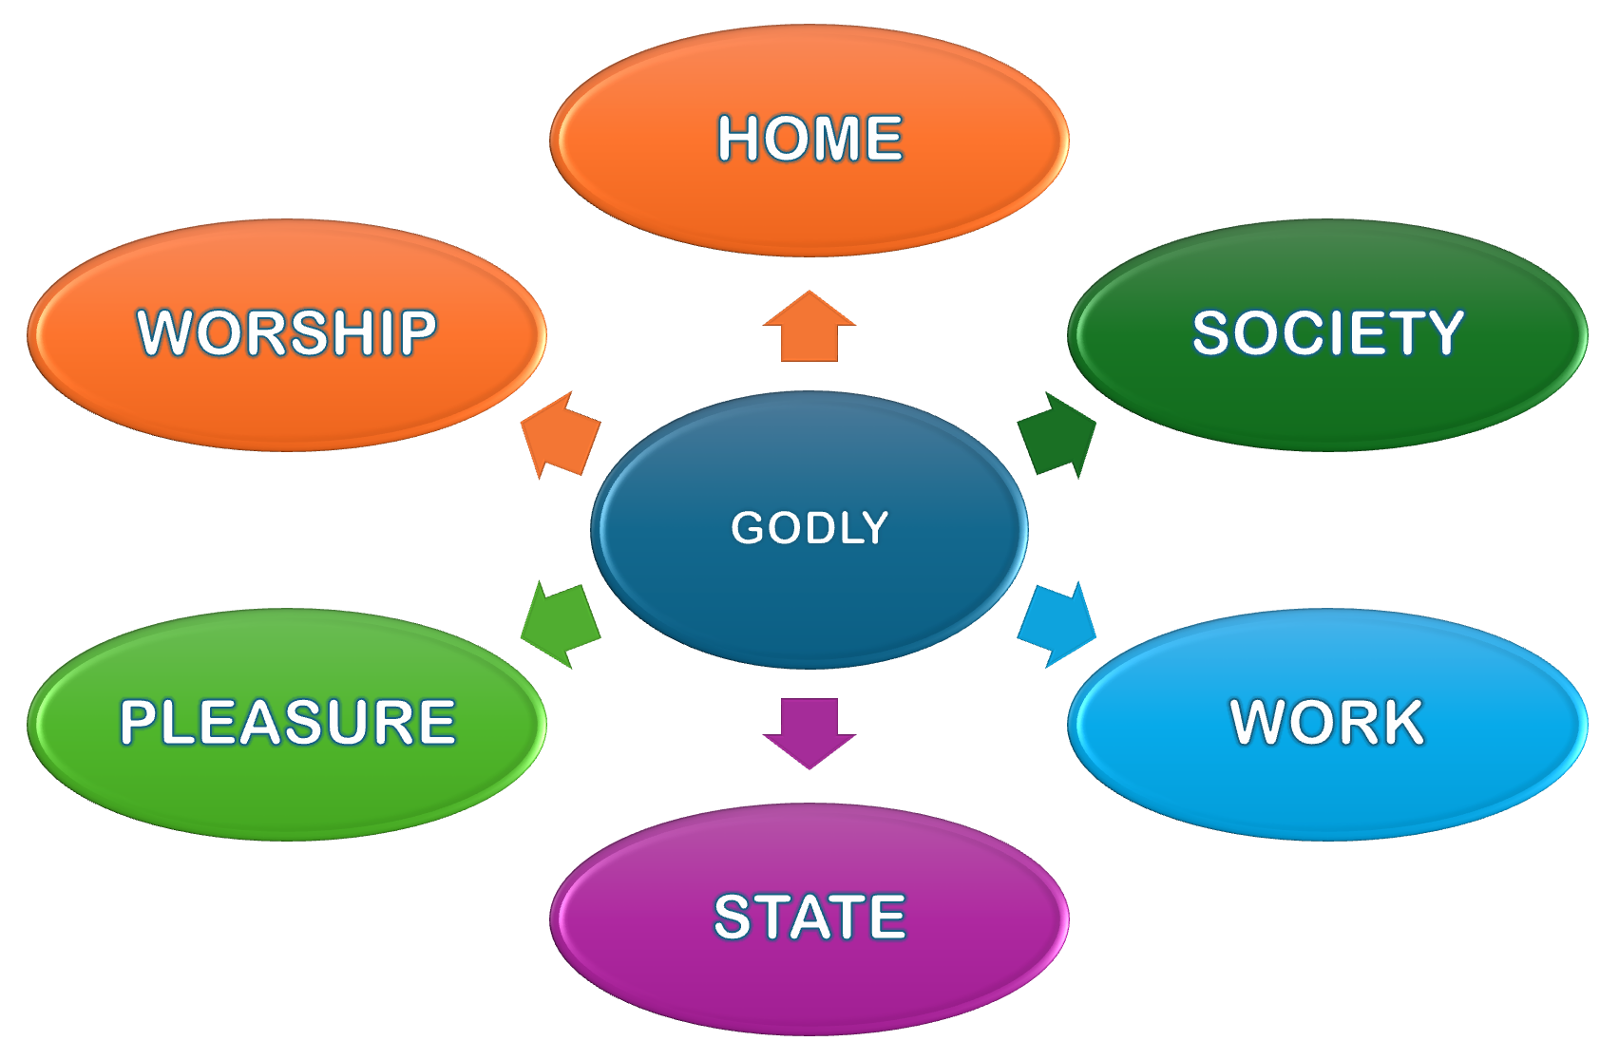
²⁴ God is Spirit, and those who worship Him must worship in spirit and truth.”

Slide 9
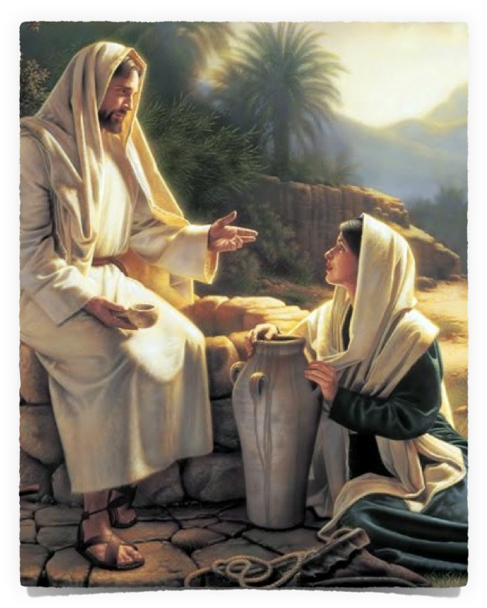
²⁴ … those who worship Him must worship in spirit and truth.”
The Samaritans & Jews disagreed over where God should be worshipped (4:20)
The Samaritans were wrong & the Jews were right (4:22; 2 Kings 17:26-33; Deut 12:5-11; 2 Chron 6:6)
John 4:20 (NKJV)
²⁰ Our fathers worshiped on this mountain, and you Jews say that in Jerusalem is the place where one ought to worship."

Slide 10

²⁴ … those who worship Him must worship in spirit and truth.”
People continue to disagree over the where, when & how one ought to worship God.
Day of worship (Saturday / Sunday)
The Lord’s supper? (When? …)
The collection? (How? …)
Music? (Instrumental / Acapella)
John 4:20 (NKJV)
²⁰ Our fathers worshiped on this mountain, and you Jews say that in Jerusalem is the place where one ought to worship."

Slide 11
²⁴ … those who worship Him must worship in spirit and truth.”
We cannot worship God without knowing God & His will (4:22; Acts 17:23-30; Rom 10:1-3)
Worship is about honoring God, (not ourselves) (Mal 1:6-14; 3:8-10)
Sincerity is essential, but NOT enough (Acts 23:1; Acts 26:9).
Worship must be offered from our hearts and according to His Law.
John 4:21 (NKJV)
²¹ Jesus said to her, "Woman, believe Me, the hour is coming when you will neither on this mountain, nor in Jerusalem, worship the Father.

Slide 12
²⁴ … those who worship Him must worship in spirit and truth.”
There would soon be a change in how men worship the Father. (4:21; 14:6; Eph 2:18; 3:14).
Jesus inaugurated this change after His death & resurrection (Acts 2; 6:14; 1 Tim 2:8)
The OT types & shadows were replaced by the “spiritual realities” to which they pointed.
John 4:21 (NKJV)
²¹ Jesus said to her, "Woman, believe Me, the hour is coming when you will neither on this mountain, nor in Jerusalem, worship the Father.

Slide 13
²⁴ … those who worship Him must worship in spirit and truth.”
OT carnal ordinances (Heb 9:1-10) | NT worship = spiritual (John 4:23,24)
A physical structure | Temple spiritual, Christians (Eph 2:19-22)
A temporal day of rest | Rest in Christ(Heb. 4:4-16)
Special priesthood, clothing | Christians are priests, Holiness (1Pe 2:5,9)
Lamp stands, burning incense | Prayers sweet incense (Rev 5:8)
Instruments of music | Melody made in heart (Ep 5:19)
Feast days | Lord's Supper (1Co 10:16-17)
Animal and meal sacrifices | Spiritual sacrifices (1 Peter 2:5)

Slide 14
²⁴ … those who worship Him must worship in spirit and truth.”
True worship is revealed worship;
(We Must know the Who, the when, the how and the why of worship)
John 4:22
Acts 17:23-30
Rom. 10:1-3, 17
John 4:21 (NKJV)
²¹ Jesus said to her, "Woman, believe Me, the hour is coming when you will neither on this mountain, nor in Jerusalem, worship the Father.

Slide 15


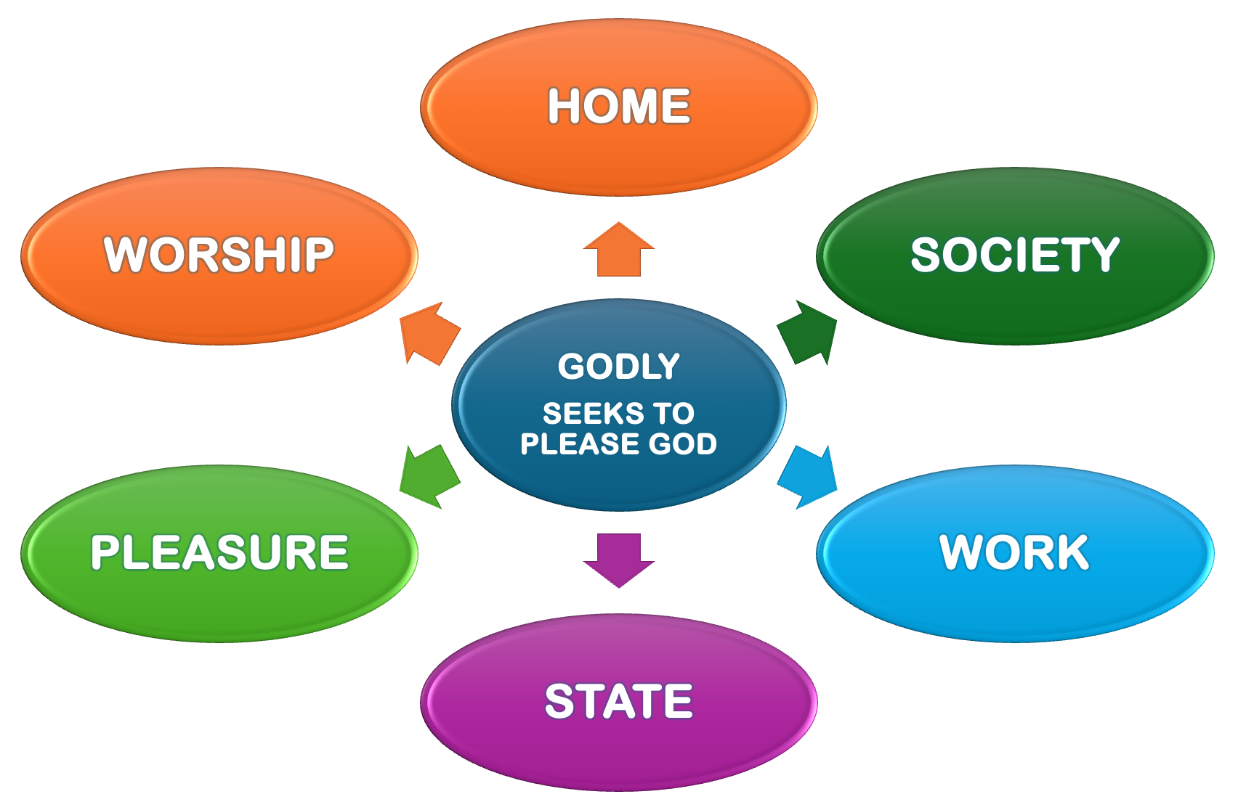
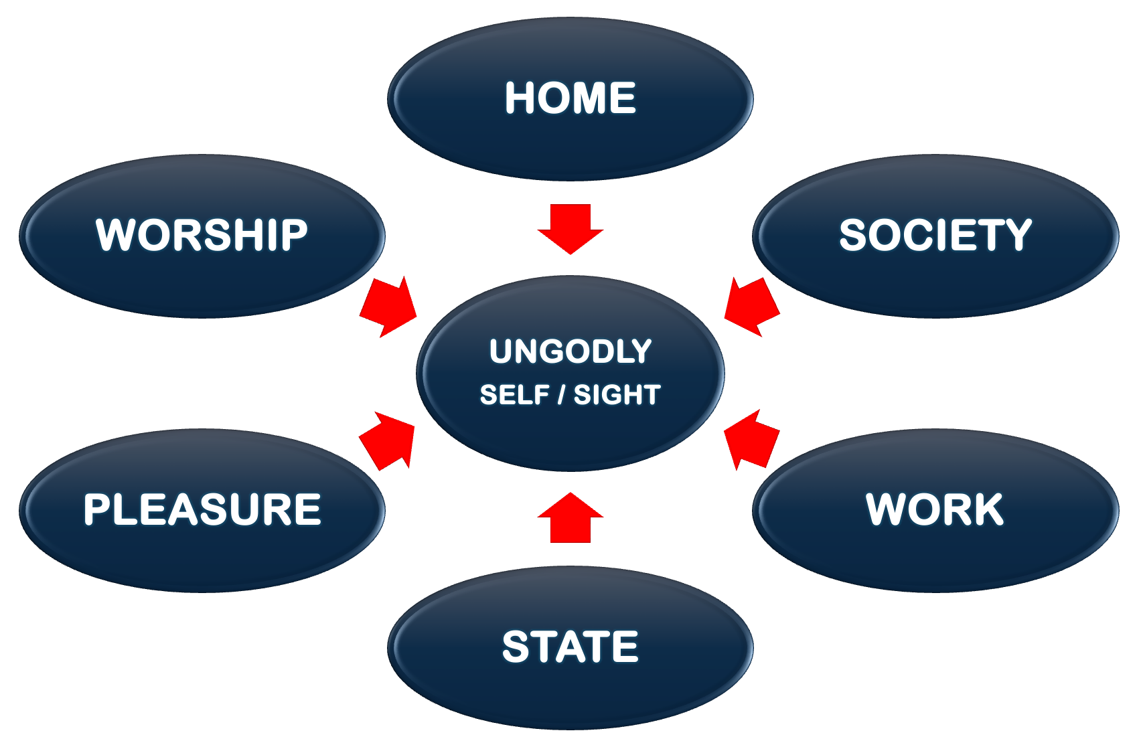

Slide 16
Scriptural
2 Tim. 3:16 - 4:4; 2:15; Acts 17:11
Requires holy, righteous living
Titus 2:11-12; Rom 6; 2 Cor 6:14-7:2; 1 Pet 1:13-19
Teaches the need to submit to the authority of the LORD
Luke 6:46; Heb 5:8,9; 2 John 9
  Doctrines of Men
  Matthew 15:7-9
  Immoral Conduct
  2Tim.3:1-5; Jude 4
  Another Jesus
  2 Cor. 11:2-4
  Men’s Philosophy
  Colossians 2:8

Slide 17
Scriptural
2 Tim. 3:16 - 4:4; 2:15; Acts 17:11
Requires holy, righteous living
Titus 2:11-12; Rom 6; 2 Cor 6:14-7:2; 1 Pet 1:13-19
Teaches the need to submit to the authority of the LORD
Luke 6:46; Heb 5:8,9; 2 John 9
  Seeking to please men
  John 12:43
  “godliness" = “gain”
  I Tim 6:5; 2 Pet 2:3,15; Jude 11
  Easy / Do nothing /
  Eph. 2:8,9 / Mat 7:13,14
  Some love preeminence
  3 John 9, Jude 16

Slide 18
Scriptural
2 Tim. 3:16 - 4:4; 2:15; Acts 17:11
Requires holy, righteous living
Titus 2:11-12; Rom 6; 2 Cor 6:14-7:2; 1 Pet 1:13-19
Teaches the need to submit to the authority of the LORD
Luke 6:46; Heb 5:8,9; 2 John 9
  Carnal people / love the world
  1 Cor 3:1-4; 1 John 2:15-17
  People do not love the truth
  2 The 2:10-12; 2 Tim 4:3,4
  People to not seek the truth
  Acts 17:11,12
  People do not put the Lord 1st Mat 6:33 / Mark 12:29-31

Slide 19
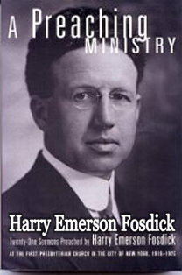
Utilizing The Wrong Methods
“Could any procedure be more surely predestined to dullness and futility? Who seriously supposes that, as a matter of fact, one in a hundred of the congregation cares, to start with, what Moses, Isaiah, Paul, or John meant in those special verses, or came to church deeply concerned about it? Nobody who talks to the public so assumes that the vital interest of the people are located in the meaning of words spoken two thousand years ago.”
(“What Is The Matter With Preaching?” Harpers Magazine, July 1928, pg 135)

Slide 20
Utilizing The Wrong Methods
“It is crucial for the leader to decide what style of worship the church will embrace. Worship style is not simply musical style. The entire worship experience must be evaluated through the eyes of your target. When you confidently determine who your target is—who you’re trying to reach—it makes crafting a worship experience for that person a lot easier. Through some trial and error you will learn what works and what does not work for your target group.”
Ron Sylvia is the founding pastor of Church @ The Springs in Ocala, Fla.
(Ron Sylvia “Determining Your Worship Style” pg 135)

Slide 21
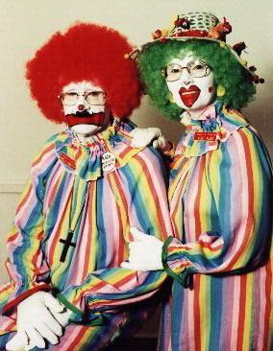
Utilizing The Wrong Methods
Pragmatism – i.e. - whatever works is good – (entertainment, recreation, etc)
A market driven ministry – Find out what people want and give it to them – (do not offer what they do not want)
Do not preach or teach about doctrine, sin, hell, etc., (doctrine isn’t important anyway), and do whatever will make Christianity popular.

Slide 22

Utilizing The Wrong Methods
Reinforces a “Man Centered” and a “Self Serving” view of worship [Idolatry] (Rom 1:25)
Cannot adequately convey deeper truths necessary for growth! (1 Tim 4:12-16)
Diminishes sense of awe and reverence that MUST be present when approaching GOD – (Heb 12:28)
Reflects and promotes a lack of confidence in the power of the gospel!! (Romans 1:16)

Slide 23
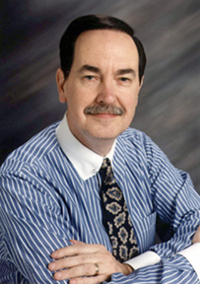
Utilizing The Wrong Methods
“The social gospel is about causes, not Christ; agendas, not Alpha and Omega; politics, not the Prince of Peace; more of this world and less of the next one. It’s a subtle, but effective, means of distracting evangelicals from their paramount calling, which is about conversion, not political convictions” –
Cal Thomas - “The Evangelical Third Coming” — published in mid-March 2005

Slide 24
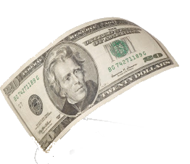

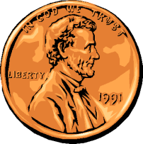

THE SOCIAL GOSPEL
?
Entertainment
?
?
Recreation
Social Ills
God’s work

Slide 25
Religious | UNgodly | GODLY
Goals? | Numbers | Eph 4:12-16
Doctrine? | Pleasing Men | 2 John 9
Worship? | “Feel Good” | Heb 12:28
Activities? | Secular | Col. 3:17

Slide 26

ARE YOU SEEKING TO PLEASE GOD?
James 1:26–27 (NKJV)
²⁶ If anyone among you thinks he is religious, and does not bridle his tongue but deceives his own heart, this one’s religion is useless. ²⁷ Pure and undefiled religion before God and the Father is this: to visit orphans and widows in their trouble, and to keep oneself unspotted from the world.

Slide 27

ARE YOU SEEKING TO PLEASE GOD?
Obey the Lord Jesus — Mat. 17:5; Heb. 1:1,2
Hear Him — Romans 10:17
Believe in Him — John 8:24
Confess Him — Romans 10:9,10
Turn from self and sin to humbly submit to Him (Repent) — Acts 17:30
Be baptized in the name of Jesus — Mat. 28:19; Acts 2:38; Rom. 6:3-6
Abide in His word — John 8:31,32; 2 Jn. 9

Slide 28
James 1:26,27; John 4:19-24
Hebrews 12:28–29 (NKJV)
²⁸ Therefore, since we are receiving a kingdom which cannot be shaken, let us have grace, by which we may serve God acceptably with reverence and godly fear. ²⁹ For our God is a consuming fire.

Slide 30
James 1:26,27; John 4:19-24
Charts by Don McClain
Preached July 12, 2026 / Alexander church of Christ
Phone: 501-568-1062
Email – donmcclain@sbcglobal.net
More Keynote, PPT & Audio Sermons
www.alexanderchurchofchrist.com

Slide 31



100 CORNERSTONE ALEXANDER AR, 72002
You Are Welcome At Any And All of Our Services!
Meeting Times:
Sunday A.M. Bible Study: 9:00
Sunday A.M. Assembly: 10:00
Sunday P.M. Assembly: 4:00
Wed. P.M. Bible Study: 7:00
ALEXANDERCHURCHOFCHRIST.COM

Slide 32

Hebrews 12:25–29 (NKJV)
²⁵ See that you do not refuse Him who speaks. For if they did not escape who refused Him who spoke on earth, much more shall we not escape if we turn away from Him who speaks from heaven, ²⁶ whose voice then shook the earth; but now He has promised, saying, “Yet once more I shake not only the earth, but also heaven.” ²⁷ Now this, “Yet once more,” indicates the removal of those things that are being shaken, as of things that are made, that the things which cannot be shaken may remain. ²⁸ Therefore, since we are receiving a kingdom which cannot be shaken, let us have grace, by which we may serve God acceptably with reverence and godly fear. ²⁹ For our God is a consuming fire.

