Slide 1


Psalm 97:10; Proverbs 8:13; Matthew 5:27-30; Romans 12:9

Slide 2




Not merely “doing good.”
Not merely “doing what is right.”
Not exactly “Godlikeness”
Opposite of Ungodliness.
An Attitude directed towards pleasing God, resulting in a way of life.
Titus 2:11–12 (NKJV)
¹¹ For the grace of God that brings salvation has appeared to all men, ¹² teaching us that, denying ungodliness and worldly lusts, we should live soberly, righteously, and godly in the present age,

Slide 3

Thayer: “Reverence. Respect; in the Bible everywhere piety towards God.”
W.E. Vine: “That piety which, characterized by a Godward attitude, does that which is well pleasing to Him.”

Slide 4

GOD
RELIGION
LEISURE
FAMILY
PROFESSION

Slide 5






⁷ But reject profane and old wives’ fables, and exercise yourself toward godliness. — 1 Timothy 4:7 (NKJV)
2 Peter 1:1–11

Slide 6

James 1:26,27; John 4:19-24
Hebrews 12:28–29 (NKJV)
²⁸ Therefore, since we are receiving a kingdom which cannot be shaken, let us have grace, by which we may serve God acceptably with reverence and godly fear. ²⁹ For our God is a consuming fire.

Slide 7

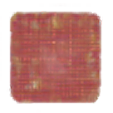
Sin is not a minor issue or a cultural preference.
Sin is rebellion against the holy God who created us.
Today, sin is increasingly celebrated, redefined, and even defended as personal freedom or identity.
Psalm 97:10 (NKJV)
¹⁰ You who love the Lord, hate evil!

Slide 8
Psalm 36:1–4 (NKJV)
¹ An oracle within my heart concerning the transgression of the wicked: There is no fear of God before his eyes. ² For he flatters himself in his own eyes, When he finds out his iniquity and when he hates. ³ The words of his mouth are wickedness and deceit; He has ceased to be wise and to do good. ⁴ He devises wickedness on his bed; He sets himself in a way that is not good; He does not abhor evil.
Psalm 97:10–12 (NKJV)
¹⁰ You who love the Lord, hate evil! He preserves the souls of His saints; He delivers them out of the hand of the wicked. ¹¹ Light is sown for the righteous, And gladness for the upright in heart. ¹² Rejoice in the Lord, you righteous, And give thanks at the remembrance of His holy name.
VS.
Psalm 97:10 (NKJV)
¹⁰ You who love the Lord, hate evil!

Slide 9
Our culture has moved from tolerating sin to celebrating and defending it.
This shift carries serious spiritual dangers and has visibly affected many churches.
Psalm 97:10 (NKJV)
¹⁰ You who love the Lord, hate evil!

Slide 10
HOW TO BECOME desensitized to sin
Familiarity (Prov. 6:27,28)
Rebranding (Isaiah 5:20)
Laughing At Sin (Eph. 5:4)
Sympathizers (Isa. 30:10)
Comparison (2 Cor. 10:12)

Slide 11

DANGER of COMPROMISING WITH SIN
Behaviors once widely recognized as sinful (sexual immorality, same-sex relationships, gender confusion, abortion, dishonesty in public life, etc.) are now often presented as rights, identities, or expressions of love.
Media, education, and law increasingly normalize and protect what Scripture calls sin, defending sin with slogans such as “love is love,” “my truth,” or “progress.”

Slide 12
DANGER of COMPROMISING WITH SIN
Presbyterian Church - 1978
“…Homosexuality is not God's wish for humanity…On the basis of our under-standing that the practice of homosexuality is sin, we are concerned that homosexual believers and the observing world should not be left in doubt about the church's mind on this issue during any further period of study.”
(Minutes of the 190th General Assembly [1978], United Presbyterian Church in the U.S.A., pp. 261-62)

Slide 13
DANGER of COMPROMISING WITH SIN
Presbyterian Church - 1980
“In 1980, a General Assembly added: ‘Homosexuality presents a particular problem for the church. It seems to be contrary to the teaching of scripture.’”
(Minutes of the 120th General Assembly [1980], Presbyterian Church in the United States, p. 213)

Slide 14
DANGER of COMPROMISING WITH SIN
Presbyterian Church - 1991
The church should “re-evaluate its definition of sin to reflect the changing mores of society.” … the church should sound “a call for widening the circle of the faithful—not with children, but with non-reproductive gays, lesbians, and heterosexual singles who practice ‘safe sex.’
We feel that marriage is not what legitimates sexual gratification.”
(Roll Over John Calvin, Time Magazine, 5-6-91, p. 59)

Slide 15
DANGER of COMPROMISING WITH SIN
1978 - Homosexuality is sin.
1980 – “Seems” to be contrary to Scripture.
1991 - Re-evaluate Definition of Sin.
2011 - deleted language "fidelity within the covenant of marriage between a man and a woman or chastity in singleness."
2014 - the General Assembly voted to change the constitutional definition of marriage from "a man and a woman" to "two people."

Slide 16
DANGER of COMPROMISING WITH SIN
The Episcopal Church: In 2015 formally authorized liturgies for same-sex marriage.
Evangelical Lutheran Church in America (ELCA): voted at its 2009 Churchwide Assembly to allow the ordination of clergy in faithful, same-sex relationships.
The United Methodist Church (UMC) in May 2024 voted overwhelmingly (692 to 43) to remove the 52-year-old ban on LGBTQ+ clergy and same-sex wedding prohibitions.

Slide 17

SIN IS NOT DETERMINED BY:
Majority – Matt. 7:13-14; Gen. 6:5-7
Family Relations – Matt. 10:34-37
Government – Acts 4:19; 5:29
Sincerity – Acts 26:9-11; 23:1; 1 Tim. 1:15
End Justifies the Means – Rom. 3:8
Feelings – Gen. 37:35; Prov. 16:25
Changing Mores of Society – Acts 17:30

Slide 18


SIN IS WHAT GOD SAYS IS SIN
Sin is lawlessness — active rebellion against God’s revealed will (1 John 3:4)
If not of faith, violation of ones conscience (Romans 14:23)
All unrighteousness, injustice (1 John 5:17)
Sin includes sins of omission, failing to do what we know is right, O+A=R (James 4:17)
Sin is falling short of God’s standard He has prescribed (Romans 3:23; cf. Ecc. 12:13)

Slide 19
1 Corinthians 6:7–11 (NKJV)
⁷ Now therefore, it is already an utter failure for you that you go to law against one another. Why do you not rather accept wrong? Why do you not rather let yourselves be cheated? ⁸ No, you yourselves do wrong and cheat, and you do these things to your brethren! ⁹ Do you not know that the unrighteous will not inherit the kingdom of God? Do not be deceived. Neither fornicators, nor idolaters, nor adulterers, nor homosexuals, nor sodomites, ¹⁰ nor thieves, nor covetous, nor drunkards, nor revilers, nor extortioners will inherit the kingdom of God. ¹¹ And such were some of you. But you were washed, but you were sanctified, but you were justified in the name of the Lord Jesus and by the Spirit of our God.

Slide 20
Galatians 5:19–21 (NKJV)
¹⁹ Now the works of the flesh are evident, which are: adultery, fornication, uncleanness, lewdness, ²⁰ idolatry, sorcery, hatred, contentions, jealousies, outbursts of wrath, selfish ambitions, dissensions, heresies, ²¹ envy, murders, drunkenness, revelries, and the like; of which I tell you beforehand, just as I also told you in time past, that those who practice such things will not inherit the kingdom of God.

Slide 21

Defining What Sin Is
Commission
Omission
Doing what God Forbids (Gen 2:17,18; 3:6,17; 1 Cor 6:9-11).
Adding to God’s Word (Deut. 4:2; Rev. 22:19; 2 Sam. 6:3; Num. 4:1-15; Mat. 15:5,6).
Making substitutions (Gen. 4:4; Lev. 10; Heb 8:5).
Not doing what God Commands (1 Sam. 15; 1 Chro. 15:13).
Subtracting from God’s Word (Deut. 4:2; Rev. 22:19; Mat. 23:1-3).
Knowing to do good and not doing it (Jam. 4:17)

Slide 22
Defining What Sin Is
Knowledge
Teaching
G
R
O
W
T
H
No such thing as situational ethics!!
Patience
Service
Christian Growth - 2 Peter 1:5-10
Adultery – Homosexuality
Fornication – Murder
Lying - Stealing, etc. . . .
Absolute, Immediately Condemns –
1 Cor 6:9-11;
Gal 5:19-21
All Sin Must be forgiven
years
5 10 15 20
No Time - Heb 13:4
Time - Heb 5:12

Slide 23
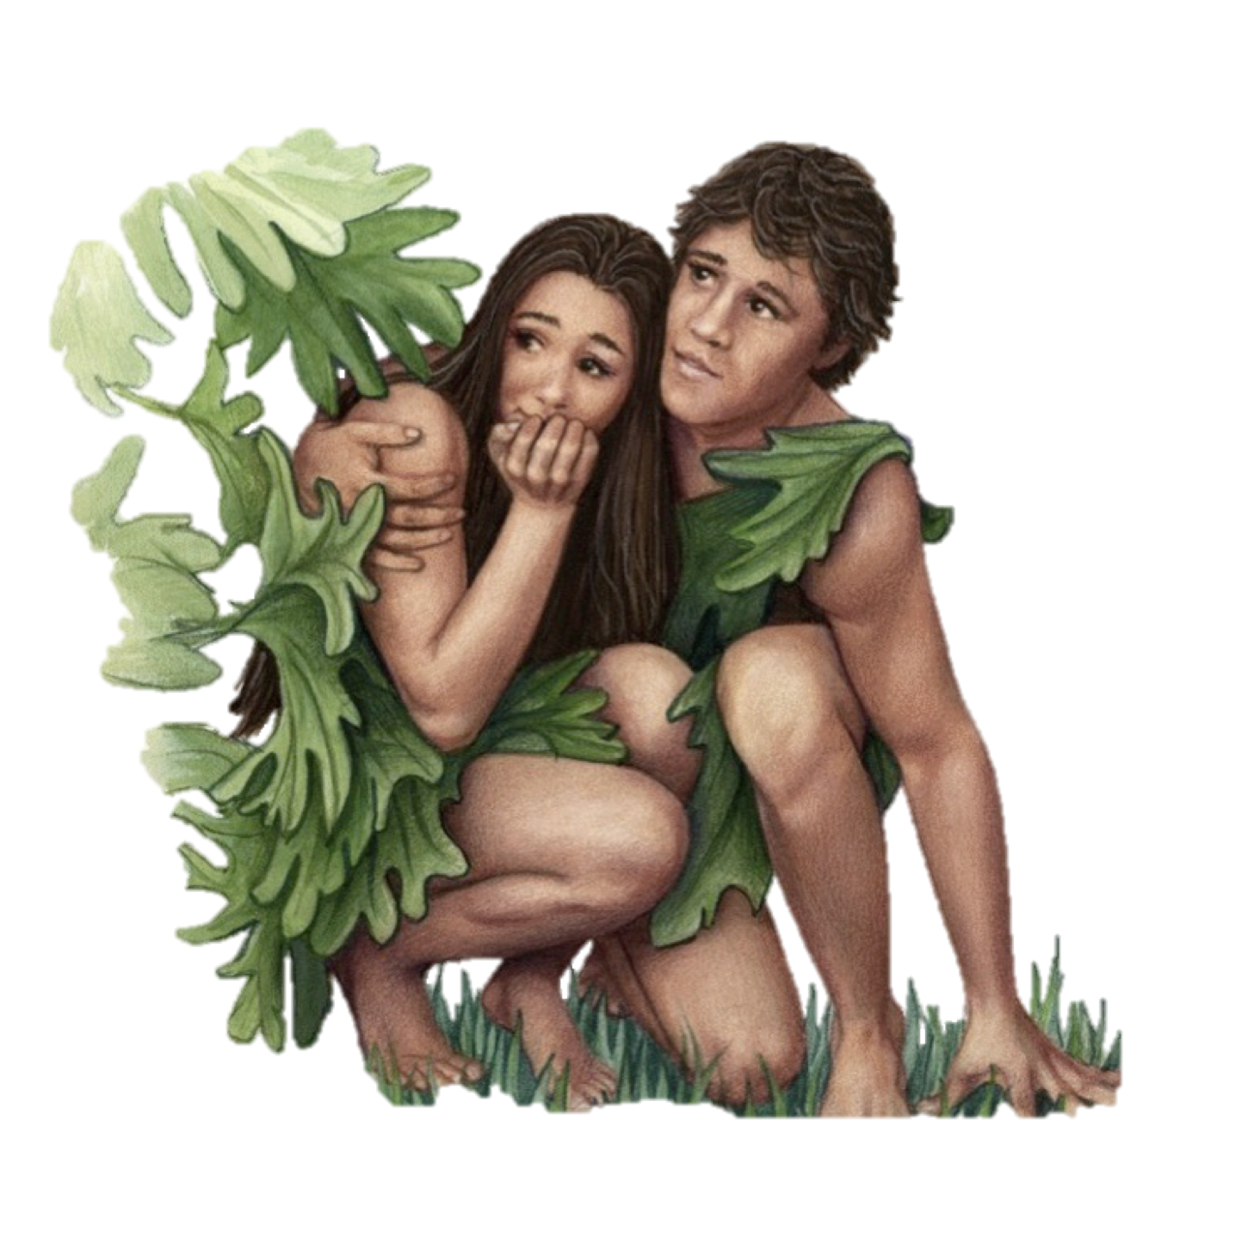
Defining What Sin Is
The first sin is a case study of all sin - Gen. 3:1-6; 1 Jn 2:15,16
Jesus was tempted through the same avenues - Mat 4:1-11; Heb. 4:15
Sin OCCURS when desire is enticed and the will yields - James 1:13-16; 1 Cor 9:27

Slide 24
Defining What Sin Is
Sin is not merely a mistake, a weakness, social construct, or inherent human nature.
Sin is any lack of conformity to or transgression of the law of God in thought, word, or deed, and is ultimately an offense against God’s holy character (Psalm 51:4 — “Against thee, thee only, have I sinned…”).
Even “respectable” sins (pride, gossip, bitterness, greed, self-righteousness) are offensive to God.

Slide 25
Scripture calls God’s people to a radically different attitude:
Not acceptance, not indifference, not tolerance,
But a holy hatred of sin that flows from our love for God and His love for us.
Romans 12:9 (NKJV)
⁹ Let love be without hypocrisy. Abhor what is evil. Cling to what is good.

Slide 26
Psalm 97:10–12 (NKJV)
¹⁰ You who love the Lord, hate evil! He preserves the souls of His saints; He delivers them out of the hand of the wicked. ¹¹ Light is sown for the righteous, And gladness for the upright in heart. ¹² Rejoice in the Lord, you righteous, And give thanks at the remembrance of His holy name.

Slide 27
Psalm 119:102–104, 127,128 (NKJV)
¹⁰² I have not departed from Your judgments, For You Yourself have taught me. ¹⁰³ How sweet are Your words to my taste, Sweeter than honey to my mouth! ¹⁰⁴ Through Your precepts I get understanding; Therefore I hate every false way.
… ¹²⁷ Therefore I love Your commandments More than gold, yes, than fine gold! ¹²⁸ Therefore all Your precepts concerning all things I consider to be right; I hate every false way.

Slide 28
Proverbs 8:12–17 (NKJV)
¹² “I, wisdom, dwell with prudence, And find out knowledge and discretion. ¹³ The fear of the Lord is to hate evil; Pride and arrogance and the evil way And the perverse mouth I hate. ¹⁴ Counsel is mine, and sound wisdom; I am understanding, I have strength. ¹⁵ By me kings reign, And rulers decree justice. ¹⁶ By me princes rule, and nobles, All the judges of the earth. ¹⁷ I love those who love me, And those who seek me diligently will find me.

Slide 29
God does not merely ask us to avoid sin or feel mildly uncomfortable with it (righteous Lot, who was oppressed by the filthy conduct of the wicked — (2 Peter 2:7)
He calls His people to hate sin with a holy hatred that reflects His own character (1 Peter 1:16; cf. Lev. 11:44, 45; 19:2; 20:7).
Jesus Himself reinforced this radical attitude toward sin …
Romans 12:9 (NKJV)
⁹ Let love be without hypocrisy. Abhor what is evil. Cling to what is good.

Slide 30
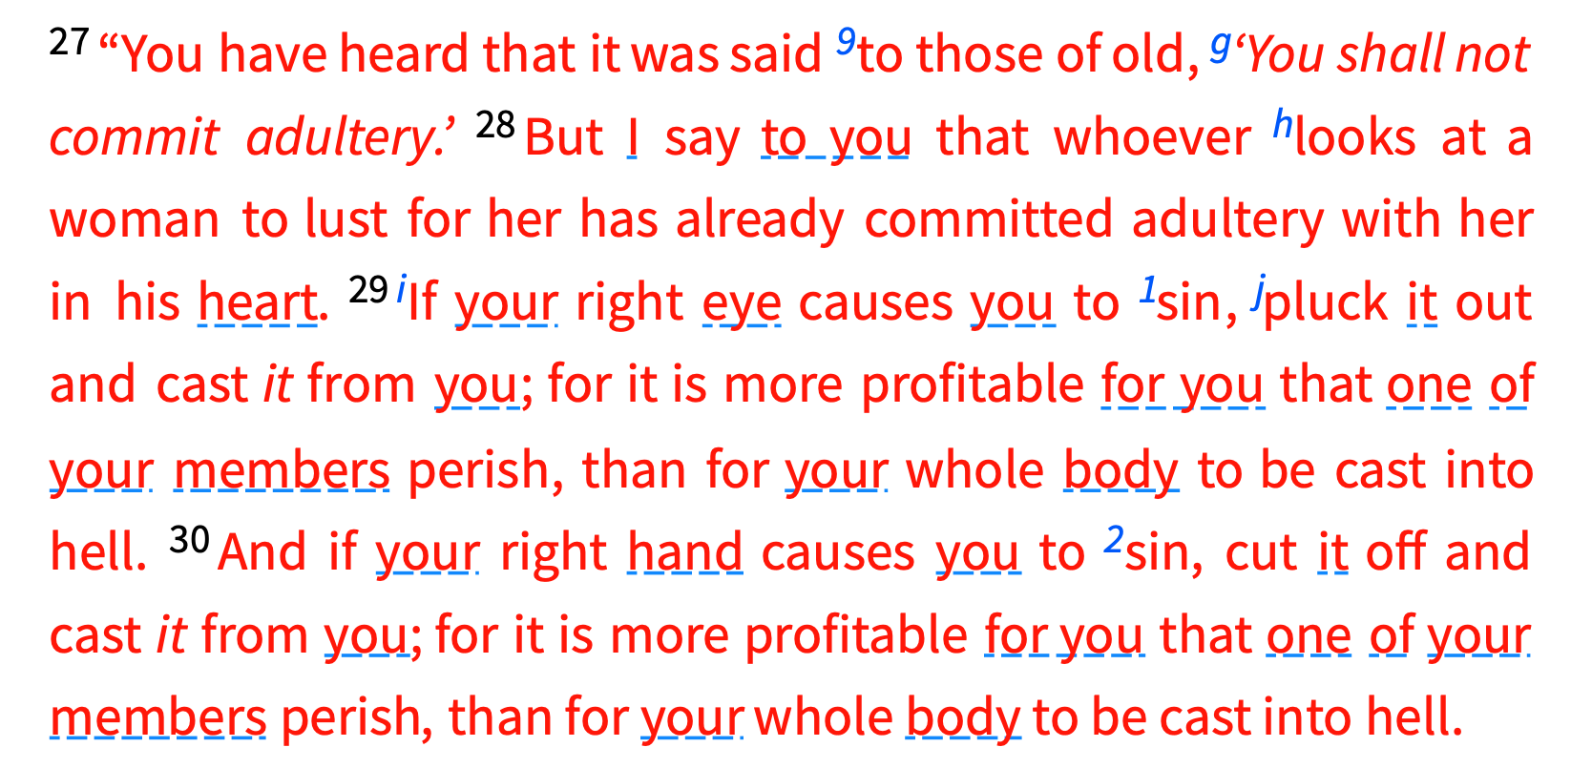
Matthew 5:27-30 (NKJV)

Slide 31
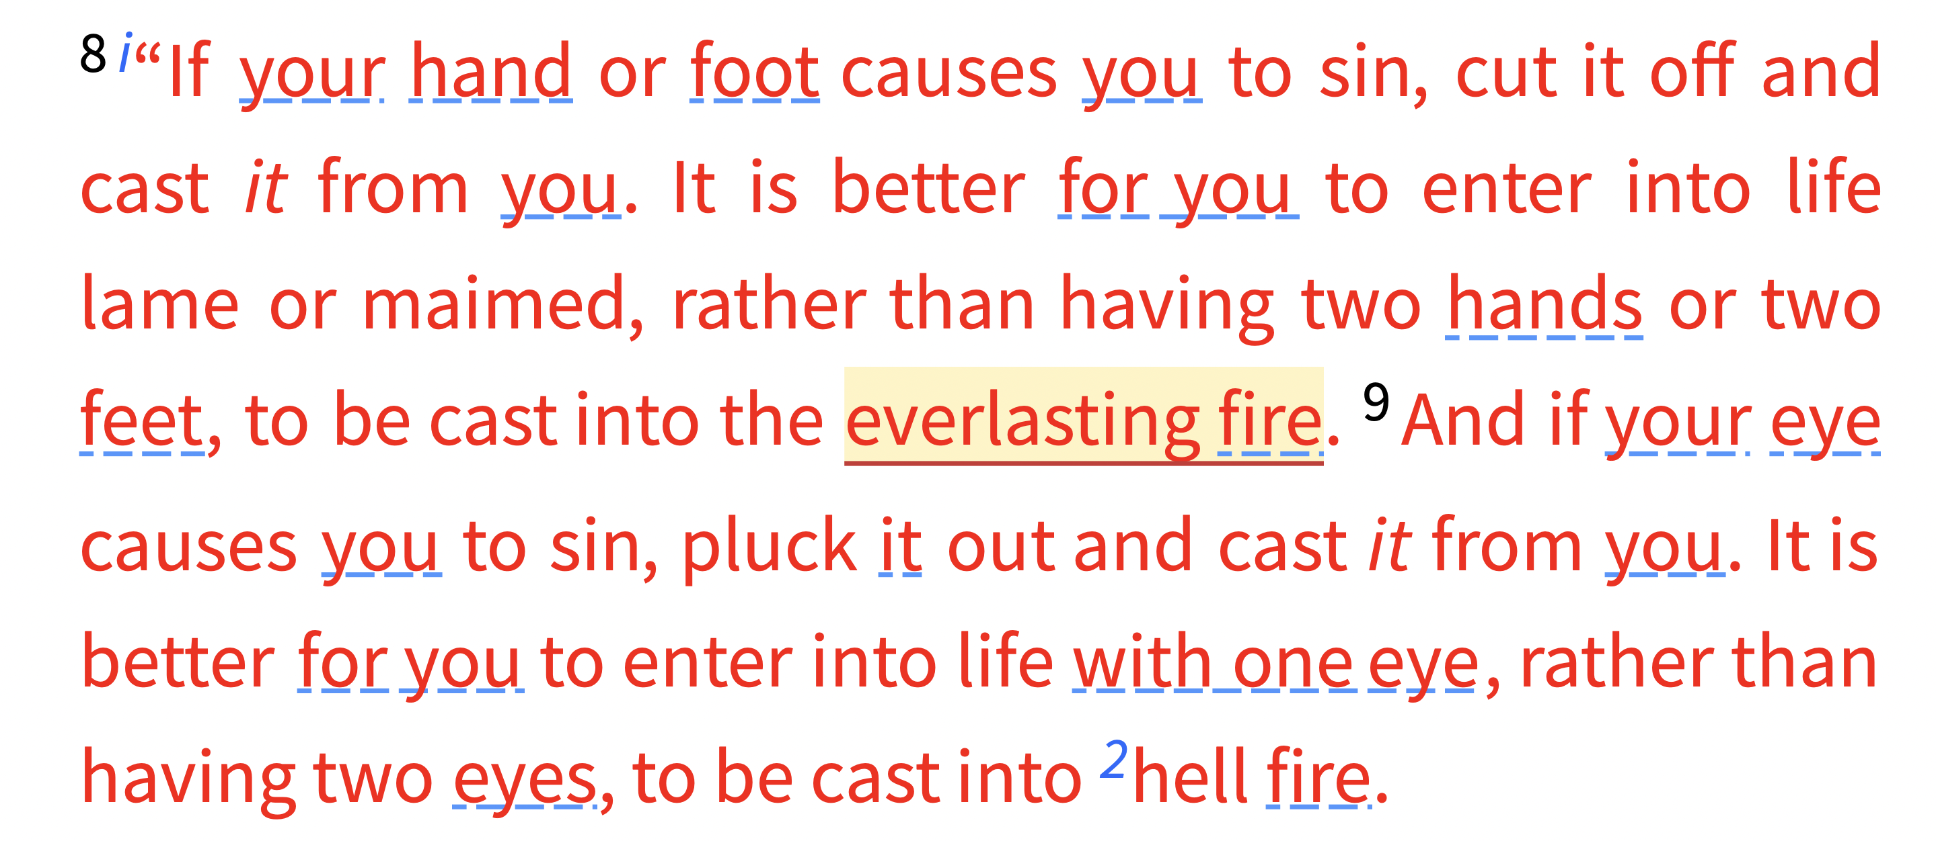
Matthew 18:8,9 (NKJV)

Slide 32
Jesus calls His followers to be willing to take the most radical, costly, and painful measures necessary to remove whatever causes them to stumble —
Jesus may be using hyperbolic language, but He is making a profound point: sin is so destructive and so offensive to God that believers must deal with it decisively and without compromise.
Matthew 18:8,9 (NKJV)
It is better for you to enter into life lame or maimed, rather than having two hands or two feet, to be cast into the everlasting fire.

Slide 33
We are to treat sin with such holy hatred that we are prepared to amputate its sources at great personal cost rather than allow it to remain and lead us (and others) into judgment.
This illustrates the depth of abhorrence toward sin that God requires of those who claim to love Him.
Matthew 18:8,9 (NKJV)
It is better for you to enter into life lame or maimed, rather than having two hands or two feet, to be cast into the everlasting fire.

Slide 34

HOW TO CULTIVATE A GODLY VIEW OF SIN:
Regular, prayerful engagement with Scripture — The more we love God’s Word, the more we will hate every false way (Psalm 119).
Mortification of sin (Rom. 8:13; Col. 3:5-10).
Putting on Christ (Rom. 6:3-19; Col. 3:12-17)
Guarding the heart and avoiding temptation — Flee from what fuels sinful desires (Prov. 4:23; Mat. 5:29-32; 1 Cor. 6:18).

Slide 35
HOW TO CULTIVATE A GODLY VIEW OF SIN:
Pray for conviction and hatred of sin (Psalm 139:23-24 — “Search me, O God…”).
Daily self examination, confession and turning from sin (1 John 1:9; 2:1-2).
Fixing our eyes on JESUS (Hebrews 12:1) Meditating on who Jesus is and what He accomplished makes sin appear increasingly ugly and offensive.
Surround yourself with believers who will speak truth in love (Heb. 3:12-13; 10:24,25).

Slide 36
HOW TO CULTIVATE A GODLY VIEW OF SIN:
James 4:7–10 (NKJV)
⁷ Therefore submit to God. Resist the devil and he will flee from you. ⁸ Draw near to God and He will draw near to you. Cleanse your hands, you sinners; and purify your hearts, you double-minded. ⁹ Lament and mourn and weep! Let your laughter be turned to mourning and your joy to gloom. ¹⁰ Humble yourselves in the sight of the Lord, and He will lift you up.

Slide 37

IF YOU ARE DEAD IN SIN …
Obey the Lord Jesus — Mat. 17:5; Heb. 1:1,2
Hear Him — Romans 10:17
Believe in Him — John 8:24
Confess Him — Romans 10:9,10
Turn from self and sin to humbly submit to Him (Repent) — Acts 17:30
Be baptized in the name of Jesus — Mat. 28:19; Acts 2:38; Rom. 6:3-6
Abide in His word — John 8:31,32; 2 Jn. 9

Slide 38
Psalm 97:10–12 (NKJV)
¹⁰ You who love the Lord, hate evil! He preserves the souls of His saints; He delivers them out of the hand of the wicked. ¹¹ Light is sown for the righteous, And gladness for the upright in heart. ¹² Rejoice in the Lord, you righteous, And give thanks at the remembrance of His holy name.

Slide 39



100 CORNERSTONE ALEXANDER AR, 72002
You Are Welcome At Any And All of Our Services!
Meeting Times:
Sunday A.M. Bible Study: 9:00
Sunday A.M. Assembly: 10:00
Sunday P.M. Assembly: 4:00
Wed. P.M. Bible Study: 7:00
ALEXANDERCHURCHOFCHRIST.COM

Slide 41
Charts by Don McClain
Preached July 19, 2026 / Alexander church of Christ
Phone: 501-568-1062
Email – donmcclain@sbcglobal.net
More Keynote, PPT & Audio Sermons
www.alexanderchurchofchrist.com

