Slide 1

Is Perfection Possible?

Slide 2
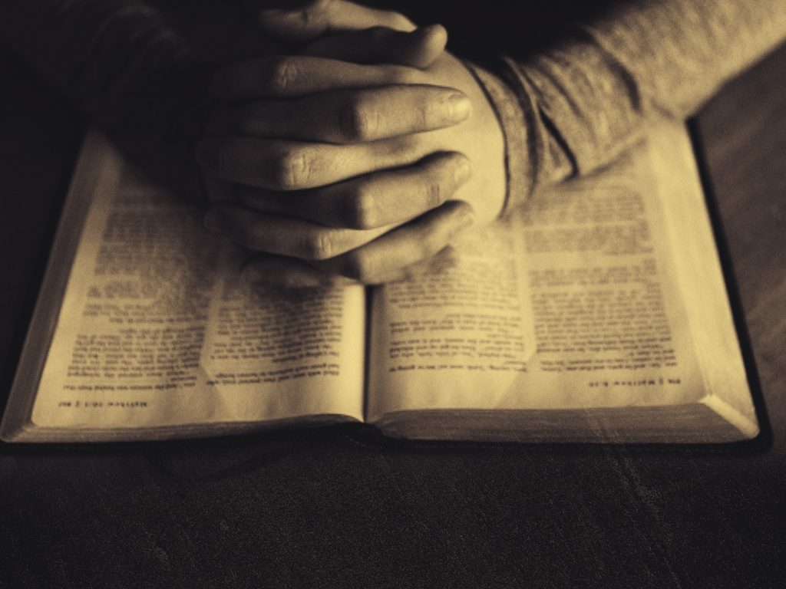
The Biblical Meaning of “Perfection”
The word “teleios” is often translated “perfect,” but it means:
  Complete, mature, whole, or full grown.
  It carries the idea of reaching an intended goal or purpose.
  It does not mean flawlessness or sinless perfection in the modern sense.

Slide 3
The Biblical Meaning of “Perfection”
Hebrew word “tam” or “tamim” is translated “blameless” or “upright.”
Job is described as “blameless and upright” – not sinless, but sincere and faithful.
Noah is described as a “righteous man, blameless among the people of his time” (Gen. 6:9).

Slide 4
The Biblical Meaning of “Perfection”
Matthew 5:48 – Loving your enemies as God loves
James 1:4 – Spiritual wholeness
1 Corinthians 14:20 – Paul contrasts being spiritual “infants” in thinking with being “mature”
The biblical usage of the term “perfection” in the lives of God’s children refers to maturity and wholeness

Slide 5
God’s Calling:
“Be Perfect”
The context: Love like God
  Love your enemies (Matt. 5:44)
  Pray for persecutors (Matt. 5:44)
  Don’t restrict your love to those who love you (Matt. 5:46-47)
Christ invites us to grow in spiritual maturity, love and fellowship
  Renewed in Christ (Eph. 4:23-24)
  Encouraged to be partakers and participants of the divine nature (2 Cor. 3:18; 2 Pet. 1:4)

Slide 6
A Call to Imitation,
Not Instant Arrival
“Be kind to one another, tender-hearted, forgiving each other, just as God in Christ also has forgiven you. Therefore, be imitators of God, as beloved children; and walk in love, just as Christ also loved you and gave Himself for us…” (Eph. 4:32-5:2).
Peter writes: “After you have suffered for a little while, the God of all grace, who called you to His eternal glory in Christ, will Himself perfect, confirm, strengthen, and establish you” (1 Pet. 5:10).
“Therefore, since we have these promises, dear friends, let us purify ourselves from everything that defiles body and spirit, perfecting holiness out of reverence for God” (2 Cor. 7:1).

Slide 7
The Path to Perfection
We grow into spiritual maturity (Heb. 6:1; Col. 1:25-29; 4:12)
How does God help us to grow?
  Word of God (2 Tim. 3:16-17)
  Trials and testing (James 1:2-4; cf. 2 Cor. 12:9)
  Teaching, edifications, and correction found in a faithful local church (Eph. 4:11-13)
Biblical perfection is not about being flawless, but being fully formed in Christ through discipleship, obedience, and by grace: “My children, with whom I am again in labor until Christ is formed in you…” (Gal. 4:19).

Slide 8
Jesus Christ:
Our Model and Means of Perfection
“Although He was a Son, He learned obedience by the things which He suffered. And having been made perfect, He became to all those who obey Him the source of eternal salvation” (Heb. 5:8-9).
“For I am confident of this very thing, that He who began a good work in you will perfect it until the day of Jesus Christ” (Phil. 1:6)
“For by one offering He has perfected for all time those who are sanctified” (Heb. 10:14)

Slide 9
Jesus Christ:
Our Model and Means of Perfection
“Such were some of you; but you were washed, but you were sanctified, but you were justified in the name of the Lord Jesus Christ and in the Spirit of our God” (1 Cor. 6:11).
“But whoever keeps His word, in him the love of God has truly been perfected” (1 John 2:5).
“There is no fear in love; but perfect love casts out fear, because fear involves punishment, and the one who fears is not perfected in love” (1 John 4:18).

Slide 10
Jesus Christ:
Our Model and Means of Perfection
“There is no fear in love; but perfect love casts out fear, because fear involves punishment, and the one who fears is not perfected in love” (1 John 4:18).
“And in Him you have been made complete…” (Col. 2:10)
“… so that Christ may dwell in your hearts through faith; and that you, being rooted and grounded in love, ¹⁸ may be able to comprehend with all the saints what is the width and length and height and depth, ¹⁹ and to know the love of Christ which surpasses knowledge, that you may be filled to all the fullness of God” (Eph. 3:17-19).

Slide 11
The Promise of
Final Perfection
Paul was not perfect in the sense that he had not experienced the future bodily resurrection and transformation (Phil. 3:11, 20-21; cf. 1 Cor. 15:45-49).
Are to be perfect in the sense of spiritual maturity: “Let us therefore, as many as are perfect (spiritually mature), have this attitude…however let us keep living by that same standard to which we have attained” (Phil. 3:15-16).
Paul was spiritually mature: “Brethren, join in following my example, and observe those who walk according to the pattern you have in us” (Phil. 3:17).
We can be spiritually mature and continue to grow simultaneously (1 Cor. 2:6, 14-3:1; 14:20; Heb. 5:12-14).

