Slide 1

Psalm 127:1; Deuteronomy 6:4–9; Colossians 3:18–21

Slide 2



GOD
RELIGION
LEISURE
FAMILY
PROFESSION

Slide 3


Necessity of Godliness.
Essentials To Godliness.
Godly Religion.
Godly View of Sin.
Godly Use of Our Bodies.
Titus 2:11–12 (NKJV)
¹¹ For the grace of God that brings salvation has appeared to all men, ¹² teaching us that, denying ungodliness and worldly lusts, we should live soberly, righteously, and godly in the present age,

Slide 4

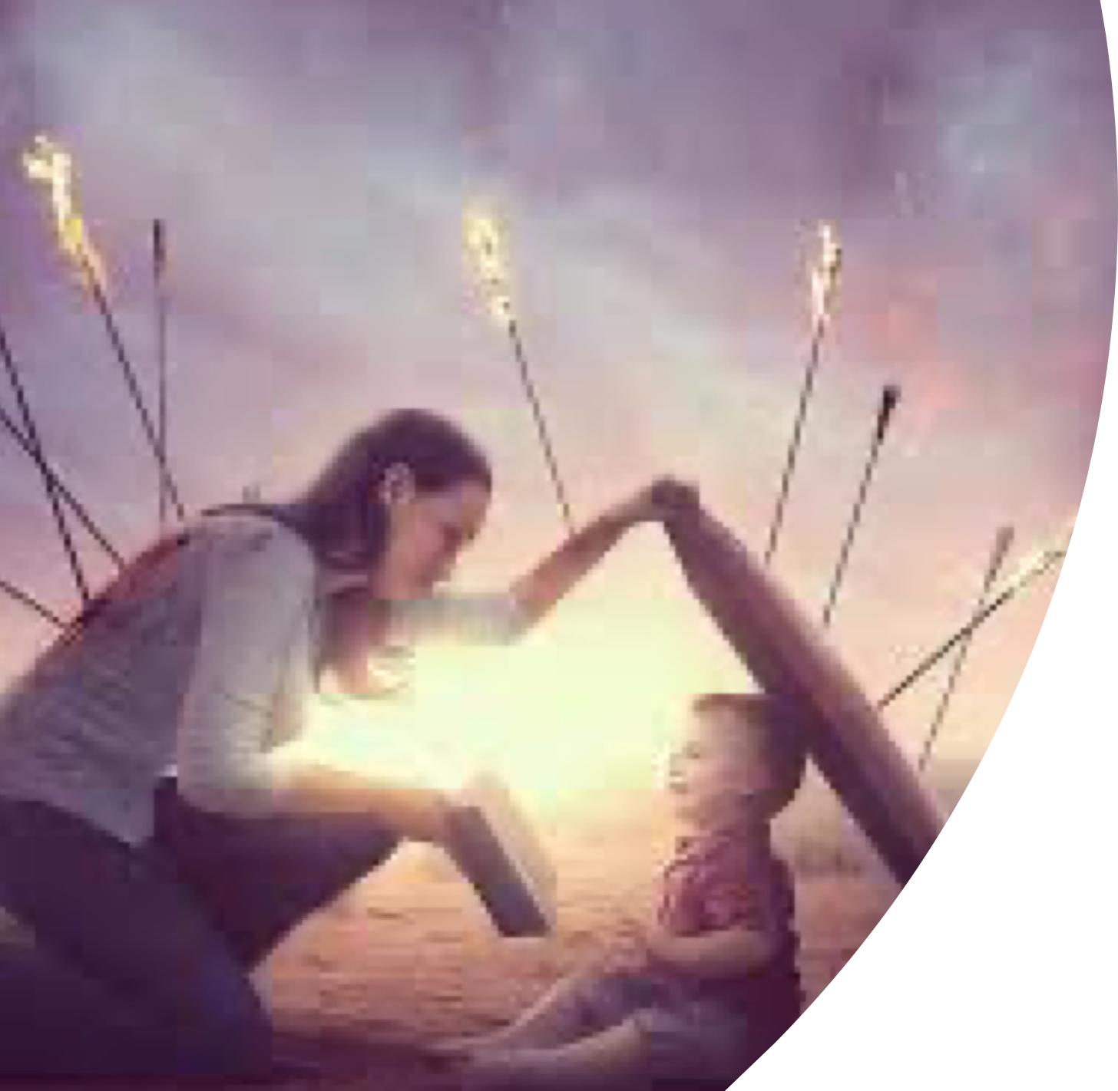



HOME UNDER ATTACK
Entertainment :(movies, sitcoms, cartoons, music, etc.)
Society : (radical individualism; post modernism; rank immorality; anger; discontent; etc.)
Education : (natural evolution; immorality; humanism; etc.)

Slide 5
HOME UNDER ATTACK
Distracted - busy mom’s, dad’s, & Kids
Marriage not respected
Unfaithfulness too common
M.D.R. acceptable & normal
Normalization of L.G.B.T.Q. agenda.
DESTROYED / DIFUNCTIONAL

Slide 6
Romans 12:2 (NKJV)
² And do not be conformed to this world, but be transformed by the renewing of your mind, that you may prove what is that good and acceptable and perfect will of God.

Slide 7

Psalm 127:1 (NKJV)
¹ Unless the Lord builds the house, They labor in vain who build it; Unless the Lord guards the city, The watchman stays awake in vain.

Slide 8
Colossians 3:18–21 (NKJV)
¹⁸ Wives, submit to your own husbands, as is fitting in the Lord. ¹⁹ Husbands, love your wives and do not be bitter toward them. ²⁰ Children, obey your parents in all things, for this is well pleasing to the Lord. ²¹ Fathers, do not provoke your children, lest they become discouraged.

Slide 9

Families are comprised of imperfect people - every family has challenges, problems, and dilemmas, that need to be overcome. . . .
The first family - Gen 2-4
Abraham’s family - Gen 12-21
Isaac’s family - Gen 25:20-27:46
Jacob’s family - Gen 29-42
David’s family - 2 Sam. 12; 13:1

Slide 10
When every family member puts God first in their heart, the family becomes what God intends it to be.

Slide 11





Slide 12
A Biblical View of Marriage
Embracing God’s Designed Roles
Training Children in the Way of the Lord
Choosing Godly Friendships
Practicing True Worship as a Family
Choosing a Place to Live that benefit our Spiritual Priorities
Managing Money as Stewards of God

Slide 13





A Biblical View of Marriage
(Genesis 2:24; Matthew 19:9; 1 Corinthians 7)
Instituted By God
“A man shall leave his father and mother and be joined to his wife, and they shall become one flesh.” (Genesis 2:18-24 )
Design: One man / One Woman for LIFE (Matthew 19:3-6)
Divorce is SIN except for one reason (Mathew 19:7-9; 1 Corinthians 7:10,11)
Hebrews 13:4 (NKJV)
⁴ Marriage is honorable among all, and the bed undefiled; but fornicators and adulterers God will judge.

Slide 14


Embracing God’s Designed Roles
(Genesis 2:24; Matthew 19:9; 1 Corinthians 7)
The Husband:
Lead – take responsibility (Eph. 5:25-28)
With gentleness (1 Pet. 3:7)
Provide for his own house (1 Tim. 5:8)
The Wife:
Submits willingly (1 Pet. 3:1-6; Titus 2:4-5)
Guide & keep house (1 Tim 5:14; Tit 2:5)
The Children:
Respect & obey parents (Eph. 6:1-4)
1 Corinthians 7:20 (NKJV)
²⁰ Let each one remain in the same calling in which he was called.

Slide 15


Training Children in the Lord’s Way
(Prov. 22:6; Deut 6:4-9; Eph. 6:1-4)
Train in Way Of Lord (Prov. 22:6)
Father’s responsibility (Eph. 6:4)
Requires diligence (Deut 6:4-9)
House divided against itself will not stand (Mark 3:25; James 3:16)
EMPHASIZE spiritual OVER Material (Mt 6:33; Deut 6:4-9)
Discipline (Prov.13:24; 19:18; 22:15; 23:13-14; 29:15)
Ephesians 6:4 (NKJV)
⁴ … bring them up in the training and admonition of the Lord.

Slide 16


Choosing Godly Friendships
(1 Cor. 15:33; Prov 1:11–19; 2:12–19; 13:20)
Evil company corrupts good habits. (1 Cor. 15:33)
Parents need to be aware and careful who their children “hang around” (Proverbs 1:11–19; 13:20)
This warning does NOT JUST APPLY TO CHILDREN (Deut. 7:16–26; 2 Cor. 6:14-7:1)
1 Corinthians 15:33 (NKJV)
³³ Do not be deceived: “Evil company corrupts good habits.”

Slide 17

Practicing True Worship as a Family
(Deut. 6:4–9; Ps. 78:4–7; Eph. 6:4; John 4:23,24)
The home is the training ground for true worship (Genesis 18:19; Deut. 6:4-9)
Household Commitment to Serve the Lord (Josh. 24:15)
Teaching God’s Word in the Home (2 Timothy 3:14–15)
Training / equipping family for service and spiritual leadership (Ephesians 6:4)
Worship to be in spirit and truth (John 4:24)
John 4:24 (NKJV)
²⁴ God is Spirit, and those who worship Him must worship in spirit and truth.”

Slide 18

Choosing a Place to Live
(Deut. 6:4–9; Ps. 78:4–7; Eph. 6:4; John 4:23,24)
Lot’s Mistake (Gen 13:6-13)
Moral and Cultural Climate of the Broader Area (Genesis 13:10–13)
Neighbors / Peer influence (1 Cor. 15:33)
Educational Environment (Ephesians 6:4)
Employment and Financial Trade-offs (Matthew 6:33)
Proximity to a Faithful Congregation (Hebrews 10:24,25)
Genesis 13:11 (NKJV)
¹¹ Then Lot chose for himself all the plain of Jordan, and Lot journeyed east. …

Slide 19
Managing Money as Stewards of God
(Prov. 3:9–10; 1 Cor. 16:1,2; 2 Cor 8:24; 9:13)
God owns it all — We are stewards, not owners (Psalm 24:1).
Giving to the Lord (Firstfruits) (1 Cor. 16:1,2
Seek first the kingdom (Matthew 6:33)
Contentment (1 Timothy 6:6-10).
Provide for your household (1 Timothy 5:8).
Generosity (2 Cor. 9:6-8).
Avoid the slavery of debt (Proverbs 22:7).
Proverbs 3:9 (NKJV)
⁹ Honor the Lord with your possessions, And with the firstfruits of all your increase;

Slide 20

Marriage
Budget
Roles
GOD
Location
Training
Worship
Friends

Slide 21

¹ Unless the Lord builds the house, They labor in vain who build it; Unless the Lord guards the city, The watchman stays awake in vain. Psalm 127:1 (NKJV)

Slide 22
A Godly Father . . .
"For I have known him, in order that he may command his children and his household after him, that they keep the way of the LORD, to do righteousness and justice. . .” Genesis 18:19

Slide 23
A Godly Mother . . .
“¹ Wives, likewise, be submissive to your own husbands, that even if some do not obey the word, they, without a word, may be won by the conduct of their wives, ² when they observe your chaste conduct accompanied by fear.”
1 Peter 3:1-2 (NKJV)

Slide 24
Godly Children . . .
1 Children, obey your parents in the Lord, for this is right. 2 "Honor your father and mother," which is the first commandment with promise: 3 "that it may be well with you and you may live long on the earth."
Ephesians 6:1-3 (NKJV)

Slide 25
Deuteronomy 6:6-9 (NKJV)
⁶ "And these words which I command you today shall be in your heart. ⁷ You shall teach them diligently to your children, and shall talk of them when you sit in your house, when you walk by the way, when you lie down, and when you rise up. ⁸ You shall bind them as a sign on your hand, and they shall be as frontlets between your eyes. ⁹ You shall write them on the doorposts of your house and on your gates.

Slide 26
A godly home is Intentional,
Intentionally God centered
Intentionally Bible focussed
Intentionally ordered according to God’s design,
Intentionally focused on raising the next generation to know and serve the Lord.

Slide 27

HAVE YOU BELIEVED? (John 8:24)
HAVE YOU REPENTED? (Acts 17:30)
HAVE YOU CONFESSED? (Rom. 10:9,10)
HAVE YOU BEEN BAPTIZED? (Rom. 6:3-6)
ARE YOU LIVING FOR JESUS WHO DIED FOR YOU? (Rom. 6:8–11; 2 Cor. 5:15)

Slide 28



100 CORNERSTONE ALEXANDER AR, 72002
You Are Welcome At Any And All of Our Services!
Meeting Times:
Sunday A.M. Bible Study: 9:00
Sunday A.M. Assembly: 10:00
Sunday P.M. Assembly: 4:00
Wed. P.M. Bible Study: 7:00
ALEXANDERCHURCHOFCHRIST.COM

Slide 30
Psalm 127:1; Deuteronomy 6:4–9; Colossians 3:18–21
Charts by Don McClain
Preached August 9, 2026 / Alexander church of Christ
Phone: 501-568-1062
Email – donmcclain@sbcglobal.net
More Keynote, PPT & Audio Sermons
www.alexanderchurchofchrist.com

Slide 31

Deuteronomy 6:1–9 (NKJV)
¹ “Now this is the commandment, and these are the statutes and judgments which the Lord your God has commanded to teach you, that you may observe them in the land which you are crossing over to possess, ² that you may fear the Lord your God, to keep all His statutes and His commandments which I command you, you and your son and your grandson, all the days of your life, and that your days may be prolonged.

Slide 32
Deuteronomy 6:1–9 (NKJV)
³ Therefore hear, O Israel, and be careful to observe it, that it may be well with you, and that you may multiply greatly as the Lord God of your fathers has promised you—‘a land flowing with milk and honey.’ ⁴ “Hear, O Israel: The Lord our God, the Lord is one! ⁵ You shall love the Lord your God with all your heart, with all your soul, and with all your strength. ⁶ “And these words which I command you today shall be in your heart.

Slide 33
Deuteronomy 6:1–9 (NKJV)
⁷ You shall teach them diligently to your children, and shall talk of them when you sit in your house, when you walk by the way, when you lie down, and when you rise up. ⁸ You shall bind them as a sign on your hand, and they shall be as frontlets between your eyes. ⁹ You shall write them on the doorposts of your house and on your gates.

