Slide 1


Job 1:20–22; 2:9–10; Habakkuk 3:17–19; James 1:2–8

Slide 2



Necessity of Godliness.
Essentials To Godliness.
Godly Religion.
Godly View of Sin.
Godly Use of Our Bodies.
Need For Godly Families.
Titus 2:11–12 (NKJV)
¹¹ For the grace of God that brings salvation has appeared to all men, ¹² teaching us that, denying ungodliness and worldly lusts, we should live soberly, righteously, and godly in the present age,

Slide 3

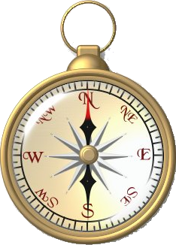
GOD
RELIGION
ADVERSITY
FAMILY
PROFESSION

Slide 4

Job 1:20–22 (NKJV)
²⁰ Then Job arose, tore his robe, and shaved his head; and he fell to the ground and worshiped. ²¹ And he said: “Naked I came from my mother’s womb, And naked shall I return there. The Lord gave, and the Lord has taken away; Blessed be the name of the Lord.” ²² In all this Job did not sin nor charge God with wrong.

Slide 5
Job 2:7–10 (NKJV)
⁷ So Satan went out from the presence of the Lord, and struck Job with painful boils from the sole of his foot to the crown of his head. ⁸ And he took for himself a potsherd with which to scrape himself while he sat in the midst of the ashes. ⁹ Then his wife said to him, “Do you still hold fast to your integrity? Curse God and die!” ¹⁰ But he said to her, “You speak as one of the foolish women speaks. Shall we indeed accept good from God, and shall we not accept adversity?” In all this Job did not sin with his lips.

Slide 6
Job 14:1–2 (NKJV)
¹ “Man who is born of woman Is of few days and full of trouble. ² He comes forth like a flower and fades away; He flees like a shadow and does not continue.

Slide 7



THE REALITY OF ADVERSITY
Our Lives On Earth Will Be UNSETTLED!! – Ever Changing
    Good & Bad Days
    Good & Bad Weeks
    Good & Bad Months
    Good & Bad Years
Job 14:1–2 (NKJV)
¹ “Man who is born of woman Is of few days and full of trouble. ² He comes forth like a flower and fades away; He flees like a shadow and does not continue.

Slide 8
There are many things beyond our control - especially the judgments of God! (1:15; Dan. 4:35.)
    There is nothing wrong with changing the things we can – But we must learn to accept the things we cannot change (Phili 4:11-13)
Ecclesiastes 7:13 (NKJV)
¹³ Consider the work of God; For who can make straight what He has made crooked?

Slide 9
There are many things beyond our control - especially the judgments of God! (1:15; Dan. 4:35.)
    When things go well, be cheerful; accept the situation and enjoy it - make the best of the present.
    “in the evil day, consider,” i.e., use the times of adversity for solemn reflection.
Ecclesiastes 7:14 (NKJV)
¹⁴ In the day of prosperity be joyful, But in the day of adversity consider: Surely God has appointed the one as well as the other, So that man can find out nothing that will come after him.

Slide 10
Habakkuk 3:17–19 (NKJV)
¹⁷ Though the fig tree may not blossom, Nor fruit be on the vines; Though the labor of the olive may fail, And the fields yield no food; Though the flock may be cut off from the fold, And there be no herd in the stalls— ¹⁸ Yet I will rejoice in the Lord, I will joy in the God of my salvation. ¹⁹ The Lord God is my strength; He will make my feet like deer’s feet, And He will make me walk on my high hills.

Slide 11

POVERTY
FRIENDS
GOD
Persecution
SUFFERING
Temptation
DEATH
SICKNESS

Slide 12
James 1:2–8 (NKJV)
² My brethren, count it all joy when you fall into various trials, ³ knowing that the testing of your faith produces patience. ⁴ But let patience have its perfect work, that you may be perfect and complete, lacking nothing. ⁵ If any of you lacks wisdom, let him ask of God, who gives to all liberally and without reproach, and it will be given to him. ⁶ But let him ask in faith, with no doubting, for he who doubts is like a wave of the sea driven and tossed by the wind. ⁷ For let not that man suppose that he will receive anything from the Lord; ⁸ he is a double-minded man, unstable in all his ways.

Slide 13
FAITH IN TRIALS
² My brethren, count it all joy when you fall into various trials, — James 1:2 (NKJV)
Need correct perspective (2)
WHEN, not if (cf. 2 Tim. 3:12)
Christians will encounter MANY types and degrees of trials. (2)
We can be victorious (3-12)

Slide 14
THE PURPOSE OF ADVERSITY
To Cause Reflection
Ecclesiastes 7:2-3 (NKJV)
2 Better to go to the house of mourning Than to go to the house of feasting, For that is the end of all men; And the living will take it to heart. 3 Sorrow is better than laughter, For by a sad countenance the heart is made better.
To Produce Humility
Turn Us To His Will
To Produce Patience
To Turn Our Minds From Temporal To Eternal

Slide 15
THE PURPOSE OF ADVERSITY
To Cause Reflection
Luke 15:17-18 (NKJV)
17 But when he came to himself, he said, 'How many of my father's hired servants have bread enough and to spare, and I perish with hunger! 18 I will arise and go to my father, and will say to him, "Father, I have sinned against heaven and before you,
To Produce Humility
Turn Us To His Will
To Produce Patience
To Turn Our Minds From Temporal To Eternal

Slide 16
THE PURPOSE OF ADVERSITY
To Cause Reflection
Deuteronomy 8:3 (NKJV)
3 So He humbled you, allowed you to hunger, and fed you with manna which you did not know nor did your fathers know, that He might make you know that man shall not live by bread alone; but man lives by every word that proceeds from the mouth of the Lord.
To Produce Humility
Turn Us To His Will
To Produce Patience
To Turn Our Minds From Temporal To Eternal

Slide 17
THE PURPOSE OF ADVERSITY
To Cause Reflection
Psalms 119:71 (NKJV)
71 It is good for me that I have been afflicted, That I may learn Your statutes.
Psalms 94:12-13 (NKJV)
12 Blessed is the man whom You instruct, O Lord, And teach out of Your law, 13 That You may give him rest from the days of adversity, Until the pit is dug for the wicked.
To Produce Humility
Turn Us To His Will
To Produce Patience
To Turn Our Minds From Temporal To Eternal

Slide 18
THE PURPOSE OF ADVERSITY
To Cause Reflection
Romans 5:3-4 (NKJV)
3 And not only that, but we also glory in tribulations, knowing that tribulation produces perseverance; 4 and perseverance, character; and character, hope.
To Produce Humility
Turn Us To His Will
To Produce Patience
To Turn Our Minds From Temporal To Eternal

Slide 19
THE PURPOSE OF ADVERSITY
To Cause Reflection
2 Corinthians 4:17–18 (NKJV)
¹⁷ For our light affliction, which is but for a moment, is working for us a far more exceeding and eternal weight of glory, ¹⁸ while we do not look at the things which are seen, but at the things which are not seen. For the things which are seen are temporary, but the things which are not seen are eternal.
To Produce Humility
Turn Us To His Will
To Produce Patience
To Turn Our Minds From Temporal To Eternal

Slide 20
THE PURPOSE OF ADVERSITY
To Cause Reflection
Romans 8:17–18 (NKJV)
¹⁷ and if children, then heirs—heirs of God and joint heirs with Christ, if indeed we suffer with Him, that we may also be glorified together. ¹⁸ For I consider that the sufferings of this present time are not worthy to be compared with the glory which shall be revealed in us.
To Produce Humility
Turn Us To His Will
To Produce Patience
To Turn Our Minds From Temporal To Eternal

Slide 21

3 IMPERATIVES - KNOW / LET / ASK (3-8)
KNOWING - “to possess information about—‘to know, to know about, to have knowledge of, to be acquainted with, acquaintance.’” - (Lou Nida)
Patience is NOT passive acceptance; It denotes steadfastness and constancy in the face of difficulty!
It is a courageous perseverance in the face of suffering, faithfulness in spite of circumstances.
James 1:3 (NKJV)
³ knowing that the testing of your faith produces patience.

Slide 22
3 IMPERATIVES - KNOW / LET / ASK (3-8)
But let patience have its perfect work …
The word LET does not mean that we are allowing something to be done to us passively, (to hold one's self to a thing, to lay hold of a thing, to adhere or cling - (Thayer)
We want to get our trials or difficulties over with quickly, but true growth occurs best through resistance training, (knowledge & wisdom; immune system; muscle strengthening; physical stamina …)
James 1:4 (NKJV)
⁴ But let patience have its perfect work, that you may be perfect and complete, lacking nothing.

Slide 23
3 IMPERATIVES - KNOW / LET / ASK (3-8)
But let patience have its perfect work …
Instead of grumbling and complaining . . . Hold to patience – patiently endure the trial, doing good despite the trial — TRUSTING GOD.
Patience doesn’t do the work for us – but we, by holding onto patience, eventually will receive the fruits of endurance . . . IT PRODUCES “MATURITY” and “SUFFICIENCY!” (PERFECT - "completeness, wholeness, maturity)
James 1:4 (NKJV)
⁴ But let patience have its perfect work, that you may be perfect and complete, lacking nothing.

Slide 24
3 IMPERATIVES - KNOW / LET / ASK (3-8)
ASK FOR WISDOM …
God has told us the purpose of trials – let us believe Him!
God has told us how to live and react to trials – let us obey Him!
God has promised to be with us, aide us, strengthen us, - let us trust Him!
Let us pray for the wisdom to allow God to use whatever means He sees fit to bring us to maturity
James 1:5 (NKJV)
⁵ If any of you lacks wisdom, let him ask of God, who gives to all liberally and without reproach, and it will be given to him.

Slide 25
3 IMPERATIVES - KNOW / LET / ASK (3-8)
James 1:6–8 (NKJV)
⁶ But let him ask in faith, with no doubting, for he who doubts is like a wave of the sea driven and tossed by the wind.
ASK IN FAITH WITHOUT DOUBTING
MUST BELIEVE God’s revealed word regarding the purpose and benefits of trials.
MUST FOLLOW God’s Word – will grow in grace and knowledge of God’s word, gaining wisdom!
MUST TRUST in God’s providential care – Will understand God is with us and will use trials for our good (to bring his children to maturity, and purity)

Slide 26
3 IMPERATIVES - KNOW / LET / ASK (3-8)
James 1:6–8 (NKJV)
⁷ For let not that man suppose that he will receive anything from the Lord; ⁸ he is a double-minded man, unstable in all his ways.
ASK IN FAITH WITHOUT DOUBTING
A double minded man is unstable in all his ways - like a ship tossed about - without anchor (Eph 4:14)
A double minded man cannot please God! (James 4:8; Mat. 6:24; 1 Kings 18:21)
Such a one will not receive wisdom - He lacks the values, focus, devotion and dedication that is necessary . . .

Slide 27
DO NOT WORRY
Matthew 6:30–34 (NKJV)
³⁰ Now if God so clothes the grass of the field, which today is, and tomorrow is thrown into the oven, will He not much more clothe you, O you of little faith? ³¹ “Therefore do not worry, saying, ‘What shall we eat?’ or ‘What shall we drink?’ or ‘What shall we wear?’ ³² For after all these things the Gentiles seek. For your heavenly Father knows that you need all these things.

Slide 28
DO NOT WORRY
Matthew 6:30–34 (NKJV)
³³ But seek first the kingdom of God and His righteousness, and all these things shall be added to you. ³⁴ Therefore do not worry about tomorrow, for tomorrow will worry about its own things. Sufficient for the day is its own trouble.

Slide 29
POVERTY
FRIENDS
GOD
Persecution
SUFFERING
Temptation
DEATH
SICKNESS

Slide 30

James 1:12 (NKJV)
¹² Blessed is the man who endures temptation; for when he has been approved, he will receive the crown of life which the Lord has promised to those who love Him.
Instead of becoming VICTIMS, we can BE VICTORS!

Slide 31
Lamentations 3:21-26 (NKJV)
21 This I recall to my mind, Therefore I have hope. 22 Through the Lord's mercies we are not consumed, Because His compassions fail not. 23 They are new every morning; Great is Your faithfulness. 24 "The Lord is my portion," says my soul, "Therefore I hope in Him!“ 25 The Lord is good to those who wait for Him, To the soul who seeks Him. 26 It is good that one should hope and wait quietly For the salvation of the Lord.

Slide 32
Is The Lord Your Portion?
Do You Hope In Him?
Do You Wait For Him?
Do You Seek Him?
Will You Be Saved By Him?

Slide 33
Romans 8:17–18 (NKJV)
¹⁷ and if children, then heirs—heirs of God and joint heirs with Christ, if indeed we suffer with Him, that we may also be glorified together. ¹⁸ For I consider that the sufferings of this present time are not worthy to be compared with the glory which shall be revealed in us.

Slide 34
This world can be (is) cruel & harsh
Do NOT attempt to face it without JESUS
(John 8:24; Luke 13:3,5; Acts 2:38)

Slide 35

HAVE YOU BELIEVED? (John 8:24)
HAVE YOU REPENTED? (Acts 17:30)
HAVE YOU CONFESSED? (Rom. 10:9,10)
HAVE YOU BEEN BAPTIZED? (Rom. 6:3-6)
ARE YOU LIVING FOR JESUS WHO DIED FOR YOU? (Rom. 6:8–11; 2 Cor. 5:15)

Slide 36



100 CORNERSTONE ALEXANDER AR, 72002
You Are Welcome At Any And All of Our Services!
Meeting Times:
Sunday A.M. Bible Study: 9:00
Sunday A.M. Assembly: 10:00
Sunday P.M. Assembly: 4:00
Wed. P.M. Bible Study: 7:00
ALEXANDERCHURCHOFCHRIST.COM

Slide 38
Job 1:20–22; 2:9–10; James 1:2–4
Charts by Don McClain
Preached August 16, 2026 / Alexander church of Christ
Phone: 501-568-1062
Email – donmcclain@sbcglobal.net
More Keynote, PPT & Audio Sermons
www.alexanderchurchofchrist.com

Slide 39
Job 1:13–22 (NKJV)
¹³ Now there was a day when his sons and daughters were eating and drinking wine in their oldest brother’s house; ¹⁴ and a messenger came to Job and said, “The oxen were plowing and the donkeys feeding beside them, ¹⁵ when the Sabeans raided them and took them away—indeed they have killed the servants with the edge of the sword; and I alone have escaped to tell you!”

Slide 40
Job 1:13–22 (NKJV)
¹⁶ While he was still speaking, another also came and said, “The fire of God fell from heaven and burned up the sheep and the servants, and consumed them; and I alone have escaped to tell you!” ¹⁷ While he was still speaking, another also came and said, “The Chaldeans formed three bands, raided the camels and took them away, yes, and killed the servants with the edge of the sword; and I alone have escaped to tell you!” ¹⁸ While he was still speaking, another also came and said, “Your sons and daughters were eating and drinking wine in their oldest brother’s house,

Slide 41
Job 1:13–22 (NKJV)
¹⁹ and suddenly a great wind came from across the wilderness and struck the four corners of the house, and it fell on the young people, and they are dead; and I alone have escaped to tell you!” ²⁰ Then Job arose, tore his robe, and shaved his head; and he fell to the ground and worshiped. ²¹ And he said: “Naked I came from my mother’s womb, And naked shall I return there. The Lord gave, and the Lord has taken away; Blessed be the name of the Lord.” ²² In all this Job did not sin nor charge God with wrong.

Slide 42
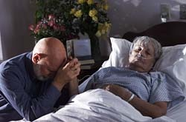
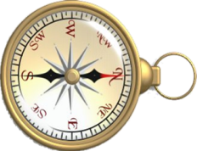

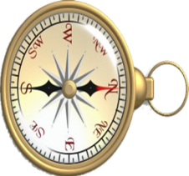




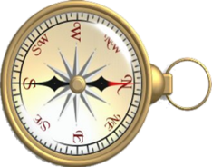



How To Face Adversity
Resisting Temptation
Mat 4:1-12; 1 Cor 10:13
Suffering of a Loved One
2 Sam 12:15-23; 1 Tim 5:16
Enduring
Persecution
1 Pet 2:19,20
Family Problems
Luke 14:26
Loss of job / Job problems
Mat 6:25-34
Financial Problems
1 Tim 6:6-10
Sickness
Job 2:7-10
Don McClain
W 65th St church of Christ
Notes:
Temptation
Persecution
Rejection
Loss of Health
Loss of Job
Financial Problems
Family Problems
Suffering of Loved Ones

Slide 43
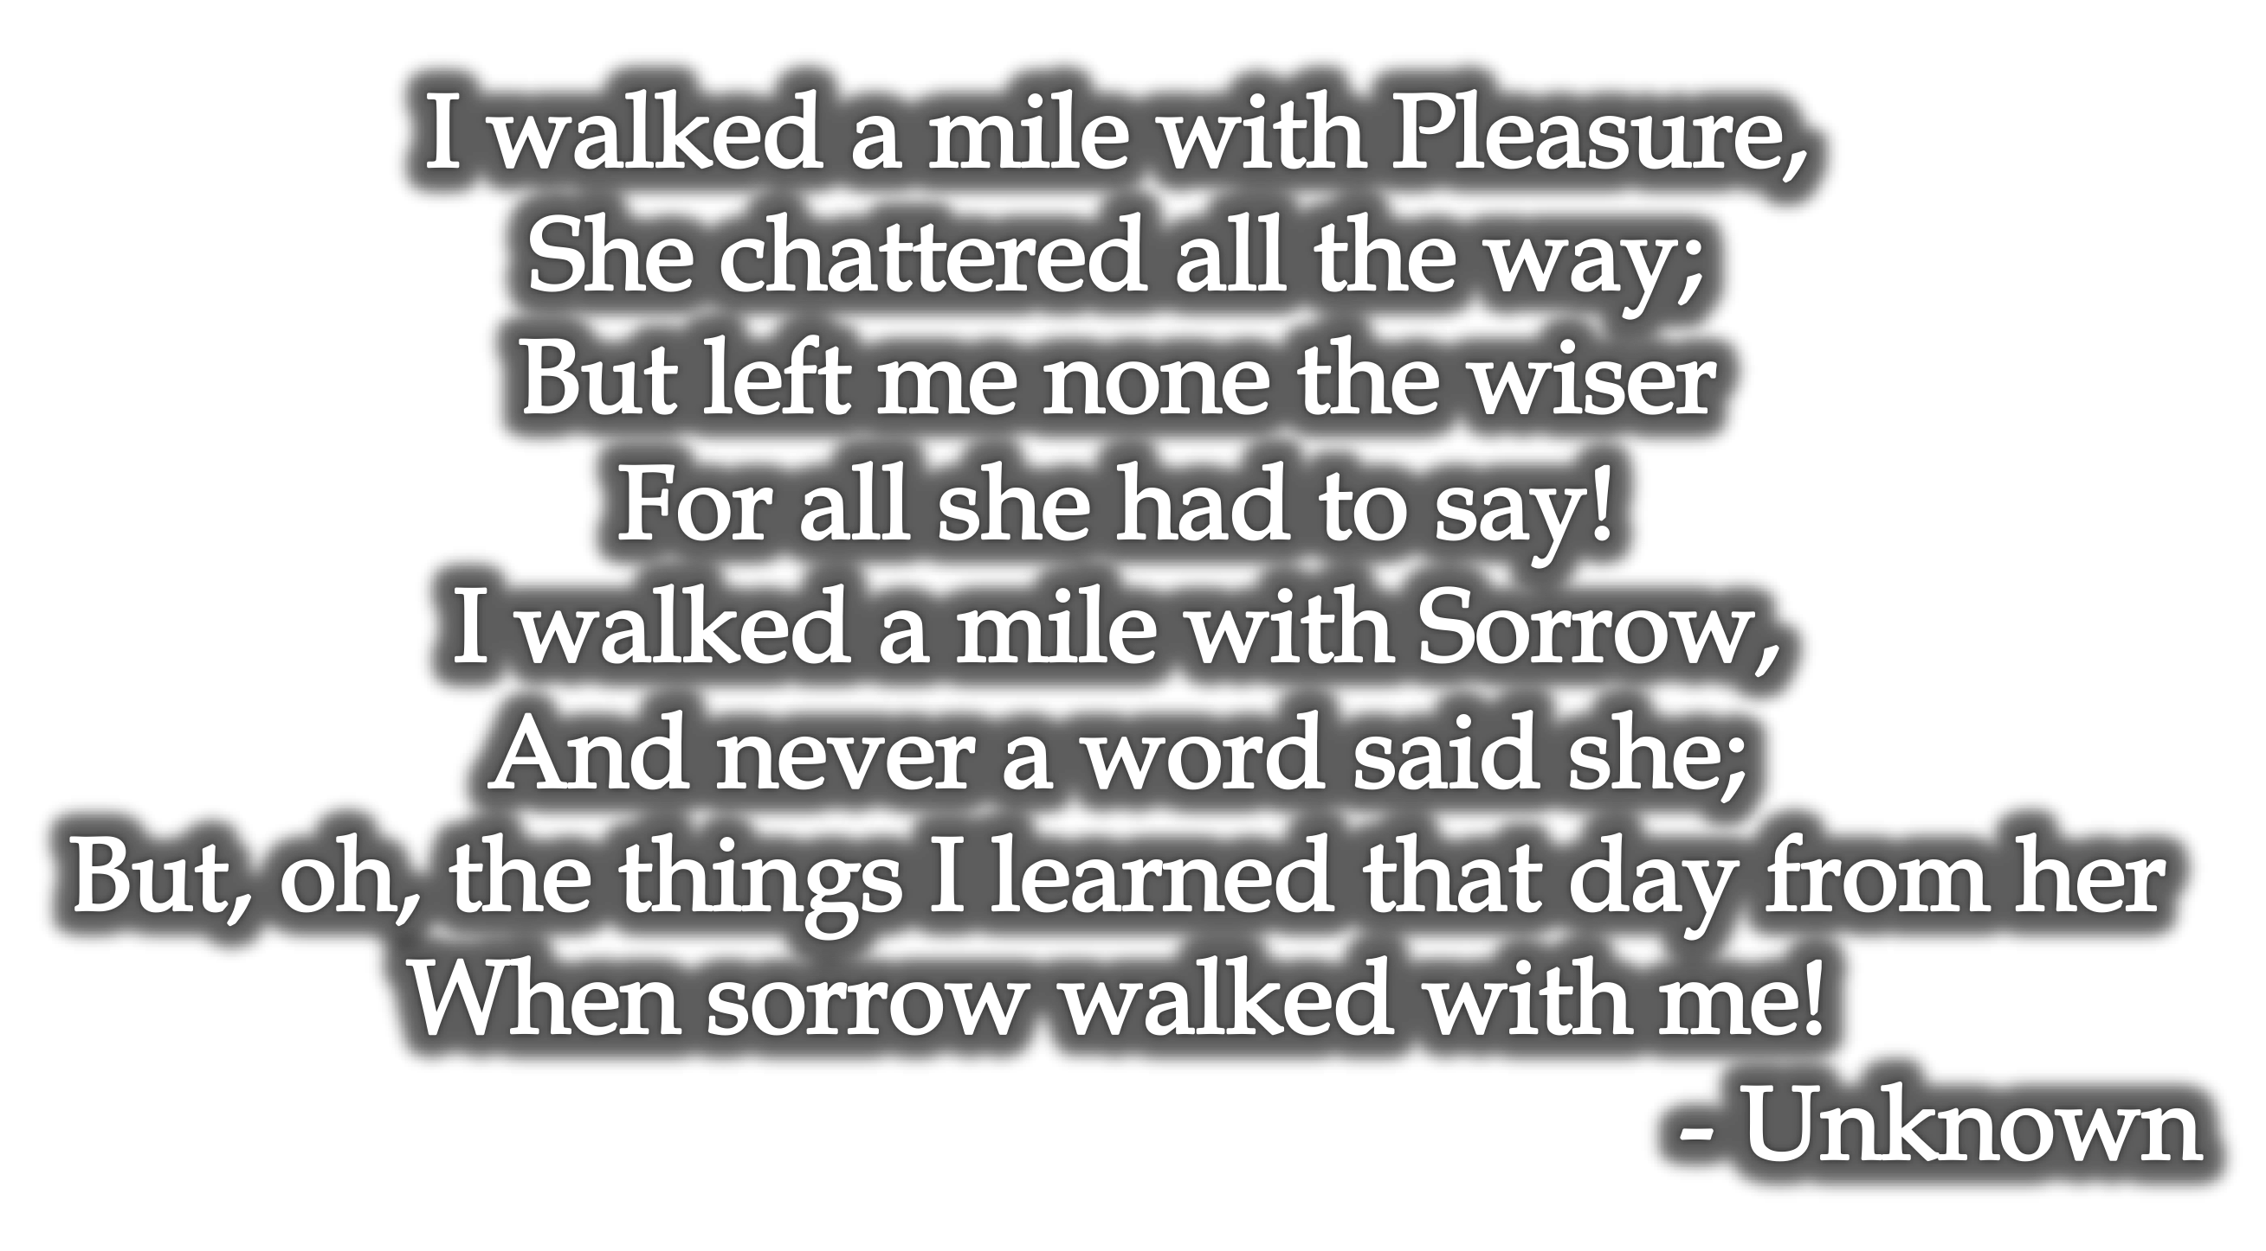
FAITH IN TRIALS: HOW CAN I HAVE JOY IN TRIALS?
temporary nature of trials (1:9-11)
James 1:12 (NKJV)
¹² Blessed is the man who endures temptation; for when he has been approved, he will receive the crown of life which the Lord has promised to those who love Him.

Slide 44
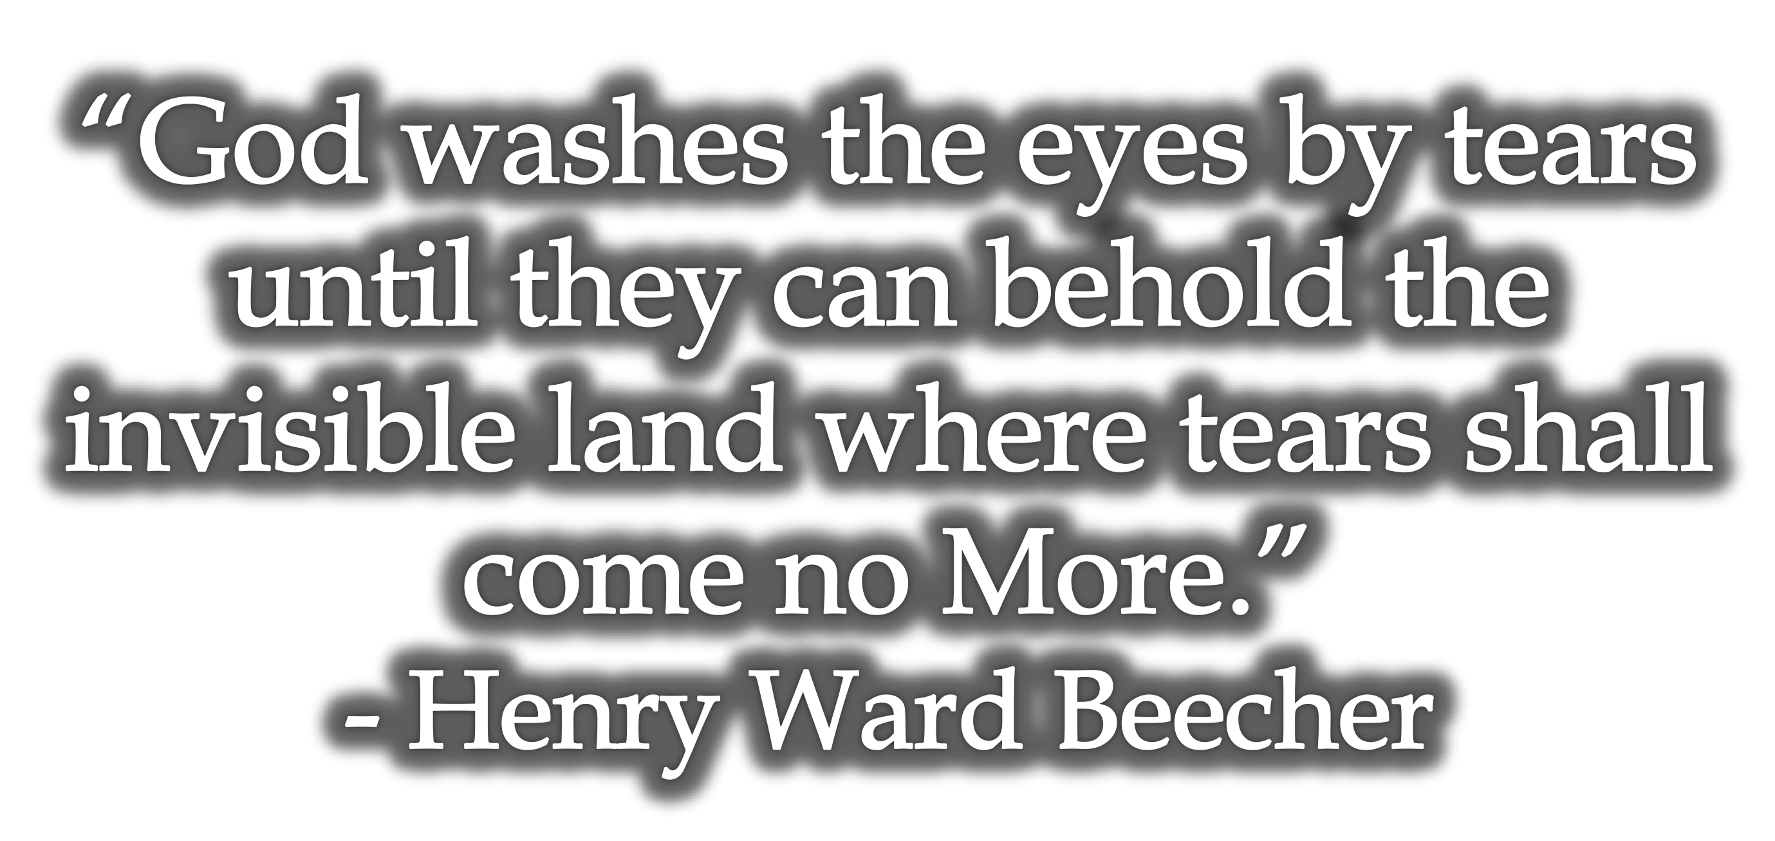
FAITH IN TRIALS: HOW CAN I HAVE JOY IN TRIALS?
temporary nature of trials (1:9-11)
James 1:12 (NKJV)
¹² Blessed is the man who endures temptation; for when he has been approved, he will receive the crown of life which the Lord has promised to those who love Him.

Slide 45
FAITH IN TRIALS: HOW CAN I HAVE JOY IN TRIALS?
temporary nature of trials (1:9-11)
Job (Job 1-3)
Joseph (Gen. 37,39,40)
Moses (Num. 11:14-15)
Elijah (1 Kings 19)
David (1 Sam. 18-30; Ps. 41-43)
Daniel, Hananiah, Mishael, and Azariah (Daniel 1:3-21; 3:8-30)
Paul (2 Cor. 12:7-10)
Jesus (Luke 22:42-44; Heb. 5:7; 12:1,2)
James 1:12 (NKJV)
¹² Blessed is the man who endures temptation; for when he has been approved, he will receive the crown of life which the Lord has promised to those who love Him.

