Slide 1


Numbers 22-25; 31:16; Jude 5-16; 2 Pet. 2:15-16; Rev. 2:14

Slide 2
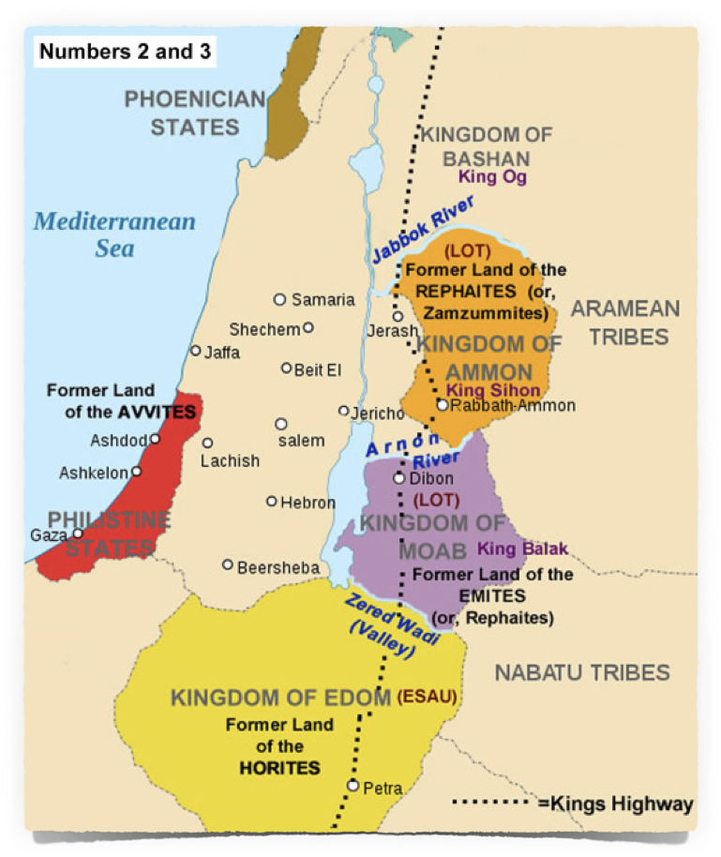


THE SETTING
The final year of the Israelites’ journey from Egypt to Canaan,
They had conquered the Amorites and their mighty kings (Num 21:21-35).
Balak, the king of Moab, and the Moabites were “exceedingly afraid,” . . . and “sick with dread” - (Num 22:2,3).
He calls on Balaam to come and curse them.

Slide 3
THE SETTING
Numbers 22:5–6 (NKJV)
⁵ Then he sent messengers to Balaam the son of Beor at Pethor, which is near the River in the land of the sons of his people, to call him, saying: “Look, a people has come from Egypt. See, they cover the face of the earth, and are settling next to me! ⁶ Therefore please come at once, curse this people for me, for they are too mighty for me. Perhaps I shall be able to defeat them and drive them out of the land, for I know that he whom you bless is blessed, and he whom you curse is cursed.”

Slide 4
From “Pethor of Mesopotamia,” on the River, (Euphrates?). App. 12 miles south of Carchemish,
(Num 22:5; Deut. 23:4).

Slide 5
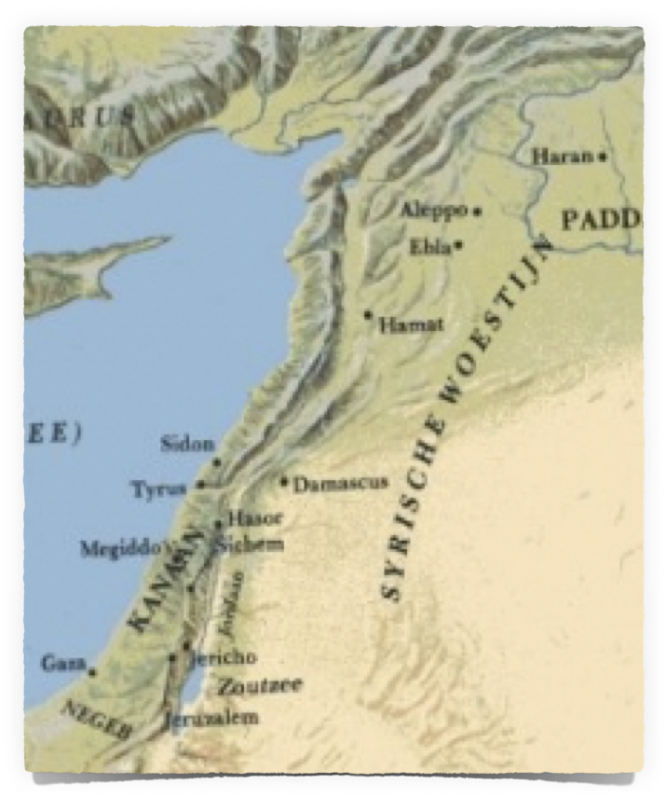



About Balaam
  “Known” as a prophet, soothsayer, or diviner (used sorcery or enchantments) (22:6; 24:1; cf. Josh 13:22)
  Knew who the true God is - refers to God several times as “the LORD (YWH) my God” or “The LORD (YWH) (22:18; 23:8,12; etc.)
Carchemish
Pethor ?
Journey would take an estimated 20-25 days.
Moab

Slide 6
About Balaam
His connection with Israel & death are recorded in the book of Numbers,
  His dealings with Balak, king of Moab, are recorded in 22:1-24:25
  Balaam is killed by the Israelites when they defeated the Midianites in 31:8.

Slide 7
The Deir 'Alla Inscription was discovered during a 1967 excavation in Deir 'Alla, Jordan. The excavation revealed a many-chambered structure that had been destroyed by earthquake.
The inscription is datable to 840–760 BCE;
It was painted in inks on fragments of a plastered wall - red and black inks were used, apparently to emphasize the text. In all, 119 pieces of inked plaster were recovered.
Since 1972, the fragments are on display at the Archeological Museum in Amman Jordan.
Notes:
The Deir 'Alla Inscription (or Bala'am Son of Be'or Inscription) was discovered during a 1967 excavation in Deir 'Alla, Jordan. The excavation revealed a many-chambered structure that had also been destroyed by earthquake, during the Persian period at the site, on the wall of which was written a story relating visions of the seer of the gods Bala'am, son of Be'or, who may be the same Bala'am mentioned in Numbers 22–24 and in other passages of the Bible. This Bala'am differs from the one in Numbers in that rather than being a prophet of Yahweh, he is associated with Ashtar, a god named Shgr, and Shadday gods and goddesses.[1] It also features the word "Elohim", taken to mean "gods" in the plural rather than the Hebrew deity.
The Oxford Handbook of Biblical Studies describes it as "the oldest example of a book in a West Semitic language written with the alphabet, and the oldest piece of Aramaic literature."[2] The inscription is datable to ca. 840–760 BCE; it was painted in inks on fragments of a plastered wall - red and black inks were used, apparently to emphasize the text. In all, 119 pieces of inked plaster were recovered. The wall, near the summit of the tell, was felled by yet another tremor.[3] - - https://en.wikipedia.org/wiki/Deir_Alla_Inscription

Slide 8

“Warnings from the Book of Balaam the son of Beor. He was a seer of the gods.”

Slide 9

About Balaam
8 books of the Bible mention Balaam
  Numbers 22:5-24:25; 31:8,16
  Deuteronomy 23:4, 5
  Joshua 13:22; 24:9, 10
  Nehemiah 13:2
  Micah 6:5
  2 Peter 2:15
  Jude 11
  Revelation 2:14
The Holy Spirit intended for us to learn some lessons from this man’s life.

Slide 10
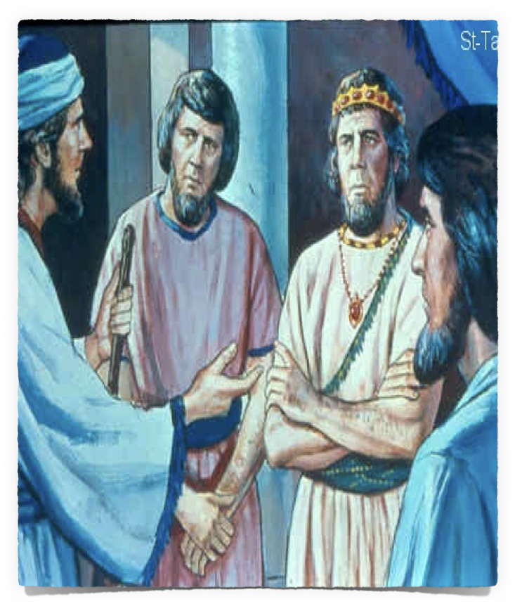


About Balaam
At first glance Balaam appears to be worthy of admiration & respect.
  He appears to seek God’s will (22:8)
  He obeys God initially by saying no (22:12,13)
  Balak counters / Balaam is given permission / Balaam informs Balak he can say ONLY what the Lord commands him (22:18,19).

Slide 11
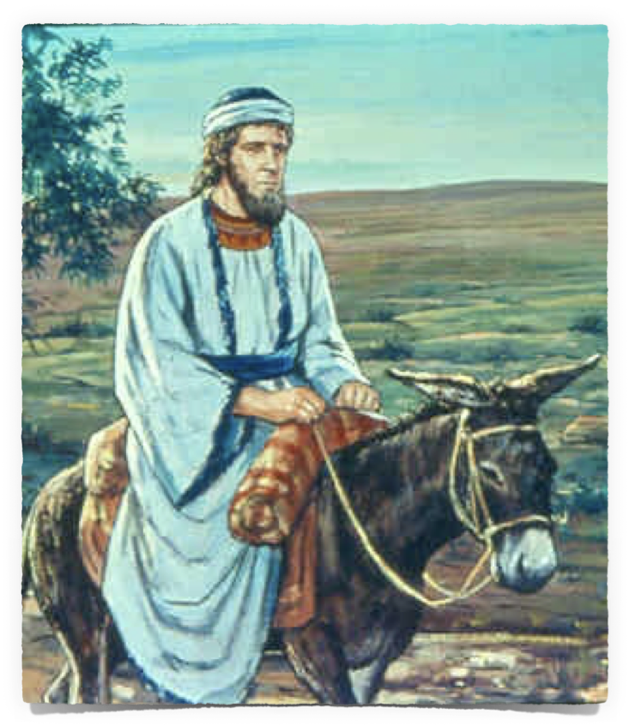
Lessons & Applications
God will not keep you from doing what you truly want to do (22:20,21)
Many insist on flirting with sin, they want what they want, they keep searching for a way to justify what God has forbidden, until they “find it!” (Deut. 24:1-4; Mat. 19:,8)
We need to learn that when God says No, it’s no.

Slide 12
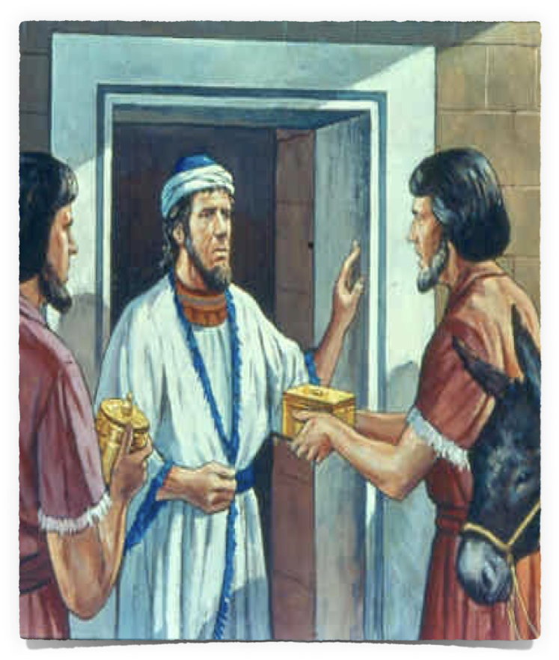
Lessons & Applications
Is our love and commitment to God complete if we are willing to give it up for a price? (Num. 22:18,38; 23:10,12, 26; 22:18; 24:13).
Satan doesn’t stop just because we say no, (Mat. 4:1-11; Job 1:9; 2:4).
If our commitment to God is not complete, we give Satan an opportunity to destroy us (2 Th. 2:10-11; Mt. 16:23-26; Eph. 4:27; Prov. 23:23)

Slide 13
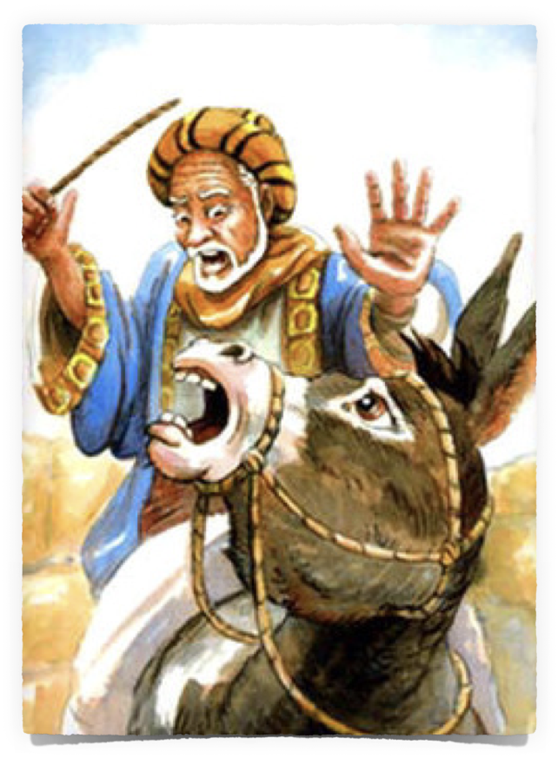
Balaam Resists Warning …
God sent His angel to hinder Balaam’s way (22:22).
The donkey saw the angel and avoided him, angering Balaam - so he strikes the donkey (22:23).
The Angel of the Lord again obstructed Balaam’s way - this time the donkey hurts Balaam’s leg - so Balaam strikes the donkey again (22:24,25)

Slide 14
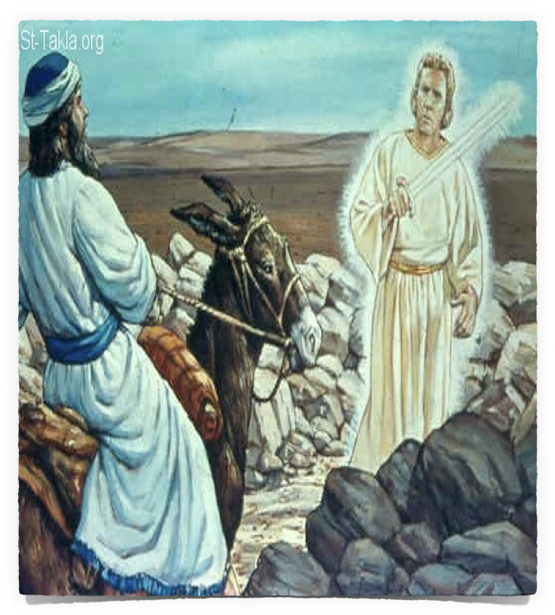
Balaam Resists Warning …
Numbers 22:26–28 (NKJV)
²⁶ Then the Angel of the Lord went further, and stood in a narrow place where there was no way to turn either to the right hand or to the left. ²⁷ And when the donkey saw the Angel of the Lord, she lay down under Balaam; so Balaam’s anger was aroused, and he struck the donkey with his staff. ²⁸ Then the Lord opened the mouth of the donkey, and she said to Balaam, “What have I done to you, that you have struck me these three times?”

Slide 15
Balaam Resists Warning …
Balaam is FURIOUS with the donkey (22:29).
The donkey, tries REASONING with Balaam (22:30)
The Lord opens Balaam’s eyes, he sees the Angel of the Lord with sword drawn - Balaam is ashamed for striking his donkey (22:31-33).

Slide 16
Balaam Resists Warning …
The Angel of the Lord says to Balaam, “I have come out to stand against you, because your way is perverse before Me” (Num. 22:32)
Instead of turning back, he has the gall to say, “if it displeases You, I will turn back” (Num. 22:34).

Slide 17
Balaam Resists Warning …
Balaam didn’t want to turn back - Balaam wanted to get paid - Balaam’s heart wanted what it wanted - therefore God allowed Balaam to do what he wanted.
Even so - God used Balaam for His purpose (22:35; 23:1-12; 13-26; 23:27-24:14)

Slide 18
Lessons & Applications …
God allows us to do what we truly desire to do, but He continues to provide warnings, hinderances and a way of escape (2 Pet 3:1-9; Gen 20:1-6; 1 Cor 10:13)
Why do we sometimes resent, and even become angry, when someone tries to help us, correct us, preventing us from bringing harm to ourselves? (Gal 4:16; 1 Kings 18:17; Prov 9:8; Jn 8:45)

Slide 19
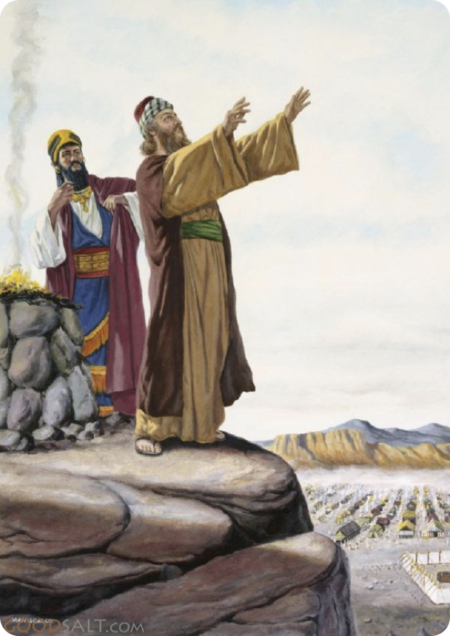
God’s Protection of His people …
Balaam blessed God’s people 3 times instead of cursing them (23:1-24:9).
Balak is angry with Balaam (24:10–11)
Sadly - this is not the end of the story (25:1-3; Num 31:8,16).
God protected His people from outside forces - the only way harm could come upon them was if they were unfaithful to God (Num 31:16; Rev 2:14).

Slide 20
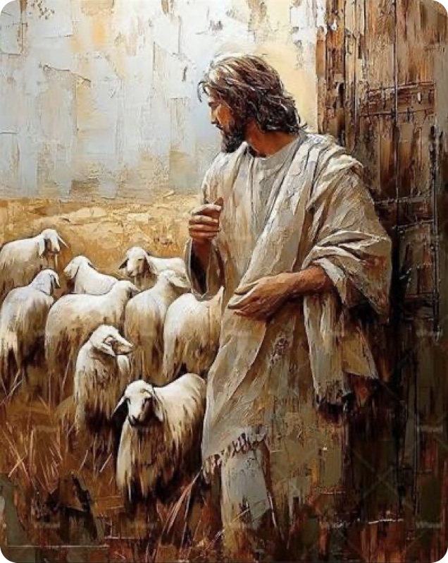
Lessons & Applications
God provides security & protection for His people today in Christ (John 10:27-30; Rom 8:28-39).
This protection & security is conditioned on us remaining faithful (2 Pet 1:5-11; 1 Cor. 10:1-13; Heb 3:12-4:11; Gal. 5:1-4)

Slide 21
THE WAY, ERROR & DOCTRINE of BALAAM
Numbers 31:15–16 (NKJV)
¹⁵ And Moses said to them: “Have you kept all the women alive? ¹⁶ Look, these women caused the children of Israel, through the counsel of Balaam, to trespass against the Lord in the incident of Peor, and there was a plague among the congregation of the Lord.
Numbers 25:9 (NKJV)
⁹ And those who died in the plague were twenty-four thousand.

Slide 22
2 Peter 2:14–16 (NKJV) | Jude 11 (NKJV) | Revelation 2:14 (NKJV)
15 They have forsaken the right way and gone astray, following the way of Balaam the son of Beor, who loved the wages of unrighteousness; 16 but he was rebuked for his iniquity: a dumb donkey speaking with a man’s voice restrained the madness of the prophet. | 11 Woe to them! For they have gone in the way of Cain, have run greedily in the error of Balaam for profit, and perished in the rebellion of Korah. | 14 But I have a few things against you, because you have there those who hold the doctrine of Balaam, who taught Balak to put a stumbling block before the children of Israel, to eat things sacrificed to idols, and to commit sexual immorality.
THE WAY, ERROR & DOCTRINE of BALAAM

Slide 23

Then, there is Balaam’s fourth oracle …

Slide 24
Numbers 24:10–19 (NKJV)
¹⁵ So he took up his oracle and said: “The utterance of Balaam the son of Beor, And the utterance of the man whose eyes are opened; ¹⁶ The utterance of him who hears the words of God, And has the knowledge of the Most High, Who sees the vision of the Almighty, Who falls down, with eyes wide open: ¹⁷ “I see Him, but not now; I behold Him, but not near; A Star shall come out of Jacob; A Scepter shall rise out of Israel, And batter the brow of Moab, And destroy all the sons of tumult. ¹⁸ “And Edom shall be a possession; Seir also, his enemies, shall be a possession, While Israel does valiantly. ¹⁹ Out of Jacob One shall have dominion, And destroy the remains of the city.”

Slide 25

Matthew 16:24–26 (NKJV)
²⁴ Then Jesus said to His disciples, “If anyone desires to come after Me, let him deny himself, and take up his cross, and follow Me. ²⁵ For whoever desires to save his life will lose it, but whoever loses his life for My sake will find it. ²⁶ For what profit is it to a man if he gains the whole world, and loses his own soul? Or what will a man give in exchange for his soul?

Slide 26
Lessons & Applications
Do we consult with the word of Christ superficially, not truly seeking what is pleasing to God, but seeking for a way to justify what we want to do?

Slide 27
Lessons & Applications
We can lie to ourselves, we can lie to others, we can try to lie to God - but the true desires of our heart will always win out.

Slide 28
Lessons & Applications
Let us RESOLVE to be wholly, completely & TOTALLY committed to serving & obeying the will of God - genuinely, & diligently striving to please Him!
Colossians 1:9-12

Slide 29
Lessons & Applications
We are free to choose, but we are not free to choose the consequences.

Slide 31
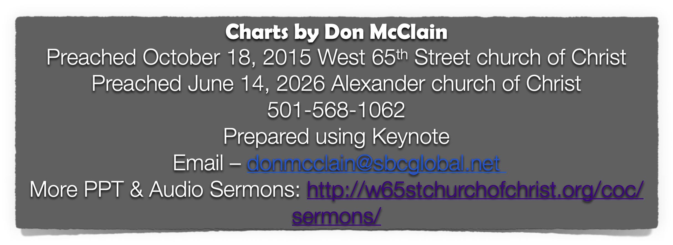
Jude 5-16; Numbers 22-25; 31:16; 2 Pet. 2:15-16; Rev. 2:14

Slide 32
Jude 5–11 (NKJV)
⁵ But I want to remind you, though you once knew this, that the Lord, having saved the people out of the land of Egypt, afterward destroyed those who did not believe. ⁶ And the angels who did not keep their proper domain, but left their own abode, He has reserved in everlasting chains under darkness for the judgment of the great day; ⁷ as Sodom and Gomorrah, and the cities around them in a similar manner to these, having given themselves over to sexual immorality and gone after strange flesh, are set forth as an example, suffering the vengeance of eternal fire.

Slide 33
Jude 5–11 (NKJV)
⁸ Likewise also these dreamers defile the flesh, reject authority, and speak evil of dignitaries. ⁹ Yet Michael the archangel, in contending with the devil, when he disputed about the body of Moses, dared not bring against him a reviling accusation, but said, “The Lord rebuke you!” ¹⁰ But these speak evil of whatever they do not know; and whatever they know naturally, like brute beasts, in these things they corrupt themselves. ¹¹ Woe to them! For they have gone in the way of Cain, have run greedily in the error of Balaam for profit, and perished in the rebellion of Korah.

