Slide 1
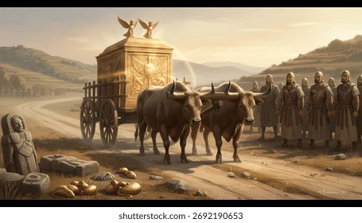

Slide 2
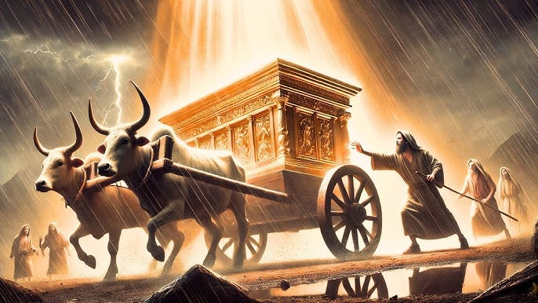
1 Chronicles 15:13 (NKJV)
¹³ For because you did not do it the first time, the Lord our God broke out against us, because we did not consult Him about the proper order.”

Slide 3
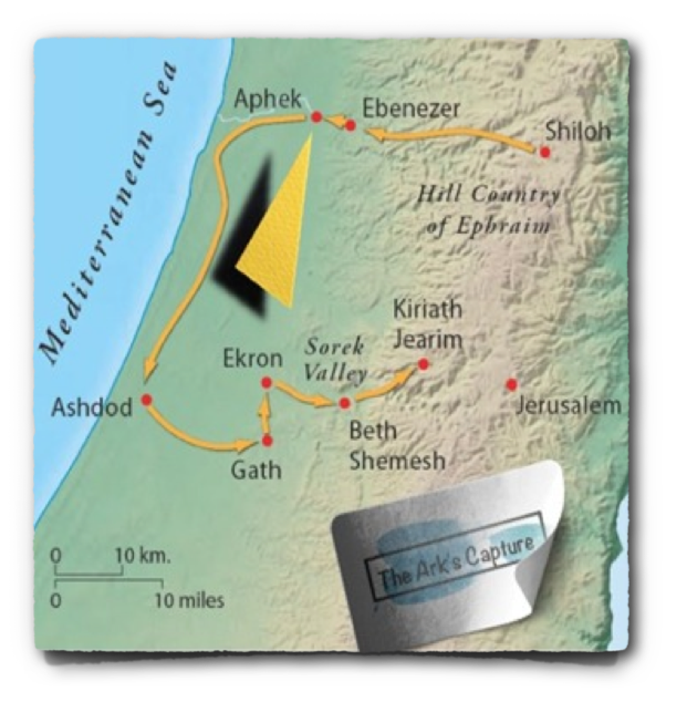
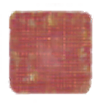
The Ark of God Takes A 7 Month Journey - 1 Sam 4-6
The Ark of God Captured by The Philistines (1 Sam 4:1-11)
When Eli heard, he“fell off the seat backward … his neck was broken and he died (1 Sam 4:12-18)
Phinehas’ wife has a son / names him Ichabod [“The glory has departed from Israel, for the ark of God has been captured”] and then she dies (1 Sam 4:19-22)

Slide 4
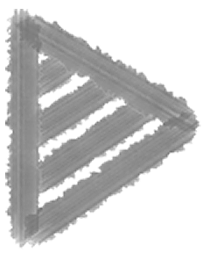
The Ark of God Takes A 7 Month Journey - 1 Sam 4-6
Philistines & the Ark:
Ashdod: Dagon falls / people stricken with tumors (1 Sam 5:1-8)
Men of Gath made sick with tumors also (1 Sam 5:9)
Men of Ekron made sick with tumors - many died (1 Sam 5:10)
Ark sent back to Israel (1 Sam 5:11,12)

Slide 5
The Ark Taken Back To Israel - To Kirjath Jearim (1 Sam 6:13-7:1)
Many men of Beth Shemesh die because they looked into the ark (1 Sam 6:13-19).
“the men of Kirjath Jearim came and took the ark … into the house of Abinadab on the hill, and consecrated Eleazar his son to keep the ark of the Lord.” (1 Sam 6:20-7:1)

Slide 6
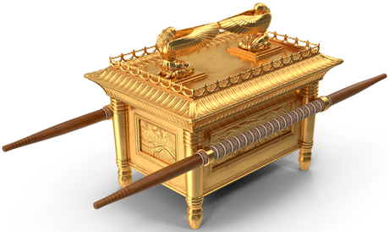
1 Samuel 4 — 2 Samuel 6 / 1094 to 1003 b.c.
The ark was in Kirjath Jearim, in the house of Abinadab for 20 years when Samuel pleaded with the people (1 Samuel 7:2).
Israel demands a king in 1 Sam 8.
Saul appointed king & reigns for 42 years (1 Sam 9:1-31:6).
Saul’s son, Ishbosheth Made King of Israel & reigns 2 years (2 Sam 2:8-11; 4:5-8)

Slide 7
1 Samuel 4 — 2 Samuel 6 / 1094 to 1003 b.c.
David reigns over Judah for 7 1/2 years (2 Sam. 2:11)
There is civil war between Israel & Judah, (Ishbosheth & Abner vs. David & Joab) (2 Sam. 2:12-4:12)
David is made king over all Israel (2 Sam. 5:1-5)

Slide 8
1 Samuel 4 — 2 Samuel 6 / 1094 to 1003 b.c.
David takes Jerusalem from the Jebusites / calls it “the city of David” (2 Sam 5:6-14)
David drives the Philistines, out of Israel solidifying his kingdom (2 Sam 5:17-25)
Now to retrieve the ark & bring it to Mount Zion (2 Sam 6:1,2;
1 Chron 13:5,6)

Slide 9
2 Samuel 6:1–11 (NKJV)
¹ Again David gathered all the choice men of Israel, thirty thousand. ² And David arose and went with all the people who were with him from Baale Judah to bring up from there the ark of God, whose name is called by the Name, the Lord of Hosts, who dwells between the cherubim. ³ So they set the ark of God on a new cart, and brought it out of the house of Abinadab, which was on the hill; and Uzzah and Ahio, the sons of Abinadab, drove the new cart. ⁴ And they brought it out of the house of Abinadab, which was on the hill, accompanying the ark of God; and Ahio went before the ark. ⁵ Then David and all the house of Israel played music before the Lord on all kinds of instruments of fir wood, on harps, on stringed instruments, on tambourines, on sistrums, and on cymbals.

Slide 10
2 Samuel 6:1–11 (NKJV)
⁶ And when they came to Nachon’s threshing floor, Uzzah put out his hand to the ark of God and took hold of it, for the oxen stumbled. ⁷ Then the anger of the Lord was aroused against Uzzah, and God struck him there for his error; and he died there by the ark of God. ⁸ And David became angry because of the Lord’s outbreak against Uzzah; and he called the name of the place Perez Uzzah to this day. ⁹ David was afraid of the Lord that day; and he said, “How can the ark of the Lord come to me?” ¹⁰ So David would not move the ark of the Lord with him into the City of David; but David took it aside into the house of Obed-Edom the Gittite. ¹¹ The ark of the Lord remained in the house of Obed-Edom the Gittite three months. And the Lord blessed Obed-Edom and all his household.

Slide 11
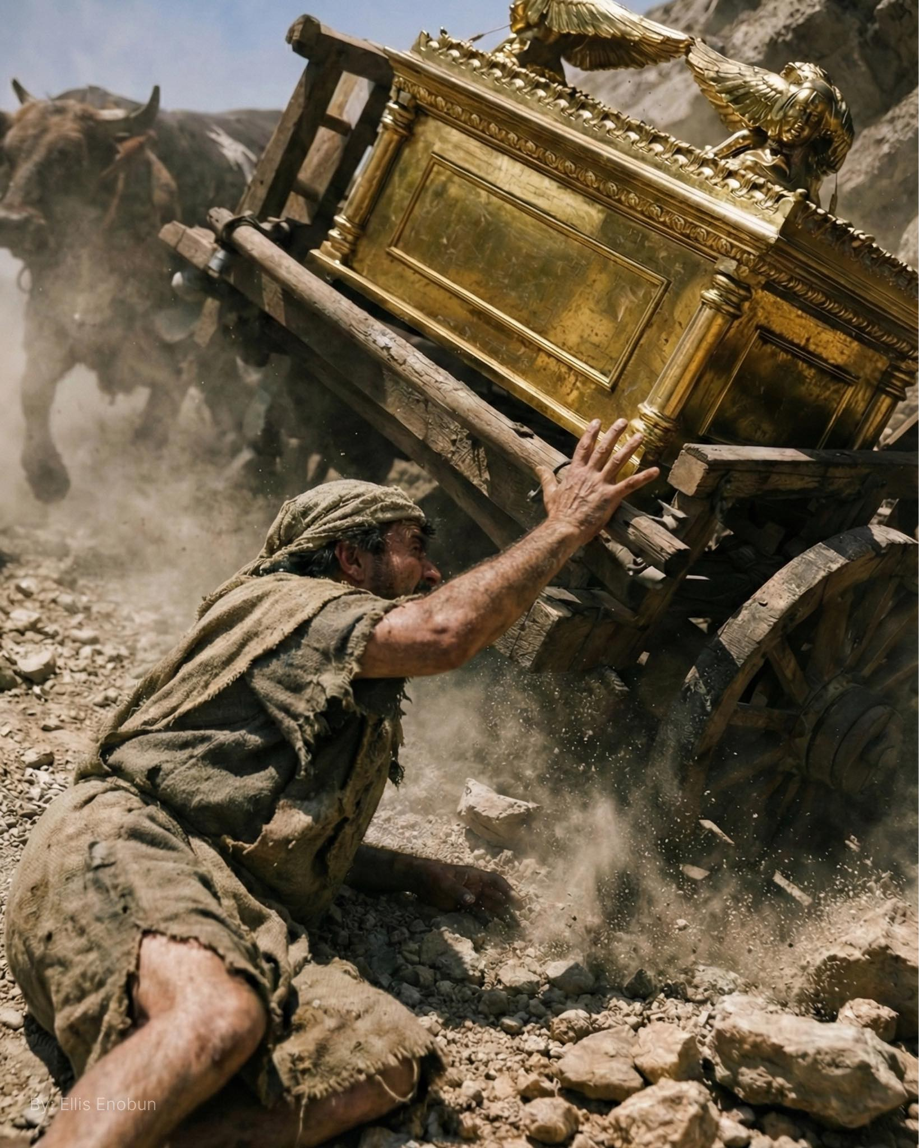
David’s first attempt to bring the ark to Jerusalem was unsuccessful.
Uzzah loses his life.
David is afraid of the Lord.
What did David do wrong?
What did David learn?

Slide 12
What David Did Wrong
David’s plans were formed using “human wisdom” instead of divine revelation (1 Chron 15:11-15)
God had specified how the ark was to be moved (Num. 3:30-31; 4:15; 7:9; Exod. 25:14-15).
Thus David disobeyed God
(1 Chron 15:13)
Notes:
cf Numbers 4:21ff - with Numbers 7:6ff
The sons of Gershom and Merari could use carts to transport the tabernacle, but the sons of Koath were not give carts for they carried the holy things.

Slide 13
What Uzzah Did Wrong
1 Chronicles 13:10 (NKJV)
¹⁰ Then the anger of the Lord was aroused against Uzza, and He struck him because he put his hand to the ark; and he died there before God.
Uzzah “put out his hand to the ark of God and took hold of” it, … “and God struck him there for his error” (2 Sam 6:7; 1 Chron 13:10)
Should have known better (Nu. 4:15, 19, 20)
Though doing what he thought was good, Uzzah sinned, and He died.
Notes:
cf Numbers 4:21ff - with Numbers 7:6ff
The sons of Gershom and Merari could use carts to transport the tabernacle, but the sons of Koath were not give carts for they carried the holy things.

Slide 14
1 Chronicles 13:11–12 (NKJV)
¹¹ And David became angry because of the Lord’s outbreak against Uzza; therefore that place is called Perez Uzza to this day. ¹² David was afraid of God that day, saying, “How can I bring the ark of God to me?”

Slide 15
1 Chronicles 15:2 (NKJV)
² Then David said, “No one may carry the ark of God but the Levites, for the Lord has chosen them to carry the ark of God and to minister before Him forever.”

Slide 16
1 Chronicles 15:13 (NKJV)
¹³ For because you did not do it the first time, the Lord our God broke out against us, because we did not consult Him about the proper order.”

Slide 17

Popularity or public approval does not make one right (1 Chron 13:1-4).
David consults every leader (v 1).
His plans met public approval (v 4).
He did not include consulting with God & His word. (1 Chron 15:13; Num. 3:30-31; 4:15; 7:9; Exod. 25:14-15; Ex 23:2).

Slide 18
Popularity or public approval does not make one right (1 Chron 13:1-4).
Homosexuality . . .
Fornication . . .
Divorce & Remarriage for any cause
Worship w/ instrumental music
Unauthorized organization & work of the church …

Slide 19
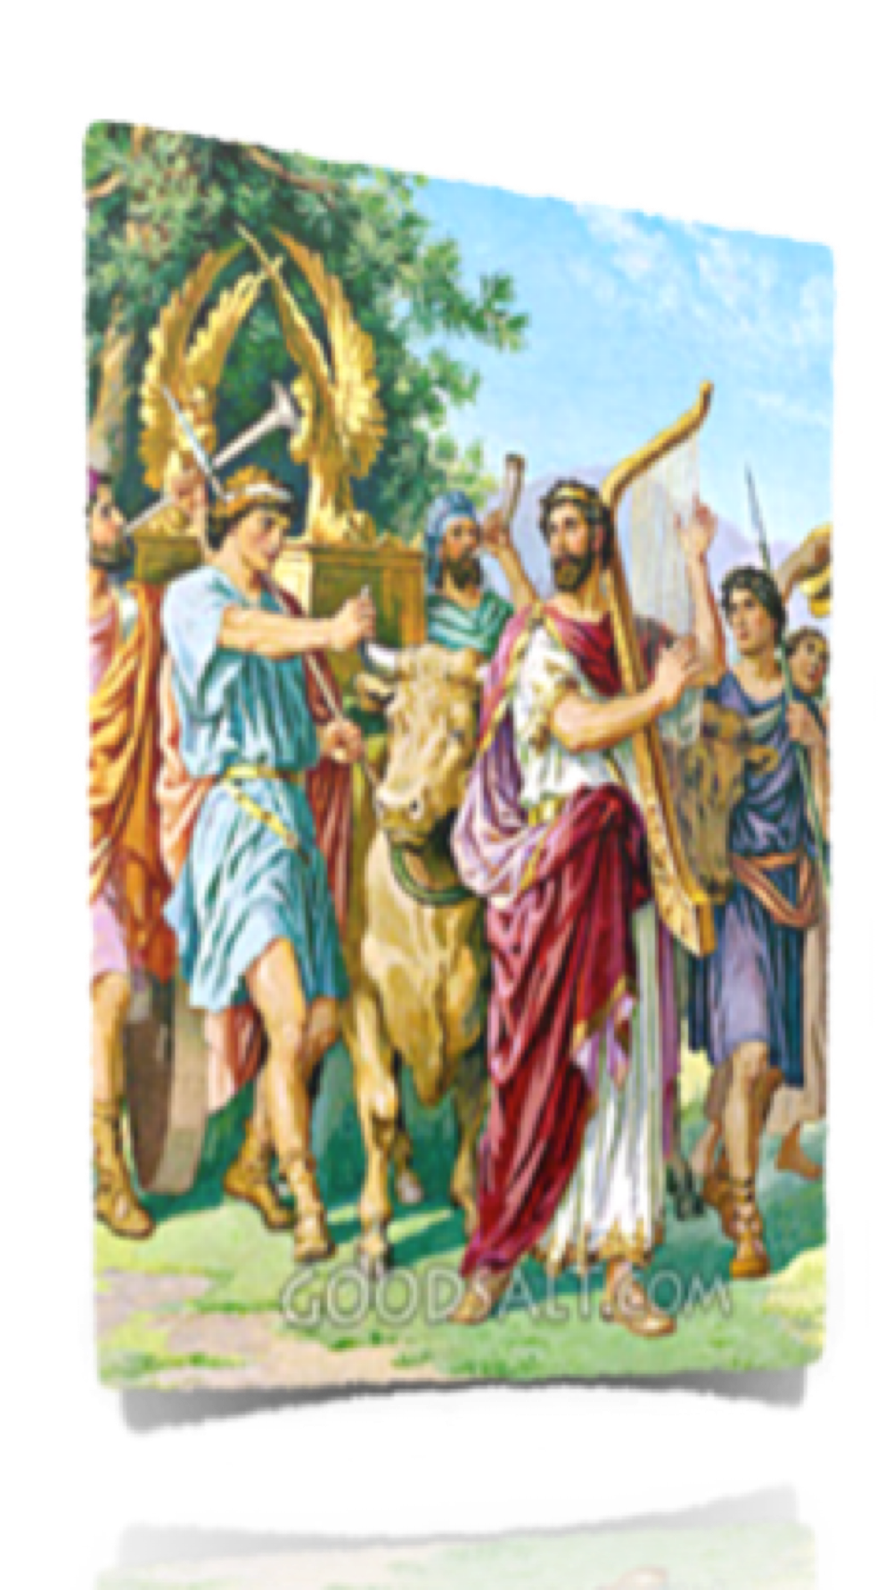
Zeal does not make one right (2 Sam 6:1-5; 1 Chron 13:8).
David & Israel only wanted to honor God (1 Chron. 13:2)
Prepared a new oxcart - made big plans / honored God with their words / but rushed ahead without “consulting the proper order” (1 Chronicles 13:5-8; cf. 15:13)

Slide 20
Zeal does not make one right (2 Sam 6:1-5; 1 Chron 13:8).
Zeal without truth is dangerous!
The Jews in Paul’s day were zealous for God but lost (Rom 10:1,2)
We must be zealous & obedient (Gal 4:18; Eph 5:15-18)

Slide 21
Good intentions are insufficient (1 Chron 13:2,3; Prov. 14:12; Acts 26:9–11 ).
David and Israel had good intentions (2 Sam 6:2; 1 Chron. 13:3,4)
Uzzah had good intentions when he reached out to steady the ark (2 Sam 6:6,7; 1 Chron. 13:10,11)

Slide 22
Good intentions are insufficient (1 Chron 13:2,3; Prov. 14:12; Acts 26:9–11 ).
No substitute for obedience (1 Sam 15:22,23; Mat 7:21-23)
A good conscience does NOT make one right (Prov 14:12; Acts 23:1)
Ignorance is no excuse / sins has its consequences (1 Chr 13:12; Hos 4:6).

Slide 23
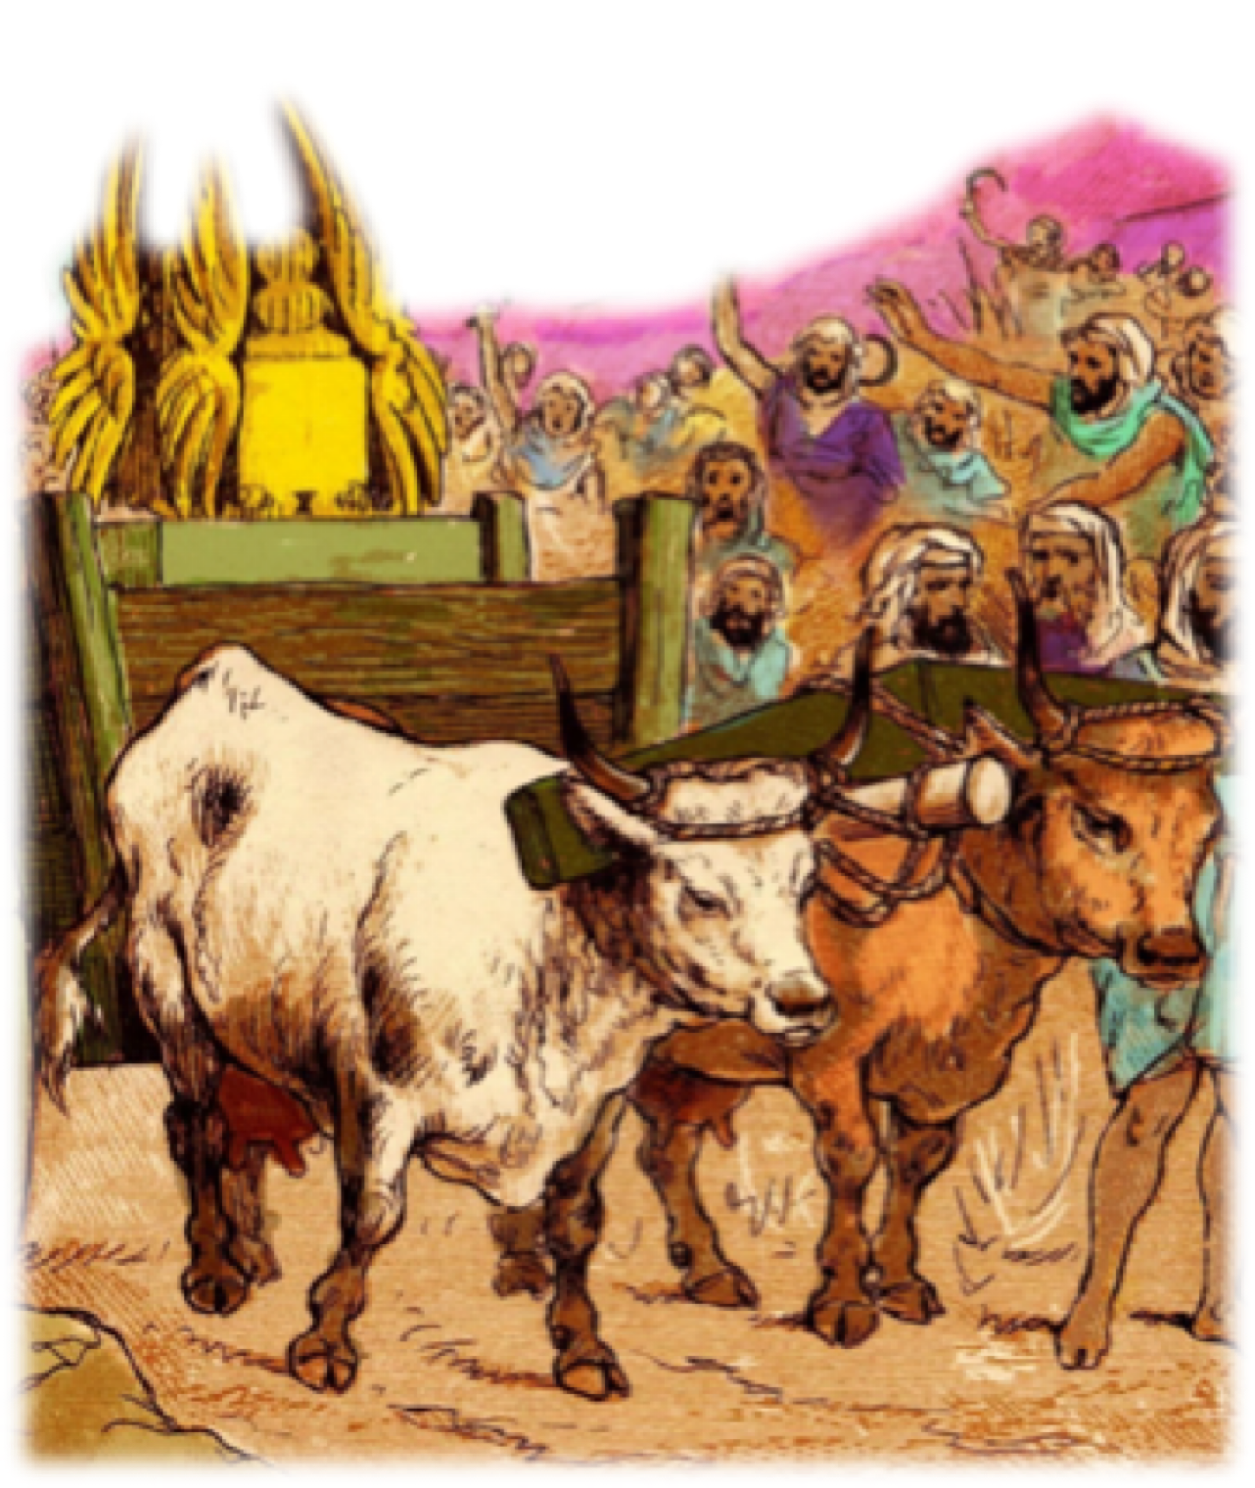
When God specifies - we CANNOT substitute. (1 Chron 13:5-8)
David’s best attempt to serve God according to his own thinking dishonored God instead of honoring Him (Lev 10:1-4; 1 Chron 15:2,13; Isa 55:6-9; Hos 14:9; Col. 3:17)

Slide 24
When God specifies - we CANNOT substitute. (1 Chron 13:5-8)
Cain’s offering (Gen. 4:7; Heb 11:4)
Nadab and Abihu’s fire (Lev. 10:1,2)
Moses’s disobedience (Num 20:8-24)
King Saul’s failure to obey (1 Sam. 13 & 15)
Jeroboam’s calves & priests (1 Ki. 12:25-33)
Uzziah’s incense (2 Chr. 26:16-23)

Slide 25
When God specifies - we CANNOT substitute. (1 Chron 13:5-8)
We must remember that any substitute for what God specifies is evil, regardless of intent (cf Num 20:8,11; Matt 7:21-23; 2 Jn 9,10; Dt 4:2; 12:32; Jos 1:7; Pro 30:6; Rev 22:18,19).

Slide 26
When God specifies - we CANNOT substitute. (1 Chron 13:5-8)
Different ways other than the one way (Mat 7:13-14; John 14:6; Acts 4:12; Prov 14:12).
Creeds replacing Scripture (2 Tim 3:16,17).
Man made doctrines instead of Christ’s
(Mat 15:7-9; 2 John 9-11).
Man made churches instead of Christ’s
(Mat 16:18; Eph 4:5).

Slide 27
When God specifies - we CANNOT substitute. (1 Chron 13:5-8)
Faith only for obedience to the gospel (James 2:24; 2 Thes 1:7-9)
Infant Baptism, sprinkling, pouring for Believers’ immersion (Mark 16:15-16; Rom 6:3-6; Col. 2:12,13).
Man’s organizational structure instead of God’s (Phili 1:1; 2 Tim 3:1-10)

Slide 28
When God specifies - we CANNOT substitute. (1 Chron 13:5-8)
Musical Instruments for Singing (Eph 5:19; Col 3:16,17).
Entertainment for reverential, true worship (John 4:24; Heb 12:28,29).
Social, recreational, secular work, not spiritual work (Rom 14:17; 2 Tim 4:2-4; 1 Tim 5:16)

Slide 29
What happens to our worship when we put it on a New Oxcart rather than following the divine order?
What happens to our work when we load it on an oxcart we have made (institutionalism) rather than following the divine order?
Notes:
cf Numbers 4:21ff - with Numbers 7:6ff
The sons of Gershom and Merari could use carts to transport the tabernacle, but the sons of Koath were not give carts for they carried the holy things.

Slide 30
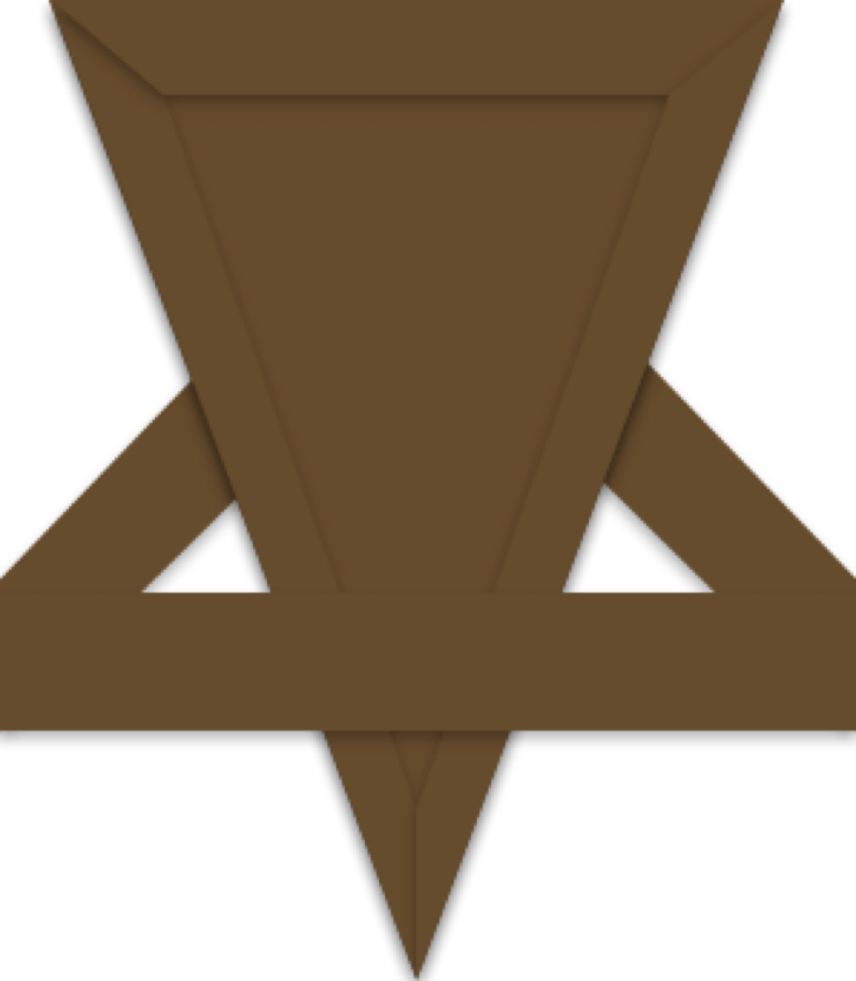
Cannot know the mind of God except through revelation
1 Cor 2:10, 11,14
Eph 3:3-5
Isaiah 55:8,9
Faith comes by hearing
God has revealed everything that He wants from us
2 Pet 1:3;
2 Tim 3:16,17
Jude 3
ROMANS 10:17
Walking by faith means walking by what God has said
2 Cor. 5:7; 1 Cor. 4:6; Gal. 1:6-9
Notes:
cf Numbers 4:21ff - with Numbers 7:6ff
The sons of Gershom and Merari could use carts to transport the tabernacle, but the sons of Koath were not give carts for they carried the holy things.

Slide 31
Walking by faith means walking by what God has said
2 Cor. 5:7; 1 Cor. 4:6; Gal. 1:6-9
Notes:
cf Numbers 4:21ff - with Numbers 7:6ff
The sons of Gershom and Merari could use carts to transport the tabernacle, but the sons of Koath were not give carts for they carried the holy things.

Slide 32
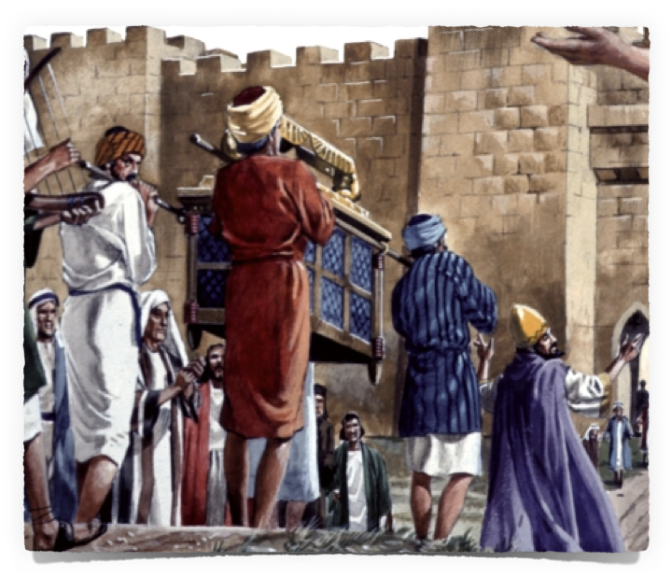
HOW CAN ONE PLEASE GOD?
1 Chronicles 13:12 (NKJV)
¹² David was afraid of God that day, saying, “How can I bring the ark of God to me?”
Walking by faith means walking by what God has said
2 Cor. 5:7; 1 Cor. 4:6; Gal. 1:6-9
Notes:
cf Numbers 4:21ff - with Numbers 7:6ff
The sons of Gershom and Merari could use carts to transport the tabernacle, but the sons of Koath were not give carts for they carried the holy things.

Slide 33
HOW CAN ONE PLEASE GOD?
Consult the proper order
(1 Chro 15:1,2; 11-13; Acts 17:11)
Follow the proper order
(1 Chro. 15:14-28; 2 Timothy 2:15; James 1:22-25)
Walking by faith means walking by what God has said
2 Cor. 5:7; 1 Cor. 4:6; Gal. 1:6-9
Notes:
cf Numbers 4:21ff - with Numbers 7:6ff
The sons of Gershom and Merari could use carts to transport the tabernacle, but the sons of Koath were not give carts for they carried the holy things.

Slide 34
HOW CAN ONE PLEASE GOD?
Hear, believe, repent, confess, be baptized (Rom 10:17; John 8:24; Acts 17:30; Rom 10:9; Acts 2:38; 22:16; 1 Pet 3:21)
Serve faithfully (1 Cor 15:58; 2 Tim 1:13; 2:5; Luke 6:46)
Walking by faith means walking by what God has said
2 Cor. 5:7; 1 Cor. 4:6; Gal. 1:6-9
Notes:
cf Numbers 4:21ff - with Numbers 7:6ff
The sons of Gershom and Merari could use carts to transport the tabernacle, but the sons of Koath were not give carts for they carried the holy things.

Slide 36
And Uzzah's Error
2 Samuel 6:1-11; 1 Chronicles 13:1-14
Charts by Don McClain
Preached October 5, 2014 — West 65th Street church of Christ
Preached February 22, 2026 — Alexander church of Christ
501-568-1062
Prepared using Keynote
Email – donmcclain@sbcglobal.net
More PPT & Audio Sermons:
http://w65stchurchofchrist.org/coc/sermons/
Note – Many of the transition effects used in this presentation may be lost using PPT 2007 Viewer
http://www.microsoft.com/downloads/details.aspx?FamilyID=cb9bf144-1076-4615-9951-294eeb832823&displaylang=en

Slide 37
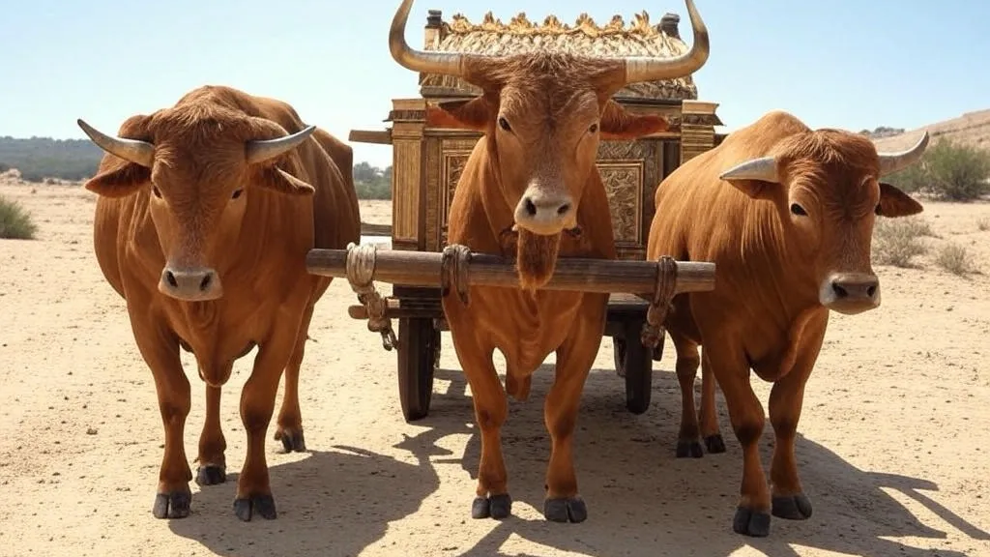
1 Chronicles 15:13 (NKJV)
¹³ For because you did not do it the first time, the Lord our God broke out against us, because we did not consult Him about the proper order.”

