Slide 1


1 Samuel 15
Don’t Try To Rationalize Your Disobedience

Slide 2



Don’t Try To Rationalize Your Disobedience
Saul is chosen & anointed to be king over Israel (1 Sam. 9; cf. 8:3-21)
Two chapters in First Samuel stand out as turning points in the life of king Saul. (13 & 15)

Slide 3
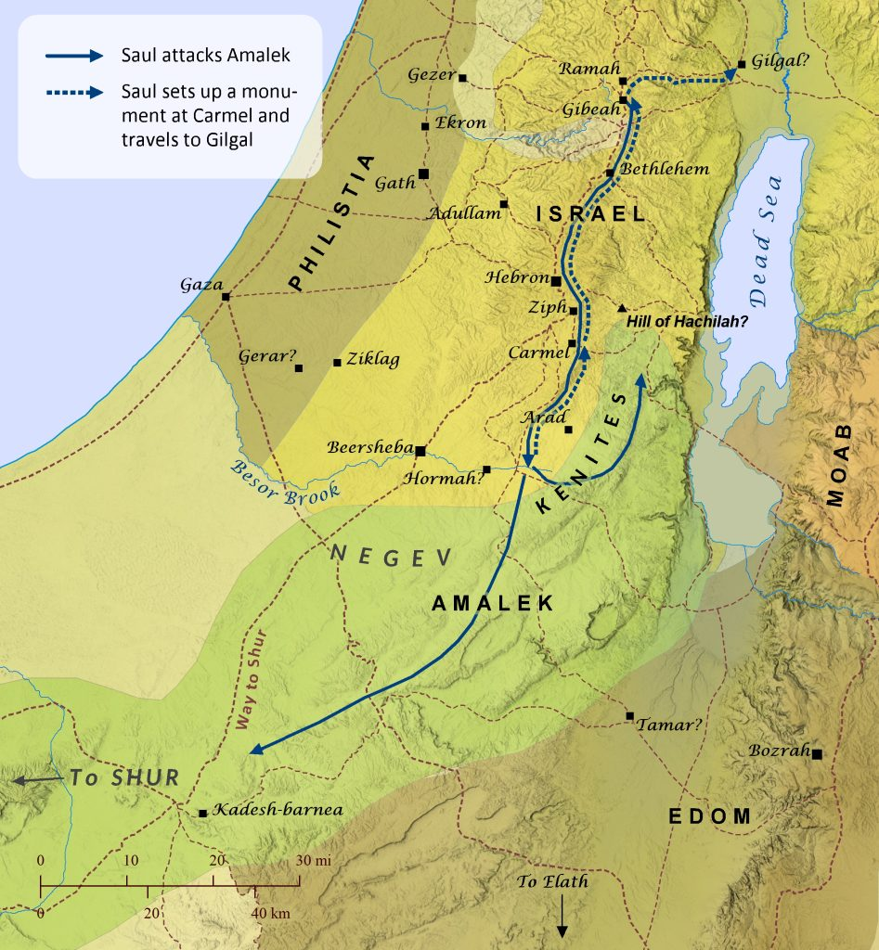
Don’t Try To Rationalize Your Disobedience
Amalekites had previously attacked Israel in Rephidim (Ex. 17:8-14)
God promised to destroy the Amalekites when Israel had rest in Canaan (Dt. 25:17-19)
Saul was to carry out God’s vengeance against them
(1 Sam 15:1-3).

Slide 4
And Try To Rationalize Your Disobedience
1 Samuel 15
Saul defeats Amelek (15:4-7)
Saul proved disobedient (15:8-9).
Saul deposed by God (15:10,11,23)
Samuel confronts Saul for his rebellion against God (15:12-31).
Samuel kills Agag by hacking him to pieces (15:32-33).

Slide 5
And Try To Rationalize Your Disobedience
1 Samuel 15
Because of Saul’s rebellion, the Amalekites continued to be a thorn in Israel’s side.
Killed Saul (2 Sam. 1:13)
Raided Ziklag, burned it with fire and took captive the wives & children of David & his men (1 Sam. 30:1-19)

Slide 6
Don’t Try To Rationalize Your Disobedience
1 Samuel 15:2–9 (NKJV)
² Thus says the Lord of hosts: ‘I will punish Amalek for what he did to Israel, how he ambushed him on the way when he came up from Egypt. ³ Now go and attack Amalek, and utterly destroy all that they have, and do not spare them. But kill both man and woman, infant and nursing child, ox and sheep, camel and donkey.’ ” …. ⁷ And Saul attacked the Amalekites, from Havilah all the way to Shur, which is east of Egypt.

Slide 7
Don’t Try To Rationalize Your Disobedience
1 Samuel 15:2–9 (NKJV)
⁸ He also took Agag king of the Amalekites alive, and utterly destroyed all the people with the edge of the sword. ⁹ But Saul and the people spared Agag and the best of the sheep, the oxen, the fatlings, the lambs, and all that was good, and were unwilling to utterly destroy them. But everything despised and worthless, that they utterly destroyed.

Slide 8
Don’t Try To Rationalize Your Disobedience
1 Samuel 15:12–14 (NKJV)
¹² So when Samuel rose early in the morning to meet Saul, it was told Samuel, saying, “Saul went to Carmel, and indeed, he set up a monument for himself; and he has gone on around, passed by, and gone down to Gilgal.” ¹³ Then Samuel went to Saul, and Saul said to him, “Blessed are you of the Lord! I have performed the commandment of the Lord.” ¹⁴ But Samuel said, “What then is this bleating of the sheep in my ears, and the lowing of the oxen which I hear?”

Slide 9



Don’t Try To Rationalize Your Disobedience
Wrong Ways To Deal With Sin
DENIAL (I have Obeyed The Lord …)
  “Blessed are you of the Lord” {15:13}
  "I have performed the commandment of the Lord” {15:13}
  “I have obeyed the voice of the Lord, and gone on the mission on which the Lord sent me, … I have utterly destroyed the Amalekites. {15:20}

Slide 10
Don’t Try To Rationalize Your Disobedience
Wrong Ways To Deal With Sin
DENIAL (I have Obeyed The Lord …)
  Saul defined partial obedience as full compliance that should be rewarded.
  Any “almost” or “mostly” compliance that edits God’s word is still disobedience. (the rich young ruler Mark 10, or the Pharisees’ precise tithing while neglecting weightier matters in Matthew 23:23).

Slide 11
Don’t Try To Rationalize Your Disobedience
Wrong Ways To Deal With Sin
DENIAL (I have Obeyed The Lord …)
Proverbs 28:13 (NKJV)
¹³ He who covers his sins will not prosper, But whoever confesses and forsakes them will have mercy.

Slide 12
Don’t Try To Rationalize Your Disobedience
Wrong Ways To Deal With Sin
DENIAL (I have Obeyed The Lord …)
1 John 1:8–10 (NKJV)
⁸ If we say that we have no sin, we deceive ourselves, and the truth is not in us. ⁹ If we confess our sins, He is faithful and just to forgive us our sins and to cleanse us from all unrighteousness. ¹⁰ If we say that we have not sinned, we make Him a liar, and His word is not in us.

Slide 13
Don’t Try To Rationalize Your Disobedience
Wrong Ways To Deal With Sin
EXCUSES Saul tried to shift blame:
  “They have brought them from the Amalekites; for the people spared the best of the sheep and the oxen,” [15:15]
  “But the people took of the plunder, sheep and oxen, the best of the things which should have been utterly destroyed” [15:21]

Slide 14

Don’t Try To Rationalize Your Disobedience
Ezekiel 18:20 (NKJV)
²⁰ The soul who sins shall die. The son shall not bear the guilt of the father, nor the father bear the guilt of the son. The righteousness of the righteous shall be upon himself, and the wickedness of the wicked shall be upon himself.

Slide 15
Don’t Try To Rationalize Your Disobedience
Romans 2:6–8 (NKJV)
⁶ who “will render to each one according to his deeds”: ⁷ eternal life to those who by patient continuance in doing good seek for glory, honor, and immortality; ⁸ but to those who are self-seeking and do not obey the truth, but obey unrighteousness—indignation and wrath,

Slide 16
Don’t Try To Rationalize Your Disobedience
Galatians 6:7–8 (NKJV)
⁷ Do not be deceived, God is not mocked; for whatever a man sows, that he will also reap. ⁸ For he who sows to his flesh will of the flesh reap corruption, but he who sows to the Spirit will of the Spirit reap everlasting life.

Slide 17
Don’t Try To Rationalize Your Disobedience
Wrong Ways To Deal With Sin
Pragmatism - Saul claimed his purposes were good:
  “and brought back Agag king of Amalek;” [15:20]
  “in order to sacrifice them to the LORD your God at Gilgal.” [15:21]
The end does NOT justify the means (cf Rom 3:8; 15:21-23)

Slide 18
Don’t Try To Rationalize Your Disobedience
Wrong Ways To Deal With Sin
Fear of people / concern for reputation over God
  “I have transgressed the commandment of the Lord and your words, because I feared the people and obeyed their voice” [15:24]

Slide 19
Don’t Try To Rationalize Your Disobedience
Wrong Ways To Deal With Sin
Half-hearted or delayed confession without corresponding action:
1 Samuel 15:24 (NKJV)
²⁴ Then Saul said to Samuel, “I have sinned, for I have transgressed the commandment of the Lord and your words, because I feared the people and obeyed their voice.

Slide 20
Don’t Try To Rationalize Your Disobedience
Wrong Ways To Deal With Sin
Half-hearted or delayed confession without corresponding action:
1 Samuel 15:30 (NKJV)
³⁰ Then he said, “I have sinned; yet honor me now, please, before the elders of my people and before Israel, and return with me, that I may worship the Lord your God.”

Slide 21
Don’t Try To Rationalize Your Disobedience
Wrong Ways To Deal With Sin
Half-hearted or delayed confession without corresponding action:
  He eventually says “I have sinned,” yet again blames others {15:24}
  Again he proclaims “I have sinned,” but seeks public honor {15:30}.
  True dealing with sin is remorseful and only concerned with God’s will.

Slide 22
Don’t Try To Rationalize Your Disobedience
Wrong Ways To Deal With Sin
Selective Comparison {2 Cor 10:12}
Claim ignorance {Acts 17:11; 2 Tim 2:15; Acts 17:30}
Claim moderation {Eph 5:3-7;
1 Thes 5:22; Heb 2:1-3}
I’m the victim {1 Pet 2:18-23}
Procrastination {Acts 24:25}

Slide 23
Don’t Try To Rationalize Your Disobedience
Wrong Ways To Deal With Sin
1 Samuel 15:22–23 (NKJV)
²² So Samuel said: “Has the Lord as great delight in burnt offerings and sacrifices, As in obeying the voice of the Lord? Behold, to obey is better than sacrifice, And to heed than the fat of rams. ²³ For rebellion is as the sin of witchcraft, And stubbornness is as iniquity and idolatry. Because you have rejected the word of the Lord, He also has rejected you from being king.”

Slide 24

Don’t Try To Rationalize Your Disobedience
Sin MUST be dealt with
Obey God’s Word without editing (15:3, 18, 33)
Confess without making excuses (Psalm 51:4; Luke 18:13; 1 John 1:9).
Execute judgment on the sin itself by executing it (Romans 6; Col. 3:5)
Value obedience above “religious” substitutes (15:22–23; )

Slide 25
Don’t Try To Rationalize Your Disobedience
Sin MUST be dealt with
With God’s help & provisions [Eph. 6:10-18; Jam 4:6-10; 2 Pet. 1:5-10]
Ruthlessly [Mat. 5:29,30; 18:8,9; Rom 13:13,14]
Completely / fully [2 Cor. 10:5; Eph. 6:16; Heb 12:1]
Quickly [1 Cor. 6:18; 1 Thes. 5:22; 2 Cor. 6:2; Rom. 13:11,12]

Slide 26
Don’t Try To Rationalize Your Disobedience
Sin MUST be dealt with
Recognize how horrible sin is to a "holy" God (Hab. 1:13; 1 Pet. 1:15,16)
Be led by the Spirit (Rom. 8:12-14; [vss. 1-8]; Gal 5:16).
Draw closer to the Lord (Rom 13:14; Col. 3:10-12; Tit. 2:14; 3:14).
Do whatever it takes to avoid sin (Rom. 13:14; Matt. 5:27-30; 1 Pet. 2:11; 1 Cor. 10:13)

Slide 27

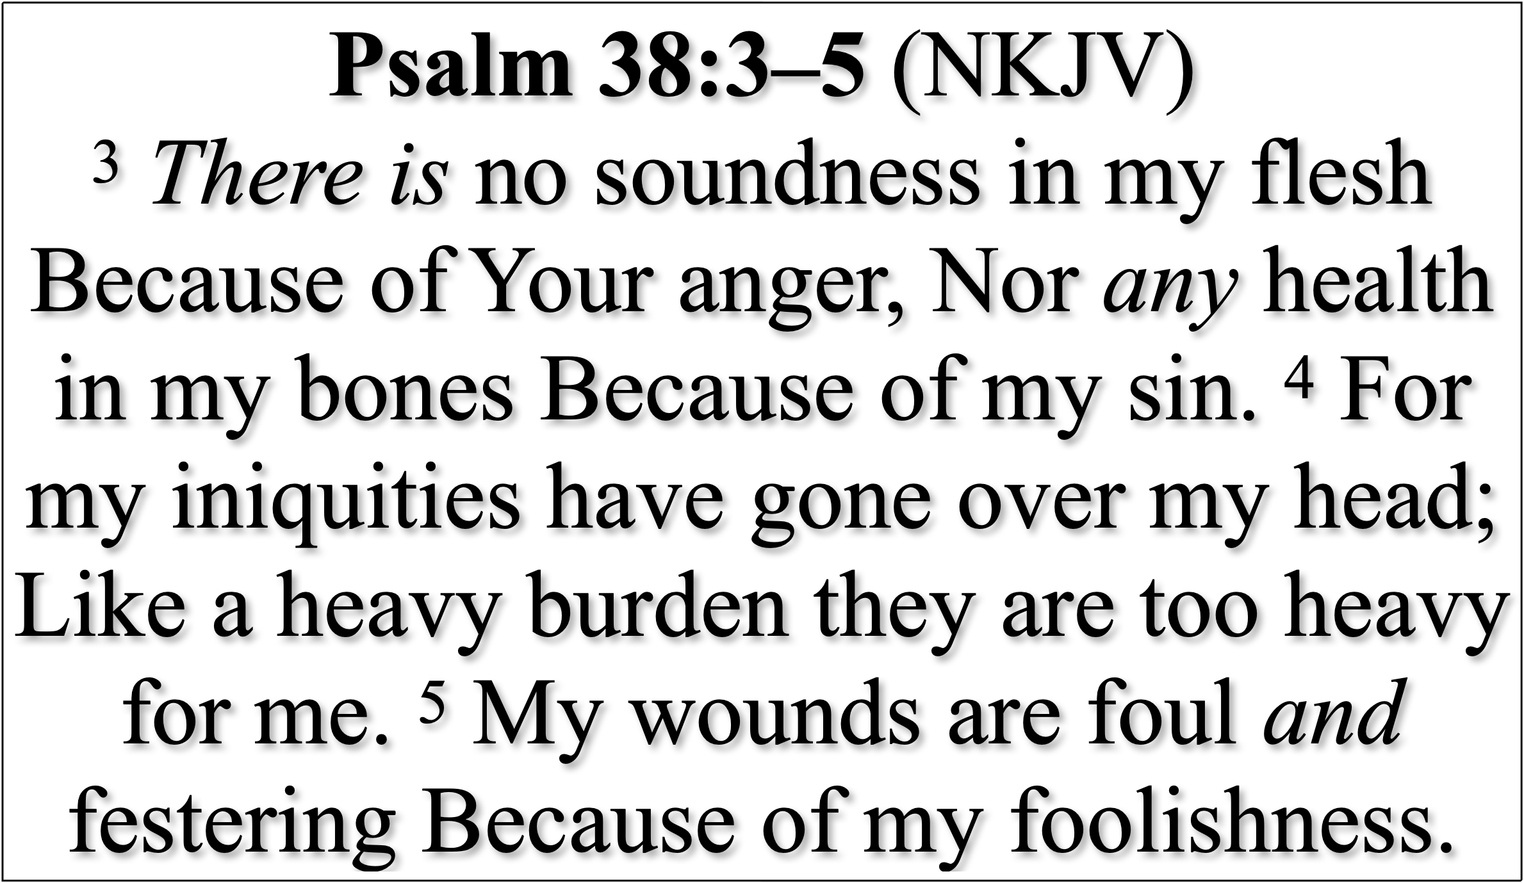
Don’t Try To Rationalize Your Disobedience
Sin MUST be dealt with

Slide 28
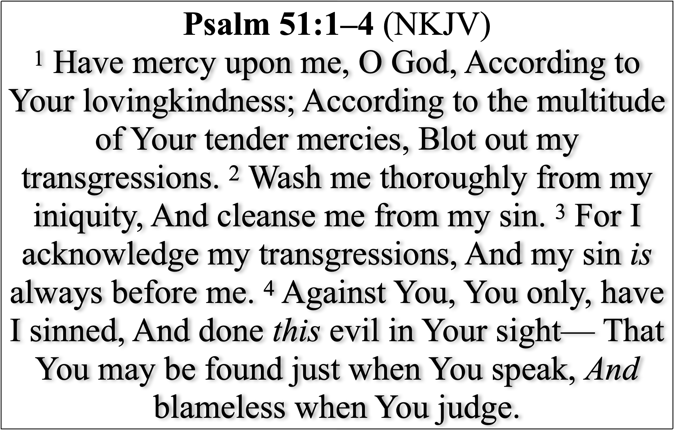
Don’t Try To Rationalize Your Disobedience
Sin MUST be dealt with

Slide 29
Don’t Try To Rationalize Your Disobedience
Sin MUST be dealt with
Conversion requires an execution (Rom. 6:3-6).
Baptism does not end our conflict with sin (Acts 2:38-42; Rom. 6:3-23; 1 Cor. 6:9-11; Gal. 5:16-21).
God commands us to CONTINUE to put sin to death (Mat. 5:29,30; Rom. 6; 8:12,13; Gal. 5:24; Col. 3:5-8).

Slide 30
Don’t Try To Rationalize Your Disobedience
Selective Obedience is Disobedience (We must do all God says, the way God says)
Sacrifice Without Submission (Religious ritual without true, humble obedience is worthless)
We MUST Kill What God Has Told You to Kill

Slide 31
Don’t Try To Rationalize Your Disobedience
This battle between us and sin will never end, but the key is that we actively engage in combat, not denying our sins but confessing them (1 John 1:8-9).
If we do not commit ourselves to merciless combat against sin, some day, like Saul, it will come back to haunt and destroy us.

Slide 32
Don’t Try To Rationalize Your Disobedience
Those not in Christ must hear the truth, believe Jesus is the Christ, the Son of God, confess Him, repent, & be baptized into Him (Acts 2:38)
The proper way for God’s people to deal with their sins and receive forgiveness is to confess these sins, repent, and pray to God for forgiveness (1 John 1:9; Acts 8:22).

Slide 34
1 Samuel 15
And Try To Rationalize Your Disobedience
Charts by Don McClain
Preached June 18, 2017 West 65th Street church of Christ
Preached November 1, 2026, Alexander church of Christ
501-568-1062 / Email – donmcclain@sbcglobal.net
Prepared using Keynote 2014 – More PPT & Audio Sermons:
alexanderchurchofchrist.com

Slide 35
And Try To Rationalize Your Disobedience
1 Samuel 15:22 (NKJV)
²² So Samuel said: “Has the Lord as great delight in burnt offerings and sacrifices, As in obeying the voice of the Lord? Behold, to obey is better than sacrifice, And to heed than the fat of rams.

