Slide 1



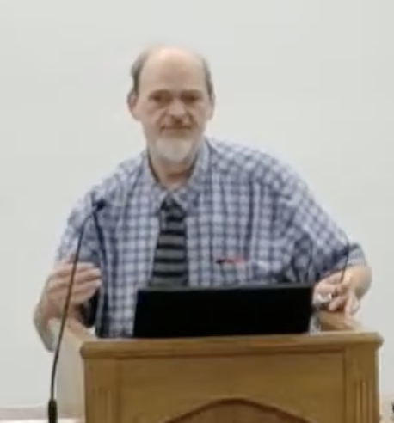
“Church of Christ MEETING @ 100 CORNERSTONE, Alexander AR. 72002”
TODAY’S LESSON
Sunday evening lesson live stream 4:00 PM ^{CDT} June 28, 2026
https://www.youtube.com/user/donmcclain11/live / WWW.ALEXANDERCHURCHOFCHRIST.COM

Slide 2
FOLLOWING JESUS THE COMFORTER
JOHN 14:12-21

Slide 3
Comfort From God
2 Corinthians 1:3-7 the God of all comfort
2 Cor. 7 God comforts the downcast
John 14:16-18 the Holy Spirit is another Comforter

Slide 4
John 14:16-18
¹⁶ "And I will pray the Father, and He will give you another Helper, that He may abide with you forever— the Spirit of truth, whom the world cannot receive, because it neither sees Him nor knows Him; but you know Him, for He dwells with you and will be in you. I will not leave you orphans; I will come to you.”

Slide 5
Comfort From God
2 Corinthians 1:3-7 the God of all comfort
2 Cor. 7 God comforts the downcast
John 14:16-18 the Holy Spirit is another Comforter
Implies Jesus was a comforter for the disciples
Still with them in spirit v.18; Matt. 28:20
Still with them in Spirit v.18; Ephesians 2:22

Slide 6
What Is Comfort?
Greek noun PARAKLESIS (comfort” in 2 Cor. 1:3,4; “consolation” in Luke 2:25; “exhortation” in 1 Cor. 14:3; 1 Thess. 2:3; Hebrews 12:5; “encouragement in Acts 4:36)
Greek Verb PARAKALEO (“comfort” in 2 Cor. 1:4; 2:7; “exhort” in Acts 2:40; “pleading” in Acts 19:31; “entreat” in 1 Cor. 4:13)
Greek noun PARAKLETOS (“Comforter” or “Helper” in John 14:16,26; 15:26; 16:7; “Advocate” in 1 John 2:1)

Slide 7
Qualities of Christ as Comforter
Presence John 14:16-18
Words of comfort John 14:25-26
Love John 15:9
Empathy John 15:11 sharing
Peace John 15:25-28
Optimism John 16:12-13; 25-33

Slide 8
Comfort One Another
Presence John 14:16-18
Words of comfort John 14:25-26
Love John 15:9 so show love 2 Cor. 2:3-8
Empathy John 15:11 so share Rom. 12:15
Peace John 15:25-28 so live peaceably
Optimism John 16:12-13

Slide 9
Comfort One Another
Presence John 14:16-18 so show up Hebrews 10:24-25
Words of comfort John 14:25-26
Love John 15:9 so show love 2 Cor. 2:3-8
Empathy John 15:11 so share Rom. 12:15
Peace John 15:25-28 so live peaceably
Optimism John 16:12-13

Slide 10
Comfort One Another
Presence John 14:16-18 so show up Hebrews 10:24-25
Words of comfort John 14:25-26 so comfort one another 1 Thessalonians 4:18
Love John 15:9 so show love 2 Cor. 2:3-8
Empathy John 15:11 so share Rom. 12:15
Peace John 15:25-28 so live peaceably
Optimism John 16:12-13

Slide 11
Comfort One Another
Presence John 14:16-18 so show up Hebrews 10:24-25
Words of comfort John 14:25-26 so comfort one another 1 Thessalonians 4:18
Love John 15:9 so show love 2 Cor. 2:3-8
Empathy John 15:11 so share Rom. 12:15
Peace John 15:25-28 so live peaceably
Optimism John 16:12-13

Slide 12
Comfort One Another
Presence John 14:16-18 so show up Hebrews 10:24-25
Words of comfort John 14:25-26 so comfort one another 1 Thessalonians 4:18
Love John 15:9 so show love 2 Cor. 2:3-8
Empathy John 15:11 so share Rom. 12:15
Peace John 15:25-28 so live peaceably
Optimism John 16:12-13

Slide 13
Comfort One Another
Presence John 14:16-18 so show up Hebrews 10:24-25
Words of comfort John 14:25-26 so comfort one another 1 Thessalonians 4:18
Love John 15:9 so show love 2 Cor. 2:3-8
Empathy John 15:11 so share Rom. 12:15
Peace John 15:25-28 so live peaceably Romans 12:18; Matt. 5:9
Optimism John 16:12-13

Slide 14
Comfort One Another
Presence John 14:16-18 so show up Hebrews 10:24-25
Words of comfort John 14:25-26 so comfort one another 1 Thessalonians 4:18
Love John 15:9 so show love 2 Cor. 2:3-8
Empathy John 15:11 so share Rom. 12:15
Peace John 15:25-28 so live peaceably Romans 12:18; Matt. 5:9
Optimism John 16:12-13 so radiate hope Rom. 12:12

Slide 15
Daily Renewing The Inner Man with The Comfort of God
John 14:1-31 the promise of the Holy Spirit
John 15:1-27 Jesus comforts the apostles
John 16:1-33 gentle & honest words of comfort
Romans 12:9-16 kindness & empathy
2 Cor. 1:3-11 God comforts you…so you can comfort others
2 Cor.7:9-11 mourn → comforted Matt. 5:4
1 Thessalonians 2:4-12 example of Paul

Slide 16



100 CORNERSTONE ALEXANDER AR, 72002
You Are Welcome At Any And All of Our Services!
Meeting Times:
Sunday A.M. Bible Study: 9:00
Sunday A.M. Assembly: 10:00
Sunday P.M. Assembly: 4:00
Wed. P.M. Bible Study: 7:00
ALEXANDERCHURCHOFCHRIST.COM

