Slide 1

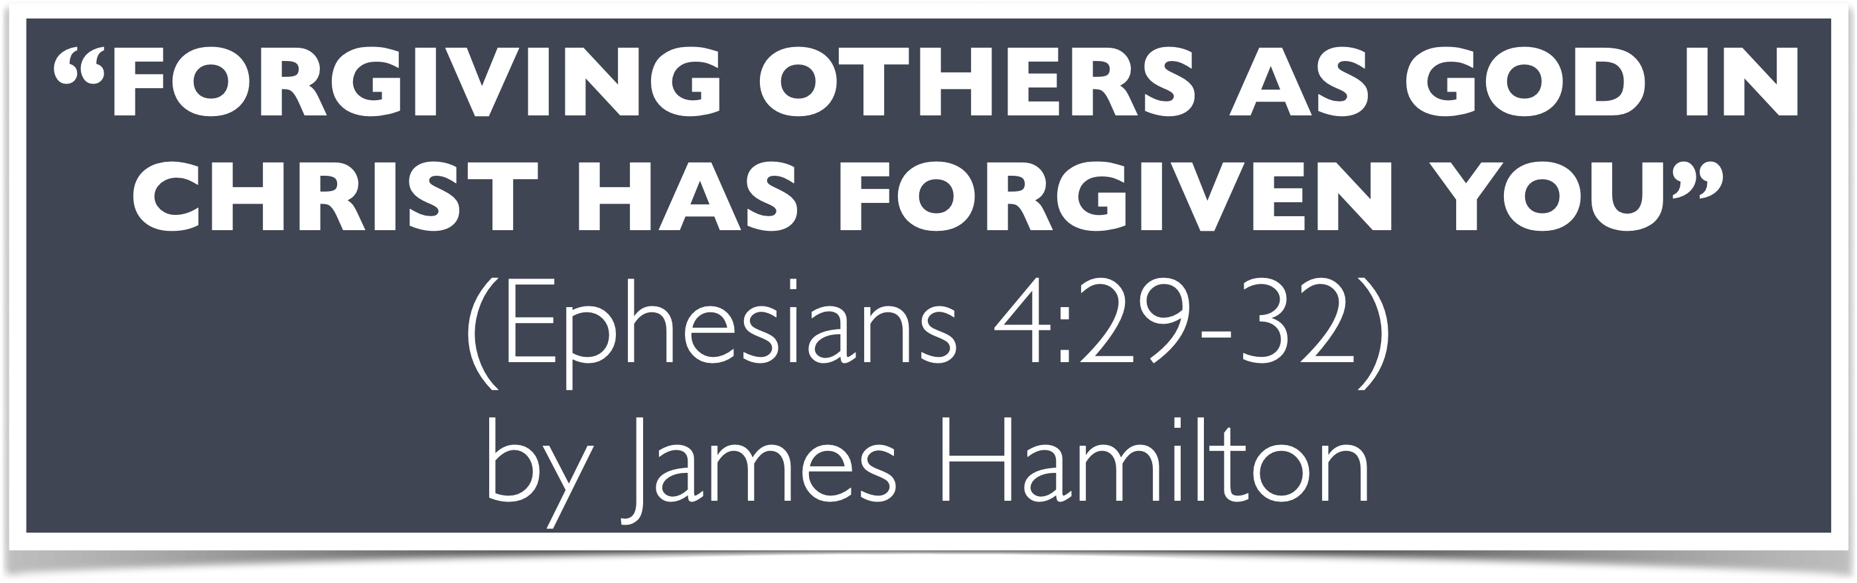

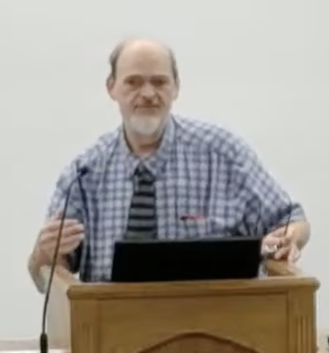
“Church of Christ MEETING @ 100 CORNERSTONE, Alexander AR. 72002”
TODAY’S LESSON
Sunday Morning Live Stream 10:00 AM ^{CT} May 24, 2026
https://www.youtube.com/user/donmcclain11/live / WWW.ALEXANDERCHURCHOFCHRIST.COM

Slide 2
FORGIVING OTHERS AS GOD IN CHRIST FORGAVE YOU
EPHESIANS 4:29-32

Slide 3
Colossians 3:12-15
Therefore, as the elect of God, holy and beloved, put on tender mercies, kindness, humility, meekness, longsuffering; bearing with one another, and forgiving one another, if anyone has a complaint against another; even as Christ forgave you, so you also must do. But above all these things put on love, which is the bond of perfection. And let the peace of God rule in your hearts, to which also you were called in one body; and be thankful.

Slide 4
Ephesians 4:29-32
Let no corrupt word proceed out of your mouth, but what is good for necessary edification, that it may impart grace to the hearers. And do not grieve the Holy Spirit of God, by whom you were sealed for the day of redemption. Let all bitterness, wrath, anger, clamor, and evil speaking be put away from you, with all malice. And be kind to one another, tenderhearted, forgiving one another, even as God in Christ forgave you.

Slide 5
We Have Been Forgiven We Must Forgive
What is forgiveness?
Why is forgiveness important?
How are we to forgive?

Slide 6
What Is Forgiveness?
Old Testament Hebrew CHALACH only used for the LORD’s pardon of the sins of men against Him Exodus 34:9

Slide 7
Exodus 34:6-9
And the Lord passed before him and proclaimed, “The Lord, the Lord God, merciful and gracious, longsuffering, and abounding in goodness and truth, keeping mercy for thousands, forgiving iniquity and transgression and sin, by no means clearing the guilty, visiting the iniquity of the fathers upon the children and the children’s children to the third and the fourth generation.”

Slide 8
Exodus 34:6-9
So Moses made haste and bowed his head toward the earth, and worshiped. Then he said, “If now I have found grace in Your sight, O Lord, let my Lord, I pray, go among us, even though we are a stiff-necked people; and pardon our iniquity and our sin, and take us as Your inheritance.”

Slide 9
What Is Forgiveness?
Old Testament Hebrew CHALACH only used for the LORD’s pardon of the sins of men against Him Exodus 34:9
2 Chronicles 7:14 If My people, who are called by My name, shall humble themselves, and pray, and seek My face, and turn from their wicked ways; then I will hear from heaven, and WILL FORGIVE their sin, and will heal their land.

Slide 10
What Is Forgiveness?
Promised in the new covenant Jeremiah 31:34 (TODAY! Hebrews 8:6-13)
This objective forgiveness is given by God Mark 2:5-12
Another Hebrew word NASA is forgiveness between people or God Ex. 34:7; NASA has many uses and applications depending on context Genesis 50 carried Jacob (v.13), forgave brothers (v.17-21)
Basic meaning is “to lift up” Genesis 22:4,13; 40:13,20; 1 Chronicles 21; 2 Chron. 3:1; John 2:18-22; 12:32-33
Lift up=take in Exodus 20:7

Slide 11
What Is Forgiveness?
New Testament Greek CHARIZOMAI in Ephesians 4:32 to grant as a favor
The word CHARIS (“grace”) is part of it
To forgive is to give Ephesians 1:3,7; 2 Corinthians 2:6-11 (proof of forgiveness)
Forgiveness is not earned; it is given by grace.
We were made alive by the grace of God
We must continue to live in the grace of God

Slide 12
Forgiveness Is Absolutely Necessary For Eternal Life!
We need forgiveness from God in order to live with God now and for eternity
My sins separated me from God Isaiah 59:1-2
I was dead in sin Ephesians 2:1; Romans 3:23; 6:16-17a
I learned that Jesus died for my sins because God loves me and gave His Son for me! John 3:16; 1 John 3:16; 4:16

Slide 13
Forgiveness Is Absolutely Necessary For Eternal Life!
I know His death has power to wash away my sins because Jesus arose from the dead three days later 1 Corinthians 15:3-4
Jesus is Lord! He became the author of eternal salvation unto all that obey Him Hebrews 5:9
I believe Jesus is Lord so strongly that I confess Him as Lord and submit to His word (where His authority is) I want to know His will and submit to His total authority over heaven and earth Romans 10:9

Slide 14
Forgiveness Is Absolutely Necessary For Eternal Life!
By faith in the word of Christ (the faith the Holy Spirit revealed to us in the New Testament), I called upon the name of the Lord by being baptized in His name for the remission of my sins Acts 2:21,36-41; 10:43,47-48; 22:16; Colossians 2:12
I know that I am forgiven! I felt that burden be removed from me. Sin no longer has the influence over me that it used to have; no fear, no doubt; filled with love, joy, peace, etc. Galatians 2:20; 5:14-25

Slide 15
Forgiveness Is Absolutely Necessary For Eternal Life!
Now I walk by faith with Christ in order to be transformed into His image 2 Corinthians 5:7; 3:17-18; 4:16-18; Ephesians 4:11-16
My Lord Jesus commands me to forgive others Eph. 4:32
Forgiveness is the foundation of the way of Christ Matt. 6:9-15; 18:21-35
Why He came John 1:14-18
Why He died John 3:16; 1 John 3:16; Hebrews 2:9-18

Slide 16
Daily Renewing the Inner Man To Forgive
Genesis 50:15-21 Joseph forgave his brothers
Exodus 33:18-34:28 Who God is
Leviticus 19:15-18 no favoritism, no gossip; no grudges; love others as you want to be loved
1 Samuel 25:2-35 David forgave his reviler’s family
Proverbs 16:6; 3:3-4; Psalm 85:7-10 mercy & truth
Psalm 18:23-27 you will reap what you sow

Slide 17
Psalm 18:23-27
I was also blameless before Him, and I kept myself from my iniquity. Therefore the Lord has recompensed me according to my righteousness, according to the cleanness of my hands in His sight.

Slide 18
Psalm 18:23-27
With the merciful You will show Yourself merciful; with a blameless man You will show Yourself blameless; with the pure You will show Yourself pure; and with the devious You will show Yourself shrewd. For You will save the humble people, but will bring down haughty looks.

Slide 19
Daily Renewing the Inner Man To Forgive
Genesis 50:15-21 Joseph forgave his brothers
Exodus 33:18-34:28 Who God is
Leviticus 19:15-18 no favoritism, no gossip; no grudges; love others as you want to be loved
1 Samuel 25:2-35 David forgave his reviler’s family
Proverbs 16:6; 3:3-4; Psalm 85:7-10 mercy & truth
Psalm 18:23-27 you will reap what you sow

Slide 20
Daily Renewing the Inner Man To Forgive
Genesis 50:15-21 Joseph forgave his brothers
Exodus 33:18-34:28 Who God is
Leviticus 19:15-18 no favoritism, no gossip; no grudges; love others as you want to be loved
1 Samuel 25:2-35 David forgave his reviler’s family
Proverbs 16:6; 3:3-4; Psalm 85:7-10 mercy & truth
Psalm 18:23-27 you will reap what you sow
Ephesians 4:29-32 forgive just as God forgave you

Slide 21
Forgiving Others Is Absolutely Necessary For God To Forgive Us!
Matt 6:9-15 forgive → forgiven
Matt. 18:21-35 forgiven → forgive
You WILL reap what you sow Galatians 6:7
Psalm 18:23-27
Are you sowing forgiveness or unforgiveness in your life?

Slide 22
“Church of Christ MEETING @ 100 CORNERSTONE, Alexander AR. 72002”
TODAY’S LESSON
Sunday Morning Live Stream 10:00 AM ^{CT} May 24, 2026
https://www.youtube.com/user/donmcclain11/live / WWW.ALEXANDERCHURCHOFCHRIST.COM

