Slide 1
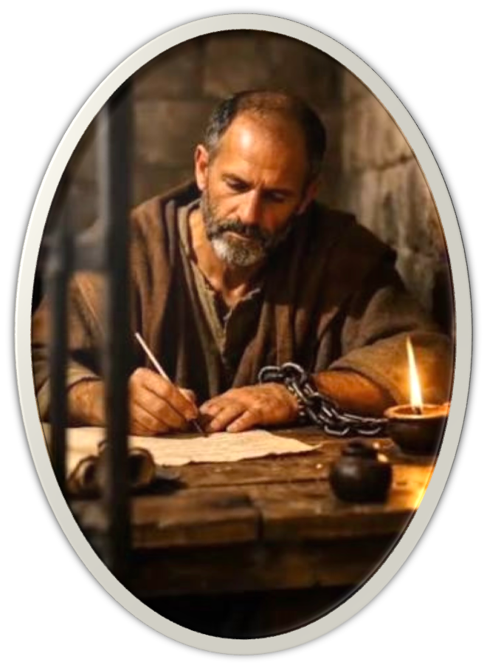

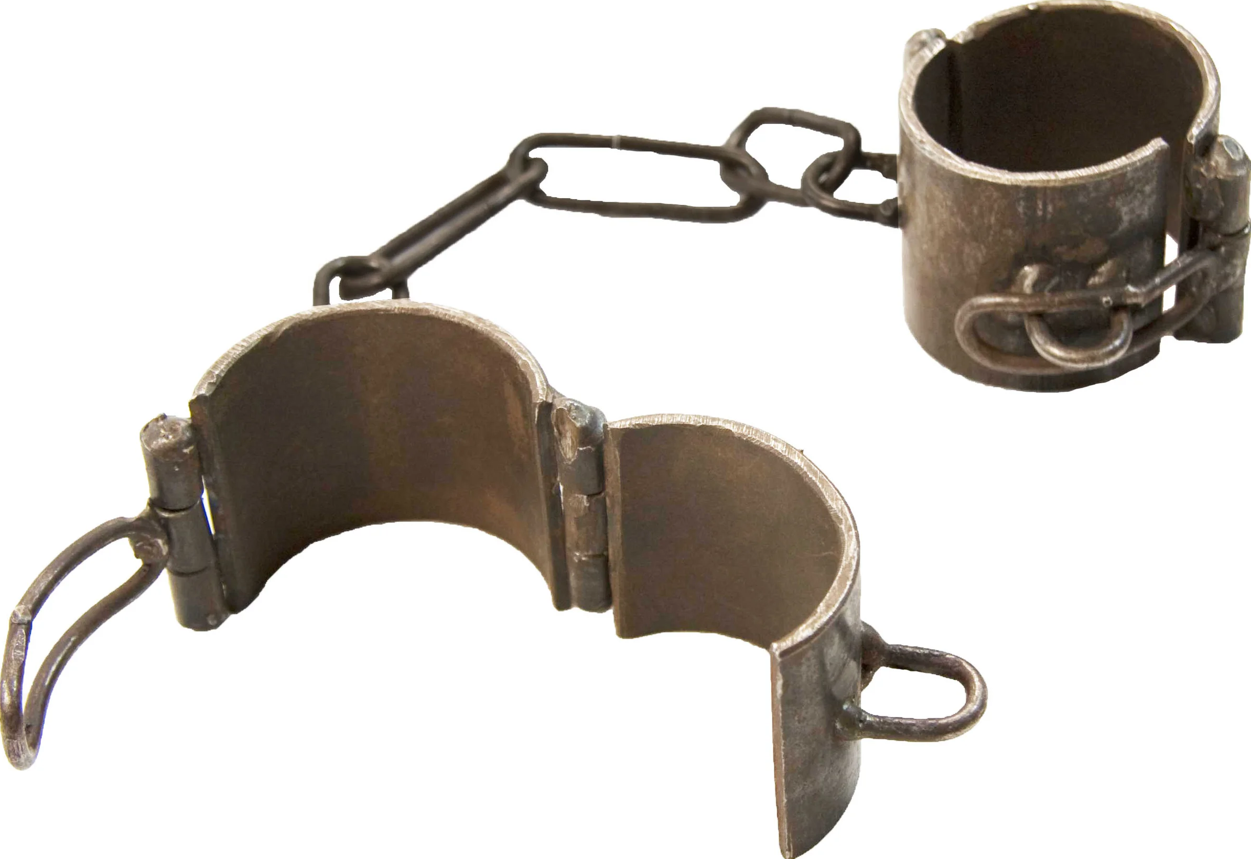
THE BOOK OF PHILEMON
9 “Yet for love’s sake I rather appeal to you—…10 … for my son Onesimus, whom I have begotten while in my chains,”

Slide 2

9 “Yet for love’s sake I rather appeal to you—…10 … for my son Onesimus, whom I have begotten while in my chains,”

Slide 3
THE BOOK OF PHILEMON
9 “Yet for love’s sake I rather appeal to you—…10 … for my son Onesimus, whom I have begotten while in my chains,”

Slide 4

THE BOOK OF PHILEMON
The shortest of Paul’s letters, only 335 words in Greek, yet it is rich in meaning and application.
It is an appeal from an imprisoned apostle to a faithful friend regarding his runaway slave, who is now a beloved brother.
Its governing note is not coercion but love. Paul could have commanded. He chooses instead to plead “for love’s sake” (v. 9).

Slide 5
THE BOOK OF PHILEMON
Author: Paul (Phm 1,9,10,13,23)
Probably during first imprisonment in Rome - 62,63 AD (Col. 4:18; Eph. 3:1; Phili. 1:12-14; Acts 28:30,31)
About the same time as Colossians —with Timothy (Phm 1; Col 1:1) & Epaphras, Mark, Aristarchus, Demas, & Luke (Phm 23; Col. 4:10-14)
Onesimus delivered both (Col 4:7-9)

Slide 6

THE BOOK OF PHILEMON
Philemon (1)
Beloved friend & fellow laborer (1)
A faithful, loving & hospitable Christian (5-6)
One of Paul’s own converts (19)
Apphia (2) Possibly Philemon’s wife
Archippus — A Minister of the gospel (Col 4:17) Some suggest Philemon’s son.

Slide 7
THE BOOK OF PHILEMON
Onesimus (10)
Philemon’s slave (16)
Ran away (15, 18)
After traveling to Rome, converted to Christ (10)
Very dear and useful to Paul (11-13 and Col 4:10)

Slide 8
THE BOOK OF PHILEMON
Purpose — Paul writes to persuade Philemon to receive Onesimus no longer as a mere slave, but as a beloved brother (v. 16), to forgive the wrong, and to welcome him as he would welcome Paul himself (v. 17).
The letter is not a sealed private note. It is addressed to the gathered believers. Reconciliation is to take place in the light, not in the dark.

Slide 9
THE BOOK OF PHILEMON
Structure
Greeting (1-3)
Thanksgiving and intercession (4-7)
The appeal for Onesimus (8-16)
Partnership, pledge, and confidence (17-22)
Final greetings and benediction (23-25)

Slide 10
THE BOOK OF PHILEMON
Philemon 1–7,19 (NKJV)
¹ Paul, a prisoner of Christ Jesus, and Timothy our brother, To Philemon our beloved friend and fellow laborer, ² to the beloved Apphia, Archippus our fellow soldier, and to the church in your house: ³ Grace to you and peace from God our Father and the Lord Jesus Christ.
Dear Philemon … (1-7,19)
What he meant to Paul personally “our beloved friend and fellow laborer,” (1-2)

Slide 11
THE BOOK OF PHILEMON
Philemon 1–7,19 (NKJV)
⁴ I thank my God, making mention of you always in my prayers, ⁵ hearing of your love and faith which you have toward the Lord Jesus and toward all the saints, ⁶ that the sharing of your faith may become effective by the acknowledgment of every good thing which is in you in Christ Jesus.
Dear Philemon … (1-7,19)
What he meant to Paul personally “our beloved friend and fellow laborer,” (1-2)
Manifested love & faith towards Christ & brethren (4,5)
Shared his faith (6)

Slide 12
THE BOOK OF PHILEMON
Philemon 1–7,19 (NKJV)
⁷ For we have great joy and consolation in your love, because the hearts of the saints have been refreshed by you, brother. ….
¹⁹ I, Paul, am writing with my own hand. I will repay—not to mention to you that you owe me even your own self besides.
Dear Philemon … (1-7,19)
What he meant to Paul personally “our beloved friend and fellow laborer,” (1-2)
Manifested love & faith towards Christ & brethren (4,5)
Shared his faith (6)
An encourager (7)
Philemon was indebted to Paul (19)

Slide 13
THE BOOK OF PHILEMON
Philemon 8–9 (NKJV)
⁸ Therefore, though I might be very bold in Christ to command you what is fitting, ⁹ yet for love’s sake I rather appeal to you—being such a one as Paul, the aged, and now also a prisoner of Jesus Christ—
Paul’s humble approach (8,9)
Right as an apostle to ORDER Philemon to receive Onesimus (1 Thes. 2:6, 7; 1 Cor. 5:4).
But instead, he appeals to the authority of love, (8, 9; Col. 2:12-15; 1 Cor. 13:4-8)
The motivation of the gospel appeal (Jn 12:32; Rom 5:8-10)

Slide 14
THE BOOK OF PHILEMON
Philemon 8–9 (NKJV)
⁸ Therefore, though I might be very bold in Christ to command you what is fitting, ⁹ yet for love’s sake I rather appeal to you—being such a one as Paul, the aged, and now also a prisoner of Jesus Christ—
Paul’s humble approach (8,9)
Paul appeals to Philemon as a wise and seasoned veteran (1 Pet. 5:5; 1 Cor. 4:16; 11:1; etc.)
Paul appeals to Philemon as one who is suffering for the cause of Christ - desiring that the gospel of reconciliation reach as many as possible - 2 Cor. 5:12-21; etc.

Slide 15
THE BOOK OF PHILEMON
Philemon 10–11 (NKJV)
¹⁰ I appeal to you for my son Onesimus, whom I have begotten while in my chains, ¹¹ who once was unprofitable to you, but now is profitable to you and to me.
On Behalf of Onesimus (10-18)
“My son” - Onesimus had become a Christian through the teaching of Paul while he was in prison (Acts 28:30,31)
The gospel can change ANYONE who by faith yields to Christ - making them profitable to God & man! (2 Cor. 5:17; Rom. 6:3-7).

Slide 16
THE BOOK OF PHILEMON
Philemon 12–14 (NKJV)
¹² I am sending him back. You therefore receive him, that is, my own heart, ¹³ whom I wished to keep with me, that on your behalf he might minister to me in my chains for the gospel. ¹⁴ But without your consent I wanted to do nothing, that your good deed might not be by compulsion, as it were, but voluntary.
On Behalf of Onesimus (10-18)
“I am sending him back” - as the law of the land & true repentance would demand (Col. 3:22-25; Ep. 6:5–7; 1 Ti. 6:1, 2; Tit. 2:9, 10; 1 Pe. 2:18, 19; Rom. 13:1-7; Mat. 3:8; Acts 26:20)
“You therefore receive him, that is, my own heart” — Have mercy on him for me (Col. 3:12-15; Luk. 15:11-32; Mat. 6:14,15; Ep. 4:32).

Slide 17
THE BOOK OF PHILEMON
Philemon 12–14 (NKJV)
¹² I am sending him back. You therefore receive him, that is, my own heart, ¹³ whom I wished to keep with me, that on your behalf he might minister to me in my chains for the gospel. ¹⁴ But without your consent I wanted to do nothing, that your good deed might not be by compulsion, as it were, but voluntary.
On Behalf of Onesimus (10-18)
“Whom I wished to keep with me” - He was helpful to Paul, therefore Paul wished he could have stayed.
The RIGHT & necessary thing to do was to send Onesimus back - Paul did NOT want to take advantage of Philemon or Onesimus.
Paul wanted Philemon’s good deed to be his own choice (Rom 16:16-18)

Slide 18
THE BOOK OF PHILEMON
Philemon 15–16 (NKJV)
¹⁵ For perhaps he departed for a while for this purpose, that you might receive him forever, ¹⁶ no longer as a slave but more than a slave—a beloved brother, especially to me but how much more to you, both in the flesh and in the Lord.
On Behalf of Onesimus (10-18)
“For perhaps he departed for a while for this purpose,” - God works providentially - we cannot know for certain what God does behind the scene (cf. Esther 4:14).
God can turn man’s disobedience, trials and hopeless circumstances into a blessing (Rom. 8:28; Gen 50:19; Acts 2:23,24; James 1:2-18).

Slide 19
THE BOOK OF PHILEMON
Philemon 15–16 (NKJV)
¹⁵ For perhaps he departed for a while for this purpose, that you might receive him forever, ¹⁶ no longer as a slave but more than a slave—a beloved brother, especially to me but how much more to you, both in the flesh and in the Lord.
On Behalf of Onesimus (10-18)
“No longer a slave but more than a slave —a beloved brother” - Paul doesn’t call for emancipation (1 Cor. 7:20-22), but LOVE!
The gospel is not focused on social reform - but gospel principles will inevitably reform any culture.
Christ can heal, strengthen & sustain ANY relationship - 1 Pet 3:1-7; 1 Cor. 13:4-8; Col. 3:12-15; Eph. 4:1-6; etc.

Slide 20
THE BOOK OF PHILEMON
Philemon 17–19 (NKJV)
¹⁷ If then you count me as a partner, receive him as you would me. ¹⁸ But if he has wronged you or owes anything, put that on my account. ¹⁹ I, Paul, am writing with my own hand. I will repay—not to mention to you that you owe me even your own self besides.
On Behalf of Onesimus (10-18)
“Receive him as you would me” - as a faithful servant of Jesus - as a friend - as a brother — Gal 3:28; Acts 10:34; James 2:1-13; Mat 12:48-50.
Onesimus COULD NOT repay Philemon - Paul obligates himself to take care of any debt owed …

Slide 21
THE BOOK OF PHILEMON
Philemon 17–19 (NKJV)
¹⁷ If then you count me as a partner, receive him as you would me. ¹⁸ But if he has wronged you or owes anything, put that on my account. ¹⁹ I, Paul, am writing with my own hand. I will repay—not to mention to you that you owe me even your own self besides.
A beautiful parallel to our salvation, (19)
All have sinned (Romans 3:23)
The wages of sin is death (Romans 6:23; James 1:13-15)
Cannot repay our debt — Salvation is by grace through faith (Eph. 2:5-10)
Jesus gave Himself so our sins could be forgiven! (Rom. 5:10,11; 11:6; Col. 1:20, 21; He. 2:17; 1 Jno. 2:2; 4:10; 2 Cor. 5:17-21)

Slide 22
THE BOOK OF PHILEMON
Paul’s closing passionate plea (20-21)
Philemon 20–22 (NKJV)
²⁰ Yes, brother, let me have joy from you in the Lord; refresh my heart in the Lord. ²¹ Having confidence in your obedience, I write to you, knowing that you will do even more than I say. ²² But, meanwhile, also prepare a guest room for me, for I trust that through your prayers I shall be granted to you.

Slide 23
THE BOOK OF PHILEMON
Acknowledge and be thankful for the good in others and encourage them to continue — 4-7
Expect the best from one another - and encourage one another to do what is right — 8-12, 21
The need to be forgiving - just as Christ has forgiven us! — 12,15,16,19.
Christians are brethren — we are all one in Christ Jesus — 16; Gal. 3:26-28

Slide 24
THE BOOK OF PHILEMON
Regardless of what we have done, if we turn to Christ, trust and obey Him, we can be useful to God and others — 10; Luke 15:11-32; Mat 5:13-16.
True love, as taught by Christ, WILL heal, strengthen and improve ANY relationship IF ALL involved will WHOLLY SUBMIT to Christ! — A troubled marriage; A strained friendship; Church problems; etc. 15,16; 1 Cor. 13:4-8; Eph. 5:22-32; etc.

Slide 25
THE BOOK OF PHILEMON
Social structures are changed under the lordship of Christ. — Philemon does not offer a complete program for the abolition of slavery. It plants a seed that no slave system can finally survive: the master and the slave are brothers, and the brother must be received as the apostle himself.
FOR LOVE’S SAKE: Receive the brother. Cancel the debt. Do even more than asked. Refresh the heart.

Slide 26
THE BOOK OF PHILEMON
Receive Christ by faith, repenting of your sins & being baptized into Him — Rom. 6:3-6; Gal. 3:26,27; Col. 2:12,13.
If you are already in Christ, but sin has again entered into your life, repent, confess & pray — 1 Jn 1:9,10; Ac 8:22
If you are already in Christ, be filled with love and faith — serving one another — Heb. 10:24,25

Slide 28
THE BOOK OF PHILEMON
Charts by Don McClain /
Preached April 23, 2017 West 65th Street church of Christ
Preached August 30, 2026 Alexander church of Christ
501-568-1062 / Email – donmcclain@sbcglobal.net
Prepared using Keynote 2014 – More PPT & Audio Sermons:
ALEXANDERCHURCHOFCHRIST.COM

Slide 29

Colossians 3:9–17 (NKJV)
⁹ Do not lie to one another, since you have put off the old man with his deeds, ¹⁰ and have put on the new man who is renewed in knowledge according to the image of Him who created him, ¹¹ where there is neither Greek nor Jew, circumcised nor uncircumcised, barbarian, Scythian, slave nor free, but Christ is all and in all. ¹² Therefore, as the elect of God, holy and beloved, put on tender mercies, kindness, humility, meekness, longsuffering; ¹³ bearing with one another, and forgiving one another, if anyone has a complaint against another; even as Christ forgave you, so you also must do.

Slide 30
Colossians 3:9–17 (NKJV)
¹⁴ But above all these things put on love, which is the bond of perfection. ¹⁵ And let the peace of God rule in your hearts, to which also you were called in one body; and be thankful. ¹⁶ Let the word of Christ dwell in you richly in all wisdom, teaching and admonishing one another in psalms and hymns and spiritual songs, singing with grace in your hearts to the Lord. ¹⁷ And whatever you do in word or deed, do all in the name of the Lord Jesus, giving thanks to God the Father through Him.

