Slide 1



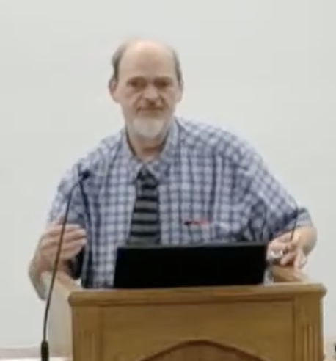
“Church of Christ MEETING @ 100 CORNERSTONE, Alexander AR. 72002”
TODAY’S LESSON
Sunday Morning Stream
10:00 AM ^{CT} August 2, 2026
https://www.youtube.com/user/donmcclain11/live / WWW.ALEXANDERCHURCHOFCHRIST.COM

Slide 2
THE GENEROSITY OF JESUS
2 CORINTHIANS 8:1-9

Slide 3
LOVE → GIVING
1 John 4:16 We have known and believed the love that God has for us. God is love, and he who abides in love abides in God, and in Him.
John 3:16 God loved the world so much that He gave His only begotten Son
1 John 3:16 This is how we know love, because He laid down His life for us.
2 Corinthians 8:9

Slide 4
2 Corinthians 8:9
You know the grace of our Lord Jesus Christ, that though He was rich, yet for your sakes He became poor, that you through His poverty might become rich.

Slide 5
LOVE → GIVING
2 Cor. 8:1-9 Macedonians begged to give
Opportunity to give is a gift from God v.7
Giving is proportional to faith v.10-13
Giving to the poor is an investment 9:6-10

Slide 6
2 Corinthians 9:6-10
But this I say: He who sows sparingly will also reap sparingly, and he who sows bountifully will also reap bountifully. So let each one give as he purposes in his heart, not grudgingly or of necessity; for God loves a cheerful giver. And God is able to make all grace abound toward you, that you, always having all sufficiency in all things, may have an abundance for every good work.

Slide 7
2 Corinthians 9:6-10
As it is written: “He has dispersed abroad, He has given to the poor; His righteousness endures forever.” Now may He who supplies seed to the sower, and bread for food, supply and multiply the seed you have sown and increase the fruits of your righteousness, while you are enriched in everything for all liberality, which causes thanksgiving through us to God.

Slide 8
LOVE → GIVING
2 Cor. 8:1-9 Macedonians begged to give
Opportunity to give is a gift from God v.7
Giving is proportional to faith v.10-13
Giving to the poor is an investment 9:6-10
Proverbs 19:17 He who is kind to the poor lends to the LORD; He will repay what he has given.
Acts 2:41-47
Acts 3:1-6 don’t give only money 2 Cor. 8:5

Slide 9
Malachi 1:2-14
God expressed His love v.2a
Israel questioned it v.2b
Special relationship better than Edom’s v.4-5
God questioned Israel’s worship v.6
Complained about worship v.7
Did not give what God said v.8-10
Respect → Giving v.11
Wrong attitude v.12-14

Slide 10
Daily Renewing the Inner Man with Generosity
Gen. 4:1-5
Gen. 14:8-20
Gen. 18:1-8
Gen. 19:1-8
Gen. 42:11-26
Exodus 35:4-36:7
Ruth 2
Job 29:11-16
Proverbs 31:10-31

Slide 11
Daily Renewing the Inner Man with Generosity
Matthew 25:31-46
Luke 10:25-37
Luke 12:13-34
Luke 16:1-15
Luke 16:19-31
Acts 2:41-47; 4:32-37
Acts 9:36-39
Hebrews 13:1-6,15-16
1 Peter 4:9-11

Slide 12



100 CORNERSTONE ALEXANDER AR, 72002
You Are Welcome At Any And All of Our Services!
Meeting Times:
Sunday A.M. Bible Study: 9:00
Sunday A.M. Assembly: 10:00
Sunday P.M. Assembly: 4:00
Wed. P.M. Bible Study: 7:00
ALEXANDERCHURCHOFCHRIST.COM

