Slide 2
1 Chronicles 29:16–19 (NKJV)
¹⁶ “O Lord our God, all this abundance that we have prepared to build You a house for Your holy name is from Your hand, and is all Your own. ¹⁷ I know also, my God, that You test the heart and have pleasure in uprightness. As for me, in the uprightness of my heart I have willingly offered all these things; and now with joy I have seen Your people, who are present here to offer willingly to You. ¹⁸ O Lord God of Abraham, Isaac, and Israel, our fathers, keep this forever in the intent of the thoughts of the heart of Your people, and fix their heart toward You. ¹⁹ And give my son Solomon a loyal heart to keep Your commandments and Your testimonies and Your statutes, to do all these things, and to build the temple for which I have made provision.”

Slide 3
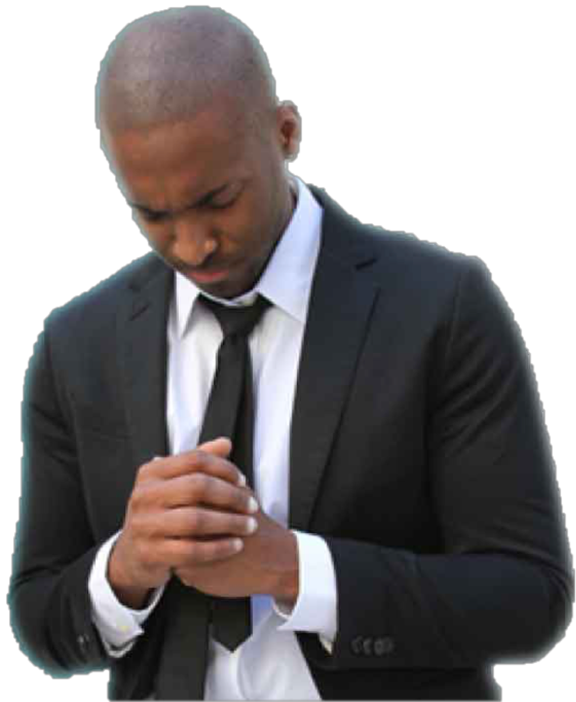
Psalm 44:20–21 (NKJV)
²⁰ If we had forgotten the name of our God, Or stretched out our hands to a foreign god, ²¹ Would not God search this out? For He knows the secrets of the heart.

Slide 4
1 Chronicles 28:9–10 (NKJV)
⁹ “As for you, my son Solomon, know the God of your father, and serve Him with a loyal heart and with a willing mind; for the Lord searches all hearts and understands all the intent of the thoughts. If you seek Him, He will be found by you; but if you forsake Him, He will cast you off forever. ¹⁰ Consider now, for the Lord has chosen you to build a house for the sanctuary; be strong, and do it.

Slide 5
1 Kings 8:39–40 (NKJV)
³⁹ then hear in heaven Your dwelling place, and forgive, and act, and give to everyone according to all his ways, whose heart You know (for You alone know the hearts of all the sons of men), ⁴⁰ that they may fear You all the days that they live in the land which You gave to our fathers.

Slide 6
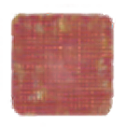
God searches the heart (Psalm 44:21; 1 Kings 8:39; Jer. 17:9–10)
God judges the heart (Jer 17:10; 1 Sam. 16:7)
God CANNOT be deceived — BUT we CAN BE!

Slide 7
Jeremiah 17:10 (NKJV)
¹⁰ I, the Lord, search the heart, I test the mind, Even to give every man according to his ways, According to the fruit of his doings.

Slide 8
Luke 16:15 (NKJV)
¹⁵ And He said to them, “You are those who justify yourselves before men, but God knows your hearts. For what is highly esteemed among men is an abomination in the sight of God.

Slide 9
“Someday” - ‘… Felix was afraid and answered, “Go away for now; when I have a convenient time I will call for you.” (Acts 24:25)
“Someone” - ²¹ Peter, seeing him, said to Jesus, “But Lord, what about this man?” (John 21:21)
“Somewhat” - “But I have obeyed the voice of the Lord, and gone on the mission on which the Lord sent me …” (1 Samuel 15:20)

Slide 10

Often said when the disparity between what the Scriptures teach and what a person actually believes or does becomes apparent
Salvation (Mark 16:16; Acts 2:38).
Worship (John 8:24; Eph 5:19; Heb 12:28,29)
Manner of life (attendance; treatment of others; language; activities; etc.)

Slide 11
Excuse to excuse disobedience: “Because God knows my heart.”
“God knows I have good intentions” does NOT render the teaching of the scripture moot — 1 Sam 15:14-26
“I’m sincere” does NOT CHANGE DISOBEDIENCE INTO acceptable behavior! — Ac 26:9-11; Rm 10:2; Ga. 1:13, 14; Phi. 3:6; 1 Tim. 1:13

Slide 12
The Fact that “God Knows your Heart” DOES NOT Mean It Is Accepted!
Sinful behavior CANNOT be disassociated from THE HEART (Mat. 15:18-19).
This “defense” or “self-justification” for continued disobedience ONLY prevents the sinner from making the changes necessary to become obedient to God — (Jere. 13:10; 23:17; 2 Thes 2:10-12)

Slide 13
Jeremiah 13:10 (NKJV)
¹⁰ This evil people, who refuse to hear My words, who follow the dictates of their hearts, and walk after other gods to serve them and worship them, shall be just like this sash which is profitable for nothing.

Slide 14
2 Thessalonians 2:10–12 (NKJV)
¹⁰ and with all unrighteous deception among those who perish, because they did not receive the love of the truth, that they might be saved. ¹¹ And for this reason God will send them strong delusion, that they should believe the lie, ¹² that they all may be condemned who did not believe the truth but had pleasure in unrighteousness.

Slide 15
Psalm 78:8 (NKJV)
⁸ And may not be like their fathers, A stubborn and rebellious generation, A generation that did not set its heart aright, And whose spirit was not faithful to God.

Slide 16
Proverbs 21:2 (NKJV)
² Every way of a man is right in his own eyes, But the Lord weighs the hearts.

Slide 17
Jeremiah 17:9–10 (NKJV)
⁹ “The heart is deceitful above all things, And desperately wicked; Who can know it? ¹⁰ I, the Lord, search the heart, I test the mind, Even to give every man according to his ways, According to the fruit of his doings.

Slide 18
1 Corinthians 4:3–4 (NKJV)
³ … In fact, I do not even judge myself. ⁴ For I know of nothing against myself, yet I am not justified by this; but He who judges me is the Lord.

Slide 19

By the scriptures — ALL of God’s truth is revealed in His word and it reveals the true nature of our heart (2 Tim 3:16,17; Lk 8:11; Heb 4:12).
By our obedience — our heart is revealed in our response to God’s word (1 John 4:1,2; Rom 8:1,2,12-14; Mat. 7:16–17; 12:33; 13:3-23; 15:18).

Slide 20
We may have confidence only in that which God has revealed
2 Timothy 4:2-4
I John 3:19–23;

Slide 21
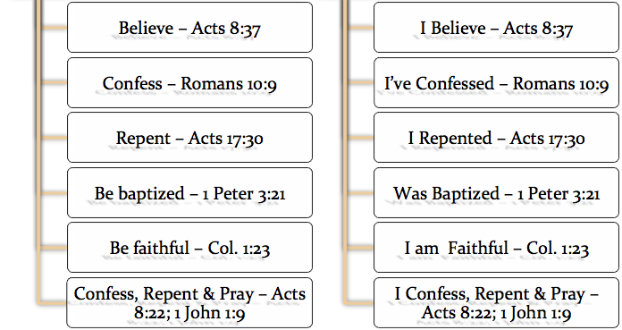

Slide 22
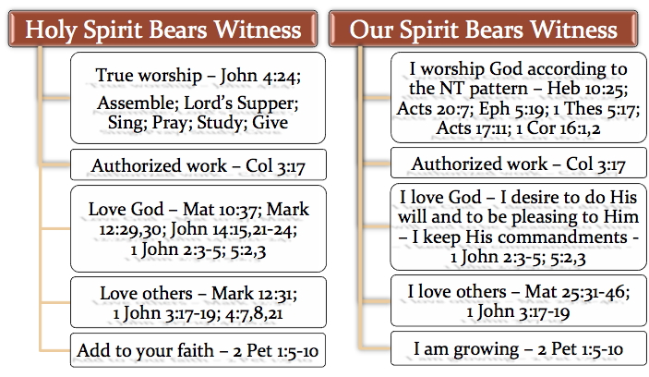

Slide 23

God’s knowing my heart is not proof of God ruling my heart (Job 11:11; Matthew 9:4; Acts 8:22).
Doing God’s revealed will is proof of God ruling my heart (Deut 6:5–6; I Chron 28:8–9; 2 Chron 12:14; Rom 6:16-18; 1 Pet 1:22,23).

Slide 24
1 Peter 3:13–17 (NKJV)
¹³ And who is he who will harm you if you become followers of what is good? ¹⁴ But even if you should suffer for righteousness’ sake, you are blessed. “And do not be afraid of their threats, nor be troubled.” ¹⁵ But sanctify the Lord God in your hearts,

Slide 25
1 Peter 3:13–17 (NKJV)
and always be ready to give a defense to everyone who asks you a reason for the hope that is in you, with meekness and fear; ¹⁶ having a good conscience, that when they defame you as evildoers, those who revile your good conduct in Christ may be ashamed. ¹⁷ For it is better, if it is the will of God, to suffer for doing good than for doing evil.

Slide 26
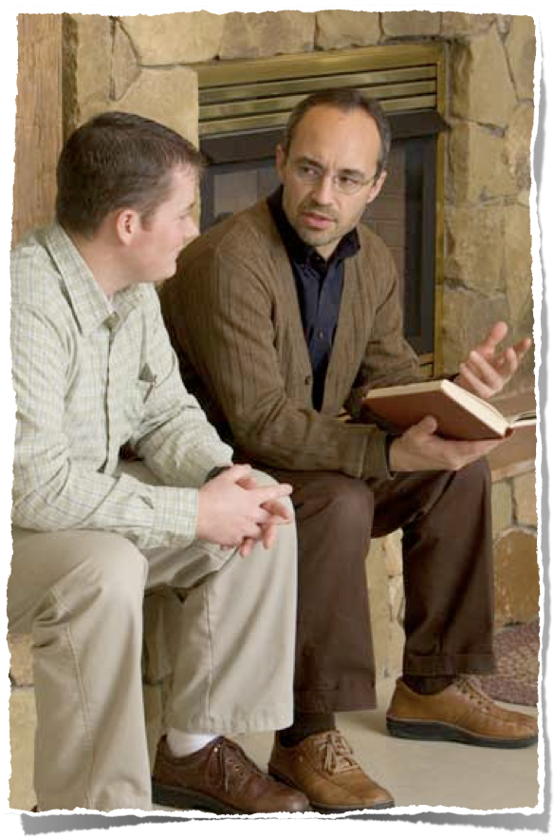
God Knows Every Heart Whether It Is Good or Evil
The fact that God knows the heart does not prove anything relative to whether or not we are accepted by Him.
It is what God knows about the heart that matters.

Slide 27
IS OUR HEART IN HARMONY WITH WHAT GOD SAYS IN HIS WORD?
Assurance is not found in how we feel, but in believing & living in harmony with what God has revealed (1 Jn 3:19-21; Heb 4:12).
God is the judge (I Cor 4:3-5; John 12:48; Rom. 2:5-11).

Slide 28
We CANNOT contend God accepts us when we refuse to obey HIM
(Matt 7:21; Luke 6:46).

Slide 29
Do I KNOW my heart is RIGHT in the sight of God?
Am I OBEYING God from my heart - or Not?
Romans 6:16-18

Slide 30
Romans 6:16–17 (NKJV)
¹⁶ Do you not know that to whom you present yourselves slaves to obey, you are that one’s slaves whom you obey, whether of sin leading to death, or of obedience leading to righteousness? ¹⁷ But God be thanked that though you were slaves of sin, yet you obeyed from the heart that form of doctrine to which you were delivered.

Slide 31
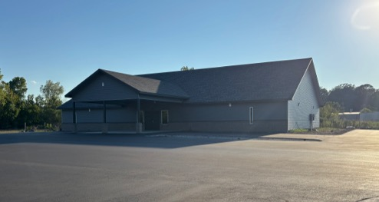

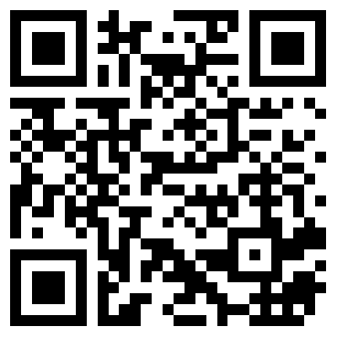
100 CORNERSTONE ALEXANDER AR, 72002
You Are Welcome At Any And All of Our Services!
Meeting Times:
Sunday A.M. Bible Study: 9:00
Sunday A.M. Assembly: 10:00
Sunday P.M. Assembly: 4:00
Wed. P.M. Bible Study: 7:00
ALEXANDERCHURCHOFCHRIST.COM

Slide 33
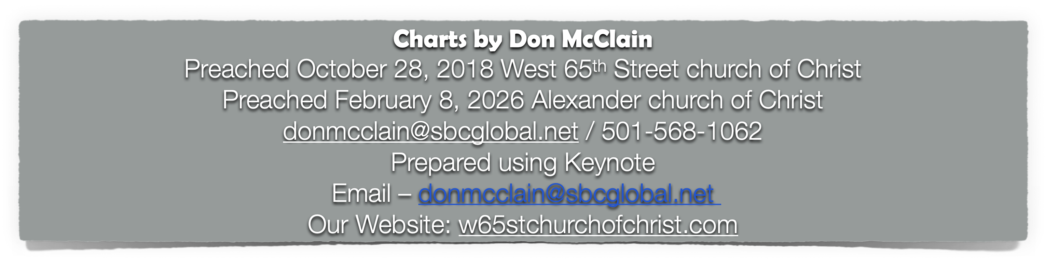

Slide 34
1 Chronicles 29:16–19 (NKJV)
¹⁶ “O Lord our God, all this abundance that we have prepared to build You a house for Your holy name is from Your hand, and is all Your own. ¹⁷ I know also, my God, that You test the heart and have pleasure in uprightness. As for me, in the uprightness of my heart I have willingly offered all these things; and now with joy I have seen Your people, who are present here to offer willingly to You. ¹⁸ O Lord God of Abraham, Isaac, and Israel, our fathers, keep this forever in the intent of the thoughts of the heart of Your people, and fix their heart toward You. ¹⁹ And give my son Solomon a loyal heart to keep Your commandments and Your testimonies and Your statutes, to do all these things, and to build the temple for which I have made provision.”

