Slide 1

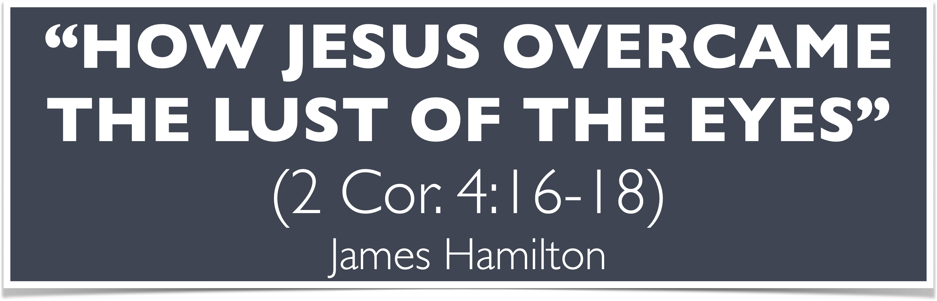
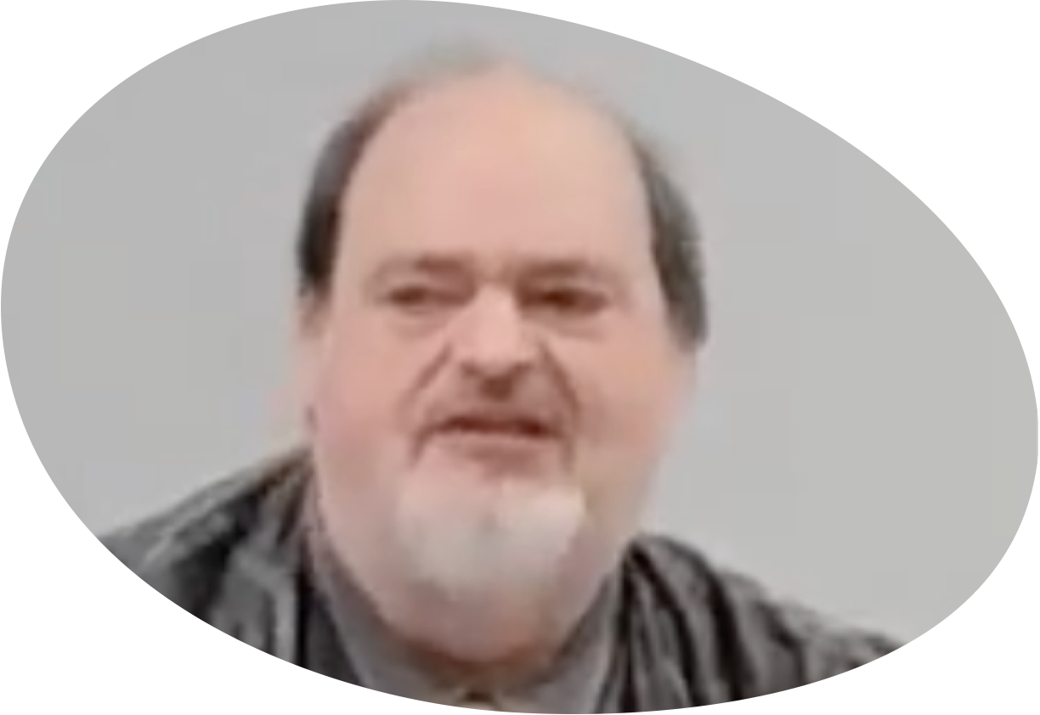
“Church of Christ MEETING @ 100 CORNERSTONE, Alexander AR. 72002”
TODAY’S LESSON
Sunday Morning Live Stream 10:00 AM ^{CT} January 4, 2026
https://www.youtube.com/user/donmcclain11/live / WWW.ALEXANDERCHURCHOFCHRIST.COM

Slide 2
Jesus, Our Savior, Lord, High Priest, Example, and Teacher
Jesus is our example of self-denial Philippians 2:1-11
He is God, was God, Creator, with the Father John 1:1-3
He became flesh John 1:10-14
He felt what we feel (hunger/thirst, weariness, survival, etc.)
He was tempted in all points just as we are Heb. 4:15-16; 1 Corinthians 10:13
He is our successful example of overcoming temptation
How He overcame is what we must learn from Him
Luke 4:1-13 narrative lines up with 1 John 2:16 & Genesis 3:6

Slide 3
1 John 2:16
For all that is in the world—
the lust of the flesh, (desiring what the body needs or wants)
the lust of the eyes, (desiring what the eyes see)
and the pride of life—(desire for significance in life)
is not of the Father but is of the world.
Genesis 3:6
So when the woman saw that the tree was
good for food,
that it was pleasant to the eyes,
and a tree desirable to make one wise,
she took of its fruit and ate. She also gave to her husband with her, and he ate.

Slide 4
Luke 4:1-13
v.1-4 temptation to make stone into food the body needs
v.5-8 Satan SHOWED Jesus all the kingdoms of the world that Jesus could have if He would bow to the god of this world
v.9-12 temptation to test God’s promise of His care and show the world that He is the Son of God
v.13 devil departed until an opportune time James 4:7

Slide 5
Luke 4:5-8
⁵ Then the devil, taking Him up on a high mountain, showed Him all the kingdoms of the world in a moment of time. ⁶ And the devil said to Him, “All this authority I will give You, and their glory; for this has been delivered to me, and I give it to whomever I wish. ⁷ Therefore, if You will worship before me, all will be Yours.”
⁸ And Jesus answered and said to him,“It is written, ‘You shall worship the Lord your God, and Him only you shall serve.’ ”

Slide 6
HOW JESUS OVERCAME
THE LUST OF THE EYES
LUKE 4:5-8

Slide 7
The Lust of the Eyes
Desiring what you see (intensifies desire) within reach
Can’t be tempted by something undesirable
What did Satan offer to give Jesus? What He desired
No less than all the world’s kingdoms & their “glory”
He showed not told Him all the kingdoms of this world
Satan is the god of this world 2 Corinthians 4:3
What Jesus understood Deuteronomy 6:13 and Isaiah 40:15-17

Slide 8
Isaiah 40:15-17
15 Behold, the nations are as a drop in a bucket,
And are counted as the small dust on the scales;
Look, He lifts up the isles as a very little thing.
¹⁶ And Lebanon is not sufficient to burn, nor its beasts sufficient for a burnt offering.
17 All nations before Him are as nothing,
And they are counted by Him less than nothing and worthless.

Slide 9
The Lust of the Eyes
Genesis 13:10 not necessarily an evil sight
INTERNET/SMARTPHONE SCREEN WARNING:
Psalm 119:37 Turn away my eyes from looking at worthless things, revive me in Your way
Proverbs 4:20-27
Prov. 6:23-26; 7:6-12
Prov. 23:5
Prov. 23:31-33

Slide 10
How Jesus Overcame the Lust of the Eyes Luke 4:1-4
Jesus understood that glory without God is momentary v.8
Temporary vs. Eternal 2 Cor. 4:16-18; Heb. 11:25
Jesus had the word of God in His heart v.8; Psalm 119:11
Jesus foresaw the joy set before Him Heb. 12:2; John 12:31 Jesus knew that God would give Him all authority in heaven as well as on earth after dying on the cross Hebrews 5:7-9
Jesus knew that Gehenna is real Matt. 10:28; 2 Cor. 5:14
Jesus loved God, you, me, and us all more than Himself John 10:17-18; 1 John 3:16; John 3:16

Slide 11
Renewing The Inner Man By Putting Off the Lust of the Eyes
Matthew 4:1-11 Jesus overcame each temptation
Genesis 39:6-15 prey and predator reversed
Joshua 7:19-21 saw → coveted → took → hid
Job 31:1-4 make a covenant with your eyes
Matthew 5:27-30 lust of the eye → adultery in heart
2 Corinthians 4:16-18 focus on the unseen
Hebrews 11:24-27 example of 2 Cor. 4:18

Slide 12
“Church of Christ MEETING @ 100 CORNERSTONE, Alexander AR. 72002”
TODAY’S LESSON
Sunday Morning Live Stream 10:00 AM ^{CT} January 4, 2026
https://www.youtube.com/user/donmcclain11/live / WWW.ALEXANDERCHURCHOFCHRIST.COM

Slide 13
SCRIPTURE READING SUNDAY, January 4, AM
2 Corinthians 4:16–18 (NKJV)
¹⁶ Therefore we do not lose heart. Even though our outward man is perishing, yet the inward man is being renewed day by day. ¹⁷ For our light affliction, which is but for a moment, is working for us a far more exceeding and eternal weight of glory, ¹⁸ while we do not look at the things which are seen, but at the things which are not seen. For the things which are seen are temporary, but the things which are not seen are eternal.

