Slide 1



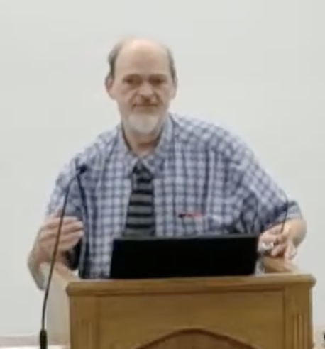
“Church of Christ MEETING @ 100 CORNERSTONE, Alexander AR. 72002”
TODAY’S LESSON
Sunday Morning Stream
10:00 AM ^{CT} September 27, 2026
https://www.youtube.com/user/donmcclain11/live / WWW.ALEXANDERCHURCHOFCHRIST.COM

Slide 2
HOW JESUS USED HIS FREE TIME
LUKE 4:40-44; 5:16; 8:22-23; John 4:6-7

Slide 3
“Free Time”
Gary Henry attributed the following statement to Lin Yu-Tang in his article, “Recreation”: “We do not know a nation until we know its pleasures of life, just as we do not know a man until we know how he spends his leisure.”

Slide 4
“Free Time”
Life is full of toil, chores, responsibilities, and obligations because of life. (Ecclesiastes)
We have to do what we have to do.
What we choose to do when have the freedom to do what we want is what reveals our true character.

Slide 5
“Free Time”
Jesus sent His disciples out. When they returned, He told them to rest (Mark 6:31)
Mark 6:31
31 And he said unto them, Come ye yourselves apart into a desert place, and rest a while: for there were many coming and going, and they had no leisure so much as to eat.

Slide 6
“Free Time”
Luke 6:12-16
12 And it came to pass in those days, that he went out into a mountain to pray, and continued all night in prayer to God.
13 And when it was day, he called unto him his disciples: and of them he chose twelve, whom also he named apostles;
14 Simon, (whom he also named Peter,) and Andrew his brother, James and John, Philip and Bartholomew,
Luke 8:22-23
22 Now it came to pass on a certain day, that he went into a ship with his disciples: and he said unto them, Let us go over unto the other side of the lake. And they launched forth.
23 But as they sailed he fell asleep: and there came down a storm of wind on the lake; and they were filled with water, and were in jeopardy.
Jesus Himself set the example for them… and us Luke 5:16; 6:12-16; 8:22-23; John 4:6
John 4:6-7
6 Now Jacob’s well was there. Jesus therefore, being wearied with his journey, sat thus on the well: and it was about the sixth hour.
7 There cometh a woman of Samaria to draw water: Jesus saith unto her, Give me to drink.
15 Matthew and Thomas, James the son of Alphaeus, and Simon called Zelotes,
16 And Judas the brother of James, and Judas Iscariot, which also was the traitor.
Luke 5:16
16 And he withdrew himself into the wilderness, and prayed.

Slide 7
“Free Time”
1 Timothy 4:7-9
7 But refuse profane and old wives’ fables, and exercise thyself rather unto godliness.
8 For bodily exercise profiteth little: but godliness is profitable unto all things, having promise of the life that now is, and of that which is to come.
9 This is a faithful saying and worthy of all acceptation.
Romans 12:1-2
1 I beseech you therefore, brethren, by the mercies of God, that ye present your bodies a living sacrifice, holy, acceptable unto God, which is your reasonable service.
2 And be not conformed to this world: but be ye transformed by the renewing of your mind, that ye may prove what is that good, and acceptable, and perfect, will of God.
Recreation is re-creation of the mind and/or the body 1 Timothy 4:7-9; Romans 12:1-2

Slide 8
“Free Time”
Hobbies are what make many people unique and interesting, and it helps to share a common interest with others by having common interests.

Slide 9
“Free Time”
This is how Jesus reached others. Jesus sat the well near Sychar, and asked for a drink of water from a woman who had come to draw water (John 4:6-7).
John 4:6-7
6 Now Jacob’s well was there. Jesus therefore, being wearied with his journey, sat thus on the well: and it was about the sixth hour.
7 There cometh a woman of Samaria to draw water: Jesus saith unto her, Give me to drink.

Slide 10
“Free Time”
This is why conversations between strangers begin with attempts at common interests: “How are you?” “Nice weather we’re having today, isn’t it?” “I perceive that in all things you are very religious…”

Slide 11
“Free Time”
Matthew 5:44-48
44 But I say unto you, Love your enemies, bless them that curse you, do good to them that hate you, and pray for them which despitefully use you, and persecute you;
45 That ye may be the children of your Father which is in heaven: for he maketh his sun to rise on the evil and on the good, and sendeth rain on the just and on the unjust.
There is purpose to greeting strangers as well as friends (Matthew 5:44-48)
46 For if ye love them which love you, what reward have ye? do not even the publicans the same?
47 And if ye salute your brethren only, what do ye more than others? do not even the publicans so?
48 Be ye therefore perfect, even as your Father which is in heaven is perfect.

Slide 12
“Free Time”
Rest, renewal, refreshment, and recreation are useful if approached with godly purpose, balance, and do not interfere with spiritual growth. Follow the example of Jesus.

Slide 13
Principles to Follow with Free Time

Slide 14
Principles to Follow with Free Time
Galatians 5:16-21
16 This I say then, Walk in the Spirit, and ye shall not fulfil the lust of the flesh.
17 For the flesh lusteth against the Spirit, and the Spirit against the flesh: and these are contrary the one to the other: so that ye cannot do the things that ye would.
18 But if ye be led of the Spirit, ye are not under the law.
Be holy in your conduct 1 Peter 1:14-16; Galatians 5:16-21
1 Peter 1:14-16
14 As obedient children, not fashioning yourselves according to the former lusts in your ignorance:
15 But as he which hath called you is holy, so be ye holy in all manner of conversation;
16 Because it is written, Be ye holy; for I am holy.
19 Now the works of the flesh are manifest, which are these; Adultery, fornication, uncleanness, lasciviousness,
20 Idolatry, witchcraft, hatred, variance, emulations, wrath, strife, seditions, heresies,
21 Envyings, murders, drunkenness, revellings, and such like: of the which I tell you before, as I have also told you in time past, that they which do such things shall not inherit the kingdom of God.

Slide 15
Principles to Follow with Free Time
Don’t be a stumblingblock to others 1 Corinthians 10:31-33
1 Corinthians 10:31-33
31 Whether therefore ye eat, or drink, or whatsoever ye do, do all to the glory of God.
32 Give none offence, neither to the Jews, nor to the Gentiles, nor to the church of God:
33 Even as I please all men in all things, not seeking mine own profit, but the profit of many, that they may be saved.

Slide 16
Principles to Follow with Free Time
Be balanced; don’t over-commit yourself to innocent activities Luke 8:14; Ephesians 5:15-17
Ephesians 5:15-17
15 See then that ye walk circumspectly, not as fools, but as wise,
16 Redeeming the time, because the days are evil.
17 Wherefore be ye not unwise, but understanding what the will of the Lord is.
Luke 8:14
14 And that which fell among thorns are they, which, when they have heard, go forth, and are choked with cares and riches and pleasures of this life, and bring no fruit to perfection.

Slide 17
Principles to Follow with Free Time
Opportunity to multi-task (strengthen relationship with God or Christians) Deuteronomy 6:7
Deuteronomy 6:7
7 And thou shalt teach them diligently unto thy children, and shalt talk of them when thou sittest in thine house, and when thou walkest by the way, and when thou liest down, and when thou risest up.

Slide 18
Principles to Follow with Free Time
Beware of evil companions 1 Corinthians 15:33
1 Corinthians 15:33
33 Be not deceived: evil communications corrupt good manners.

Slide 19
Principles to Follow with Free Time
Make sure your time doing what you want does not cause you to procrastinate James 4:13-17
James 4:13-17
13 Go to now, ye that say, To day or to morrow we will go into such a city, and continue there a year, and buy and sell, and get gain:
14 Whereas ye know not what shall be on the morrow. For what is your life? It is even a vapour, that appeareth for a little time, and then vanisheth away.
15 For that ye ought to say, If the Lord will, we shall live, and do this, or that.
16 But now ye rejoice in your boastings: all such rejoicing is evil.
17 Therefore to him that knoweth to do good, and doeth it not, to him it is sin.

Slide 20
Principles to Follow with Free Time
Don’t get addicted to hobbies or pursuit of pleasure 1 Corinthians 6:12
1 Corinthians 6:12
12 All things are lawful unto me, but all things are not expedient: all things are lawful for me, but I will not be brought under the power of any.

Slide 21
Principles to Follow with Free Time
Turn your “must do” to become your “want to”

Slide 22
Principles to Follow with Free Time
Focus on what you must do for eternal life more than earthly life Matthew 6:33
Matthew 6:33
33 But seek ye first the kingdom of God, and his righteousness; and all these things shall be added unto you.

Slide 23
Principles to Follow with Free Time
Acts 2:38
38 Then Peter said unto them, Repent, and be baptized every one of you in the name of Jesus Christ for the remission of sins, and ye shall receive the gift of the Holy Ghost.
Romans 10:9
9 That if thou shalt confess with thy mouth the Lord Jesus, and shalt believe in thine heart that God hath raised him from the dead, thou shalt be saved.
Do not neglect what you must do Acts 2:38; Romans 10:9; Hebrews 12:1-2; 3:12-13; 10:24-25
Hebrews 3:12-13
12 Take heed, brethren, lest there be in any of you an evil heart of unbelief, in departing from the living God.
13 But exhort one another daily, while it is called To day; lest any of you be hardened through the deceitfulness of sin.
Hebrews 10:24-25
24 And let us consider one another to provoke unto love and to good works:
25 Not forsaking the assembling of ourselves together, as the manner of some is; but exhorting one another: and so much the more, as ye see the day approaching.
Hebrews 12:1-2
1 Wherefore seeing we also are compassed about with so great a cloud of witnesses, let us lay aside every weight, and the sin which doth so easily beset us, and let us run with patience the race that is set before us,
2 Looking unto Jesus the author and finisher of our faith; who for the joy that was set before him endured the cross, despising the shame, and is set down at the right hand of the throne of God.

Slide 24
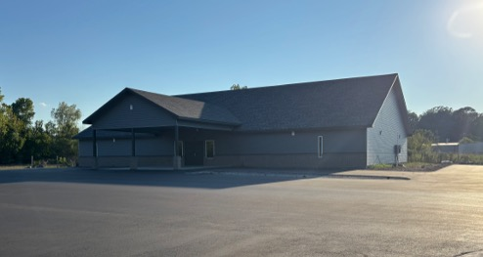

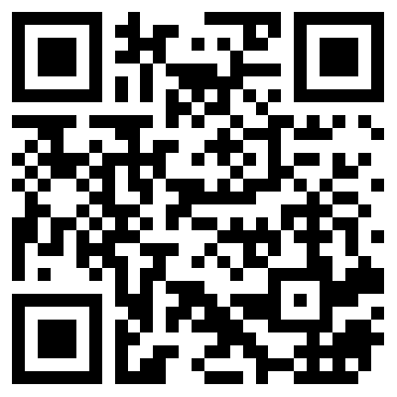
100 CORNERSTONE ALEXANDER AR, 72002
You Are Welcome At Any And All of Our Services!
Meeting Times:
Sunday A.M. Bible Study: 9:00
Sunday A.M. Assembly: 10:00
Sunday P.M. Assembly: 4:00
Wed. P.M. Bible Study: 7:00
ALEXANDERCHURCHOFCHRIST.COM

