Slide 1

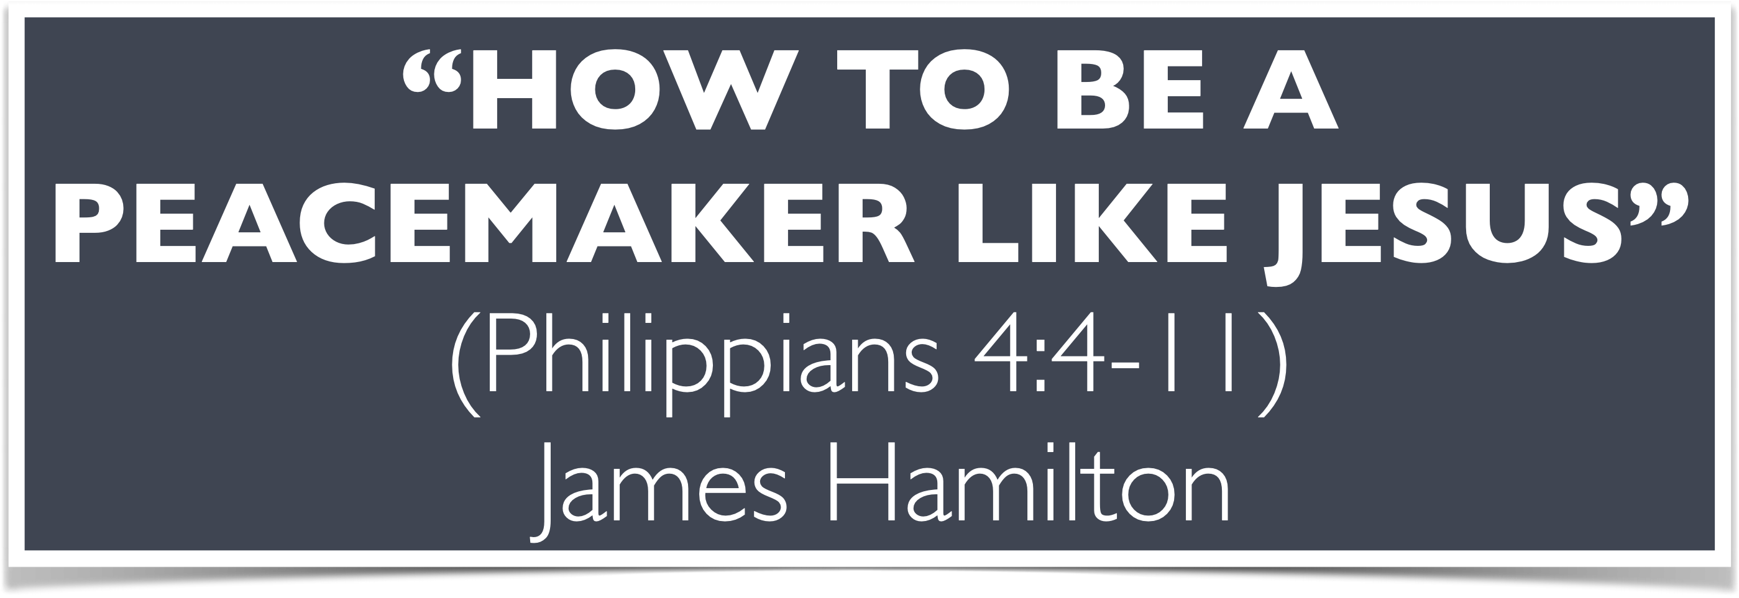

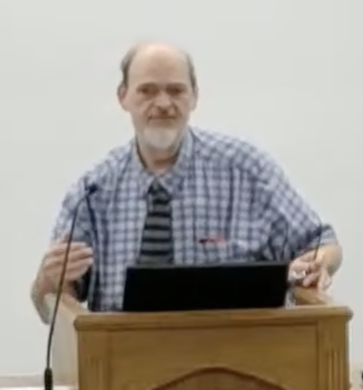
“Church of Christ MEETING @ 100 CORNERSTONE, Alexander AR. 72002”
TODAY’S LESSON
Sunday Morning Live Stream 10:00 AM ^{CT} May 10, 2026
https://www.youtube.com/user/donmcclain11/live / WWW.ALEXANDERCHURCHOFCHRIST.COM

Slide 2
HOW YOU CAN BE A PEACEMAKER LIKE JESUS CHRIST
PHILIPPIANS 4:4-13

Slide 3
James 3:13-18
Who is wise and understanding among you? Let him show by good conduct that his works are done in the meekness of wisdom. But if you have bitter envy and self-seeking in your hearts, do not boast and lie against the truth. This wisdom does not descend from above, but is earthly, sensual, demonic. For where envy and self-seeking exist, confusion and every evil thing are there. But the wisdom that is from above is first pure, then peaceable, gentle, willing to yield, full of mercy and good fruits, without partiality and without hypocrisy. Now the fruit of righteousness is sown in peace by those who make peace.

Slide 4
Isaiah 32:17-18
17 The work of righteousness will be peace, and the effect of righteousness, quietness and assurance forever.
18 My people will dwell in a peaceful habitation, in secure dwellings, and in quiet resting places.

Slide 5
God’s Wisdom at Work in Your Life
Isaiah 32:17-18 Righteousness→Peace
Righteousness→Quietness and Assurance
Peaceful Home=Safe, Secure, Quiet Home
Avoid causing trouble Prov. 11:29; 15:27
Speak gently Prov. 15:1; 25:15; Colossians 4:6
Speak less Prov. 17:27-28 He who has knowledge spares his words, a man of understanding is of a calm spirit. Even a fool is considered wise when he holds his peace; when he closes his lips, he is considered perceptive. Prov. 10:19

Slide 6
God’s Wisdom at Work in Your Life
Work hard Prov. 15:19 The way of the lazy—like a hedge of thorns, but the way of the upright—a highway.
Ecclesiastes 5:12 The sleep of a laboring man is sweet, but the abundance of the rich does not permit him to sleep.
It is easier not to cause problems than it is to fix them Prov. 18:19
Don’t argue Prov. 19:11 The discretion of a man makes him slow to anger; and his glory to overlook a transgression Eccleisiastes 7:21-22

Slide 7
God’s Wisdom at Work in Your Life
Ecclesiastes 7:20-22: For there is not a just man on earth who does good and does not sin.
21 Also do not take to heart everything people say, lest you hear your servant cursing you.
22 For many times, also, your own heart has known that even you have cursed others.

Slide 8
God’s Wisdom at Work in Your Life
STOP arguing Prov. 20:3; It is honorable for a man to stop striving, since any fool can start a quarrel.
Prov. 26:4-5 Do not answer a fool according to his folly, lest you also be like him. 5 Answer a fool according to his folly, lest he be “wise” in his own eyes.
Prov.25:23 The north wind brings forth rain, and a backbiting tongue an angry countenance.

Slide 9
God’s Wisdom at Work in Your Life
Do not be vengeful Prov. 20:22 Do not say, “I will repay evil.” Wait for the LORD, and He will save you.
Do right→security Prov.28:1 The wicked flees when no one is chasing him, but the righteous are bold as a lion.
2 Peter 1:10…be even more diligent to make your call and election sure, for if you do these things, you will never stumble
Peace in the midst of strife Eccl. 10:4; Ephesians 2:14-18; 4:26

Slide 10
Ecclesiastes 10:4
4 If the spirit of a ruler rises against you, do not leave your post; for conciliation pacifies great offenses.
Ephesians 2:14-18 For He Himself is our peace, who has made both one, and has broken down the middle wall of separation, ¹⁵ having abolished in His flesh the enmity, that is, the law of commandments in ordinances, so as to create in Himself one new man from the two, thus making peace, ¹⁶ and that He might reconcile them both to God in one body through the cross, thereby putting to death the enmity.

Slide 11
Ephesians 2:14-18
17 And He came and preached peace to you who were afar off and to those who were near.
18 For through Him we both have access by one Spirit to the Father.
Jesus made peace in the midst of strife
We can, we must, we will
Ephesians 4:26-27 “Be angry, and do not sin:” do not let the sun go down on your wrath, ²⁷ nor give place to the devil.

Slide 12
Philippians 4:4-13
4 Rejoice in the Lord always. Again I will say, “Rejoice!” 5 Let your gentleness be known to all men. The Lord is near.
6 Be anxious for nothing, but in everything by prayer and supplication, with thanksgiving, let your requests be made known to God; 7 and the peace of God, which surpasses all understanding, will guard your hearts and minds through Christ Jesus.

Slide 13
Philippians 4:4-13
8 Finally, brethren, whatever is true,
whatever is honorable, whatever is just, whatever is pure, whatever is lovely, whatever is reputable, if there is any excellence, and if there is anything praise-worthy—meditate on these things. 9 The things which you learned and received and heard and saw in me, these do, and the God of peace will be with you.

Slide 14
Philippians 4:4-13
10 But I rejoiced in the Lord greatly that now at last your care for me has flourished again; though you surely did care, but you lacked opportunity.
11 Not that I speak in regard to need, for I have learned in whatever state I am, to be content.

Slide 15
Daily Renewing Your Conscience with the Peace of Christ
Genesis 13:5-9 no strife; we are brothers
Genesis 26 example of Isaac Rom. 12:18
Isaiah 11:1-11 prophecy of peace of Christ
Luke 10:5-6 still have peace even if rejected
John 14:19-31 My peace I give, not as the world gives to you
Romans 5:1-11 with God and with the future
Ephesians 2:14-18 with God and with each other
Colossians 3:12-17 peace of Christ is an umpire by its presence or absence in your heart

Slide 16
Daily Renewing Your Conscience with the Peace of Christ
Isaiah 11:6-10; Rom. 15:12; Eph. 2:14-18
Let God purify your conscience Heb. 9:9-14; 10:22; 1 Peter 1:22; 3:21

Slide 17
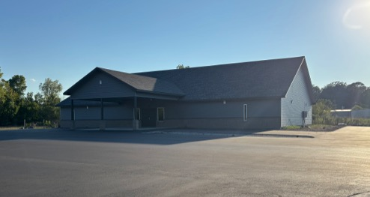

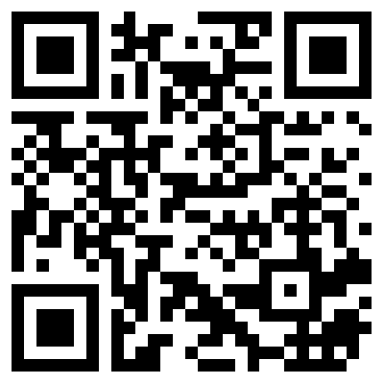
100 CORNERSTONE ALEXANDER AR, 72002
You Are Welcome At Any And All of Our Services!
Meeting Times:
Sunday A.M. Bible Study: 9:00
Sunday A.M. Assembly: 10:00
Sunday P.M. Assembly: 4:00
Wed. P.M. Bible Study: 7:00
ALEXANDERCHURCHOFCHRIST.COM

