Slide 1

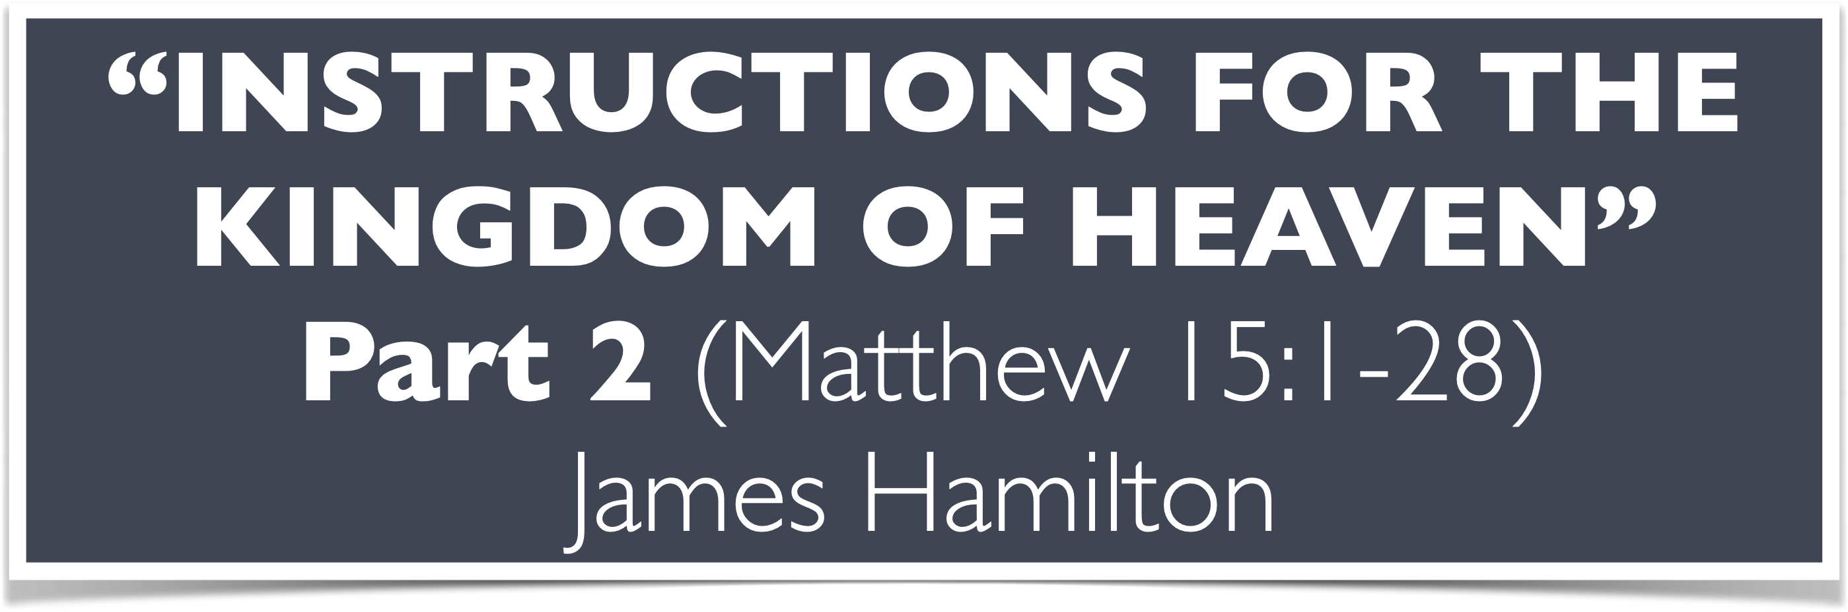

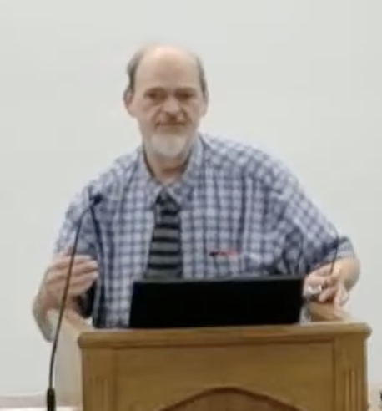
“Church of Christ MEETING @ 100 CORNERSTONE, Alexander AR. 72002”
TODAY’S LESSON
Sunday evening lesson live stream 4:00 PM ^{CDT} July 12, 2026
https://www.youtube.com/user/donmcclain11/live / WWW.ALEXANDERCHURCHOFCHRIST.COM

Slide 2
INSTRUCTIONS FOR THE KINGDOM OF HEAVEN
Part 2
MATTHEW 15:1-28

Slide 3
The Training of the Twelve
Rejection of Jesus by Nazareth 13:53-58
Execution of John the Baptist 14:1-12
Disciples’ first misunderstanding 14:13-36
  Feeding of the 5000 14:13-21
  Walking on the water (Peter’s doubt) 14:22-33
  Reception in Gennesaret 14:34-36

Slide 4
The Training of the Twelve
Disciples’ second misunderstanding 15:1-31
  Tradition of elders dispute 15:1-11
  Disciples’ concern for Pharisees 15:12-14
  Peter’s request for explanation 15:15-20
Reception by a foreigner 15:21-31
  Disciples misunderstood Jesus’ reaction v.23
  Jesus commended her faith v.28

Slide 5
Lessons from Matt. 15:1-28
Traditions of men are not equal with the word of God 15:1-9
Traditions of men reflect are heart far from God and His will 15:8 (Isaiah 29:13)
Worship is vain if based on man’s ideas and authority 15:9
God cares more about the heart than the physical condition of man 15:10-11,15-20

Slide 6
Lessons from Matt. 15:1-28
Loyalty to God’s word will offend others 15:12-14
If you have fellowship with what God has not planted, you will DIE 15:13-14
All evil words and deeds originate from an evil heart 15:18-20; 12:34-37
So keep your heart with all diligence Proverbs 4:23

Slide 7
Lessons from Matt. 15:1-28
Your faith will be tested 15:21-28; 1 Peter 1:7; James 1:2-4

Slide 8
1 Peter 1:5-7
you…are kept by the power of God through faith for salvation ready to be revealed in the last time. 6 In this you greatly rejoice, though now for a little while, if need be, you have been grieved by various trials, 7 that the genuineness of your faith, being much more precious than gold that perishes, though it is tested by fire, may be found to praise, honor, and glory at the revelation of Jesus Christ

Slide 9
James 1:2-4,12
My brethren, count it all joy when you fall into various trials, knowing that the testing of your faith produces patience. But let patience have its perfect work, that you may be perfect and complete, lacking nothing.
Blessed is the man who endures temptation; for when he has been approved, he will receive the crown of life which the Lord has promised to those who love Him.
Faith→Tested→Approved→Rewarded

Slide 10
Lessons from Matt. 15:1-28
Your faith will be tested 15:21-28; 1 Peter 1:7; James 1:2-4
Faith comes by hearing the word of Christ, but it is not necessarily proportional to knowledge 15:21-28; Romans 10:1-3

Slide 11
Romans 10:1-3
Brethren, my heart’s desire and prayer to God for Israel is that they may be saved. ² For I bear them witness that they have a zeal for God, but not according to knowledge. ³ For they being ignorant of God’s righteousness, and seeking to establish their own righteousness, have not submitted to the righteousness of God.

Slide 12
Lessons from Matt. 15:1-28
Your faith will be tested 15:21-28; 1 Peter 1:7; James 1:2-4
Faith comes by hearing the word of Christ, but it is not necessarily proportional to knowledge 15:21-28; Romans 10:1-3
Miracles are crumbs from the table 15:26-27
The gospel is the spiritual feast John 14:12; 6:35
COME TO THE FEAST!

