Slide 1

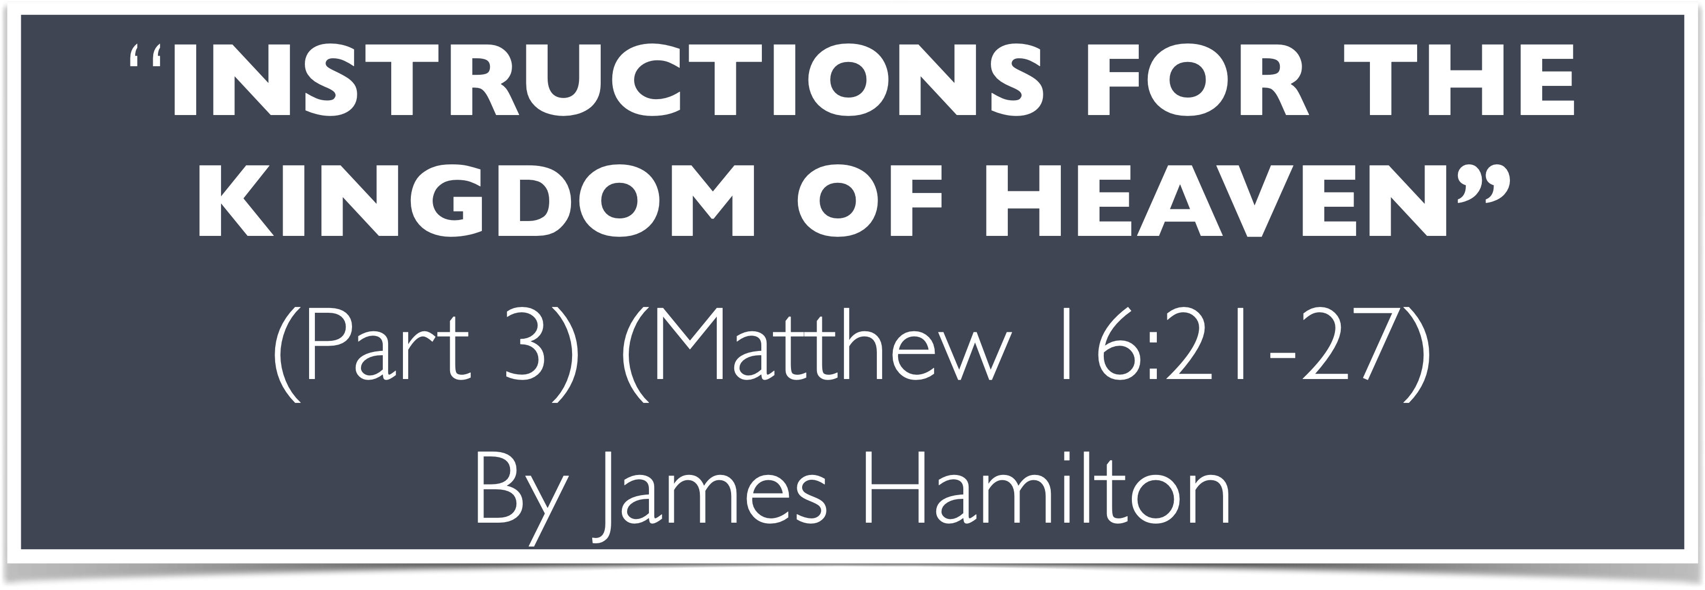

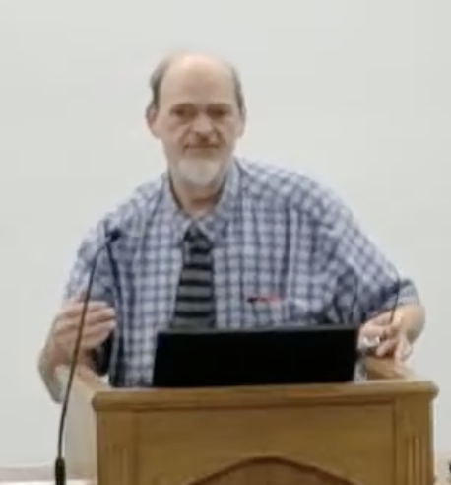
“Church of Christ MEETING @ 100 CORNERSTONE, Alexander AR. 72002”
TODAY’S LESSON
Sunday evening lesson live stream 4:00 PM ^{CDT} July 26, 2026
https://www.youtube.com/user/donmcclain11/live / WWW.ALEXANDERCHURCHOFCHRIST.COM

Slide 2
INSTRUCTIONS FOR THE KINGDOM OF HEAVEN
Part 3
MATTHEW 15:32-16:28

Slide 3
The Training of the Twelve
Rejection of Jesus by Nazareth 13:53-58
Execution of John the Baptist 14:1-12
Disciples’ first misunderstanding 14:13-36
  Feeding of the 5000 14:13-21
  Walking on the water (Peter’s doubt) 14:22-33
  Reception in Gennesaret 14:34-36 (Isaiah 35:3-6; 42:6-7; 61:1-3; John 16:25)

Slide 4
Isaiah 35:3-6
Strengthen the weak hands, and make firm the feeble knees. Say to the feart-hearted, “Be strong! Do not fear! Behold, your God will come with vengeance, the recompense of God; He will come and save you.” Then the eyes of the blind shall be opened, and the ears of the deaf shall be unstopped. Then the lame shall leap like a deer, and the tongue of the mute shall sing. For waters shall burst forth in the wilderness, and streams in the desert.

Slide 5
Isaiah 42:6-7
“O, the LORD, have called you in righteousness, and will hold your hand; I will keep you and give you as a covenant to the people, as a light to the Gentiles, to open blind eyes, to bring out prisoners from the prison house.”

Slide 6
Isaiah 60:1-3
Arise, shine; for your light has come! And the glory of the LORD has risen upon you. For behold, the darkness shall cover the earth and deep darkness over the people; but the LORD will rise over you, and His glory will be seen upon you. The Gentiles shall come to your light, and kings to the brightness of your rising.
John 16:25
“These things I have spoken to you in figurative language, but the time is coming when I will no longer speak to you in figurative language, but I will tell you plainly about the Father.”

Slide 7
The Training of the Twelve
Disciples’ second misunderstanding 15:1-31
  Tradition of elders dispute 15:1-11
  Disciples’ concern for Pharisees (Peter’s request for explanation) 15:12-20
Reception by a foreigner 15:21-31
  Disciples misunderstood Jesus’ reaction

Slide 8
The Training of the Twelve
Disciples’ third misunderstanding 15:32-16:12
  Feeding of the 4000 15:32-39
  Challenge from the Pharisees 16:1-4
  Jesus’ misunderstood warning 16:5-12
Peter’s blessed words followed by Peter’s foolish words 16:13-28

Slide 9
The Training of the Twelve
Peter’s privilege (Transfiguration of Christ) 17:1-13
  Transfiguration 17:1-3
  Peter’s rash suggestion 17:4
  God’s response 17:5-9
  Disciples’ question about scribes’ doctrine about Elijah 17:10-13

Slide 10
The Training of the Twelve
Disciples’ failure to cast out demon 17:14-23
  Disciples’ public failure 17:14-16
  Jesus’ success 17:17-18
  Private explanation for failure 17:19-21
  Jesus foretells His sacrifice 17:22-23
Peter’s rash answer concerning the temple tax 17:24-27

Slide 11
The Training of the Twelve
Disciples’ third misunderstanding 15:32-16:12
  Feeding of the 4000 15:32-39
  Challenge from the Pharisees 16:1-4
  Jesus’ misunderstood warning 16:5-12
Peter’s blessed words followed by Peter’s foolish words 16:13-28

Slide 12
Lessons from Matt. 15:32-16:28
Lessons need to be repeated until learned 15:32-39; 16:5-12
Use what you have and God will provide what you need 14:14-21; 15:32-39; Phil. 4:20; 2 Cor. 8-9
You don’t have to be men-pleasers in order to please God 16:1-4; Galatians 1:10
You can’t be men-pleasers and please God

Slide 13
Lessons from Matt. 15:32-16:28
Jesus often used figurative language 16:1-12
Literally interpreting figurative language will prevent you from obeying the truth 16:1-5,12
Christ was misunderstood by many 16:13-14; Galatians 1:10
Likewise, people misunderstand His church 16:18-19
Christ is the rock of the church 16:18; 1 Peter 2:4; Daniel 2:44

Slide 14
1 Peter 2:4-5
Coming to Him a living stone, rejected indeed by men, but chosen by God, precious, you also, as living stones, are being built up a spiritual house, a holy priesthood, to offer up spiritual sacrifices acceptable to God through Jesus Christ.
Daniel 2:44-45a
And in the days of these kings the God of heaven will set up a kingdom which shall never be destroyed; and the kingdom shall not be left to other people; it shall break in pieces and consume all these kingdoms, and it shall stand forever… you saw that the stone was cut out of the mountain without hands

Slide 15
Lessons from Matt. 15:32-16:28
Jesus told the apostles not to tell others that He is the Christ because the people misunderstood what His purpose was as the Christ 16:20-28; John 16:12
Just as Jesus told the apostles not to tell others that He was the Christ, we may be short-circuiting the gospel by talking more about the church of Christ than Christ Himself 1 Cor. 2:1-5,8; 1:1-10,31

Slide 16
1 Corinthians 2:1-5,8
And I, brethren, when I came to you, did not come with excellence of speech or of wisdom declaring to you the testimony of God. For I determined not to know anything among you except Jesus Christ and Him crucified. I was with you in weakness, in fear, and in much trembling. And my speech and my preaching were not with persuasive words of human wisdom, but in demonstration of the Spirit and of power, that your faith should not be in the wisdom of men but in the power of God…they crucified the Lord of glory.

Slide 17
Lessons from Matt. 15:32-16:28
Let him who thinks he is standing watch out lest he fall 16:17-23; 1 Cor. 10:12
Jesus had to die and rise to fulfill God’s will 16:21-23
We must follow the same path to be His disciple 16:24-27
We must deny self, live a crucified life, be like Jesus to be where He is 16:24-27; Gal. 2:20; Rom. 6:3-4; John 14:1-3; Rev. 2:10

Slide 18



100 CORNERSTONE ALEXANDER AR, 72002
You Are Welcome At Any And All of Our Services!
Meeting Times:
Sunday A.M. Bible Study: 9:00
Sunday A.M. Assembly: 10:00
Sunday P.M. Assembly: 4:00
Wed. P.M. Bible Study: 7:00
ALEXANDERCHURCHOFCHRIST.COM

