Slide 1

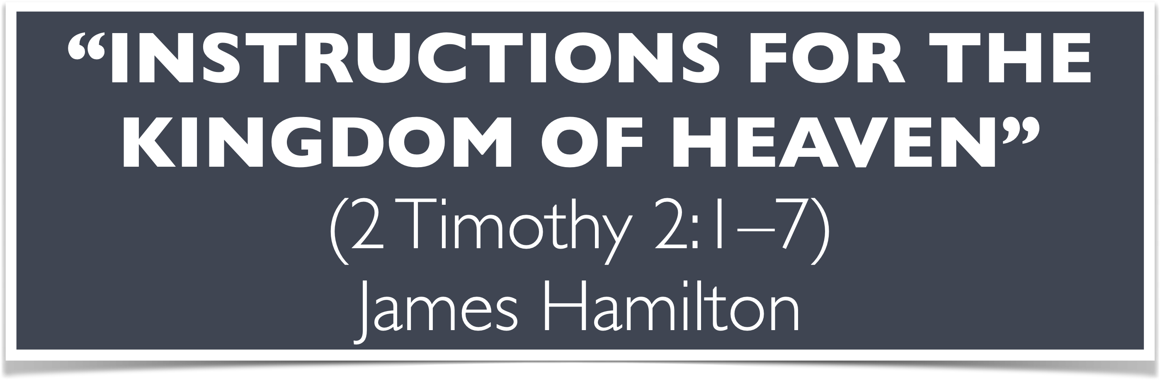

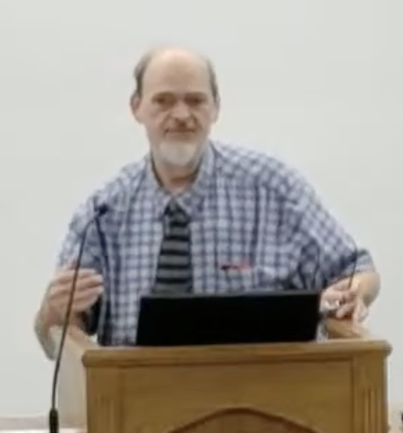
“Church of Christ MEETING @ 100 CORNERSTONE, Alexander AR. 72002”
TODAY’S LESSON
Sunday evening lesson live stream 4:00 PM ^{CDT} June 28, 2026
https://www.youtube.com/user/donmcclain11/live / WWW.ALEXANDERCHURCHOFCHRIST.COM

Slide 2
INSTRUCTIONS FOR THE KINGDOM OF HEAVEN
MATTHEW 14-17

Slide 3
The Gospel According To Matthew
Simple Outline
The Introduction Of The Kingdom 1-7
The Intent Of The Kingdom 8-10
The Influence By The Kingdom 11-13
Instructions For The Kingdom 14-18
Intransigence Against The Kingdom 19-25
The Ingress Of The Kingdom 26-28

Slide 4
Instructions For The Kingdom 14-18
Narrative 4
The Training of the Twelve 13:54-17:35
Discourse 4
Fundamentals for the Faith 18
“Now it came to pass, when Jesus had finished these sayings…” 19:1-2

Slide 5
The Training of the Twelve
Rejection of Jesus by Nazareth 13:53-58
Execution of John the Baptist 14:1-12
Disciples’ first misunderstanding 14:13-36
  Feeding of the 5000 14:13-21
  Walking on the water (Peter’s doubt) 14:22-33
  Reception in Gennesaret 14:34-36

Slide 6
The Training of the Twelve
Disciples’ second misunderstanding 15:1-31
  Tradition of elders dispute 15:1-11
  Disciples’ concern for Pharisees (Peter’s request for explanation) 15:12-20
Reception by a foreigner 15:21-31
  Disciples misunderstood Jesus’ reaction

Slide 7
The Training of the Twelve
Disciples’ third misunderstanding 15:32-16:12
  Feeding of the 4000 15:32-39
  Challenge from the Pharisees 16:1-4
  Jesus’ misunderstood warning 16:5-12

Slide 8
The Training of the Twelve
Peter’s blessed words followed by Peter’s foolish words 16:13-28
Peter’s privilege (Transfiguration of Christ) 17:1-13
  Transfiguration 17:1-3
  Peter’s rash suggestion 17:4
  God’s response 17:5-9
  Disciples’ question about scribes’ doctrine about Elijah 17:10-13

Slide 9
The Training of the Twelve
Disciples’ failure to cast out demon 17:14-23
  Disciples’ public failure 17:14-16
  Jesus’ success 17:17-18
  Private explanation for failure 17:19-21
  Jesus foretells His sacrifice 17:22-23
Peter’s rash answer concerning the temple tax 17:24-27

Slide 10
Lessons from Matt. 13:54-14:36
People closest to us can misunderstand us 13:53-58
In time of crisis draw near to God 14:1-13
Wickedness may appear to be winning, but Christ has already won 14:1-13; John 12:30-33; Revelation 14:7-11
Use what you have and God will provide what you need 14:14-21; Phil. 4:20; 2 Cor. 8-9
Pray when you are tempted 14:22-23; John 6:14-15

Slide 11
Lessons from Matt. 13:54-14:36
We will get nowhere without God’s help 14:24-25; Mark 6:47-48; John 6:16-21
Have enough faith to get out of the boat 14:28-29
Keep your eyes on Jesus 14:30; Hebrews 12:1-3; Luke 9:61-62
Jesus never fails 14:34-36; Acts 5:12-16
We fail, but Jesus is within reach
He can save you Mark 16:16; Luke 24:47

Slide 12
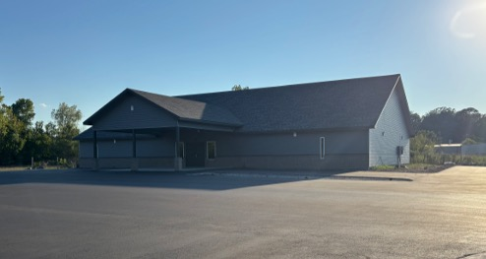

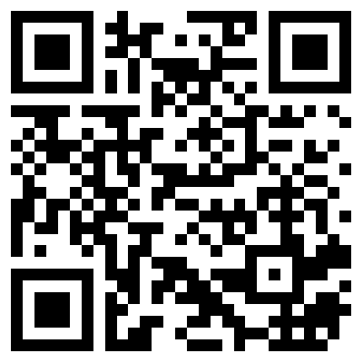
100 CORNERSTONE ALEXANDER AR, 72002
You Are Welcome At Any And All of Our Services!
Meeting Times:
Sunday A.M. Bible Study: 9:00
Sunday A.M. Assembly: 10:00
Sunday P.M. Assembly: 4:00
Wed. P.M. Bible Study: 7:00
ALEXANDERCHURCHOFCHRIST.COM

