Slide 1


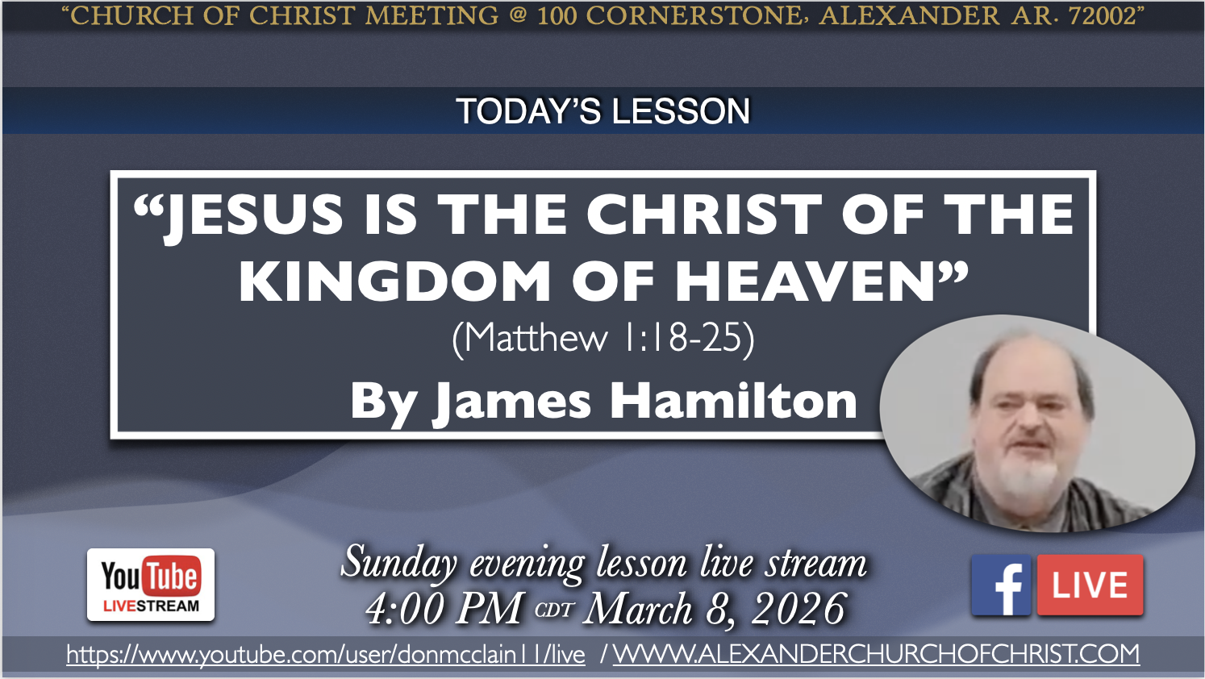
100 CORNERSTONE ALEXANDER AR, 72002
463
174
522
38
343
455

Slide 2
JESUS IS THE CHRIST OF THE KINGDOM OF GOD
MATTHEW 1-4
Part 1

Slide 3
Proofs That Jesus Is The Christ
Everything in Matthew 1-4 is to prove that Jesus is the true king of the kingdom of God
Genealogy Matt 1:1-17
Birth Matt 1:18-25
Herod’s Reaction to Jesus’ Birth Matt 2:1-18
“Nazarene” Matt 2:19-23
Testimony of John Matt 3:1-12
God’s Endorsement of Jesus Matt 3:13-17
Temptation by Satan Matt 4:1-11
More Fulfillments of Isaiah 7-12 in Matt 4:13-25

Slide 4
The Genealogy of Jesus Christ - Matt. 1:1-17
Genealogy: Narratives in Genesis 2:4; 5:1; etc.
Three sections of fourteen generations each
Jesus arrived at the right time (Daniel 9) from the right family (David 2 Samuel 7:12-17)
Women mentioned for a reason (exceptions)
Two Gentiles of faith
Two Israelites through sin
One virgin chosen to be mother for Jesus
“Jesus” (v.21) His salvation can save all sinners

Slide 5
The Birth of Jesus Christ - Matt. 1:18-25
Born of a virgin
The text is very emphatic about this fact v.18-25
Joseph is righteous v.19
Loved Mary
Angel told Joseph that Mary was still a virgin though she was expecting to give birth to a child who is the son of God v.20-21 (Psalm 2:1-7)
Isaiah 7:14 Son of God is God with us v.22-23
Did not know her until Jesus was born v.25

Slide 6
Herod’s Reaction to Jesus’ Birth - Matt. 2:1-18
Herod took the birth of Jesus seriously v.3
God’s wisdom used the enemies of Christ to prove He is Christ
Star guided magi to worship king of the Jews v.2; Numbers 24:17; Gen. 49:8-12; Psalm 110:1; Deuteronomy 17-18
Herod asked scribes where Christ would be born v.4
They quoted Micah 5:2-4

Slide 7
Herod’s Reaction to Jesus’ Birth - Matt. 2:1-18
Herod asked magi when the star appeared v.7-9
Magi listened to Herod and departed v.9
Magi worshipped Jesus v.11 (gave gifts)
God intervened with dreams again v.12,13
Joseph took Mary & Jesus to Egypt at once
Herod killed all males under the age of two v.16-18; Jeremiah 31:15,1-14,16-40

Slide 8
Joseph’s Obedience to God - Matt. 2:19-23
Joseph the dreamer 1:20; 2:13,19,22
Jesus was born in Bethlehem v.4-6; Luke 2:1-38
But He grew up in Nazareth v.23; Luke 2:39-52
Fulfilled the prophets’: “He will be called a ‘Nazarene’” context of Isaiah 11:1-12; fulfilled in Acts 2 and Romans 15:12
Branch (Hebrew NAZAR) Isa. 60:21 context in Isa. 60:21-62:2
Hebrew synonym TSAMACH “BRANCH” in Isaiah 61:11; Zechariah 3:8; 6:12; Jeremiah 33:15

Slide 9
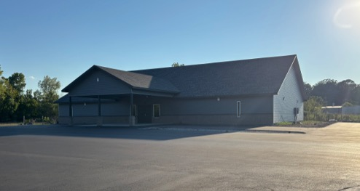

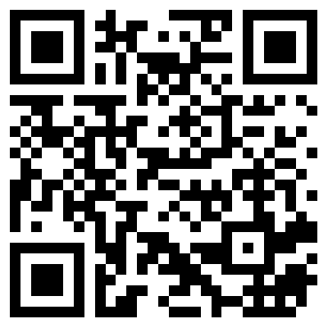
100 CORNERSTONE ALEXANDER AR, 72002
You Are Welcome At Any And All of Our Services!
Meeting Times:
Sunday A.M. Bible Study: 9:00
Sunday A.M. Assembly: 10:00
Sunday P.M. Assembly: 4:00
Wed. P.M. Bible Study: 7:00
ALEXANDERCHURCHOFCHRIST.COM

