Slide 1

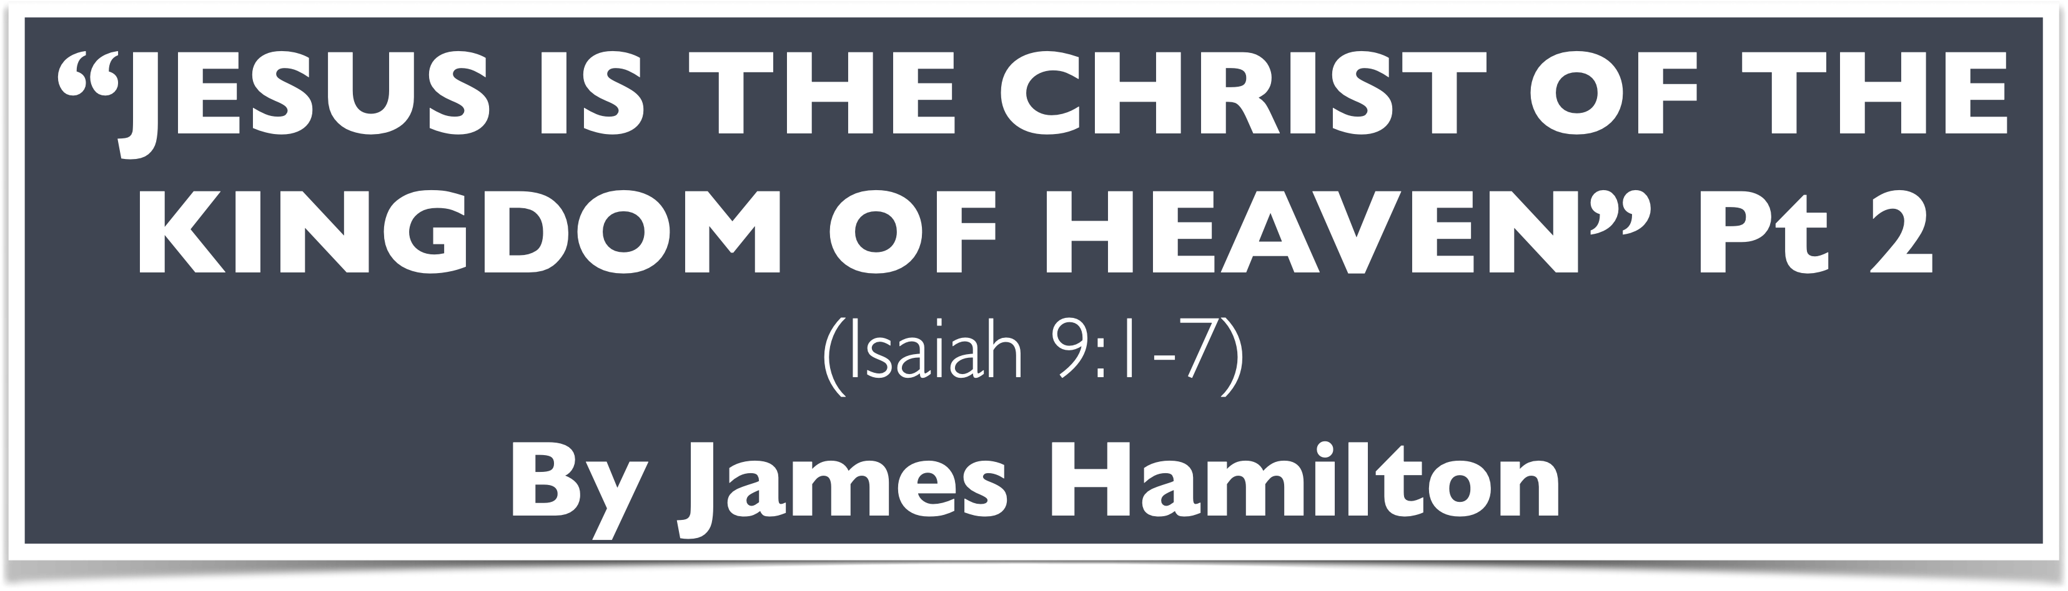
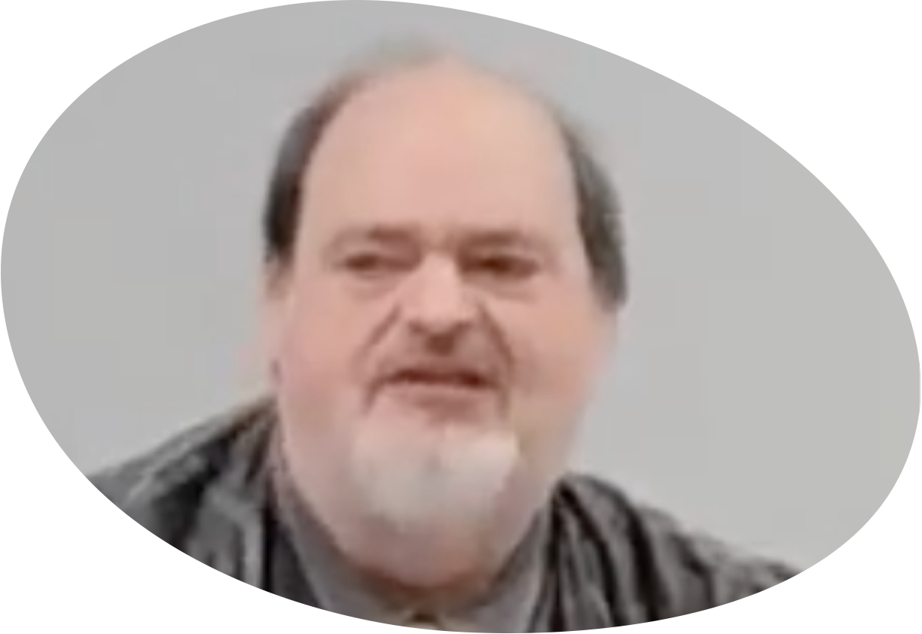
“Church of Christ MEETING @ 100 CORNERSTONE, Alexander AR. 72002”
TODAY’S LESSON
Sunday evening lesson live stream 4:00 PM ^{CDT} March 22, 2026
https://www.youtube.com/user/donmcclain11/live / WWW.ALEXANDERCHURCHOFCHRIST.COM

Slide 2
JESUS IS THE CHRIST OF THE KINGDOM OF GOD
The Harmony Between MATTHEW 1-4 & ISAIAH 7-12
Part 2

Slide 3
Proofs That Jesus Is The Christ
Genealogy Matt 1:1-17
Birth Matt 1:18-25 (Isa. 7:14)
Herod’s Reaction to Jesus’ Birth Matt 2:1-18
“Nazarene” Matt 2:19-23 (Isa. 11:1,2-10; Rom. 15:12)
Testimony of John Matt 3:1-12 (Isa. 10:15-19)
God’s Endorsement of Jesus Matt 3:13-17 (Isa. 11:2)

Slide 4
Proofs That Jesus Is The Christ
Testimony of John Matt 3:1-12 (Isa. 10:15-19)

Slide 5
John’s Testimony About Jesus - Matt. 3:1-12
John fulfilled prophecies in Malachi 3:1 and 4:5-6; Isaiah 40:3 quoted in v.3
John was first prophet in 400 years Luke 1
Jews expected something special
Said the Christ is so great that he is not worthy to serve Him as His shoe bearer v.11-12
Verses 10-12 sound a lot like Isaiah 10:15-17

Slide 6
Isaiah 10:15-17
¹⁵ Shall the ax boast itself against Him who chops with it? Or shall the saw exalt itself against Him who saws with it? As if a rod could wield itself against those who lift it up, or as if a staff could lift up, as if it were not wood! ¹⁶ Therefore the LORD, the LORD of hosts, will send leanness among his fat ones; and under His glory He will kindle a burning like the burning of a fire. ¹⁷ So the Light of Israel will be for a fire, and His Holy One for a flame; it will burn and devour His thorns and his briers in one day.

Slide 7
John’s Testimony About Jesus - Matt. 3:1-12
John fulfilled prophecies in Malachi 3:1 and 4:5-6; Isaiah 40:3 quoted in v.3
John was first prophet in 400 years Luke 1
Jews expected something special
Said the Christ is so great that he is not worthy to serve Him as His shoe bearer v.11-12
Verses 10-12 sound a lot like Isaiah 10:15-17
Ax of judgment at the root of the trees v.10
Christ will baptize with the Holy Spirit v.12
Christ will baptize with fire

Slide 8
Proofs That Jesus Is The Christ
Testimony of John Matt 3:1-12 (Isa. 10:15-19)
God’s Endorsement of Jesus Matt 3:13-17 (Isa. 11:2)

Slide 9
John Baptizes Jesus - Matt. 3:13-17
Jesus came to be baptized by John v.13
John already knew Jesus was greater than he was v.14
Holy Spirit descended upon Jesus after baptism v.16
Alighting upon Him John 1:29-34 remained Isaiah 11:2 The Spirit of the LORD shall rest upon Him (see also Isa.42:2)

Slide 10
John 1:29-34
²⁹ The next day John saw Jesus coming toward him, and said, “Behold! The Lamb of God who takes away the sin of the world! ³⁰ This is He of whom I said, ‘After me comes a Man who is preferred before me, for He was before me.’ ³¹ I did not know Him; but that He should be revealed to Israel, therefore I came baptizing with water.”

Slide 11
John 1:29-34
³² And John bore witness, saying, “I saw the Spirit descending from heaven like a dove, and He remained upon Him. ³³ I did not know Him, but He who sent me to baptize with water said to me, ‘Upon whom you see the Spirit descending, and remaining on Him, this is He who baptizes with the Holy Spirit.’ ³⁴ And I have seen and testified that this is the Son of God.”

Slide 12
John Baptizes Jesus - Matt. 3:13-17
Jesus came to be baptized by John v.13
John already knew Jesus was greater than he was v.14
Holy Spirit descended upon Jesus after baptism v.16
Alighting upon Him John 1:29-34 remained Isaiah 11:2 The Spirit of the LORD shall rest upon Him (see also Isa.42:2)
What God said v.17 (Isa. 42:1-8; Matt. 12:17-21)

Slide 13
Isaiah 42:1-8
¹ Behold my servant, whom I uphold; mine elect, in whom my soul delighteth; I have put my spirit upon him: he shall bring forth judgment to the Gentiles.
2 He shall not cry, nor lift up, nor cause his voice to be heard in the street.
³ A bruised reed shall he not break, and the smoking flax shall he not quench: he shall bring forth judgment unto truth.

Slide 14
Isaiah 42:1-8
⁴ He shall not fail nor be discouraged, till he have set judgment in the earth: and the isles shall wait for his law.
5 Thus saith God the Lord, he that created the heavens, and stretched them out; he that spread forth the earth, and that which cometh out of it; he that giveth breath unto the people upon it, and spirit to them that walk therein:

Slide 15
Isaiah 42:1-8
⁶ I the Lord have called thee in righteousness, and will hold thine hand, and will keep thee, and give thee for a covenant of the people, for a light of the Gentiles;
7 To open the blind eyes, to bring out the prisoners from the prison, and them that sit in darkness out of the prison house.
⁸ I am the Lord: that is my name: and my glory will I not give to another, neither my praise to graven images.

Slide 16
Proofs That Jesus Is The Christ
Testimony of John Matt 3:1-12 (Isa. 10:15-19)
God’s Endorsement of Jesus Matt 3:13-17 (Isa. 11:2)
Temptation by Satan Matt 4:1-11 (Isa. 7:10-17)
Galilean Ministry Matt.4:12-17 (Isaiah 9:1-7)

Slide 17
Isaiah 9:1-7
1 But there will be no more gloom for her who was in anguish. In earlier times He treated the land of Zebulun and the land of Naphtali with contempt, but later on He will make it glorious, by the way of the sea, on the other side of the Jordan, Galilee of the Gentiles. 2 The people who walk in darkness will see a great light; those who live in a dark land, the light will shine on them…

Slide 18
Isaiah 9:1-7
6 For a Child will be born to us, a Son will be given to us; and the government will rest on His shoulders; and His name will be called Wonderful Counselor, Mighty God, Eternal Father, Prince of Peace. 7 There will be no end to the increase of His government or of peace on the throne of David and over His kingdom, to establish it and to uphold it with justice and righteousness from then on and forevermore. The zeal of the LORD of hosts will accomplish this.

Slide 19
Proofs That Jesus Is The Christ
Testimony of John Matt 3:1-12 (Isa. 10:15-19)
God’s Endorsement of Jesus Matt 3:13-17 (Isa. 11:2)
Temptation by Satan Matt 4:1-11 (Isa. 7:10-17)
Galilean Ministry Matt.4:12-17 (Isaiah 9:1-7) Christ is the divine light
Jesus Calls Fishermen to Apostleship Matt. 4:18-22 character compels commitment
Fame in Syria Matt 4:24 (Isa. 7:2) historical context of Isaiah 7-12

Slide 20
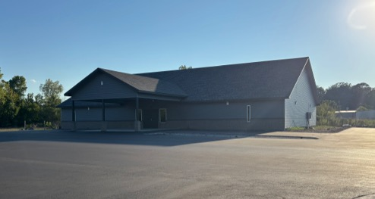

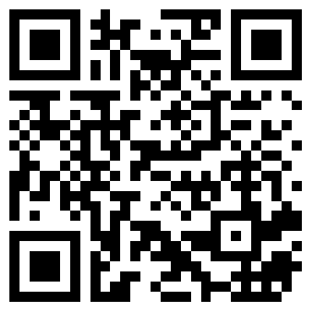
100 CORNERSTONE ALEXANDER AR, 72002
You Are Welcome At Any And All of Our Services!
Meeting Times:
Sunday A.M. Bible Study: 9:00
Sunday A.M. Assembly: 10:00
Sunday P.M. Assembly: 4:00
Wed. P.M. Bible Study: 7:00
ALEXANDERCHURCHOFCHRIST.COM

