Slide 1



Proverbs 4:1–27

Slide 2


The Bible Heart - (kardia) – Thayer, 2b) “the centre and seat of spiritual life; the soul or mind, as it is the fountain and seat of the thoughts, passions, desires, appetites, affections, purposes, endeavours…”
Heart in Hebrew can refer to one’s emotions (Prov. 12:25; 13:12; 14:10, 13) but most often to his intellect (such as understanding, 10:8; discernment, 15:14; reflection, 15:28), or will (5:12).

Slide 3
Thinks
Believes
Trusts
Loves
Wills
Reasons
Matthew 9:4 (NKJV)
⁴ But Jesus, knowing their thoughts, said, “Why do you think evil in your hearts?

Slide 4
Thinks
Believes
Trusts
Loves
Wills
Reasons
Matthew 15:19 (NKJV)
¹⁹ For out of the heart proceed evil thoughts, murders, adulteries, fornications, thefts, false witness, blasphemies.

Slide 5
Thinks
Believes
Trusts
Loves
Wills
Reasons
Romans 10:10 (NKJV)
¹⁰ For with the heart one believes unto righteousness, and with the mouth confession is made unto salvation.

Slide 6
Thinks
Believes
Trusts
Loves
Wills
Reasons
Proverbs 3:5 (NKJV)
⁵ Trust in the Lord with all your heart, And lean not on your own understanding;

Slide 7
Thinks
Believes
Trusts
Loves
Wills
Reasons
Matthew 22:37 (NKJV)
³⁷ Jesus said to him, “ ‘You shall love the Lord your God with all your heart, with all your soul, and with all your mind.’

Slide 8
Thinks
Believes
Trusts
Loves
Wills
Reasons
Exodus 35:29 (NKJV)
²⁹ The children of Israel brought a freewill offering to the Lord, all the men and women whose hearts were willing to bring material for all kinds of work …

Slide 9
Thinks
Believes
Trusts
Loves
Wills
Reasons
Mark 2:8 (NKJV)
⁸ But immediately, when Jesus perceived in His spirit that they reasoned thus within themselves, He said to them, “Why do you reason about these things in your hearts?

Slide 10


“Keep it”—“guard it,” or “watch over it.”
Implies it is precious, to be highly valued, and extremely important.
Implies it is in danger / jeopardy, needs protection.
Implies it is our personal responsibility.

Slide 11
“With all vigilance”
The Hebrew text says, “more than all vigilance,” or “more than all guarding,” “more than all protecting,” keep your heart.
Your most valuable, important possession / your most pressing, important obligation (Prov 23:7)

Slide 12
“Satan’s target”
Corrupt thinking & attitude
Create doubt, fear, anxiety, hopelessness . . . destroy faith.
Erosion of moral & doctrinal belief’s
Erosion of character & integrity
Erosion of conscience

Slide 13
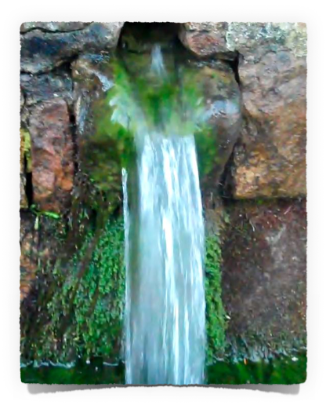
“For out of it spring the issues of life”
The “issues of life” are the impulses, the choices, the decisions made.
If the heart is pure, the life will be pure / Conversely, if the heart is corrupt, the life will be corrupt (Mat. 12:35; 15:19).

Slide 14
“For out of it spring the issues of life”
Your heart is like a spring of water from which continually flows thoughts, words, deeds & plans (beneficial & refreshing or destructive & poisonous?) (Lk 6:45; Mt 12:34-37; Mk 7:20-23; James 3:5-18)

Slide 15
“For out of it spring the issues of life”
Luke 6:45 (NKJV)
⁴⁵ A good man out of the good treasure of his heart brings forth good; and an evil man out of the evil treasure of his heart brings forth evil. For out of the abundance of the heart his mouth speaks.

Slide 16
“For out of it spring the issues of life”
Jeremiah 17:9,10 (NKJV)
⁹ “The heart is deceitful above all things, And desperately wicked; Who can know it? ¹⁰ I, the Lord, search the heart, I test the mind, Even to give every man according to his ways, According to the fruit of his doings.

Slide 17
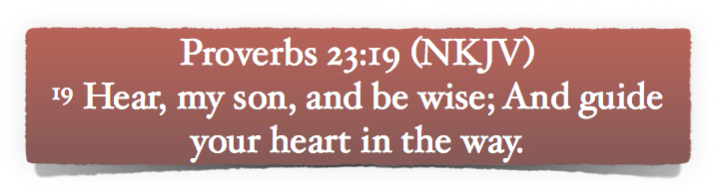
IMPLIES ONE CAN GUIDE, CONTROL, & DETERMINE THEIR …
THOUGHTS,
desires & will,
affections,
values.

Slide 18
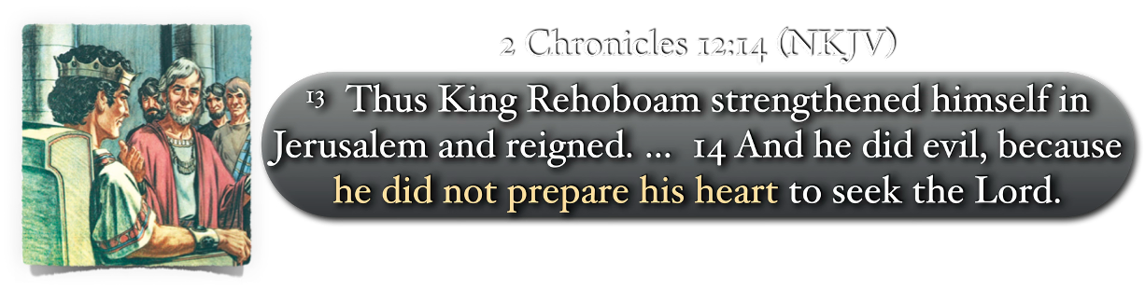
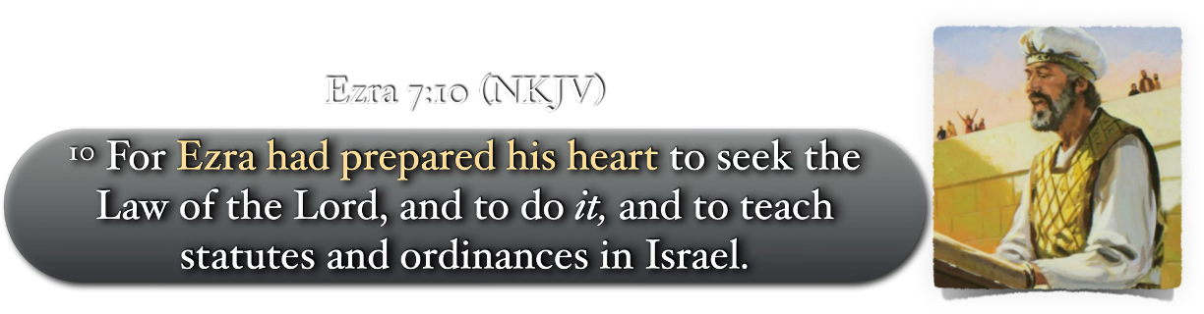

Slide 19
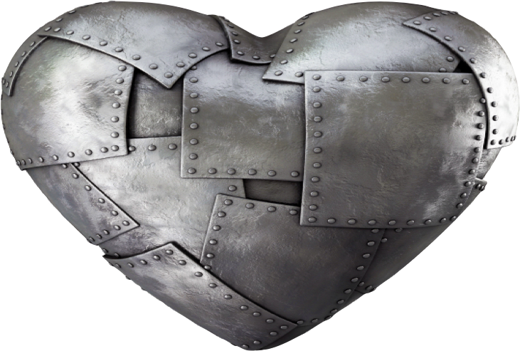
HOW?
Necessary Qualities (Prov. 3:1-12)
Hunger to understand God’s word (vv. 1-4)
Trust in God and not own understanding (vv. 5-6),
Fear God and not be wise in own eyes (vv. 7-8),
Honor God and not fail to give to Him (vv. 9-10)
Appreciate God and do not misunderstand His discipline (vv. 11-12).

Slide 20
HOW?
Necessary Actions (Prov. 4:1-22)
Feed upon, retain, keep, love, exalt, hold on to, give attention to, incline your heart to God’s word (Prov. 4:1-22; Ps 119:9-16; 1 Pet 2:2; Rom 10:16)
Govern your intake, actions, associates (Prov. 4:14; Mt 5:22; Prov 1:10-15; 1 Cor 15:33; etc.)
Purify your thoughts, desires & deeds (Prov. 4:24-27; Ps 119:9; Ez. 18:31; Jas 4:7-10; 1 Jn 3:3).

Slide 21
Proverbs 4:24–27 (NKJV)
²⁴ Put away from you a deceitful mouth, And put perverse lips far from you. ²⁵ Let your eyes look straight ahead, And your eyelids look right before you. ²⁶ Ponder the path of your feet, And let all your ways be established. ²⁷ Do not turn to the right or the left; Remove your foot from evil.

Slide 22
Proverbs 23:17–19 (NKJV)
¹⁷ Do not let your heart envy sinners, But be zealous for the fear of the Lord all the day; ¹⁸ For surely there is a hereafter, And your hope will not be cut off. ¹⁹ Hear, my son, and be wise; And guide your heart in the way.

Slide 23
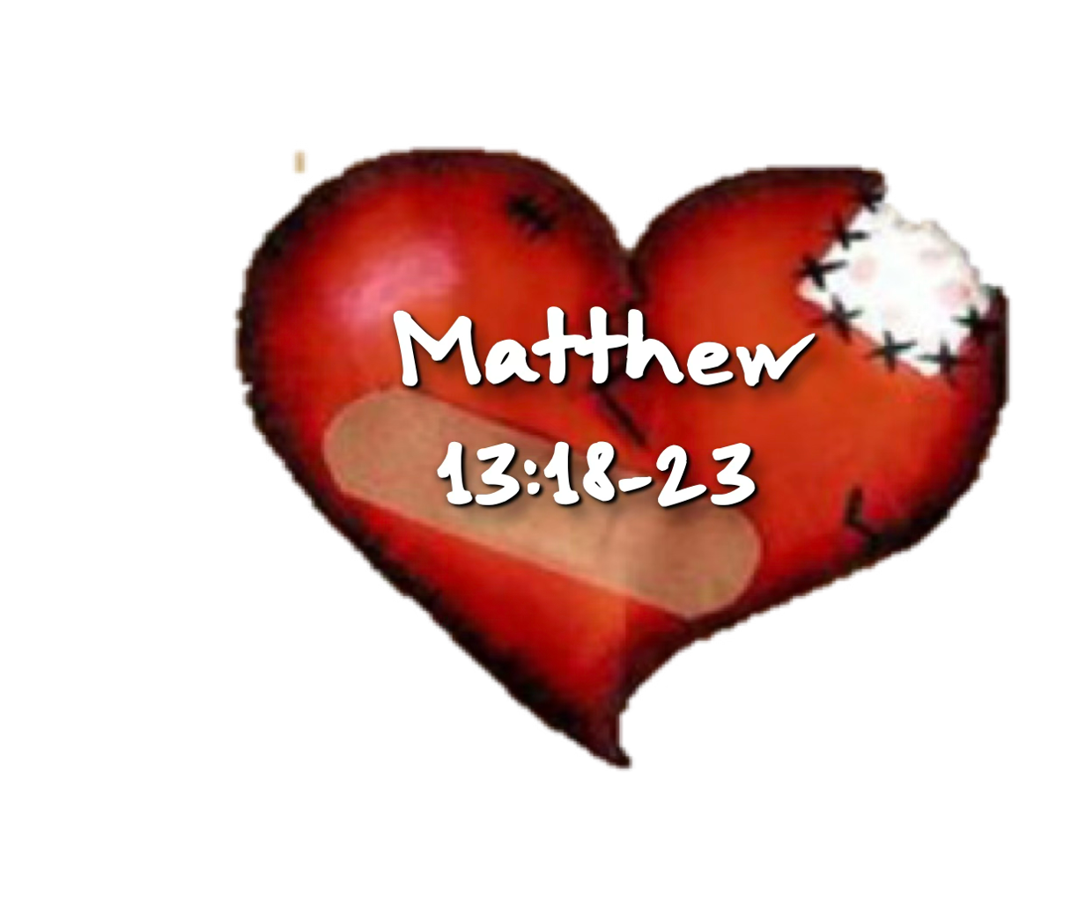

HOW?
Doubt / Fear / anxiety
Discouragement
Resentment / Anger
Jealousy / Envy
Bitterness
Hatred
Grief
Guilt
Materialism
Removing the clutter & the weeds / Changing perspectives

Slide 24

HAVE YOU OBEYED THE GOSPEL FROM THE HEART?
(Rom. 6:3-6; 16-18; 1 Pet. 1:22,23; 3:21)
Hear, believe & Obey Jesus
Hear the TRUTH — Jn 8:32; Rom 10:17
Believe the TRUTH — Jn 3:16; 8:24
REPENT from sin to God — Act 17:30
CONFESS JESUS — Rom 10:9,10
Be BAPTIZED — Mk 16:16; Acts 2:38
PERSEVERE — Col 1:21-23; Rev 2:10

Slide 26
Charts by Don McClain
Preached September 7, 2014 West 65th Street church of Christ
Preached April 18; 2026, Alexander church of Christ
501-568-1062 / Email – donmcclain@sbcglobal.net
More PPT & Audio Sermons: www.alexanderchurchofchrist.com

Slide 27
Proverbs 23:12–19 (NKJV)
¹² Apply your heart to instruction, And your ears to words of knowledge. ¹³ Do not withhold correction from a child, For if you beat him with a rod, he will not die. ¹⁴ You shall beat him with a rod, And deliver his soul from hell. ¹⁵ My son, if your heart is wise, My heart will rejoice—indeed, I myself; ¹⁶ Yes, my inmost being will rejoice When your lips speak right things. ¹⁷ Do not let your heart envy sinners, But be zealous for the fear of the Lord all the day; ¹⁸ For surely there is a hereafter, And your hope will not be cut off. ¹⁹ Hear, my son, and be wise; And guide your heart in the way.

