Slide 1




640-609 B.C.
2 Chronicles 34:2 (NKJV)
2 And he did what was right in the sight of the Lord, and walked in the ways of his father David; he did not turn aside to the right hand or to the left.
2 Chronicles 34:1-35:19
2 Kings 21:24-23:30

Slide 2
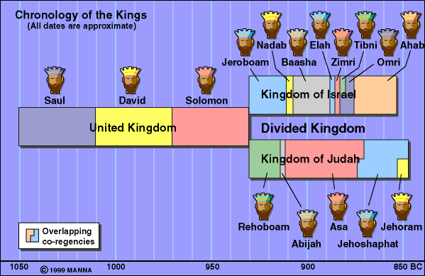

Slide 3
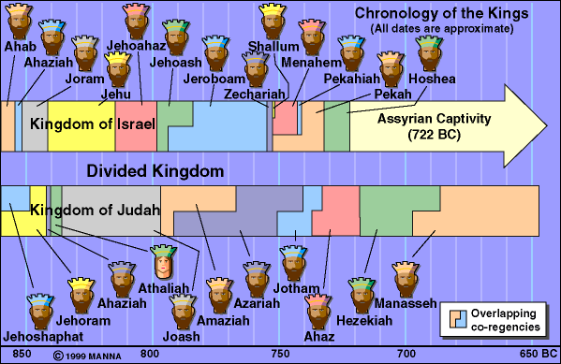
Hosea 4:6 (NKJV)
⁶ My people are destroyed for lack of knowledge. Because you have rejected knowledge, I also will reject you from being priest for Me; Because you have forgotten the law of your God, I also will forget your children.

Slide 4
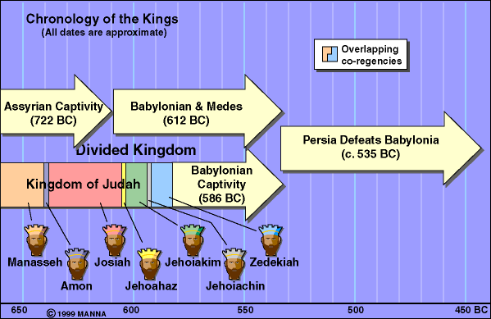
Ezekiel 23:35 (NKJV)
³⁵ “Therefore thus says the Lord God: ‘Because you have forgotten Me and cast Me behind your back, Therefore you shall bear the penalty Of your lewdness and your harlotry.’ ”
640-609 B.C.

Slide 5
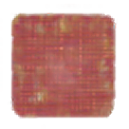
Ahaz (734 – 715 B.C. very wicked)
Hezekiah (715 – 686 B.C. A very good king, instituted many religious reforms)
Manasseh (696 – 642 B.C. very wicked, practiced child sacrifice)
Amon (642 – 640 B.C. Continued the evil ways of Manasseh)
Josiah (640 – 609 B.C. Served God with a loyal heart / restored the the Law in Judah)
640-609 B.C.

Slide 6
(630) Nahum’s prophecy against Nineveh
(627) Jeremiah begins his work and prophecies
(626) Nabopolassar becomes the first king of the Babylonian empire
(612) Fall of Nineveh by the union of Babylon & Media
(609) Death of Josiah by Pharaoh-Necho
(605) Battle of Carchemish [Control of Babylon over Egypt & Assyria]
Important world events that would impact Judah

Slide 7
Grandfather Manasseh & his father Amon were BOTH very wicked kings
Became king at 8 yrs. old.
At age 16, he began to seek the Lord (2 Chron 34:3)
From age 20 - 26 destroyed idols (2 Chron 34:3-8)
At age 26, ordered Temple repaired (2 Kgs 22:3-7)
640-609 B.C.

Slide 8
Book of the Law found & read (2 Kings 22:8-11)
The LORD consulted (2 Kings 22:12-20)
Law read publicly & applied to people (2 Kings 23:1-23)
At age 39, killed in battle
(2 Kings 23:29-30; 2 Chron 35:20-27)
640-609 B.C.

Slide 9
2 Kings 22:1–2 (NKJV)
1 Josiah was eight years old when he became king, and he reigned thirty-one years in Jerusalem. His mother’s name was Jedidah the daughter of Adaiah of Bozkath. 2 And he did what was right in the sight of the Lord, and walked in all the ways of his father David; he did not turn aside to the right hand or to the left.
2 Chronicles 34,1.2
640-609 B.C.

Slide 10
2 Kings 23:25 (NKJV)
25 Now before him there was no king like him, who turned to the Lord with all his heart, with all his soul, and with all his might, according to all the Law of Moses; nor after him did any arise like him.
640-609 B.C.

Slide 11
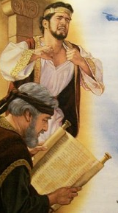

FIRST: At age 16, Josiah began to seek the Lord. (2 Chronicles 34:3a)
“For in the eighth year of his reign, while he was still young, he began to seek the God of his father David;”

Slide 12
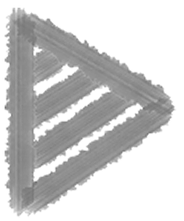
FIRST: At age 16, Josiah began to seek the Lord. (2 Chronicles 34:3a)
  Apparently blessed with God-fearing advisors who resisted the idolatrous influence of his father (2 Chron. 34:3a).
  Apparently taught him of David and how God blesses those who are faithful and earnest in their allegiance to God.

Slide 13
SECOND: At age 20, Josiah began to cleanse Jerusalem. (2 Chron 34:3b)
“in the twelfth year he began to purge Judah and Jerusalem of the high places, the wooden images, the carved images, and the molded images”

Slide 14
SECOND: At age 20, Josiah began to cleanse Jerusalem. (2 Chron 34:3b)
  Reforms even more extensive than Hezekiah’s (cf. 2 Ki 18:4; 2 Chron 29:3-36).
  Destroyed the altars of the Baals, the wooden, carved and molded images as far north as the cities of Naphtali
  (2 Chron 34:3b-7).

Slide 15
SECOND: At age 20, Josiah began to cleanse Jerusalem. (2 Chron 34:3b)
  Purged the Mount of Olives (“mt of corruption”) (2 Ki 23:13-14).
  Uncovered the altar of Jeroboam as well as the tomb of the prophet who had warned him; fulfills prophecy of 1 Kings 13:1-5 (332 yrs later - 2 Kings 23:15-18).

Slide 16
THIRD: At age 26, Josiah orders the temple repairs: 2 Chron 34:8
8 “In the eighteenth year of his reign, when he had purged the land and the temple, he sent Shaphan the son of Azaliah, Maaseiah the governor of the city, and Joah the son of Joahaz the recorder, to repair the house of the Lord his God.”

Slide 17
THIRD: At age 26, Josiah orders the temple repairs: 2 Chron 34:8
  A copy of the book of the law was discovered (2 Chronicles 34:14-15).
  When read to Josiah, he tore his clothes - horrified at how far Judah had departed from God (2 Kgs 22:12-20; 2 Chron. 34:20-28).
  Impetus for the pursuit of complete restoration in Judah (2 Kings 23:4-20).

Slide 18
THIRD: At age 26, Josiah orders the temple repairs: 2 Chron 34:8
  Calls the people to pledge to follow God’s word (2 Kings 23:1-3).
  Kept the Passover to its fullest extent since the days of the judges (2 Kings 23:21-25; 2 Chron. 35:1-19)

Slide 19
All pagan vessels found in the temple were burned & ashes carried to Bethel (2 Ki 23:4)
Removed the pagan priests that had been appointed by Manasseh & Amon (2 Ki 23:5)
Removed the image Asherah from the temple, burned it & spread ashes on graves of the people (2 Ki 23:6)
Houses of the sodomites (homosexual priests) were torn down (2 Ki 23:7)
Defiled the “high places” where the Lord was worshiped illegitimately [w/out authority] (2 Ki 23:8-9)

Slide 20
Defiled Topheth, (valley of Hinnom) where children were sacrificed to Molech (2 Ki 23:10)
Destroyed a monument of horses & chariots that had been dedicated to the sun (god) (2 Ki 23:11)
Broke down & ground to dust certain unauthorized altars - cast the dust into the brook Kidron (2 Ki 23:12)
Destroyed the pagan shrines honoring the gods of the Zidonians, Moabites & Ammonites that had been built by Solomon (2 Ki 23:13-14)

Slide 21
He removed the altar that Jeroboam had built at Bethel, destroying the high place and the idol (2 Ki 23:15)
Burned the bones of those who had practiced idolatry [fulfilling the prophecy of 1 Ki 13:2] (2 Ki 23:16)
Destroyed the shrines and high places in Israel [Samaria] and killed the priests and burned their remains on the altars they had erected (2 Ki 23:19-20)
Removed those who practiced witchcraft (2 Ki 23:24)

Slide 22

In 609 B.C., Josiah attempted to block Pharaoh Necho II of Egypt as he marched north to assist Assyria in her fight with Babylon. (2 Chron 35:20-24; 2 Kin 23:28-30)
  Necho wanted Assyria as a buffer state.
  Josiah engaged him at Megiddo and thearchers shot Josiah & seriously wounded him dying later in Jerusalem.

Slide 23
Great lamentation followed his death (2 Chron 35:20-27; Zechariah 12:11).
2 Chronicles 35:24–25 (NKJV)
²⁴ … And all Judah and Jerusalem mourned for Josiah. ²⁵ Jeremiah also lamented for Josiah. And to this day all the singing men and the singing women speak of Josiah in their lamentations. They made it a custom in Israel; and indeed they are written in the Laments.

Slide 24

Josiah was faithful in an evil environment.
  His grandfather Manasseh (2 Kings 21:1-9,16); and his father Amon (2 Kings 21:19-22) were extremely wicked.
  Judah had become worse than the nations God destroyed (2 Kings 21:9). / Jerusalem was filled “from one end to another” with blood (2 Kings 21:16). / Judah was totally given over to idolatry (2 Kings 21:2-7, 21).

Slide 25
Josiah Used His position to Glorify God.
  He removed idolatry and associated sins -
  In the 18th year of his reign, 622 B.C., he began repairs on the house of the Lord (2 Kings 22:3-7). Nearly 250 years since the restoration by Joash (2 Kings 12:4-16).
  When the Law of God was found - he demanded the people obey it fully (2 Chronicles 34:29-33).

Slide 26
Josiah Changed as his knowledge of God’s will increased.
  The king’s reaction at the reading of the law was one of immediate grief. Basis of his grief was Judah’s guilt and her coming judgment.
  He tender-heartedly received the will of God and humbled himself (James 1:21; Colossians 1:4-6; 1 Thessalonians 2:13).
  Judah was to be punished, but Josiah would be spared (2 Kin 22:18-20).

Slide 27
We can be faithful regardless of our parents / our environment / or our past —
We all have a choice
Joshua 24:15
Ezekiel 18:20ff
Romans 6:16-18

Slide 28
We should fully destroy sin in our lives and seek to destroy it in the lives of others! (Romans 6:1,2; Colossians 3:5)
We cannot participate in, approve of, nor facilitate the sins of others (Ephesians 5:3-14; Romans 1:32; 2 Corinthians 6:14-7:1)

Slide 29
We should always seek to grow in the grace and knowledge of the Lord - always bringing ourselves into greater harmony with God’s word as we learn better.
Acts 17:11,12;
2 Peter 3:15-18;
2 Corinthians 13:5; etc.

Slide 30
Jeremiah & Josiah called Israel back to God’s written revelation, which was several hundred years old!
God’s word is understandable & doable
2 Chron. 34:19; Eph 3:3-5; 2 Tim 3:16,17; Acts 20:32; Jam 1:21,22

Slide 31
Jeremiah & Josiah called Israel back to God’s written revelation, which was several hundred years old!
God’s stated, written word is the ONLY standard by which we may determine truth today
Jude 3; 2 Timothy 3:16,17

Slide 32
Jeremiah & Josiah called Israel back to God’s written revelation, which was several hundred years old!
We also need to seek Bible authority for all we do —
Colosians 3:17; 1 Corinthians 4:6

Slide 33
How does your life compare to Josiah’s?
Do you desire to seek the Lord?
Are you willing to obey Jesus completely?
2 Kings 23:25 (NKJV)
²⁵ Now before him there was no king like him, who turned to the Lord with all his heart, with all his soul, and with all his might, according to all the Law of Moses; nor after him did any arise like him.

Slide 34

Receive Christ by faith, repenting of your sins & being baptized into Him — Rom. 6:3-6; Gal. 3:26,27; Col. 2:12,13.
If you are already in Christ, but sin has again entered into your life, repent, confess & pray — 1 Jn 1:9,10; Ac 8:22
2 Kings 23:25 (NKJV)
²⁵ Now before him there was no king like him, who turned to the Lord with all his heart, with all his soul, and with all his might, according to all the Law of Moses; nor after him did any arise like him.

Slide 35



100 CORNERSTONE ALEXANDER AR, 72002
You Are Welcome At Any And All of Our Services!
Meeting Times:
Sunday A.M. Bible Study: 9:00
Sunday A.M. Assembly: 10:00
Sunday P.M. Assembly: 4:00
Wed. P.M. Bible Study: 7:00
ALEXANDERCHURCHOFCHRIST.COM

Slide 37

640-609 B.C.
Preached November 11, 2018 West 65th Street church of Christ
Preached September 5, 2026 Alexander church of Christ
501-568-1062
Prepared using KeynoteEmail – donmcclain@sbcglobal.net
More Keynote, PPT & Audio Sermons: alexanderchurchofchrist.com

Slide 38

2 Chronicles 34:29–33 (NKJV)
²⁹ Then the king sent and gathered all the elders of Judah and Jerusalem. ³⁰ The king went up to the house of the Lord, with all the men of Judah and the inhabitants of Jerusalem—the priests and the Levites, and all the people, great and small. And he read in their hearing all the words of the Book of the Covenant which had been found in the house of the Lord. ³¹ Then the king stood in his place and made a covenant before the Lord, to follow the Lord, and to keep His commandments and His testimonies and His statutes with all his heart and all his soul, to perform the words of the covenant that were written in this book. ³² And he made all who were present in Jerusalem and Benjamin take a stand. So the inhabitants of Jerusalem did according to the covenant of God, the God of their fathers. ³³ Thus Josiah removed all the abominations from all the country that belonged to the children of Israel, and made all who were present in Israel diligently serve the Lord their God. All his days they did not depart from following the Lord God of their fathers.

