Slide 1

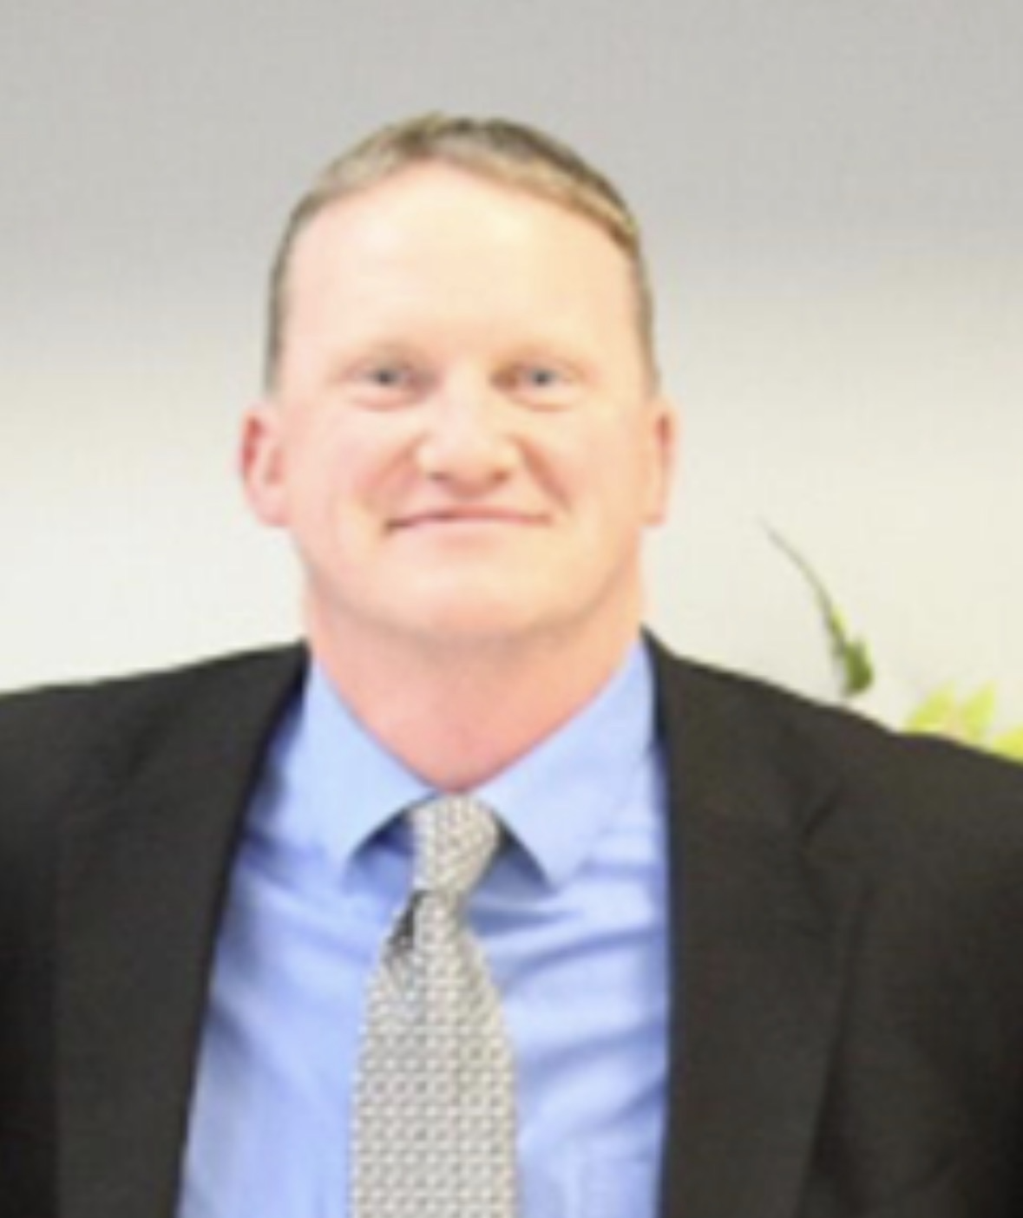
“Church of Christ MEETING @ 100 CORNERSTONE, Alexander AR. 72002”
Lessons From The Flock
Ecclesiastes 4:9-12, Galatians 6:2
Speaker: Ricky Manes
Sunday evening lesson live stream 4:00 PM ^{CDT} August 16, 2026
https://www.youtube.com/user/donmcclain11/live / WWW.ALEXANDERCHURCHOFCHRIST.COM

Slide 2
Lessons From The Flock
Ecclesiastes 4:9-12, Galatians 6:2

Slide 3
Use of Animals/Creatures
Ant -Proverbs 6:6-8
Deer - Psalms 42:1
Eagle - Isaiah 40:31
Dove - Matthew 10:16
Snake - Matthew 10:16
Rock Badger - Proverbs 30:26
Locust - Proverbs 30:27
Lizard - Proverbs 30:28
Sheep - John 10:27
Lion - Proverbs 28:1
Ox & Donkey - Isaiah 1:3
Migratory Birds - (Stork, Dove, Swift, Thrush) - Jeremiah 8:7
Horse - Jeremiah 8:6

Slide 4
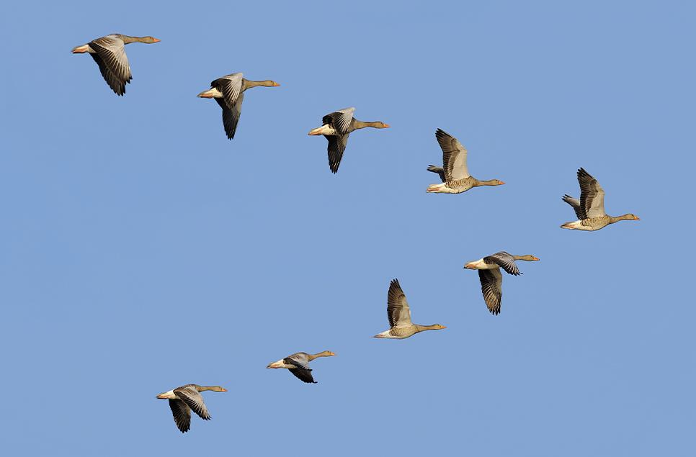
Lessons From The Flock

Slide 5
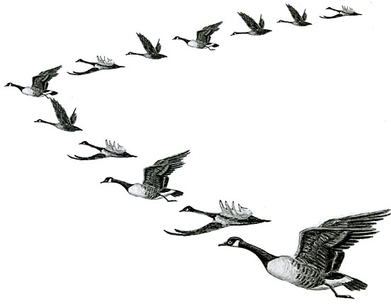
The Lift of Shared Burdens

Slide 6
The Lift of Shared Burdens
Ecclesiastes 4:9 Two are better than one, Because they have a good reward for their labor. 10 For if they fall, one will lift up his companion. But woe to him who is alone when he falls, For he has no one to help him up.
(1 Corinthians 12, Acts 2:42-47)

Slide 7
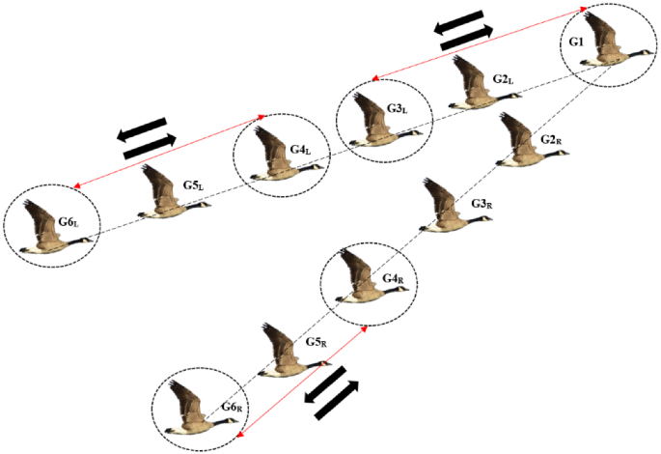
The Power of Each
One Doing Their Part

Slide 8
The Power of Each One Doing Their Part
1 Peter 4:8 And above all things have fervent love for one another, for "LOVE WILL COVER A MULTITUDE OF SINS." 9 Be hospitable to one another without grumbling. 10 As each one has received a gift, minister it to one another, as good stewards of the manifold grace of God.
(Galatians 5:13, Mark 10:43-45, Exodus 17:8-13)

Slide 9
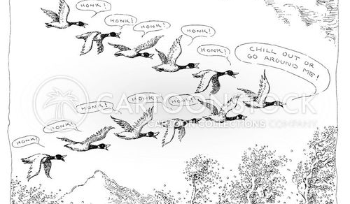
Helping Each Other Through Encouragement

Slide 10
Helping Each Other Through Encouragement
Hebrews 10:24 And let us consider one another in order to stir up love and good works, 25 not forsaking the assembling of ourselves together, as is the manner of some, but exhorting one another, and so much the more as you see the Day approaching.
(1 Thessalonians 5:11)

Slide 11
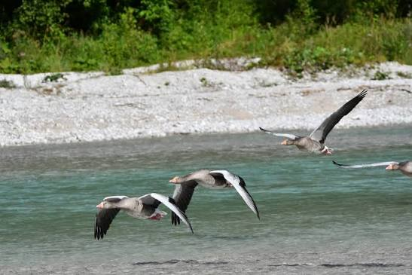
Sacrificial Care for the Wounded

Slide 12
Sacrificial Care for the Wounded
Romans 12:10 Be kindly affectionate to one another with brotherly love, in honor giving preference to one another; 11 not lagging in diligence, fervent in spirit, serving the Lord; 12 rejoicing in hope, patient in tribulation, continuing steadfastly in prayer; 13 distributing to the needs of the saints, given to hospitality.
(Luke 10)

Slide 13
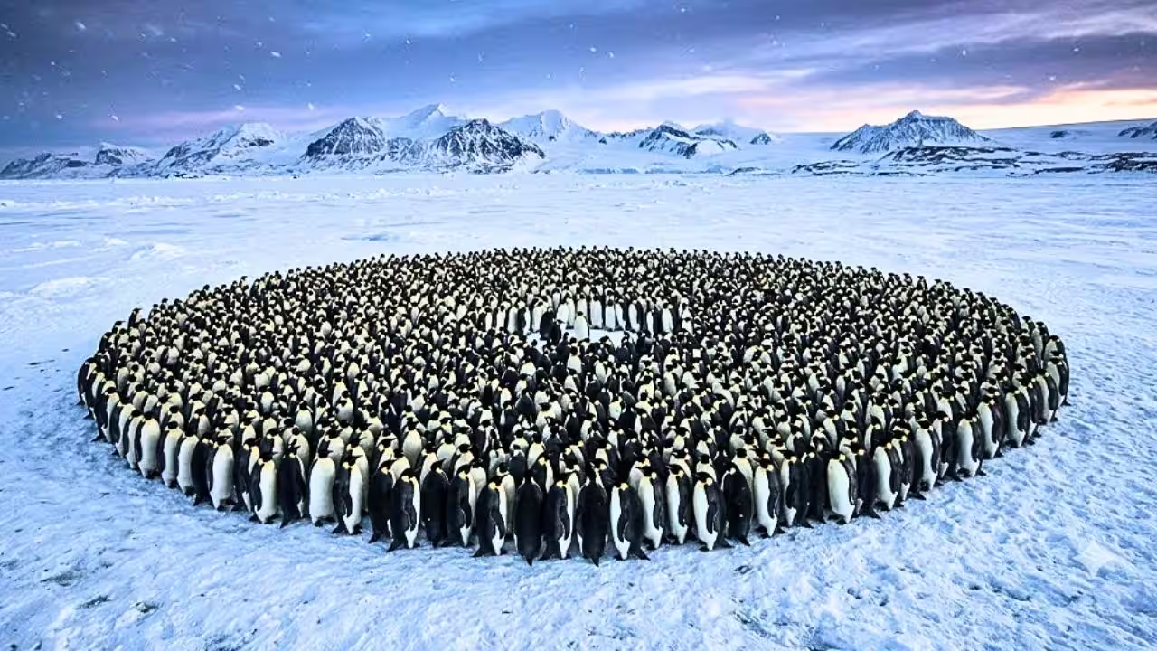
Sacrificial Care for the Wounded

Slide 14
Sacrificial Care for the Wounded
Philippians 2:3 Let nothing be done through selfish ambition or conceit, but in lowliness of mind let each esteem others better than himself. 4 Let each of you look out not only for his own interests, but also for the interests of others. 5 Let this mind be in you which was also in Christ Jesus

Slide 15
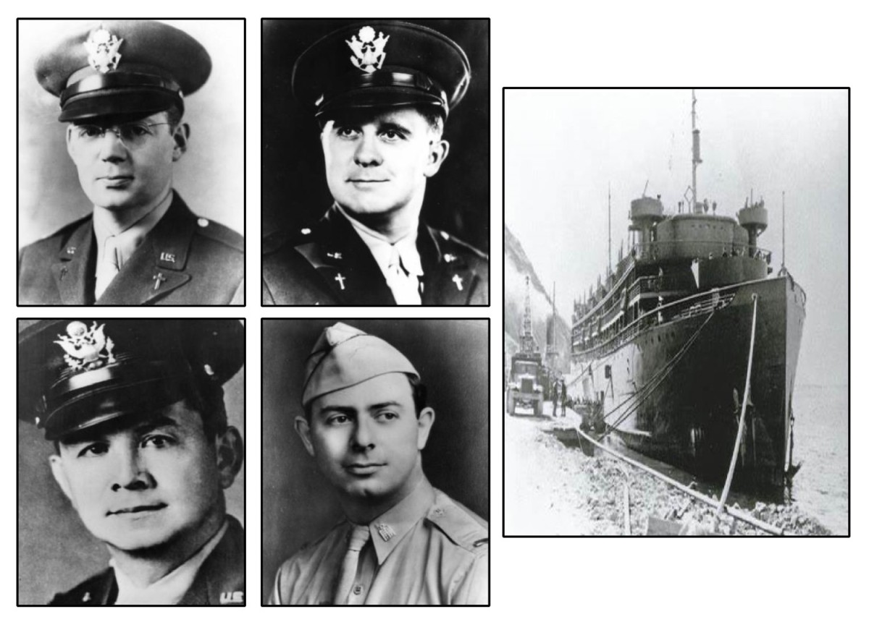
Sacrificial Care for the Wounded

Slide 16
Sacrificial Care for the Wounded
1 John 3:16 By this we know love, because He laid down His life for us. And we also ought to lay down our lives for the brethren. 17 But whoever has this world's goods, and sees his brother in need, and shuts up his heart from him, how does the love of God abide in him? 18 My little children, let us not love in word or in tongue, but in deed and in truth.

Slide 17
We Can Help The Flock Through Jesus
Isaiah 53:4 Surely He has borne our griefs And carried our sorrows; Yet we esteemed Him stricken, Smitten by God, and afflicted. 5 But He was wounded for our transgressions, He was bruised for our iniquities; The chastisement for our peace was upon Him, And by His stripes we are healed.
He carried our heaviest burden
He left the formation for us
He gave us His voice of encouragement

Slide 18
We Can Help The Flock Through Jesus
Matthew 18:11 For the Son of Man has come to save that which was lost. 12 "What do you think? If a man has a hundred sheep, and one of them goes astray, does he not leave the ninety-nine and go to the mountains to seek the one that is straying? 13 And if he should find it, assuredly, I say to you, he rejoices more over that sheep than over the ninety-nine that did not go astray.
He carried our heaviest burden
He left the formation for us
He gave us His voice of encouragement

Slide 19
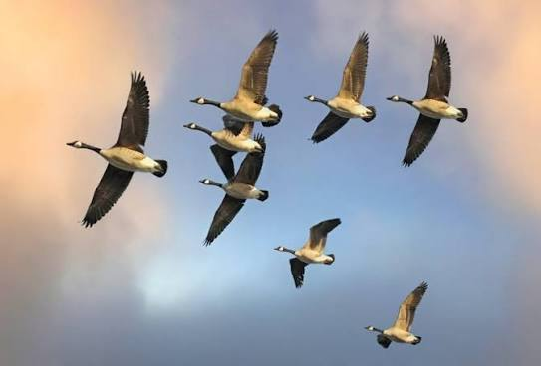

V-formation reminds us of God's design for His people:
We travel farther together than alone.
Work is shared through humble service.
Encouragement strengthens the group.
We care for those who struggle.
We keep moving toward the same heavenly goal.

Slide 20
Commit To 3 Things This Week
Lift Someone's Burden
“HONK” Words of Encouragement To A Brother or Sister in Need
Lookout For Anyone Who Has Fallen Behind

Slide 21



100 CORNERSTONE ALEXANDER AR, 72002
You Are Welcome At Any And All of Our Services!
Meeting Times:
Sunday A.M. Bible Study: 9:00
Sunday A.M. Assembly: 10:00
Sunday P.M. Assembly: 4:00
Wed. P.M. Bible Study: 7:00
ALEXANDERCHURCHOFCHRIST.COM

