Slide 1

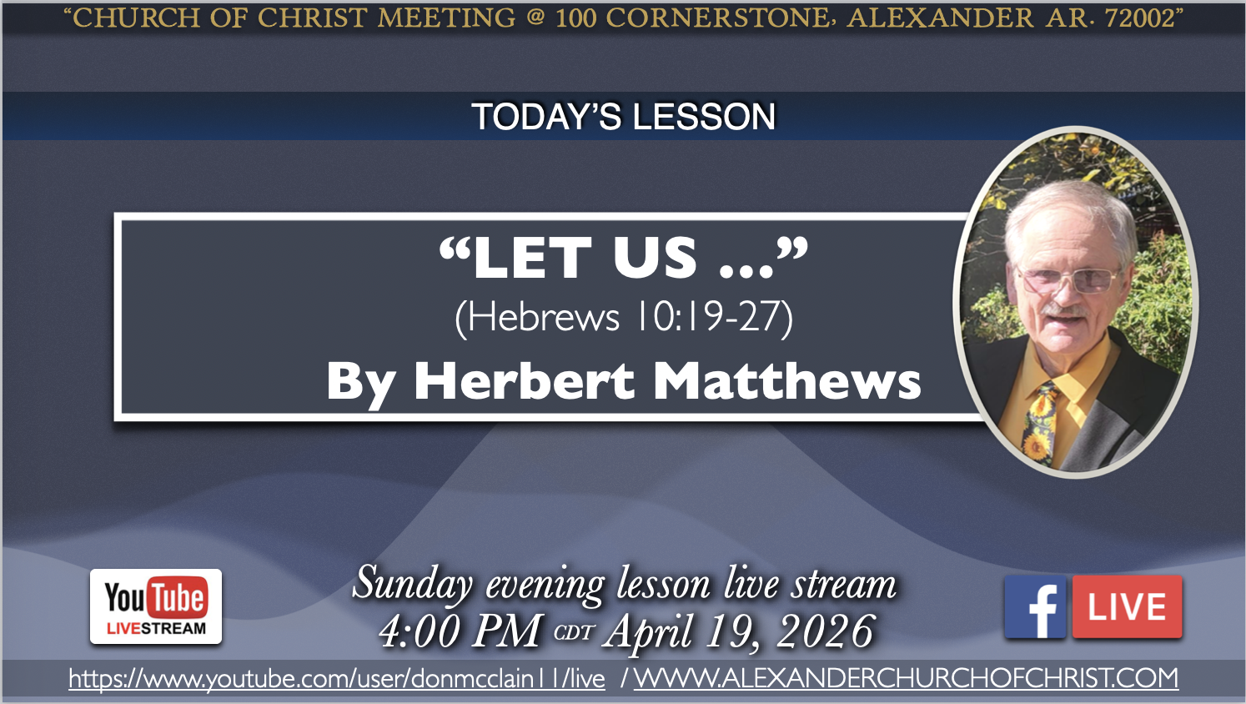
100 CORNERSTONE ALEXANDER AR, 72002
251
604
205
431
309
66

Slide 2
LET US
HEBREWS10:19-25)

Slide 3
19 Therefore, brethren, having boldness[b] to enter the Holiest by the blood of Jesus, 20 by a new and living way which He consecrated for us, through the veil, that is, His flesh, 21 and having a High Priest over the house of God, 22 let us draw near with a true heart in full assurance of faith, having our hearts sprinkled from an evil conscience and our bodies washed with pure water. 23 Let us hold fast the confession of our hope without wavering, for He who promised is faithful. 24 And let us consider one another in order to stir up love and good works, 25 not forsaking the assembling of ourselves together,

Slide 4
INTRODUCTION
To this point in "The Epistle To The Hebrews", doctrinal arguments have been presented to encourage faithfulness and steadfastness...
Demonstrating the superiority of the Son - He 1:1-8:6
Illustrating the superiority of the New Covenant - He 8:7-10:18
With He 10:19, the author begins making application based upon these premises...
Which he does through a series of exhortations and warnings
Such composing the remaining part of this epistle

Slide 5
In verses 19-25, we find a three-fold exhortation...
To draw near to God
To hold fast our faith
To stimulate one another in love and good works

Slide 6
THE BASIS FOR THIS EXHORTATION...
We are able to "enter" God's presence because:
Jesus has consecrated "a new and living way, through the veil" - He 10:19-20
There is now a new way to approach God in heaven, through One who lives!
It is made possible by "the blood of Jesus...His flesh" (His death on the cross)
Jesus now serves as "a High Priest over the house of God" - He 10:21

Slide 7
LET US DRAW NEAR IN FAITH (19-22)
Who is able to come to our aid - He 2:17-18
Who sympathizes with our weakness - He 4:14-16
Who ever lives to intercede in our behalf - He 7:24-25
But we are also able to "enter" God's presence because:
We have had "our hearts sprinkled from an evil conscience"This is an allusion to the Old Testament practice of taking blood from the altar and consecrating the priests by sprinkling them with it - Exo 29:21
It is the blood of Christ that is truly efficacious in purging our conscience of sin - He 9:14
We have had "our bodies washed with pure water"

Slide 8
Another allusion to the manner in which priests were consecrated - Exo 29:4
The author likely has reference to baptism...
For baptism is referred to as a "washing"- Ac 22:16; cf. Ep 5:26; Tit 3:5
Though the stress is on the inner cleansing, not the outer - cf. 1Pe 3:21
[With Christ as our "High Priest", and our own consecration as "priests" through the blood of Jesus, we should not hesitate to draw near to God in prayer and worship, looking forward to that day when we literally enter "through the veil" into God's wonderful presence!

Slide 9
LET US HOLD FAST OUR HOPE (23)
WE ARE EXHORTED TO HOLD FAST THE CONFESSION OF OUR HOPE...
In Christ we have a much "better hope" - He 6:19; 7:19
But there is the danger of apostasy - He 3:12-13; 4:11
For which reason we must "hold fast" the hope which we confess - He 3:6,14; 4:14
-- Indeed, we need to "hold fast...without wavering" - He 10:23

Slide 10
A GOOD REASON TO HEED THIS EXHORTATION...
The faithfulness of God: "for He who promised is faithful" - He 10:23
God will not fail us (He 13:5); therefore we need to emulate the faith of Sarah, who "judged Him faithful who had promised" - He 11:11

Slide 11
LET US CONSIDER ONE ANOTHER (24-25) IN ORDER TO STIR UP LOVE AND GOOD WORKS...
As we "draw near" to God and "hold fast" our hope, we are not to do so alone
We are to be mindful of each other and how we are doing ("consider one another")
With a view to incite or spur on ("stir up") both "love and good works" - This is reminiscent of the exhortation in He 3:12-14 and is indicative of apostasy!

Slide 12
ACCOMPLISHED THROUGH FREQUENT ASSEMBLING...
An important purpose of our assembling is to "stir up love and good works"
Yes, we do come to worship and praise God
But we also come to edify and exhort one another! - He 10:25a
Therefore we must not become guilty of "forsaking the assembling of ourselves together"
The word "forsake" means "to abandon, desert"
I.e., to stop assembling with the saints altogether
Some evidently had done so ("as is the manner of some")
, and that forsaking them

Slide 13
Exhorting one another through assembling is even more imperative "as you see the Day approaching"
Some commentators believe the "Day" referred to is the destruction of Jerusalem in A.D. 70
Which was impending at the time this epistle was written (ca. 63-65 A.D.)
Certainly such an event would call for encouragement through frequent assembling
Others suggest that the "Day" refers to the Judgment Day at the Second Coming
It certainly fits the context of He 9:27-29; 10:27,37
And while one might not know the "day and hour" of His coming, we were given some general signs of His coming - cf. 2Th 2:1-8
-- The main point is to appreciate the value and necessity of our assemblies

Slide 14
4. "Our bodies washed..."
a. This is the external part of regeneration - water baptism.
b. It is the washing of regeneration. Titus 3:5
10:23 - "Let us hold fast the confession..." - Let us continue in it
by faithful, godly living.
1. "Confession of our hope" - We confess that we wish to obtain heaven. Let us hold fast to all that this confession involves.
a. "Without wavering" - without faltering, without stumbling.
b. "For He who promised is faithful." - He is reliable and trustworthy and the one who commits his will to Him, will never be disappointed. 1 Pet. 4:19

Slide 15
10:24-25 - "And let us" - He exhorts both positively and negatively.
1. Verse 24 - the positive.
a. "Consider one another" - show concern, have interest in.
b. "To stir up" - to stimulate, provoke, arouse.
c. "Love and good works" - All of us need exhortation and encouragement; thus, let us exhort and encourage one another to do our best in living the Christian life.
2. Verse 25 - the negative. Thus, we are not to forsake any of our assemblies.
5. What did the writer encourage (command) us not to do?
"Not forsaking the assembling of ourselves together" - 10:25

Slide 16
Actually, there are three popular arguments from this verse:
1. Some say that the word "forsake" refers to forsaking all together and should not be applied to when a person missed just one service. However, the word is used in 2 Tim. 4:16 and Matt. 27:46 and refers to just once.

Slide 17
2. Some think that the verse refers to the "assembly" - only on the Lord's day morning when the Lord's supper is taken. However, it is the word "assembling" which refers to any coming together; it isthe word "episnnago" (the act of assembling), and not the word"ekklesia" the regular word for assembly.
3. Some say the word "Day" refers to the Lord's day - they needed to increase their efforts when they saw the Lord's day coming.
a. However, there is no indication in the context that it must refer to the Lord's day. It could refer to any day wherein one needed exhortation. For example, if one did not attend on Wed. nights and I had a continual opportunity to exhort him, I would increase my efforts as I saw that day approaching.

Slide 18
b. Many of the older commentators take the position that "the day"
refers to the destruction of Jerusalem--that the Hebrews, by the signs that Jesus spoke of (Matt. 24; Luke 21), could see that it was approaching.

Slide 19
c. It probably refers to the great day--the day of the Lord's coming.
We know that it is nearer than it was. Rom. 13:11-12
6. From 10:26-31, list the consequences for those who sin wilfully.
"There no longer remains a sacrifice for sins" - 10:26
"But a certain fearful expectation of judgment, and fiery indignation" - 10:27
Punishment worse than death - 10:28-29
Vengeance, judgment, and fearful things from God - 10:30-31

Slide 20
10:26
1. To "Sin Willfully" is to knowingly and deliberately go againstone's conscience.
a. In this context, it includes deliberately forsaking the assembling of the saints, i.e., relatives come and one stayshome. He goes golfing, fishing, shopping, sleeps in, orwhatever. It does not in clude those times when it is no fault Of his own.

Slide 21
2. He loses the only sacrifice for sins. (Verse 26b)
a. He didn't say there is no more forgiveness, but no more sacrifice.
b. He is rejecting the sacrifice which is his only chance and hope; he is abandoning that which purchased the church and all that pertains to it.
i. When he willfully forsakes, he is setting his will against the Lord's.
10:27
1. Application can be made regarding any wilful sin; however, because of the immediate context, we make application to the for saking theassembling of ourselves together.
2. These things remain:
a. "But a certain fearful expectation of judgment..." - We all will face judgment, but it will be a fearful time for the onewho commits the sin of verse 25.

Slide 22
b. "And fiery indignation" - He incurs the wrath of God. God is indignant, his righteous anger is aroused, when one forsake the assemblies.
c. "Which shall devour the adversaries." - One places himself in
the realm of the enemy of God when he forsakes, and God's fiery indignation shall destroy him. Luke 19:27
i. Man brings all these things upon himself when he wilfully forsakes. Many brethren do not understand the seriousnessof forsaking. It is something that is not to be taken lightly.

Slide 23
10:28-29
1. What God does to those who wilfully forsake:
a. Verse 28 - Some examples are: the man who gathered sticks on
the Sabbath (Num. 15:32-36); the boy who blasphemed the name of the Lord and cursed (Lev. 24:11-14).
b. Verse 29 - "worse punishment" - worse than capital punishment.
i. "Who has trampled the Son of God underfoot..." - How?
Attendance is part of the will of Christ and he shows hisdisrespect for Him by not attending.
ii. "Counted the blood...a common thing..." - He is reducing
the blood to no more than a common or ordinary thing; thus,
he shows his lack of appreciation for the blood atonement.
iii. "And insulted the Spirit of grace" - He shows contempt
for the Holy Spirit who delivered the message of grace.

Slide 24
10:30-32
1. Verse 30 - At the judgment, what excuse will one give the Lord for willfully forsaking?
a. God will take vengeance on the disobedient.
b. Verse 31- He falls into His hands.
7. How does this section show that God is not a God of love only?
It shows that willful sinners will be severely punished by God.

Slide 25
IF YOU ARE GUILTY OF WILLFUL SIN OF ANYKIND AND NEED THE PRAYERS AND ENCOURAGEMENT OF YOUR BROTHERS AND SISTERS

Slide 26
WILL YOU COME

Slide 27
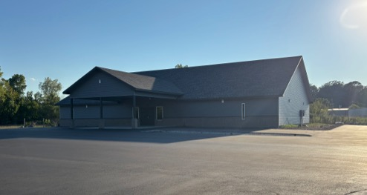

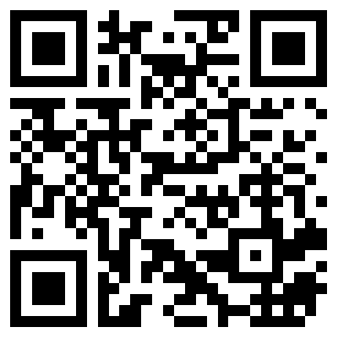
100 CORNERSTONE ALEXANDER AR, 72002
You Are Welcome At Any And All of Our Services!
Meeting Times:
Sunday A.M. Bible Study: 9:00
Sunday A.M. Assembly: 10:00
Sunday P.M. Assembly: 4:00
Wed. P.M. Bible Study: 7:00
ALEXANDERCHURCHOFCHRIST.COM

